Slide 1



Group Members
CSN 221: COMPUTER ARCHITECTURE AND MICROPROCESSOR
PROJECT 3 :
SimpleRISC PROCESSOR
Aniket Umesh Kathare (20114010)
Arnav Vyas (20114015)
Deepak Tailor (20114029)
Deepesh Garg (20114032)
Dighiya Sanidhya Ramjiprasad (20114035)
Jyoti Chauhan (20114042)
Tippana Rajesh (20114101)
Doraiswamy R Harshavardhan (18114022)

Slide 2


Project Statement
Design the SimpleRISC processor discussed in the class on Logisim simulator. Extend the basic ideas discussed in the class with several other ideas that you seem important to be included. Preferably, to enable multicore environment. Evaluate rigorously. BENCHMARK evaluations are preferred.

Slide 3
Individual Contribution
Aniket Umesh Kathare : Main processor & Control Unit, Report preparation
Arnav Vyas : Main Processor & Control Unit, Report preparation
Deepesh Garg : Register Files & Flags Unit, Report preparation
Deepak Tailor : Register Files & Flags Unit, Report preparation
Dighiya Sanidhya Ramjiprasad: Arithmetic Logical Unit & Immediate value calculation, PPT file
Jyoti Chauhan : Arithmetic Logical Unit & Immediate value calculation, PPT file
Tippana Rajesh : Branch Unit & Memory Unit, Report preparation
Doraiswamy R Harshavardhan : Simple RISC processor & ISA design method

Slide 4
About SimpleRISC Processor
RISC stands for Reduced Computer Set Instruction.
RISC processor has ‘instruction sets’ that are simple and have simple ‘addressing modes.
It is designed to perform a set of smaller computer instructions so that it can be operated at higher speeds (takes one clock per instruction).
A Simple RISC ISA contains only 21 instructions.
RISC processor emphasizes on using the registers rather than memory because registers are the ‘fastest’ available memory source.

Slide 5
Methodology & Approach
The aim of this project is to design a 32-bit SimpleRISC Processor. In doing so, we use a basic approach of dividing the processing into various stages and then design each stage.
We use multiplexers where alternate data sources are used for different instructions
The instructions are executed systematically going through each stage. Every stage performs its pre-determined tasks and thus the whole task is completed separately.

Slide 6
Processor Design
Aim
To implement the entire SimpleRISC ISA
Process the binary format of instructions
Approach
Dividing the processing into stages
Design each stage separately
Different units/stages are described as following:

Slide 7
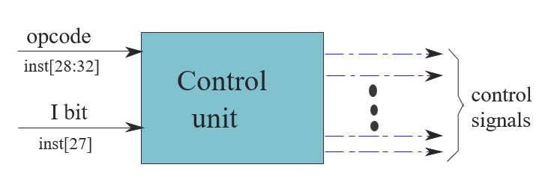
Control Unit
The processor is implemented using hardwired control unit.
This unit is given the opcode and the immediate bit.
It generates all the control signals which regulate the working of processor’s hardware.

Slide 8
Control Signals:
SNO. | SIGNAL | CONDITION
1 | isSt | Instruction: st
2 | isLd | Instruction: ld
3 | isBeq | Instruction: beq
4 | isBgt | Instruction: bgt
5 | isRet | Instruction: ret
6 | isImmediate | I bit to 1
7 | isWb | Instructions: add, sub, mul, div, mod, and, or, not, mov, ld, lsl, lsr, asr, call
8 | isUbranch | Instructions: b, call, ret
9 | isCall | Instruction: call, ALU Signals

Slide 9
ALU Signals
SNO. | SIGNAL | CONDITION
10 | isAdd | Instructions: add, ld, st
11 | isSub | Instruction: sub
12 | isCmp | Instruction: cmp
13 | isMul | Instruction: mul
14 | isDiv | Instruction: div
15 | isMod | Instruction: mod
16 | isLsl | Instruction: lsl
17 | isLsr | Instructions: lsr
18 | isAsr | Instructions: asr
19 | isOr | Instruction: or
20 | isAnd | Instruction: and
21 | isNot | Instruction: not
22 | isMov | Instruction: mov

Slide 10
List of instruction opcodes
SNO. | INSTRUCTION | CODE | SNO. | INSTRUCTION | CODE
1 | add | 00000 | 12 | lsr | 01011
2 | sub | 00001 | 13 | asr | 01100
3 | mul | 00010 | 14 | nop | 01101
4 | div | 00011 | 15 | ld | 01110
5 | mod | 00100 | 16 | st | 01111
6 | cmp | 00101 | 17 | beq | 10000
7 | and | 00110 | 18 | bgt | 10001
8 | or | 00111 | 19 | b | 10010
9 | not | 01000 | 20 | call | 10011
10 | mov | 01001 | 21 | ret | 10100
11 | lsl | 01010

Slide 11
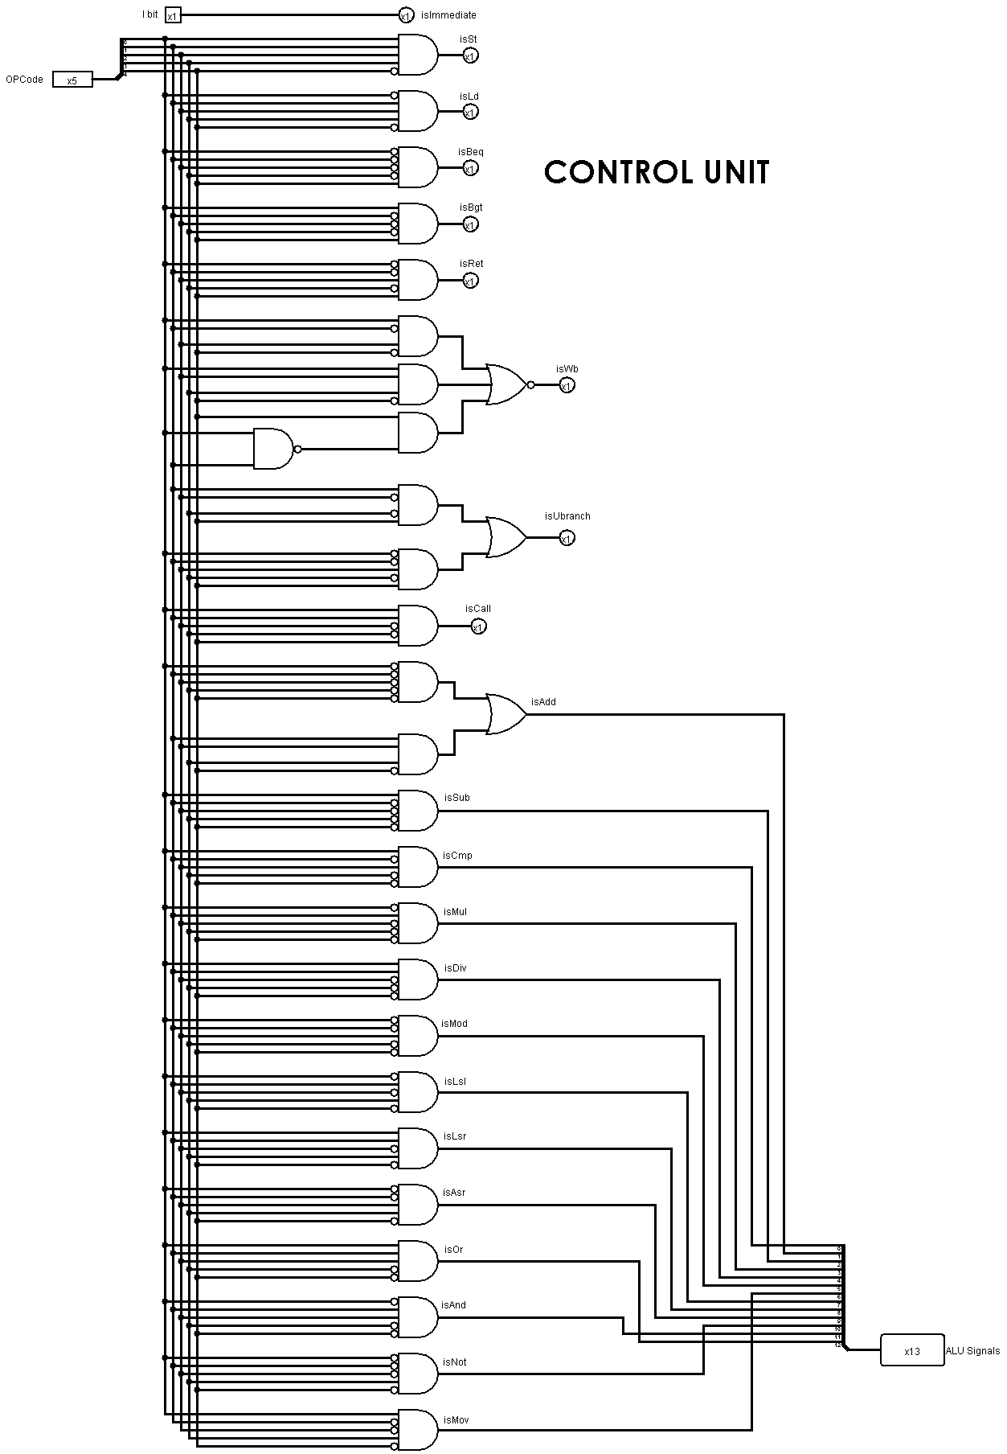

Slide 12
Memory Unit
It contains 2 registers MAR and MDR.
Mar buffers the memory address whereas mdr buffers the value that needs to be stored.
A set of arguments that specify the nature of operation such as load or store is also required and finally data is in ldResult register after load operation is done.

Slide 13
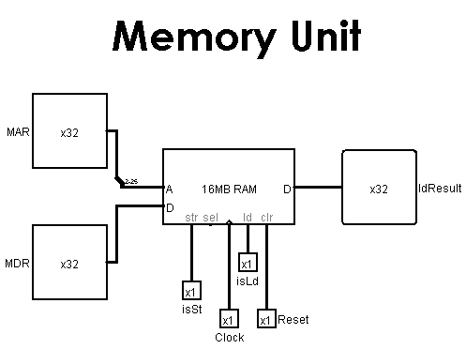

Slide 14
Branch Unit
This unit generates isBranchTaken signal which is a control signal.
For computing the branch condition (beq, bgt)
Conditions on isBranchTaken are as following:

Slide 15
Instruction | Value of isBranchTaken
Non-branch instruction | 0
call | 1
ret | 1
b | 1
beq | Branch taken: 1 Branch not taken: 0
bgt | Branch taken: 1 Branch not taken: 0

Slide 16
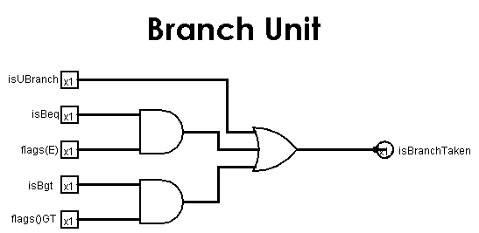

Slide 17
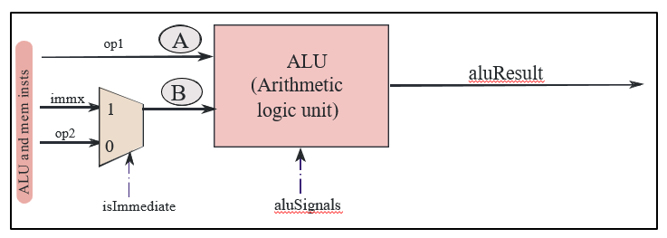
Arithmetic Logical Unit (ALU)
The first operand in the ALU is always op1 whereas the other can be either register or immediate value.
ALU takes as input of ALU signals which are generated by control unit and specify type of ALU operation.

Slide 18
It contains various modules, and we can enable or disable them as per requirement with the help of transmission gates.
Modules:
Adder: isAdd, isSub, isCmp
Multiplier: isMul
Divider: isDiv, isMod
Shift: isLsl, isLsr, isAsr
Logical: isOr, isAnd, isNot

Slide 19
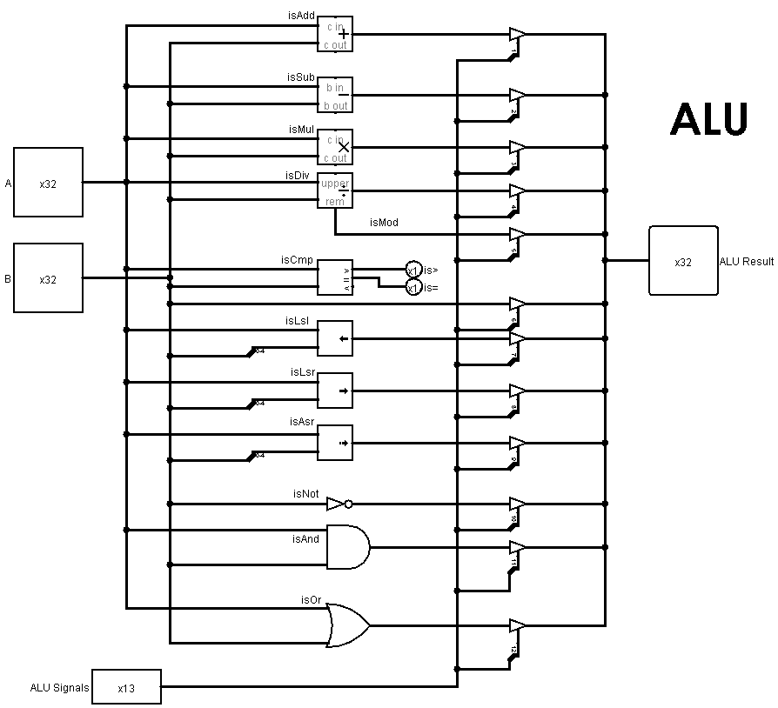

Slide 20
Flags Unit
The cmp instruction is a 2-address instruction that takes two source operands. The first source operand needs to be a register, and the second one can be an immediate or a register. It compares both the operands by subtracting the second from the first.
If the operands are equal, or in other words, the result of the subtraction is zero then it sets flags E to 1. Otherwise flags E is set to 0.
If the first operand is greater than the second operand, then the result of the subtraction will be positive. In this case, the cmp instruction sets flags GT to 1, otherwise it sets it to 0.
We require these flags when we implement branch instructions

Slide 21
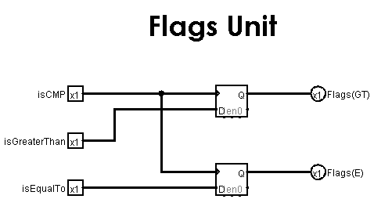

Slide 22
Immediate Value
In computer architecture, a constant value specified in an instruction is known as immediate.
Out of 32 bits, we use 18 bits to specify the immediate (2 bits for modifier and 16 bits for constant part of immediate).
The processor internally expands the immediate to a 32bit value, in accordance with the modifiers.

Slide 23
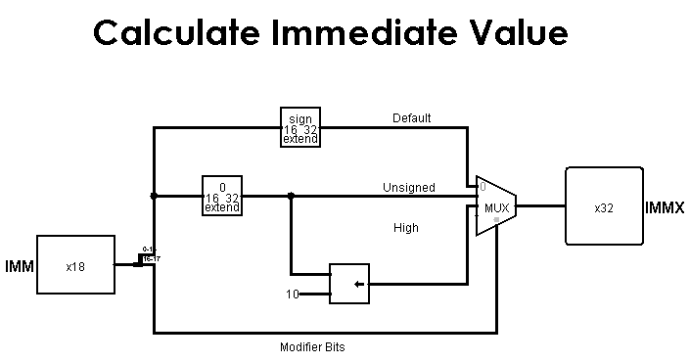

Slide 24
Register File
It contains 2 source registers: regSrc and regData.
The regSrc register contains the number of the register that needs to be accessed whereas regData contains value to be written.
Arguments of register file are read and write.
For write the value in regData is written to register specified by regSrc.
For read the register specified by regSrc is read and value is stored in regVal.
R14 is also referred to as the stack pointer (sp).
R15 is also referred to as the return address register (ra).

Slide 25
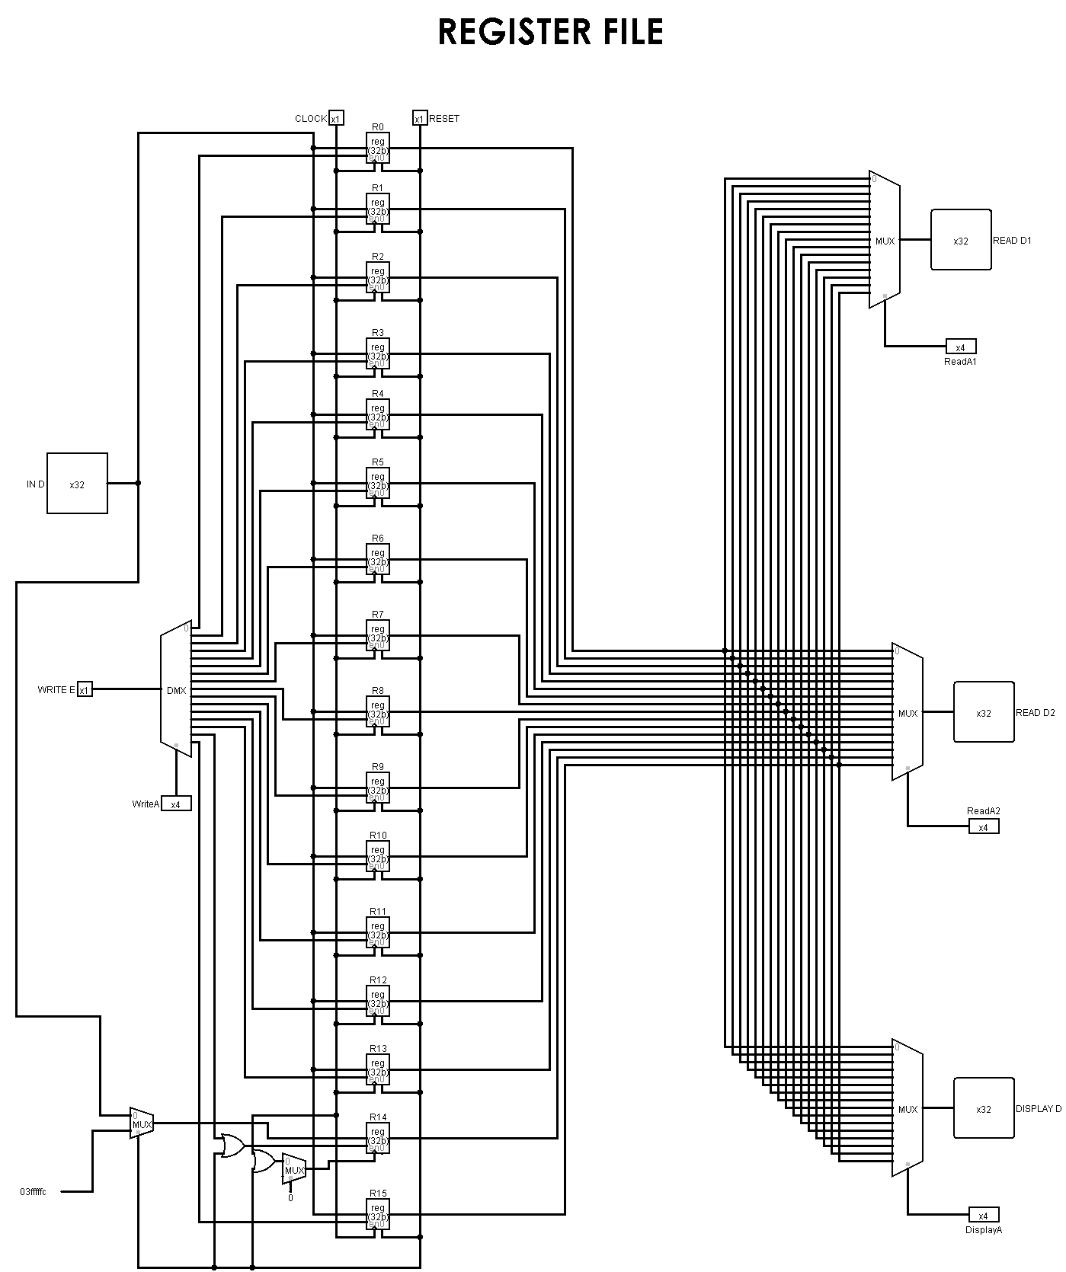

Slide 26
Main Processor
It is the main processor circuit that connects all 5 units designed individually.
Processor is divided into units/stages as follows:
Instruction
Operand
Execute
Memory
Register
Fetch
Fetch
Access
Write
(IF)
(OF)
(EX)
(MA)
(RW)

Slide 27
Instruction Fetch Stage : Fetches an instruction from the instruction memory and computes the address of the next instruction.
Operand Fetch Stage : Decodes the instruction ; fetches the register operands from register files. Generates control signals, calculates immediate value and the branch target.
Contains Control Unit.
Execute Stage : Contains the Arithmetic Logical Unit, Branch Unit, Flags Unit.
ALU for performing arithmetic and logical operations; Branch unit for computing branch conditions; flags unit to be updated by the cmp instructions.
Memory Access Stage : Contains Memory Unit.
Interfaces with the memory system; Executes a load or a store
Register Write Stage : Writes to the Register_File;

Slide 28
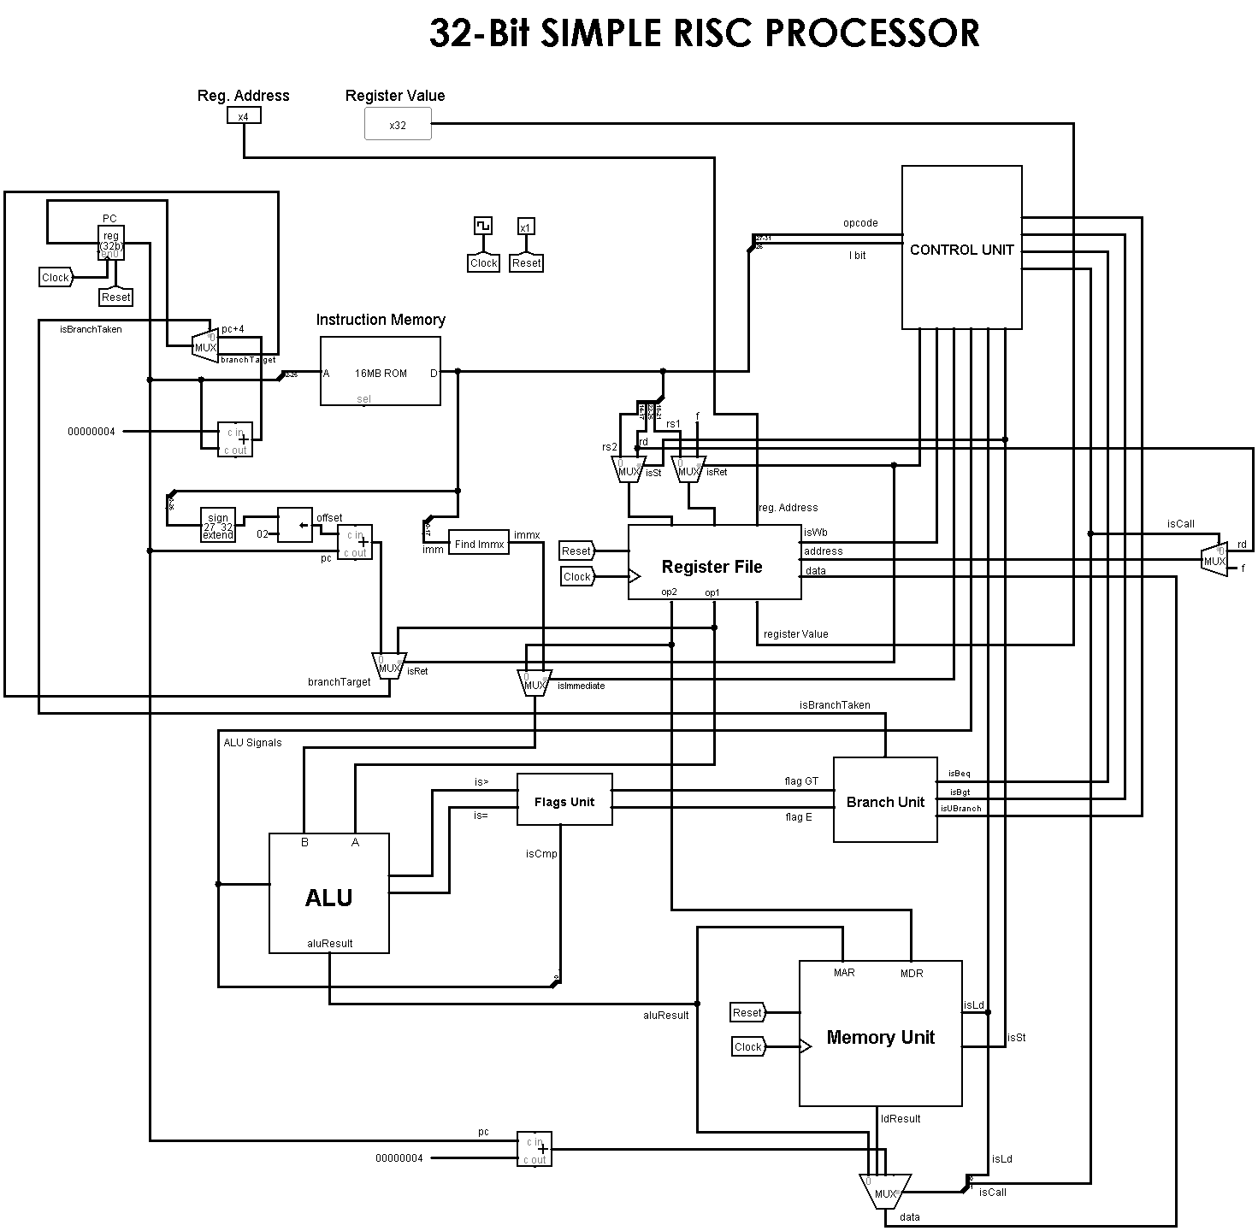

Slide 29
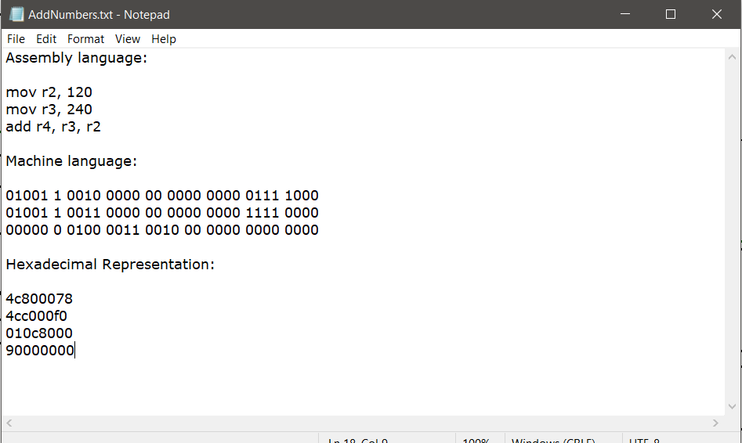
Evaluation Parameter/Testing
We can test a simple program as shown in snip below which adds the contents of two registers. The first five bits are representing the Op-code and the next bit is representing the Immediate bit. Other digits represent the register number (r0 register is represented as 0000, r1 as 0001, r2 as 0010 and so on) or Immediate value.

Slide 30
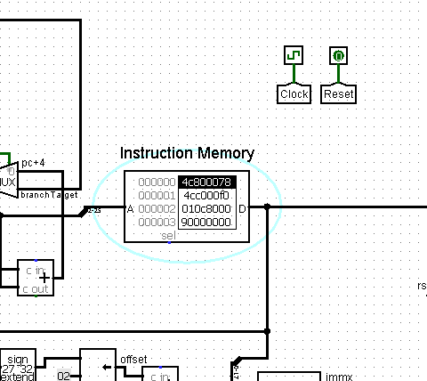
The Hexadecimal representation of the instructions is loaded in Instruction memory of our Main Processor. Here, 0x90000000 instruction tells the processor that program has ended. Below is the snip of hexadecimal instructions loaded in instruction memory.

Slide 31

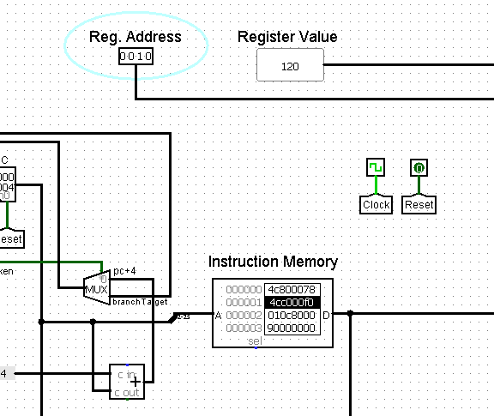
Once the instructions are loaded, we need to activate the clock. Since it’s a single cycle processor it will carry out one instruction in a single clock cycle. Below is the snip of 0th instruction executed and the value of r2 getting updated as 120.

Slide 32
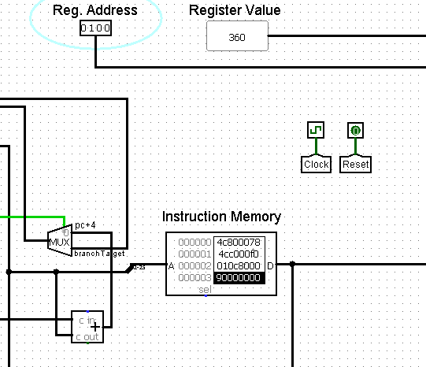
Once all the instructions are executed (in three cycles of clock), we can see in the below snip that value of r4 is gets updated as 360 (r4←r3+r2, 360 = 240 + 120).

Slide 33
Conclusion
A 32bit SimpleRISC processor is designed using Logisim software. The processor can run all the 21 microinstructions as specified under control unit. The processor is made by combining different processing units as following:
1.Main processor 5.ALU
2.Control unit 6.Memory unit
3.Set flags 7.Branch unit
4.Find immediate 8.Register file
The processor contains different modules, and we can enable or disable them as per requirement with the help of transmission gates.

Slide 34
References
Computer Organization and Architecture
Book by Dr. Smruti Ranjan Sarangi
RISC Processor
https://binaryterms.com/risc-processor.html#RISCArchitecture
Processor Design: Part 1
https://www.youtube.com/watch?v=EQGlk7UgcLs
SimpleRISC Processor:
https://www.geeksforgeeks.org/computer-organization-and-architecture-pipelining-set-1-execution-stages-and-throughput/

