Slide 1

GRIDLOCK HACKATHON 2.0
Traffic Demand Prediction
Flipkart × Bengaluru Traffic Police
Score:

Slide 2
Problem
Urban traffic demand varies significantly based on time, weather, location, and road infrastructure. Unpredictable traffic patterns can lead to congestion, inefficient resource utilization, and increased travel time.
Objective
Develop a machine learning model to accurately predict traffic demand using temporal, geographic, environmental, and infrastructure-related features.
Expected Impact
Reduce traffic congestion
Improve traffic management decisions
Optimize resource allocation
Support data-driven urban planning
Enhance mobility and transportation services
Target Variable: Traffic Demand (Normalized Traffic Volume)
2

Slide 3
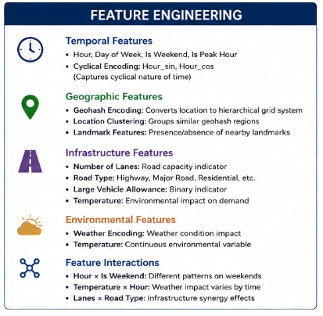
Feature engineering
Data Preprocessing
Missing Value Treatment:
Road Type → Mode Imputation (0.77%)
Temperature → Median Imputation (3.2%)
Weather → Mode Imputation (1.03%)
Duplicate Check:
No duplicate records found
Time-Based Features
Hour extraction from timestamp
Peak Hour indicator
Rush Hour indicator
Weekend/Weekday flags
Cyclic encoding using Hour Sin and Hour Cos
Traffic & Road Features
Large Vehicle binary encoding (1/0)
Vehicle-per-Lane ratio
Road Type encoding
Landmark Presence encoding
Location Intelligence
Geohash Target Encoding
Geo-Prefix Encoding to capture regional traffic patterns
Outcome
Generated 16+ engineered features from 11 raw features
Created the final feature-engineered dataset: train_fe.csv
Eliminated all missing values
Prepared data for XGBoost, LightGBM, and CatBoost model training
2

Slide 4
Approach
Predicted passenger demand (0–1 range) for 41,778 test records.
Evaluated models using Score = max(0, 100 × R²).
Leveraged temporal, geographical, road, and weather-related features.
Trained and compared XGBoost, LightGBM, and CatBoost models.
Selected the best-performing model based on validation R² score.
2

Slide 5
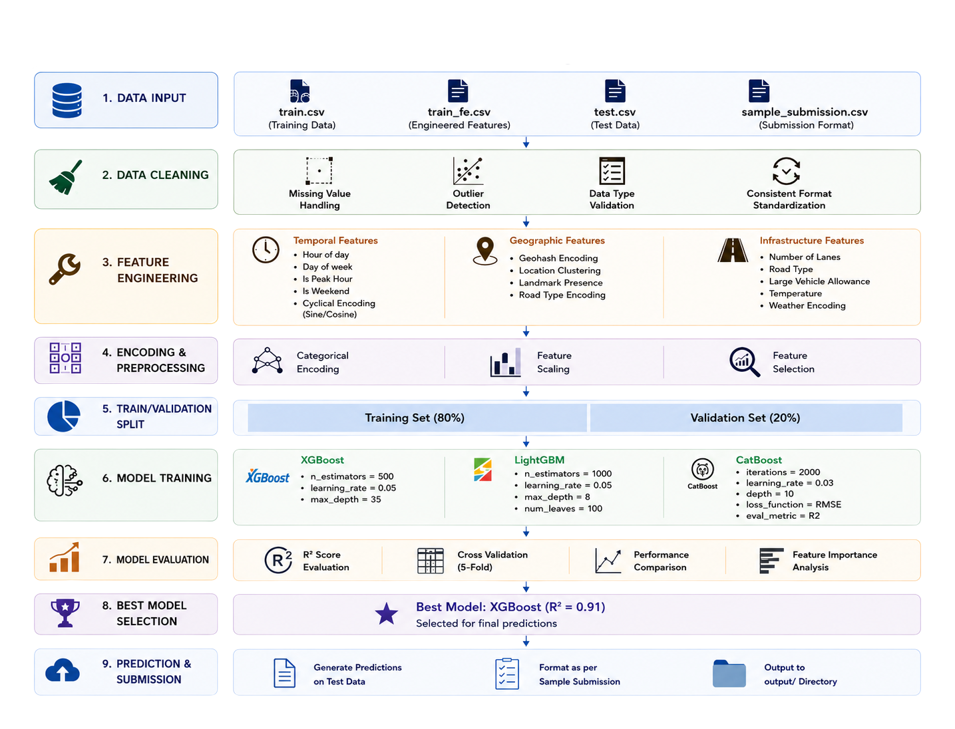
Pipeline
2

Slide 6
Results
FINAL SCORE:90.47564
PROCESSED 77,299 TRAFFIC RECORDS SUCCESSFULLY.
REMOVED ALL MISSING VALUES THROUGH IMPUTATION.
ENGINEERED 12+ NEW FEATURES INCLUDING:
HOUR, WEEKDAY, WEEKEND
PEAK-HOUR AND RUSH-HOUR INDICATORS
CYCLIC TIME ENCODING (HOUR_SIN, HOUR_COS)
VEHICLE-PER-LANE RATIO
LANDMARK AND WEATHER ENCODING
GEOHASH-BASED LOCATION FEATURES
DEMAND SHOWED HIGH POSITIVE SKEWNESS (3.73), INDICATING UNEVEN TRAFFIC DEMAND PATTERNS.
ACHIEVED AN R² SCORE OF 0.9048 (90.48%) ON THE EVALUATION DATASET.
2

Slide 7
THE END
THANK YOU
NEHA SERAKAM
JYOTI
NISHI
RAKSA
5th june 2026
GITHUB LINK :HTTPS://GITHUB.COM/NISHI885/GRIDLOCK

