Slide 1

TOPIC - “Movie Ticket Booking System”
NAME- Jyoti Baban Lohkare
ROLL NO- (55)
Exam Seat No: - 3140
CLASS- SY M.SC(CS)
COLLEGE- DR DY PATIL ACS COLLEGE PIMPRI PUNE

Slide 2
INTRODUCTION TO COMPANY
Organization Name: Anudip Foundation for Social Welfare
Year of Establishment: 2007
Type: Non-Profit Organization Headquarters: Kolkata, Mumbai, Pune Website: www.anudip.org
Overview:
Anudip Foundation is a globally recognized non-profit organization dedicated to transforming lives through technology-enabled education and livelihood programs. Established in 2007, Anudip empowers youth, women, and marginalized communities by equipping them with essential digital, technical, and professional skills. By merging technology with social innovation, the organization creates pathways to sustainable employment and economic independence.
Operating in over 20 states across India and with a growing global presence, Anudip collaborates with government institutions, corporate partners, and international NGOs to implement high-impact programs. These initiatives aim to bridge the digital divide, promote gender equality, and enhance the employability of underserved populations.

Slide 3
Project Overview
Objective:
To automate and simplify the movie ticket booking process through a desktop-based application.
Key Features:
User registration and login
View available movies and showtimes
Select theatre, date, and seats
Instant ticket booking and confirmation
Admin panel for managing movies, shows, and bookings
Why this Project?
Manual ticketing is time-consuming and prone to human error. This system provides a faster, more accurate, and user-friendly way to handle bookings.

Slide 4
Scope of the Project
Customer Functionality:
User Registration and Login
Browse current and upcoming movies
View theatre-wise show listings
Book tickets with seat selection
View booking confirmation
Admin Functionality:
Admin login
Add, update, or delete movie listings
Schedule shows in different theatres
Monitor bookings and generate reports
Scope Benefits:
Eliminates manual booking and human errors
Enhances convenience and speed for users
Provides a centralized system for theatre management

Slide 5
Technologies / Programming Languages Used
Frontend Technologies:
Python with Tkinter for GUI design
Custom dialog boxes for input/output
Event-driven programming model
Backend Technologies:
MySQL for storing user, movie, show, and booking data
MySQL Connector for Python to handle database operations
Additional Tools & Libraries:
VS Code / PyCharm for development
MySQL Workbench for database design
datetime module for scheduling and booking timing
tkinter.messagebox for popups and user interaction
2

Slide 6
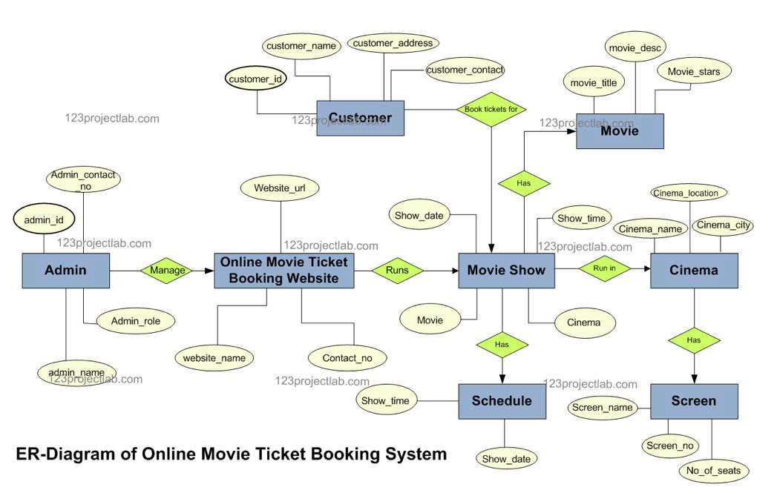
System Diagrams
1. Entity-Relationship (ER) Diagram:
Illustrates the relationships among key database entities:
User ↔ Booking ↔ Show ↔ Movie ↔ Theatre
Captures one-to-many relationships (e.g., one movie can have many shows)

Slide 7
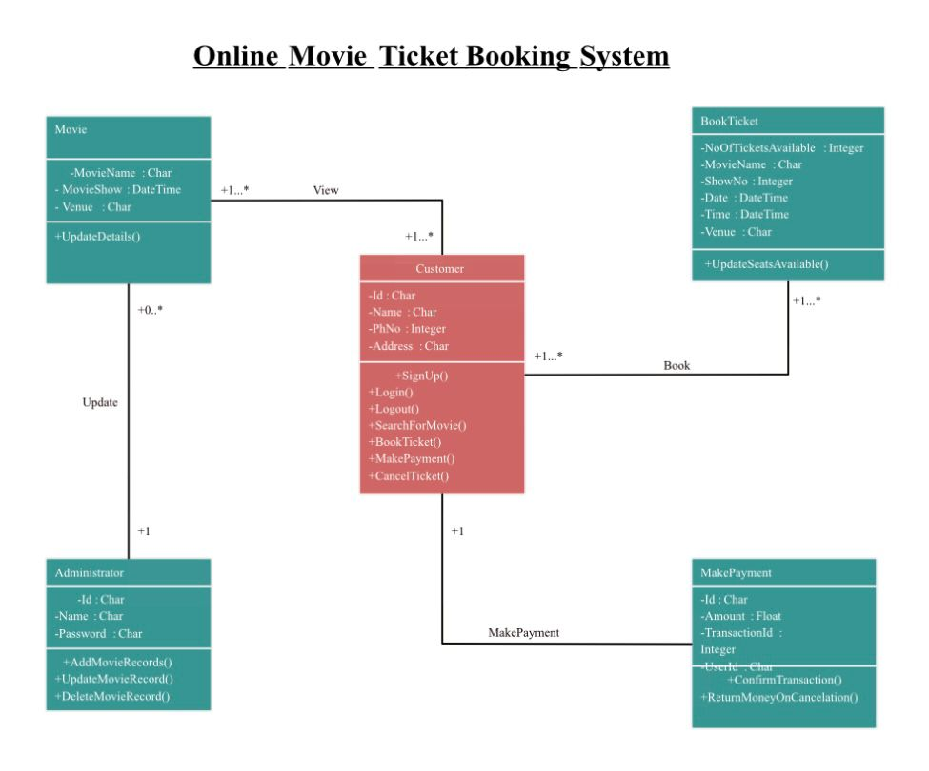
Class Diagram:
Defines core objects and their interactions:
Classes: User, Admin, Movie, Show, Booking, Theatre
Attributes & Methods: Shows attributes (e.g., movie_name, show_time) and key functions (e.g., book_ticket(), login())
Diagram Tools (Optional):
Drawn using Draw.io, Lucidchart, or manually

Slide 8
Use Case Diagram
Actors:
User
Admin
User Use Cases:
Register / Login
View Movies and Showtimes
Select Theatre and Show
Choose Seats and Book Tickets
View Booking Confirmation
Admin Use Cases:
Admin Login
Add/Edit/Delete Movies
Schedule or Cancel Shows
View Booking Reports

Slide 9
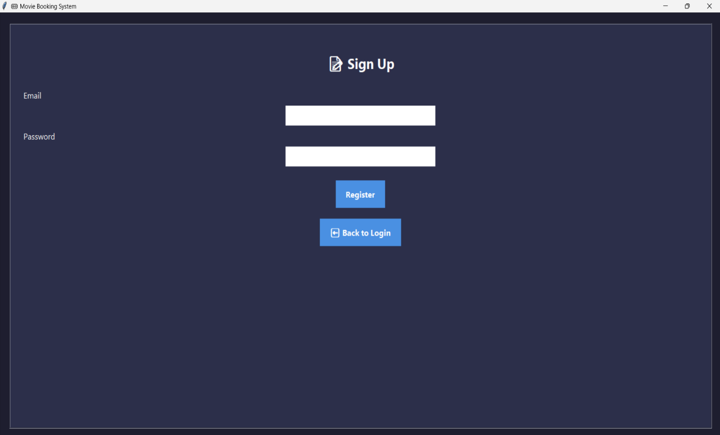
Login Page
Purpose:
To authenticate users (both customers and admins) before accessing the system.
Features of the Login Screen (Tkinter GUI):
Input Fields:
Username
Password
Buttons:
Login: Checks credentials from the MySQL database
Register: Opens registration form for new users
Validation:
Ensures no empty fields
Verifies user credentials from database

Slide 10
Input and Output Screens
Input Screens (User Interface):
Movie Search Page:
Select city/mall, browse movies
Choose language or genre filters
Show Selection:
Choose date and time for the selected movie
Select theatre or hall
Seat Selection GUI:
Click on available seats
Visual layout for booked vs available seats
Output Screens:
Booking Confirmation:
Displays movie name, showtime, theatre, seat numbers
Shows booking ID and user details
Pop-up Alerts:
Invalid login
Booking success or failure
Payment or confirmation messages (if implemented)

Slide 11
Reports (If Applicable)
Daily Booking Report:
Number of tickets booked per movie
Time-wise breakdown of bookings
Revenue Report:
Total earnings per movie, show, or day
Comparison across theatres
User Report (Optional):
Registered users and their booking history
User feedback or issue logs (if collected)
Report Format Examples:
Tables or charts showing booking trends
Export options (CSV or PDF format, optional)

