Slide 1

MOVIE TICKET
BOOKING SYSTEM

Slide 2

1.INTRODUCTION-
The main objective of the Online Movie Ticket Booking System is to provide a way for the customers to buy a movie ticket online through which they can book tickets anytime, anywhere.
The user can easily know the information of the latest movies, theatre’s screening the movies and the show details.
Every user is registered in the database using their Name, Phone Number, Email ID and Age.
The user can search for the theatres screening various movies based on location.

Slide 3

A location has many theatres,
a theatre has at least two or
three screens playing movies.
In order to buy movie tickets,
the user to needs Show details
which include the movie name,
show timings, the theatres screening the movie, and the price of the tickets.
Some theatres have different classes of seating like Gold and Silver and the costs vary accordingly.
More than one ticket can be bought by a user. Finally, each booking is referenced by a booking ID.

Slide 4
2. MODULE DESCRIPTION-
The movie table contains data about movies which will be shown in the theater. The primary key is id, which is auto incremented like all primary keys in all other tables. The other mandatory data is movie name.
The Genre shows the type of movie such as comedy , drama and horror etc . The Date shows the release date of movie and language is another data.
The theatre table identifies all data about theater. All data is mandatory such as theatre id, show id and total seats.
Here Show id is Foreign key.

Slide 5
The user table contains data of user such as first name , last name, phone , email, and age.
The booking tables consist of fields such as booking id, movie id ,class no of tickets and total cost.
Here Movie id id Foreign key.
The ticket table has fields such as ticket id, price and class.
The screening table contains data of all screenings and all fields are mandatory. A screening must have a related id, no of gold seats and no of silver seats.

Slide 6
The Payment table has fields such as card number ,movie id and name on card.
Here Movie id is Foreign key.
The Show table has fields such as show id, show time, date, and
Seats cost(gold and silver).

Slide 7
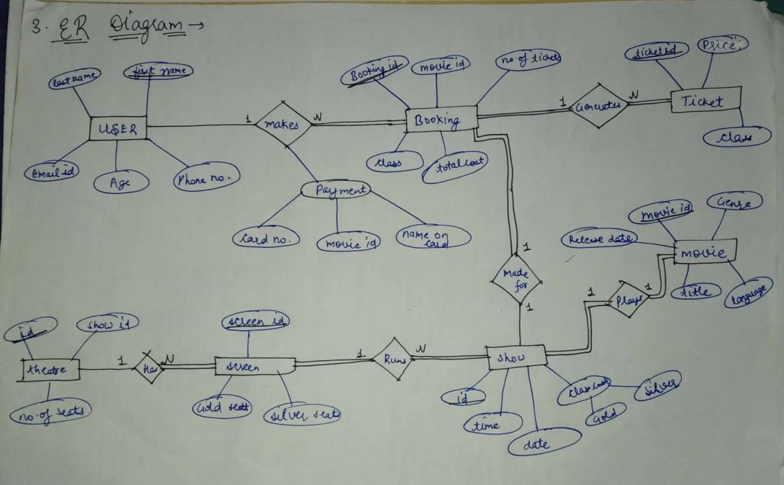

Slide 8

4. Queries-
DATABASE CREATION-
TABLE CREATION & INSERTION-

Slide 9
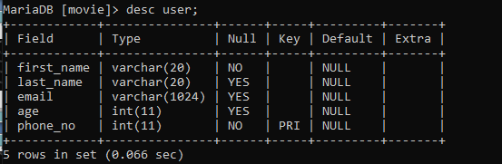
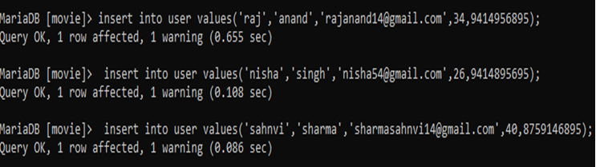

Slide 10
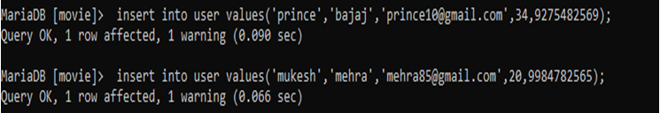

Slide 11
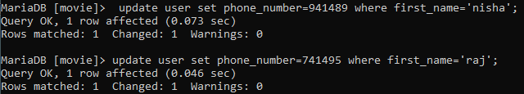

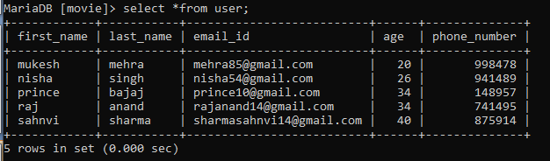

Slide 12

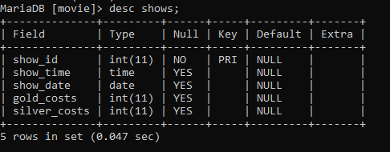

Slide 13
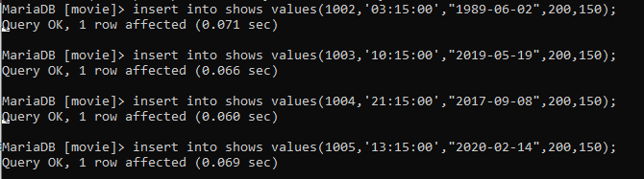
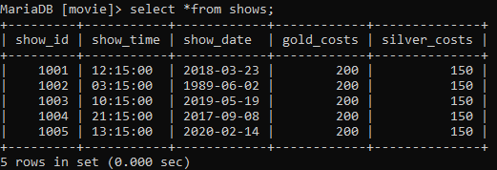

Slide 14

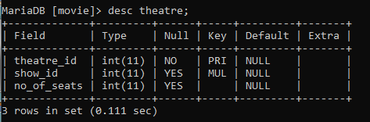

Slide 15

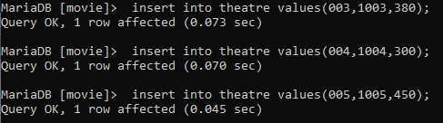
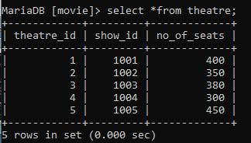

Slide 16
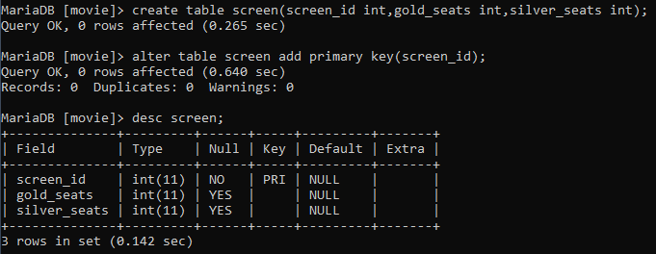


Slide 17
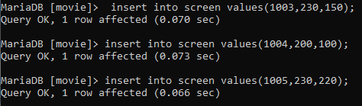
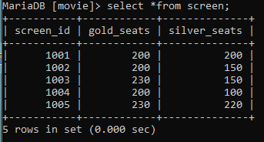

Slide 18
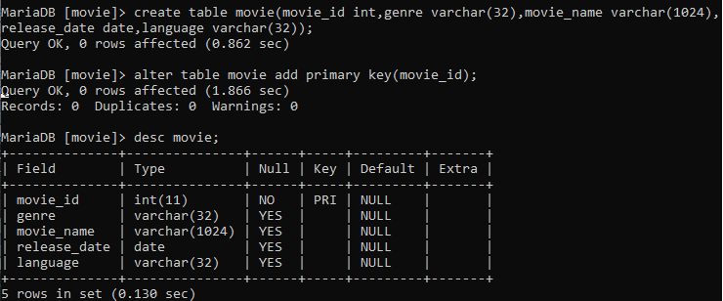


Slide 19
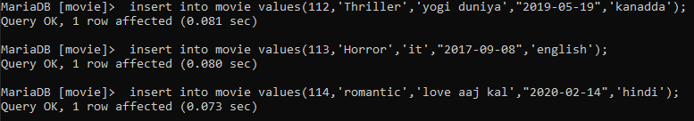
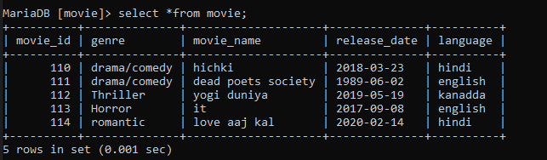

Slide 20
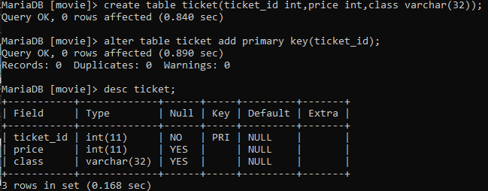

Slide 21

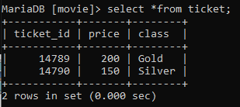

Slide 22
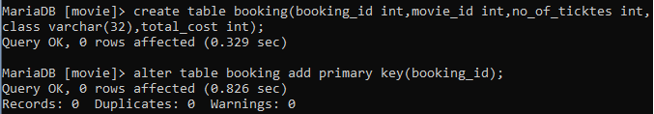
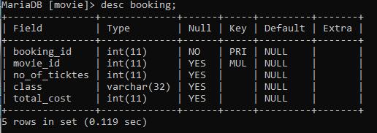

Slide 23

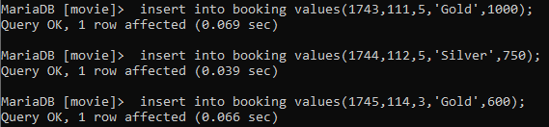
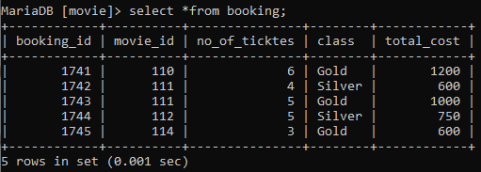

Slide 24
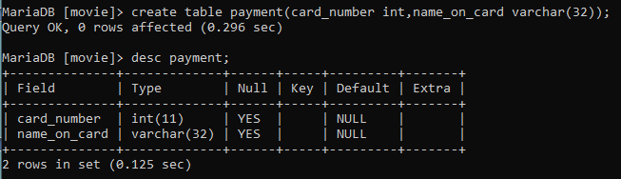
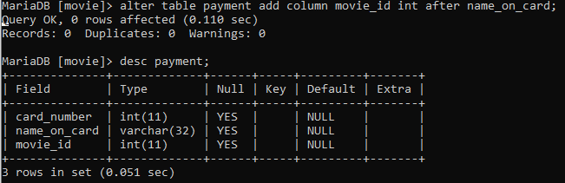
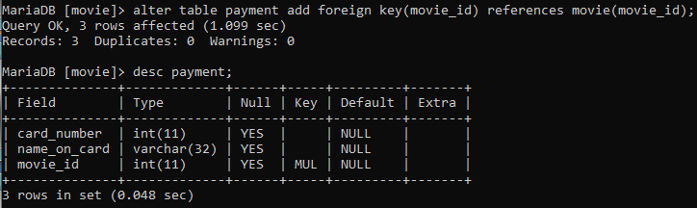

Slide 25
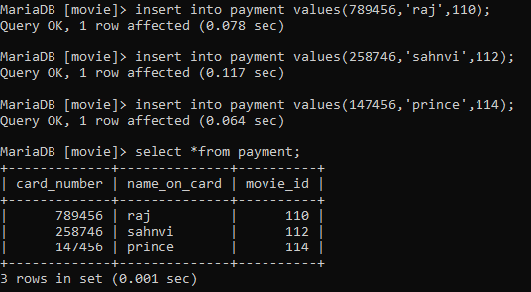

Slide 26
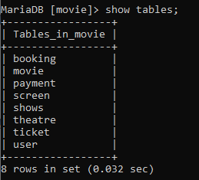
Tables in Database:-

Slide 27
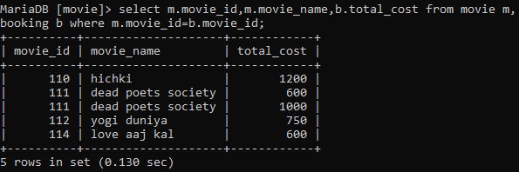
Join Queries-
1. Display Movie id, name and total cost for a booked movie.

Slide 28
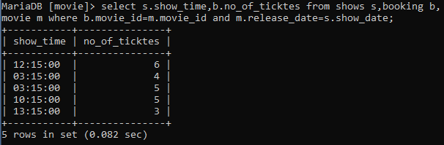
2. Display Show time and no of tickets booked for a movie.

Slide 29
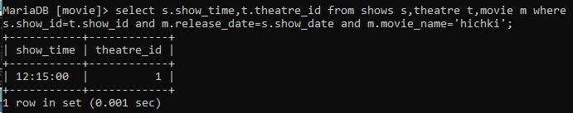
3.Display show time and theatre id booked for movie named Hichki.

Slide 30
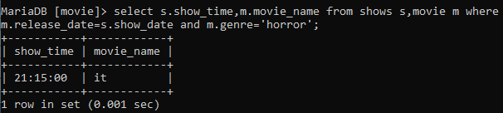
4. Display show time and movie name where movie genre is Horror.

Slide 31
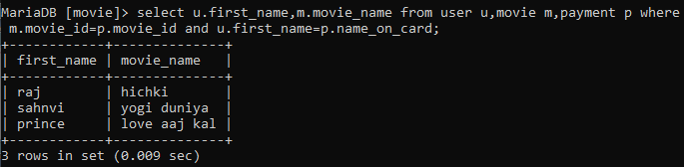
5. Display user name and movie name who has booked and paid for the movie.

Slide 32
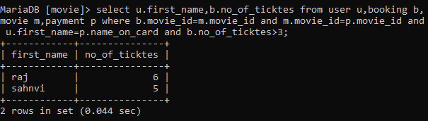
6. Display user name and movie name where no of tickets booked>3 for a paid movie.

Slide 33
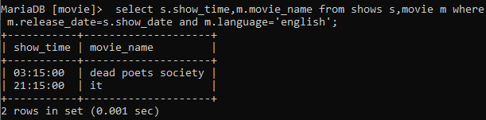
7. Display show time and movie name where movie language is English.

Slide 34
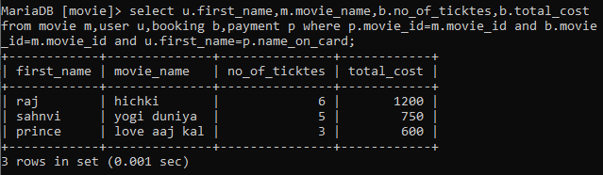
8. Display user name ,movie name , total no of tickets booked and total cost paid by him/her for the movie.

Slide 35
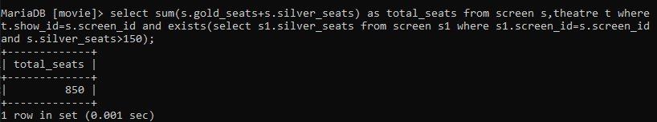
Nested Queries-
1. Display total no of seats in a theatre screen where no of silver seats >150.

Slide 36
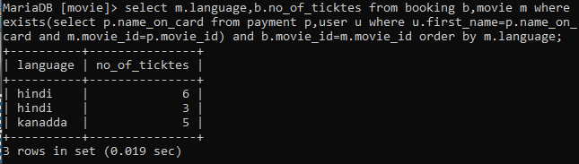
2. Display language of movie and no of tickets booked for the movie order by language ascending .

Slide 37
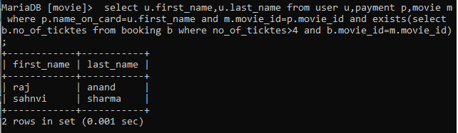
3. Display user details where no of tickets booked >4.

Slide 38
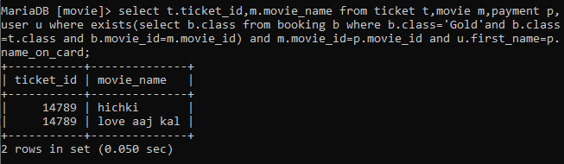
4. Display tickets booked for gold class.

Slide 39

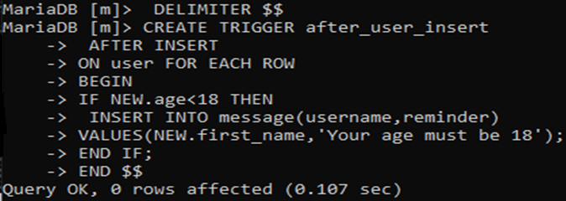
PL/SQL QUERIES-
1. Display a message that “Your age must be 18”whenever a new user whose age is less than 18 but try to book the tickets.

Slide 40
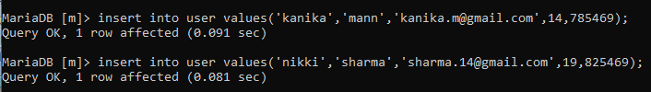
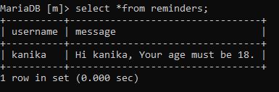

Slide 41
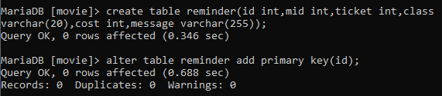
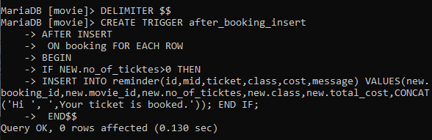
2. Display booking details of user booking a ticket and print a message that ‘Your ticket is booked’.

Slide 42
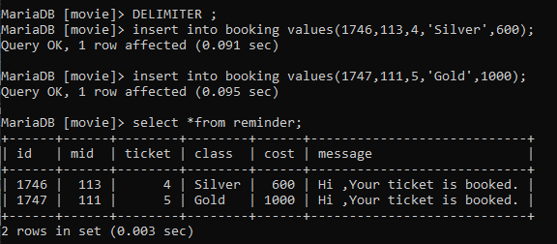

Slide 43
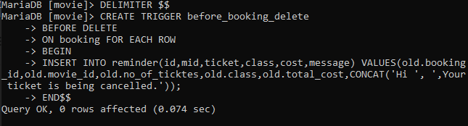
3. Display booking details of user cancelling and print message ‘Your ticket is being cancelled’.

Slide 44
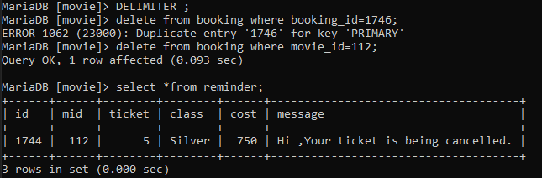

Slide 45
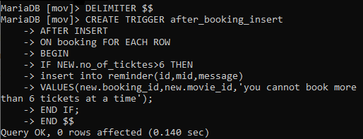
4. Display a message that ‘You cannot book more than 6 tickets’ if user want to books more than 6 tickets at a time.

Slide 46


Slide 47
THANK YOU!

