Slide 1
Vehicle Movement Analysis and Insight Generation in a College Campus
Intel Unnati Industrial Program 2024-2025
Notes:
ID=d924773e-9a16-4d6d-9803-8cb819e99682 Recipe=text_billboard Type=TextOnly Variant=0 FamilyID=AccentBoxWalbaum_Zero

Slide 2
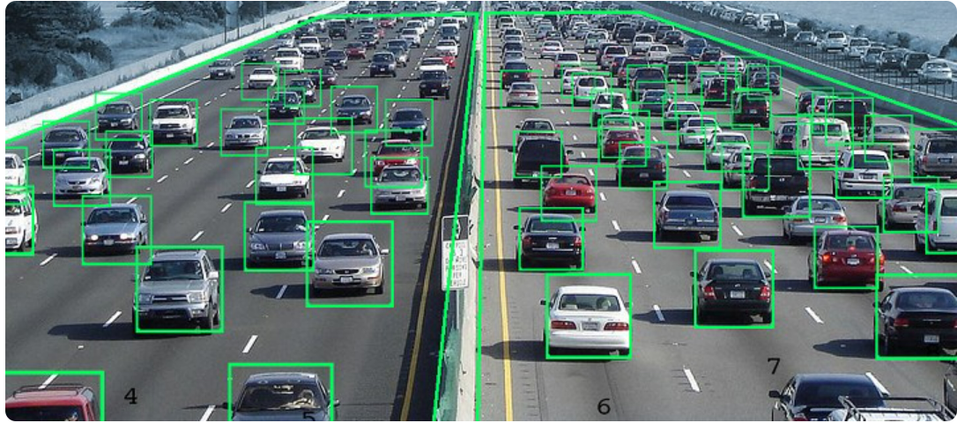
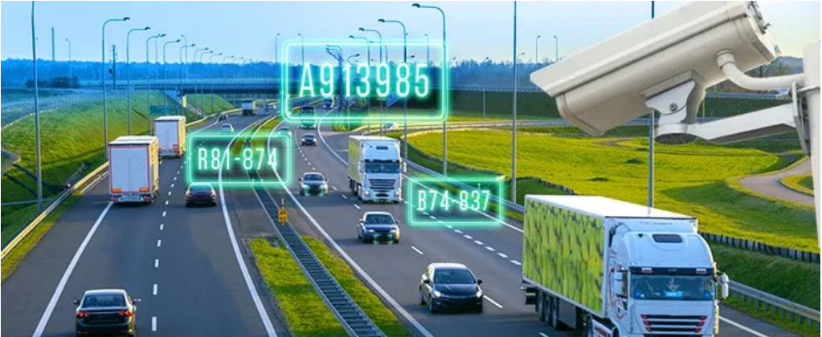
Problem Statement:
Vehicle Movement Patterns: Analyze the frequency and timing of vehicle movement in and out of the campus, identifying peak times and patterns.
Parking Occupancy: Monitor the occupancy of parking lots in real-time and indicate the slots available
Vehicle Matching: The solution should be able to match captured vehicle images and license plates to an approved vehicle database. It should be able to identify unauthorized vehicles.

Slide 3
Objective:
The primary objective of this project is to develop an Edge AI-based solution that can analyze vehicle movement in and out of a college campus using data from cameras capturing vehicle photos and license plates. This solution provides insights on vehicle movement patterns, and parking occupancy, and matches vehicle data to an approved vehicle database with is helpful for campus security

Slide 4
Features Offered:
Vehicle Detection and Recognition: Implemented AI models capable of detecting vehicles in real-time from camera feeds and recognizing license plates accurately.
License Plate Recognition (LPR): Utilize OCR (Optical Character Recognition) technology to read and interpret license plate numbers captured by the cameras.
Vehicle Movement Tracking: Track the movement of vehicles entering and exiting the college campus based on the data from the cameras.
Parking Occupancy Monitoring: Provide insights into parking availability and occupancy by analyzing which parking spots are filled or vacant.
Vehicle Database Integration: Integrate with an approved vehicle database (Excel sheet) to match detected vehicles against a list of authorized vehicles for the campus.
Insights and Analytics: Generate reports and analytics on vehicle movement patterns, including entry and exit times, frequency of visits, peak hours, etc.

Slide 5
Dataset description:
The Vehicle Movement Analysis Dataset, collected using Roboflow, has two different datasets for two different models, where 1 model is used for checking vehicle patterns and the other for parking occupancy.
The collected images are stored in JPEG or PNG format, accompanied by annotations in YOLOv8 format. The annotations are provided in text files, with a .txt extension.
Each line in the annotation file corresponds to an object and includes the class index (e.g., Vin, Vout, License plate), bounding box center coordinates (x, y), and box dimensions (width, height).
In terms of usage, the dataset is primarily employed for training machine learning models using YOLOv8, for vehicle detection and classification, evaluating model performance on unseen data, and analyzing vehicle movement patterns, traffic flow, and parking occupancy

Slide 6
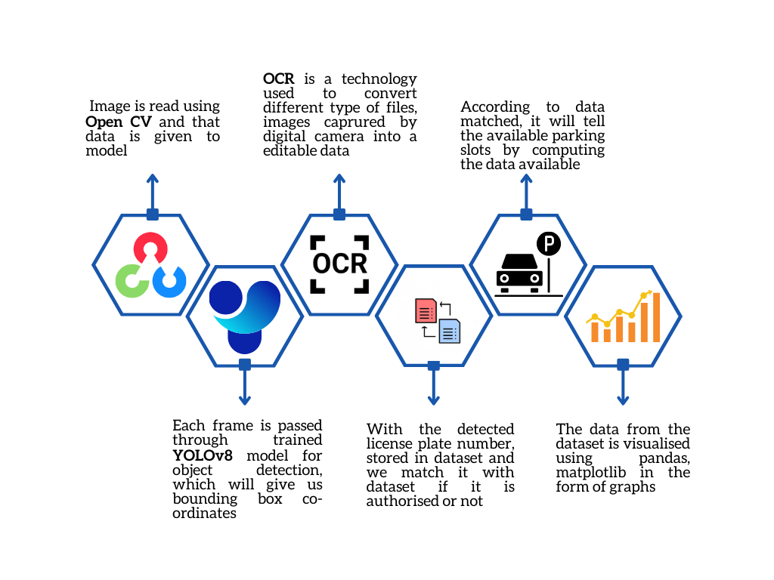
Process Flow:

Slide 7
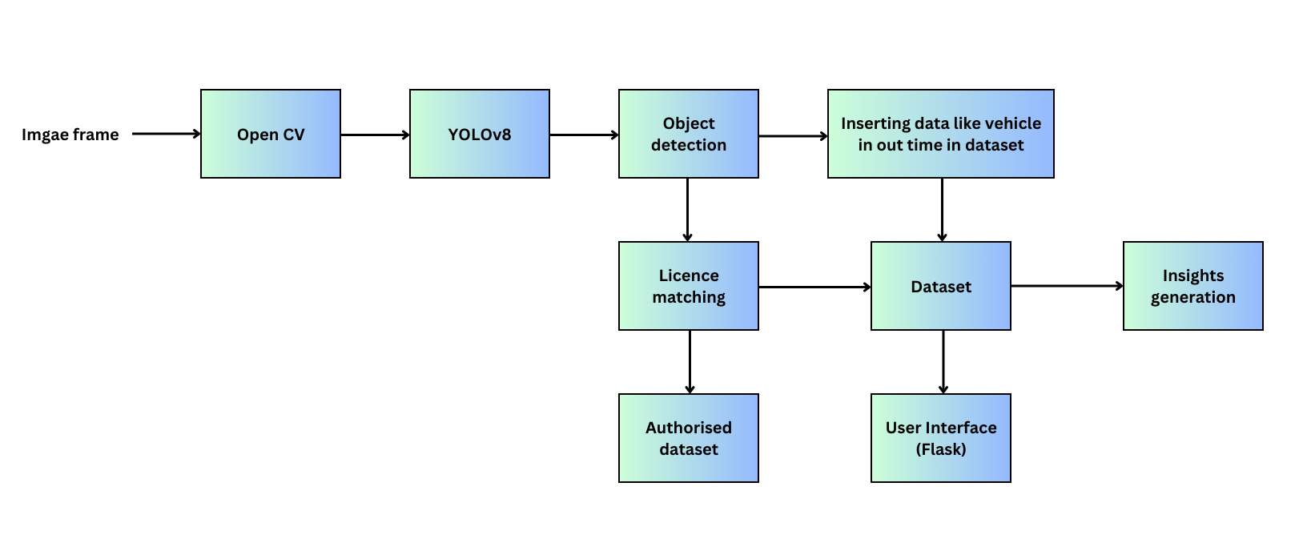
Architecture Diagram:

Slide 8
Technologies Used:
Roboflow: Using Roboflow, creating a dataset for machine learning is straightforward and efficient. You start by uploading images, optionally annotate them, and augment the data for diversity. The platform supports exporting in various formats and facilitates easy management and version control of datasets, streamlining the process of developing robust machine learning models.
YOLOv8: YOLO (You Only Look Once) is a state-of-the-art object detection algorithm in machine learning. YOLO performs detection in a single network pass, making it extremely fast. YOLO is trained on labelled datasets where bounding boxes and class labels are annotated. During training, the model learns to predict these bounding boxes accurately while optimizing a loss function that balances localization and classification accuracy.
Open CV: OpenCV is a robust open-source library for computer vision tasks, offering tools for image/video processing, object detection, machine learning. It supports multiple platforms and languages, making it essential for a wide range of applications from basic image editing to advanced AI systems.

Slide 9
Continue
Pandas: Pandas is a powerful Python library used extensively for data manipulation and analysis. It provides data structures like DataFrame and Series that allow easy handling of structured data. Pandas excels in tasks such as data cleaning, transformation, and exploration.
Matplotlib: Matplotlib is a Python library for creating high-quality static visualizations. It supports a variety of plot types, offers extensive customization options, and has both a simple interface for quick plotting and an object-oriented interface for more control.
HTML, CSS, Flask: HTML defines the structure and content of web pages, CSS enhances their visual appearance and layout, and Flask integrates these components along with backend logic to create dynamic and interactive web applications. This combination forms a powerful toolkit for building a modern web experience

Slide 10
Team Members and Contribution:
1) Jyotiba M. – Played a crucial role in the project by leading team and Training a Machine learning model using YOLOv8.
2) Jaishivarai B. – His role involved meticulously annotating and optimizing our dataset, resulting in significant improvements in model accuracy and performance using Roboflow.
3) Tejashree H. – Her role helped extract, clean, and transform data using Pandas data frame structure, applying techniques like data matching and filtering datasets seamlessly.
4) Samiksha A. – Played a crucial role in data visualization for creating insights that help in understanding the vehicle pattern and plotting graphs using Matplotlib.
5) Vinit J. – His role involved skills spanning both front-end and back-end, enabling them to develop full-stack web solutions that meet modern web development standards and user expectations.

Slide 11
Discussion/Conclusion:
The accuracy of our model is 94% for vehicle patterns and 96% for parking occupancy, we look forward to improving the accuracy of our AI model by training it on more and a variety of datasets, because the more data better the model efficiency, we can try to add more features to this project, with this project we have learned, explored a lot and now we can think of solving problems around us using AI/ML & Computer Vision.
In conclusion, developing an Edge AI-based solution to analyze vehicle movement in and out of a college campus is a pivotal initiative aimed at enhancing campus security, operational efficiency, and overall management. By leveraging advanced technologies such as real-time vehicle detection, license plate recognition, and integration with a vehicle database, the solution offers comprehensive insights into vehicle movement patterns and parking occupancy.

