Slide 1
The OSI Model
Based on Computer Networks and Internets (Comer)

Slide 2
OSI or ISO
The layering model is OSI, which stands for Open System Interconnection.
The organization that developed the model is ISO, International Organization for Standardization.
  ANSI (American National Standards Institute) is a member of ISO.
    ANSI farms out much of the hardware standardization to the IEEE.

Slide 3
ISO
International Organization for Standardization, shouldn’t that be IOS???
No. ISO is not really an acronym.
“ISO” was chosen because it means equal as in an isosceles triangle that has two equal sides.

Slide 4
Standards
“Standards are documented agreements containing technical specifications or other precise criteria to be used consistently as rules, guidelines, or definitions of characteristics, to ensure that materials, products, processes and services are fit for their purpose.”
From the ISO website

Slide 5

www.iso.org

Slide 6

Open versus Proprietary
Open: specifications are public.
  Requires committee agreement, can be slow.
Proprietary: Privately owned and controlled, specifications are kept private so that other companies cannot duplicate.
  No outside agreement needed, can be reactive (faster).
Consumers prefer open and standardized systems, as these allow them to use the products of various manufacturers.
  But sometimes it takes too long to come up with them.

Slide 7
Layering/Interfacing
Layering is an important concept in computing.
When a user runs an application,
  The user interfaces with the application.
  The application interfaces with the operating system.
  The operating system interfaces with the BIOS.
  The BIOS interfaces with the input/output hardware.

Slide 8

To what purpose?
The user need only know something about the application and doesn’t need to know any details about the operating system, the BIOS or the hardware.
Similarly the application needs information about the user and the operating system but not the BIOS or hardware.
For layering to be successful there must be a “standard” interface into a layer.
  The operating system is said to provide an Application Programming Interface (API).

Slide 9
More than just a way of thinking about it
These layers can be seen in the industry, there are
  Companies that specialize in hardware
    Seagate, Maxtor, Western Digital
  Companies that specialize in BIOS
    AMI, Phoenix
  Companies that specialize in operating systems
    Microsoft, Sun, B
  Companies that specialize in applications
    Oracle, Microsoft, AOL

Slide 10

Communications Layering
The communication between two (or more) users on a network similarly is broken down into layers.
A possible model for this layering was laid out by the ISO.

Slide 11

What is OSI?
OSI serves as a "reference model" for how information is transmitted between any two points in a network.
It guides manufacturers (a.k.a. vendors) so they can make products that will work with other products.
The OSI model is comprised of seven layers that are involved in communicating between two nodes of a network.

Slide 12

It’s not the law
The OSI model was never adopted as a rigorous set of specifications.
The lower layers (physical, data link, network and transport) are for the most part adhered to.
  Recall however that we have already mentioned a “brouter” which serves as both bridge (data link layer) and router (network layer).

Slide 13
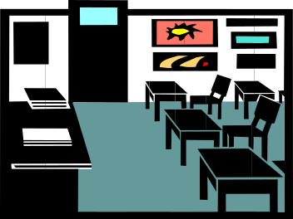
Classroom not boardroom
Many vendors agreed at one time or another to adhere to OSI, however, the system proved to be too loosely defined, overly broad and the companies had much invested in their proprietary standards.
Some products like X.400 (an e-mail system used mainly in Europe and Canada, an alternative to SMTP) adhere to OSI.
But mainly OSI has become a teaching tool.

Slide 14

OSI’s Purpose
Even if manufacturers do not restrict themselves to a particular OSI layer, they usually think of and describe their products in relationship to the OSI model.
It provides a language and framework for discussion of networks, so it persists and continues to be taught.

Slide 15
TCP/IP model
Another model for understanding communications networks is the TCP/IP model.
It also is broken into layers
  It has no equivalent of the OSI model’s physical layer.
  The next three layers of the OSI model and the TCP/IP model are roughly equivalent.
  The top three layers of the OSI model are combined into one layer in the TCP/IP model.

Slide 16

The main idea
The communication between computers can be broken down into layers.
  Each layer is characterized by its functions and how it interfaces with the adjacent layers.
Within the source’s computer and starting at the user level, the communication is passed down through the layers to the lowest layer where it is sent through some transmission medium.

Slide 17

The main idea (Cont.)
The communication travels at the lowest layer (physical), occasionally rising up to the second layer (bridge) or third layer (router) until it reaches the destination.
The communication now passes up through the layers.

Slide 18
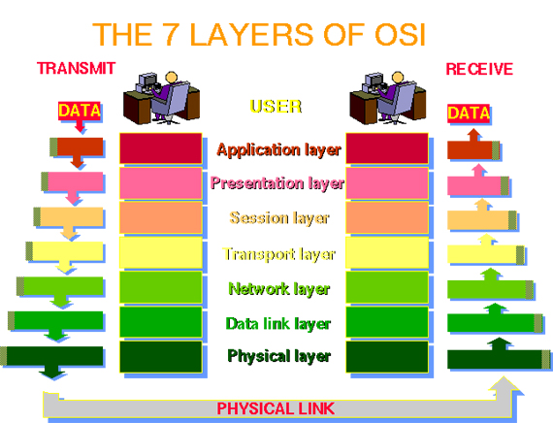

Slide 19
The main idea (Cont.)
The layers are realized by a combination of the operating system, applications (for instance a browser), network protocols such as TCP/IP, and the software and hardware that actually place a physical signal onto a transmission line (NIC, modem, etc)
  Don’t confuse TCP/IP (the stack, model) with layer protocols TCP (layer 4) and IP (layer 3).

Slide 20

OSI: Network / Computer
The Transport layer can be viewed as the division between the computer and the network.
The lowest three layers (physical, data link and network) deal with “a best effort” to get information to the desired computer.
The Transport layer verifies the effort, and hides the network from the layers above.
The remaining layers treat the data as if it was local.

Slide 21
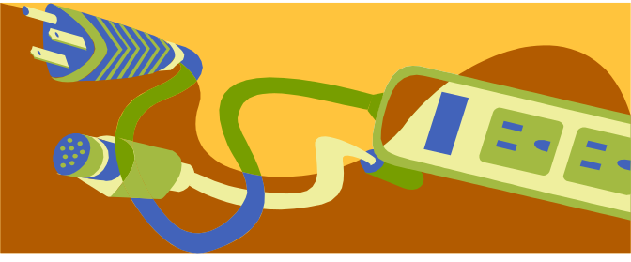
Layer 1: Physical
There is no interpretation at this level, a stream of 1’s and 0’s are put into a form convenient for transmission.
  Waves (with little regard for their information content) are sent and received.
This level is the most hardware oriented. It includes specifications about
  NIC card speeds
  Types and lengths of cable
  Voltage characteristics (range, level or edge)
  Etc.

Slide 22
Physical Layer (Cont.)
The physical layer involves protocols for actual transmission
  Ethernet
  FDDI
  RS232
  ATM
These protocols also involve the interface with the next higher layer.

Slide 23
Layer 2: The data-link layer
At this layer one begins to consider bytes instead of just bits, one examines some of the information content of the signal (at least the address and some of the error detection sequencing)
Recall that bridges operate at this level
  They know where a packet is headed.
  They know whether or not it has been involved in a collision.
  Bit stuffing occurs at this level.

Slide 24

Data Link (Cont.)
Data packets are encoded and decoded into bits.
It directs packets and handles errors from the physical layer.
It handles synchronization (timing).
  It must know where one bit ends and the next one begins.
  It must know where one byte ends and the next one begins.

Slide 25
Data link sublayers
The data link layer is divided into two sublayers:
  The MAC (Media Access Control) sublayer: takes the signal from or puts the signal onto the transmission line (“touches” physical layer).
  The LLC (Logical Link Control) sublayer: starts to interpret the signal as data, includes timing (synchronization) and error checking.

Slide 26

Layer 3: The network layer
The router acted at this layer.
One of the main functions of the layer is routing. Store and forward are network layer functions.
In a connection-oriented scheme, the virtual circuit is established at the network layer.
Building the routing tables, troubleshooting the routing tables when there is a lot of traffic or if a connection goes down.
The network layer also gathers related packets (packet sequencing).

Slide 27
Layer 4: The transport layer
As stated before, Layer 4 is the dividing line between inter-computer transactions and intra-computer transactions.
Layer 4 manages end-to-end verification.
  The lower layers make a “best effort” but if data is lost so be it. Layer 4 must ensure that the information was received intact.
It does a higher-order error-checking.
The transfer should be “transparent.” The higher layers do not know the data came from another computer.

Slide 28
Whose job is it?
At a node Layer 3 collects associated packets if one was dropped it may throw them all away.
It is the responsibility of the source’s Layer 4 to look for some acknowledgement that all packets arrived. If no acknowledgment is received, it should retransmit.

Slide 29

Layer 5: The session layer
Recall when discussing connection-oriented schemes, we mentioned the idea of a “session.”
It is an agreement between a source and destination to communicate.
This layer establishes, manages and terminates sessions between applications (they could be on the same computer or on different computers).

Slide 30

Layer 6: The presentation layer
This layer provides independence from differences in data representation (e.g., encryption) by translating from application to network format, and vice versa.
The presentation layer works to transform data into the form that the application layer can accept. This layer formats and encrypts data to be sent across a network, providing freedom from compatibility problems. It is sometimes called the “syntax layer.”

Slide 31
Layer 7: The application layer
This layer supports application and end-user processes.
Communication partners are identified, quality of service is identified, user authentication and privacy are considered, and any constraints on data syntax are identified.

Slide 32
Layer 7: The application layer
Everything at this layer is application-specific. This layer provides application services for file transfers, e-mail, and other network software services. Telnet and FTP are applications that exist entirely in the application level.
These are not applications (like Word and Excel) but services for such applications!

Slide 33

Mnemonic
Please Do Not Throw Sausage Pizza Away
  Please → Physical
  Do → Data Link
  Not → Network
  Throw → Transport
  Sausage → Session
  Pizza → Presentation
  Away → Application

Slide 34
OSI in real life
For example, TCP/IP is usually packaged with other Internet programs as a suite of products that support communication over the Internet. This suite includes the File Transfer Protocol (FTP), Telnet, the Hypertext Transfer Protocol (HTTP), e-mail protocols, and sometimes others.
Although TCP fits well into the Transport layer of OSI and IP into the Network layer, the other programs fit rather loosely (but not neatly within a layer) into the Session, Presentation, and Application layers.

Slide 35


Layered Software
In order to communicate on a network, each computer must have software that passes packets from layer to layer. Each layer only communicates with its neighbors.
The entire package of software for moving through layers may be called a “suite” or a “stack.”
  “What stack are you running?”
The most widely used communication stack is TCP/IP.

Slide 36
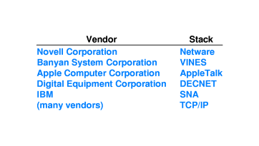
Fig. 16.3: Stacks and Vendors

Slide 37
Network Operating System
A Network Operating System (NOS) includes special features for connecting computers/devices to a LAN.
Some operating systems (OS), like UNIX and Mac OS, have networking features built in. But the term “network operating system” is usually reserved for packages that add such features to a basic OS.

Slide 38
Network Operating Systems
Some popular NOS's for networking DOS/Windows systems include
  Novell Netware
  Artisoft's LANtastic (dead)
  Microsoft LAN Manager (no future updates)
  Windows NT/W2K
Networking has become so important, that basic network connections are handled by the ordinary operating system.

Slide 39

Multiple protocol stacks
One computer may communicate with different computers using different protocols across the SAME physical medium.
The information that identifies which protocol is being used are contained within the frames.

Slide 40
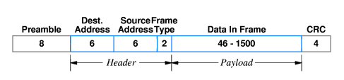
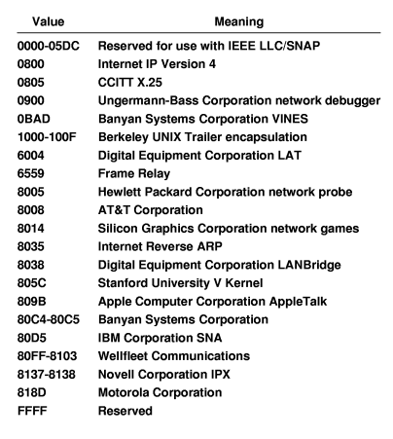
Recall that the Ethernet Frame type field identifies what kind of information is contained within and how it should be handled.

Slide 41
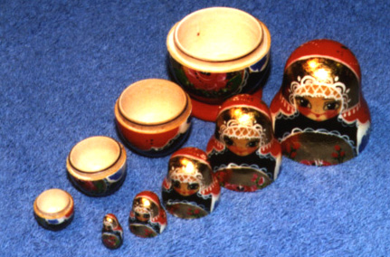
Nested Headers
As a source computer passes a message down through the protocol stack, each layer adds a header.
The header added at a particular layer is intended for the corresponding layer on the destination computer.
Thus the message passed down from Layer X to Layer Y on the source computer should be the same as the message passed up from Layer Y to Layer X on the destination computer.

Slide 42
Layer-to-Layer
Because source Layer Y added the header that destination Layer Y strips off, this is effectively a Layer-Y-to-Layer-Y communication (even though it passes through other lower layers).
For instance, the source and destination presentation layers have to negotiate the format of the data
  Will it be text? Will it be encrypted?
There is no direct link between presentation layers, the information passes down through the physical layer; nevertheless, the two layers do communicate.

Slide 43
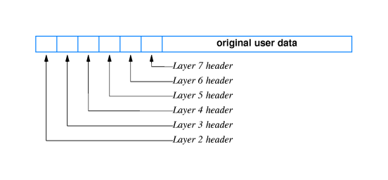

Nested Headers (Fig. 16-4)
and trailer
Layer 2 also adds a trailer

Slide 44
No physical layer header
The physical layer does not add a header.
Headers contain information needed by the layers.
The physical layer does not operate at an “information” level.

Slide 45
What’s wrong with this picture?

Slide 46
What’s the point?
The purpose of belonging to a network is for computers to communicate — an exchange of information.
  The information must get where it’s going – addressing is important to networking.
  If that information is incorrect or not trustworthy, then there is no gain. Thus error detection and correction (usually through retransmission) are a vital part of networking.
  Another issue is that one has to know what to do with the information once it arrives – types play a role.

Slide 47


Single packet and Multi-packet
In a packet-switching scheme, the information being exchanged is transmitted in sequences of packets.
Consequently error detection must take place on two basic levels
  Within an individual packet
  Within a group of related packets

Slide 48
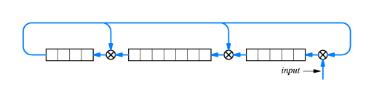
Single Packet Techniques
This sort of detection tends to take place at Layer 2, the Data Link Layer.
The standard techniques are:
  Parity bits
  Checksums
  Cyclic Redundancy Checks

Slide 49
Multi-Packets Techniques
The original information is broken down into a sequence of packets or cells.
To reconstruct the information, the receiver must know the number of packets expected to arrive and the order they should be placed in.
Recall that in a connectionless scheme, packets might be lost or arrive out-of-order.
Multi-packet error detection/correction is handled in Layers 3 and 4 (Network and Transport).

Slide 50
Sequencing
1 of 4
2 of 4
3 of 4
4 of 4

Slide 51

Various Problems
The protocol stack must be able to deal with the various scenarios that might arise
  A packet might be lost along the way.
  A packet might arrive corrupted.
    If corrupted, Layer 2 will throw the packet away, so as far as Layer 3 and higher are concerned, corrupted and lost are the same.
    There are more losses due to congestion than corruption due to hardware failure.

Slide 52

Various Problems
Packets might arrive out of order.
Duplicate packets might arrive.
  Retransmission is the solution to most problems, if a packet was delayed and assumed lost it would be retransmitted. Thus if it was only delayed there may be duplicates.

Slide 53
Who’s responsible?
Verification is mainly the responsibility of the source.
  After all how can the destination verify if it did not receive a packet?
More specifically it is the responsibility of the source’s Layer 4.
  When a packet is transmitted, a note of the time is made. If no acknowledgment is received after a set amount of time, the packet is retransmitted.

Slide 54
Some destination responsibility
Destination Layer 3 is responsible for ensuring that all the packets of a given sequence have arrived.
  “I received ‘1 of 3’ and ‘3 of 3’ but never got ‘2 of 3’
  It also eliminates duplicates.
Destination Layer 4 is responsible for acknowledging that the complete set of packets arrived.

Slide 55
Multiple sequences
One has to know what position a packet has in a sequence.
One also has to know to what sequence a packet belongs.
Each communication will have a unique connection (session) ID number.

Slide 56
Sequencing
Transmission A, 1 of 4
Transmission A: 2 of 4
Transmission B: 1 of 4
Transmission B: 3 of 4
Transmission A: 3 of 4
Transmission B: 2 of 4

Slide 57
Other References
http://www.whatis.com
http://www.webopedia.com
MCSE TCP/IP for Dummies, Brandon
http://www.iso.ch/iso/en/ISOOnline.frontpage

