Slide 1
The Internet and the
World Wide Web
World Wide Web

Slide 2
Introduction
Significance of Internet
History of Internet Development
World Wide Web (WWW)
Internet Service Providers (ISPs)
Reliability & Stability of the Web
World Wide Web

Slide 3
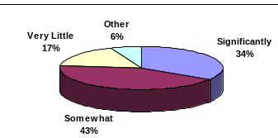
Significance of Internet
How much has Internet changed your company’s infrastructure?
  Among 150 IT managers:
Source: Informationweek, Apr. 3, 2000, p. 165.
World Wide Web

Slide 4
History of Internet Development
30-year History since 1969
  Pentagon & Cold War
Original Use:
  Military installations
  Universities
  Business firms with defense department contracts
Initial Goal:
  Design a network that maintains the safe transition of data between military computers
World Wide Web

Slide 5
Events
Date | Event
1969 | ARPAnet
1984 | MILNET & ARPANET (Internet)
1980s | National Science Foundation (NSF) controlled Internet Access
1991 | NSF eased restrictions on Internet Access
1995 | U.S. government relaxed entry into Internet for the public
World Wide Web

Slide 6
Exponential Growth in
Network Bandwidth
Year | Bandwidth
1969 | 9.6 Kbps
1985 | 54 Kbps
1987 | 1.544 Mbps (T1 speed)
1989 | 45 Mbps (T3 speed)
1995 | 155 Mbps
1997 | 622 Mbps
1998 | 1,024 Mbps
2000 | 2,048 Mbps
Growth rate:
> 210, 000 times
World Wide Web

Slide 7
World Wide Web
An organization of files designed around a group of services on Internet
Programmed to handle requests from browser software resided on users’ PCs
  Browser: a program that allows pictures & texts of a document to be viewed e.g. Netscape & IE
World Wide Web

Slide 8
Events
Date | Event
03/89 | WWW project was originated by Timothy Berners-Lee
11/90 | A revised version of project by NeXT computer
03/91 | Release of WWW for testing
09/93 | Release of 1st version of Marc Andreessen’s Mosaic by NCSA
10/93 | > 500 known HTTP servers in operation
10/94 | > 10,000 know HTTP servers in operation
World Wide Web

Slide 9
Reliability & Stability of Web
Internet Society
  Works with ISPs by providing information to prospective users & attracts product developers
Internet Architecture Board
  Focuses on TCP/IP & other protocols
World Wide Web

Slide 10
Usage of Internet
Marketing & selling products / services
  E-commerce
    > $1 million sales
    B2B, Government Agencies, Universities, B2C
  Failures
    2/3 out of 100,000 companies
Speed of doing business
  24/7
World Wide Web

Slide 11
Usage of Internet (Cont’d)
Complimenting existing brick & mortar business
  ‘Who we are’
    Sale promotion
    Customer awareness
Gathering opinions & trying out new ideas
  Online Opinion Polls
World Wide Web

Slide 12
Usage of Internet (Cont’d)
Equal Opportunity for all Business
  Allow competitions with larger companies
Mass Distribution
  ‘Marketing heaven’
  Ease of update
Paper-free Environment
World Wide Web

Slide 13
Usage of Internet (Cont’d)
Customer Service & Support Resource
  Use of FAQ
Efficiency & Unequaled Cost-effectiveness
  For niche products / services
  Provide information
Managerial Tool
  Use of e-mail
World Wide Web

Slide 14
Usage of Internet (Cont’d)
Logistics, Research & Development
  Chat rooms, online interactive sessions
  Market research firm
Presence Triggers Business
  e.g. B2C, B2G
Good Education & Information Tool
World Wide Web

Slide 15
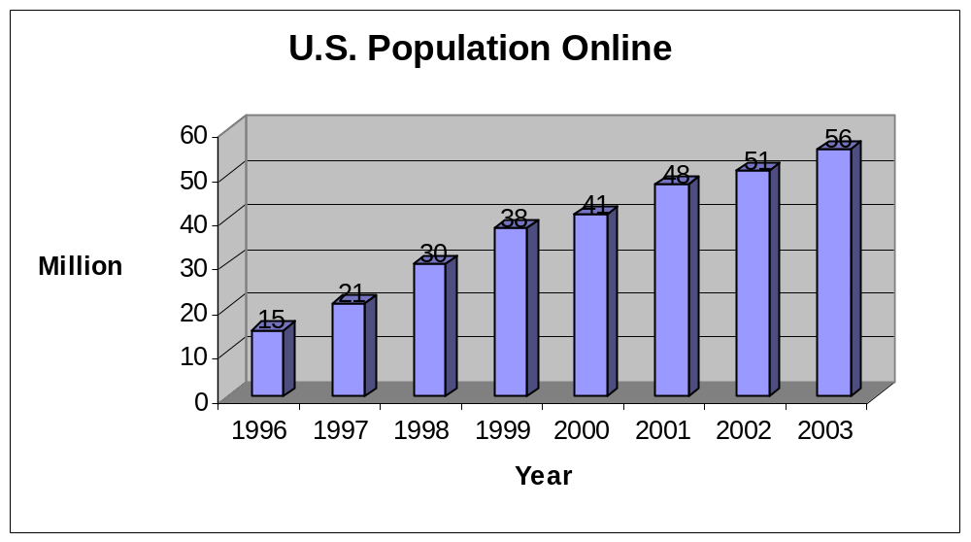
Who’s Online?
World Wide Web
Source: Peterson, Andrea, ‘Lost in the Maze.’ Wall Street Journal, Dec 6, 1999, p. R6

Slide 16
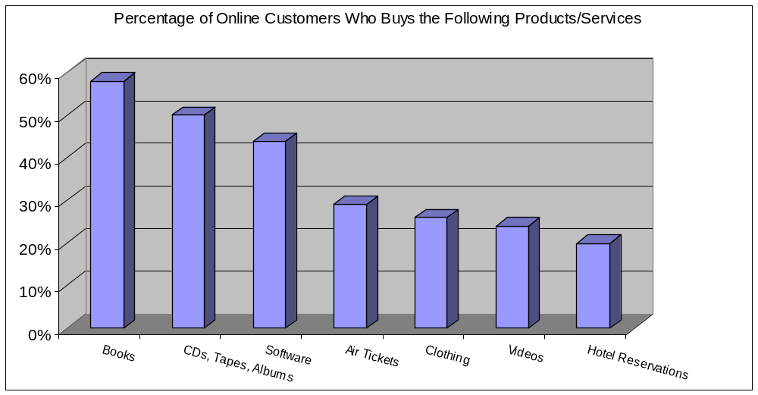
Who’s Online? (Cont’d)
Source: Peterson, Andrea, ‘Lost in the Maze.’ Wall Street Journal, Dec 6, 1999, p. R6
World Wide Web

Slide 17
Limitations
Security & Privacy
  20% met Federal Trade Commission (FTC) standards for protecting consumer privacy
  90% compliance rate by Internet companies for posting their privacy policies
  FTC ‘Fair Information’ Principles:
    Notice/Awareness
    Choice/Consent
    Access/Participation
    Security/Integrity
Source: Simpson, Glenn R., ‘FTC Finds Web Sites Fail to Guard Privacy.’ Wall Street Journal, May 11, 2000, p. B12
World Wide Web

Slide 18
Limitations (Cont’d)
Rash of Fake IDs
  Online sale of fake identification documents
  Accounts for > 30% of all fake documents in U.S.
  Three levels of fake ID procurements:
    Sell real-looking documents in customer’s name
    Sell templates that allow customers to make their own phony documents
    Do-it-yourself counterfeiter
Source: Associate Press, May 20, 2000, p. A1ff
World Wide Web

Slide 19
Limitations (Cont’d)
Threats of Hackers & Viruses
  Threaten the integrity of Internet files & transactions
  Hacking schools & Virus software
Stressed Out Networks
  Pressure to upgrade & maintain more complex networks
World Wide Web

Slide 20
Limitations (Cont’d)
Fulfillment
  Merchant’s link with vendor
  Responsiveness
Struggling Small Business
  Cost of maintaining & upgrading
  Security
World Wide Web

Slide 21
Limitations (Cont’d)
Customer Relations
  Heavy demand on customer service
Products Having No Online Demand
  e.g. Houses, cars
Regulated Products
  e.g. Alcohol
Shortage of E-literate People
World Wide Web

Slide 22
Ease of Searching Online
Search Engines
  www.selfpromotion.com
Bookmark
Revisiting
  8-second Rule
World Wide Web

Slide 23
Bulletin Board Systems vs. Pay Services
BBSs:
  Allow local people to exchange information free of charge
  e.g. e-mail, netnews
  Through subscription, e.g. AOL, Prodigy
Pay Services:
  Provide e-mail, interactive talking, etc.
  Include security software
World Wide Web

Slide 24
Web Fundamentals
World Wide Web (WWW)
  Global hypertext network of millions of Web servers & browsers
  Connected by Hypertext Transfer Protocol (HTTP)
  Web pages can be designed by Hypertext Markup Language (HTML)
World Wide Web

Slide 25
Web Fundamentals (Cont’d)
Uniform Resource Locator (URL)
  E.g. http://www.virginia.edu
  http:// - protocol designer
  www.virginia.edu - server name
    www means the network is located on a dedicated web server somewhere
    virginia is the name of the web site requested
    edu indicates the site is an educational institution
World Wide Web

Slide 26
Web Fundamentals (Cont’d)
Security Protocols
  Secure Socket Layer (SSL)
    Most widely used
    Developed by Netscape Communications
  Secure HTTP (S-HTTP)
    Allows web clients and servers to specify privacy capabilities independently of one another
World Wide Web

Slide 27
Internet Language
Provider
  An organization providing an entrance ramp to Internet
Browser
  A software program loaded in a PC allowing user to access Internet
Server
  Destination point on Internet
World Wide Web

Slide 28
Internet Language (Cont’d)
Telnet
  A basic Internet service allowing user to access remote computers
File Transfer Protocol (FTP)
  A standard protocol allowing users to copy files from computer to computer on Internet
Universal Resource Locator (URL)
  A standard way of giving the address of resources on Internet that are part of WWW
World Wide Web

Slide 29
Internet Language (Cont’d)
Malicious Software
  Viruses
  Trojan horse
    A program on the surface seems to perform legitimate work, but causes damage when executed
  Zombie
    A launching program residing in an Internet-attached computer
  Worm
    A program replicating itself on a computer’s hard disk, slowing down the computer’s performance
World Wide Web

Slide 30
Implications for Management
Surge of E-commerce
IT Job Market
  850,000 IT jobs go unfilled in 2001
  Job Loyalty
First National Techies Day
World Wide Web

