Slide 1
Automatic Essay Scoring

Slide 2
Automatic Essay Scoring: Intorduction
Why automatic essay scoring?
  to reduce laborious human effort
    Software systems do the task fully automatically
    Computer generated scores match human accuracy
  to test theoretical hypothesis in NLP
    e.g What is the role of Rough-Shifts in Centering Theory?
  to explore practical solutions
    e.g Is it possible to improve the systems’ performance ?
Automatic Essay Scoring

Slide 3
Essay scoring systems: Approaches
Length based, Indirect approach
  Fourth root of number of words in an essay
  as an accurate measure(Page,1966)
  Surface features -- Features proxies
    essay length in words
    number of commas
    number of prepositions
    number of uncommon words
  Rationale: Using direct measures is a computationally expensive task
Automatic Essay Scoring

Slide 4
Essay scoring systems: Approaches
  Two main weaknesses of indirect measures
    Susceptible to deception, why?
    Lack explanatory power
      e.g: difficult to give instructional feed back to students
  The need for more direct measures
    How do human experts evaluate an essay?
    Writing features
      ETS’s GMAT writing evaluation criteria
    Linguistic features
Automatic Essay Scoring

Slide 5
Essay scoring systems: Approaches
Intelligent Essay Assessor (IEA)
  Employs Latent Semantic Analysis
    The degree to which vocabulary patterns reflect semantic and linguistic competence
    Transitivity relations and collocation effects among vocabulary terms
    Measures semantic relatedness of documents regardless of vocabulary overlap
  More closely represents the criteria used by human experts
Automatic Essay Scoring

Slide 6
Essay scoring systems: Approaches
Electronic Essay Rater, e-rater
  Employs NLP techniques
    Sentence parsing
    Discourse structure evaluation
    Vocabulary assessment, …..
  Writing features chosen from criteria defined for GMAT essay evaluation
    Syntactic variety, argument development, logical organization and clear transitions ……
    The GMAT test
Automatic Essay Scoring

Slide 7
Electronic Essay Rater, e-rater
Research Questions
  Coherence features not explicitly represented
  Is it possible to enhance e-raters performance by adding coherence features?
  What is the role of Rough-shift transitions in Centering Theory?
  Is it possible to use Rough-shift transitions as a potential measure for discourse incoherence?
Automatic Essay Scoring

Slide 8
The Centering Model
Discourse
  Sequence of textual segments
  Segments consist of utterances, U_{i} – U_{n}
  Forward-looking Center, Cf(U_{i})
  Preferred Center, Cp
  Backward-looking Center, Cb
Automatic Essay Scoring

Slide 9
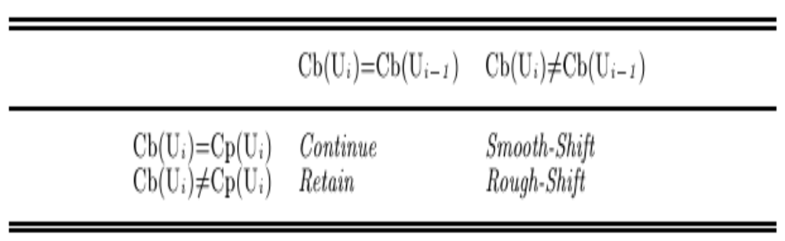
The Centering Model
Centering transitions
  Four types: Continue, Retain, Smooth-shift, Rough shift
  Transition Ordering Rule
    Continue > Retain > Smooth-Shift > Rough-Shift
  Rules for computing transitions
Automatic Essay Scoring

Slide 10
The Centering Model
Centering transitions
Example
  John went to his favorite music store to buy a piano.
Automatic Essay Scoring

Slide 11
The Centering Model
Centering transitions
Example
  John went to his favorite music store to buy a piano. Cb = ?, Cf = John > store > piano, Transition = none
  He had frequented the store for many years.
Automatic Essay Scoring

Slide 12
The Centering Model
Centering transitions
Example
  John went to his favorite music store to buy a piano. Cb = ?, Cf = John > store > piano, Transition = none
  He had frequented the store for many years.
  Cb =(He=John), Cf = (He=John) > store, Transition = continue
Automatic Essay Scoring

Slide 13
The Centering Model
Cf ranking
  Preferred center = the highest ranked member of the Cf set
  Ranking by salience status of entities in an utterance
  Cf ranking rule
    M-Subject > M - indirect object > M- direct object > M – QIS, Pro-ARB > S1-subject > S1- indirect object > S1- direct object > S1-other > S1-QIS, Pro-ARB > S2-subject >…
Automatic Essay Scoring

Slide 14
The Centering Model
Cf Ranking
Example:
  John had a terrible headache
Automatic Essay Scoring

Slide 15
The Centering Model
Cf Ranking
Example:
  John had a terrible headache
    Cb = ?, Cf = John>Headache, Transition = none
Automatic Essay Scoring

Slide 16
The Centering Model
Cf Ranking
Example:
  John had a terrible headache
    Cb = ?, Cf = John>Headache, Transition = none
  When the meeting was over, he rushed to the pharmacy store
Automatic Essay Scoring

Slide 17
The Centering Model
Cf Ranking
Example:
  John had a terrible headache
    Cb = ?, Cf = John>Headache, Transition = none
  When the meeting was over, he rushed to the pharmacy store
    Cb = John, Cf = John > pharmacy store > meeting, Transition = continue
Automatic Essay Scoring

Slide 18
The Centering Model
Cf Ranking
  Modifications
    Pronominal I
      Penalize the use of I’s, why?
    Constructions containing verb to be
      Predicational case
        E.g: John is happy/a doctor/ the President
      Specificational case
        E.g: The cause of his illness is this virus here
Automatic Essay Scoring

Slide 19
The Centering Model
Cf Ranking
  Modifications
    Pronominal I
      Penalize the use of I’s, why?
    Constructions containing verb to be
      Predicational case
        E.g: John is happy/a doctor/ the President
      Specificational case
        E.g: The cause of his illness is this virus here
        Another example of an individual who has achieved success in the business world through the use of conventional methods is Oprah Winfrey
Automatic Essay Scoring

Slide 20
The Centering Model
Cf Ranking
Complex NP’s
  Property evoking multiple discourse entities
    E.g: his mother, software industry
    Ordering from left to right
  Possessive constructions
    Linearization according to the genitive construction
    E.g: The secret of TLP’s success → TLP’s success’s secret, the rank from left to right
Automatic Essay Scoring

Slide 21
The role of Rough-Shift transitions
Are Rough-shifts valid transitions?
Hypothesis: “the incoherence found in students essays is not due to the processing load imposed on the reader to resolve anaphoric references”
Automatic Essay Scoring

Slide 22
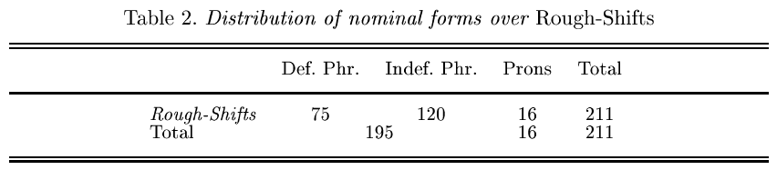
The role of Rough-Shift transitions
Incoherence due to introducing too many undeveloped topics
Rough-shifts measure discourse continuity even when anaphora resolution is not an issue
Rough shifts are the result of absent and extremely short-lived Cb’s
Automatic Essay Scoring

Slide 23
Implementation
Used corpus of 100 essays randomly selected from pool of GMAT essays
The essays cover full range of the scoring scale, where 1 is the lowest and 6 is the highest
Applied the Centering algorithm to the corpus and calculated the percentage of Rough-shifts in each essay
Run multiple regression to evaluate the contribution of Rough-Shifts to the performance of e-rater
Automatic Essay Scoring

Slide 24
Implementation
Manually tagged Co-referring expressions and Preferred Centers
Automated Discourse segmentation and the Centering Algorithm
The percentage of Rough-Shifts = number of Rough-shifts / the total number of identified transitions
Automatic Essay Scoring

Slide 25
An example of coherent text
Yet another company that strives for the “big bucks“ through conventional thinking is Famous name’s Baby Food. This company does not go beyond the norm in their product line, product packaging or advertising. If they opted for an extreme market-place, they would be ousted. Just look who their market is! As new parents, the Famous name customer wants tradition, quality and trust in their product of choice. Famous name knows this and gives it to them by focusing on “all natural“ ingredients, packaging that shows the happiest baby in the world and feel good commercials the exude great family values. Famous name has really stuck to the typical ways of doing things and in return has been awarded with a healthy bottom line.
Automatic Essay Scoring

Slide 26
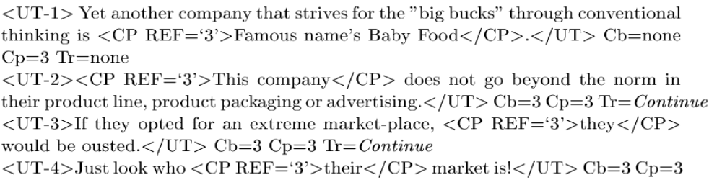
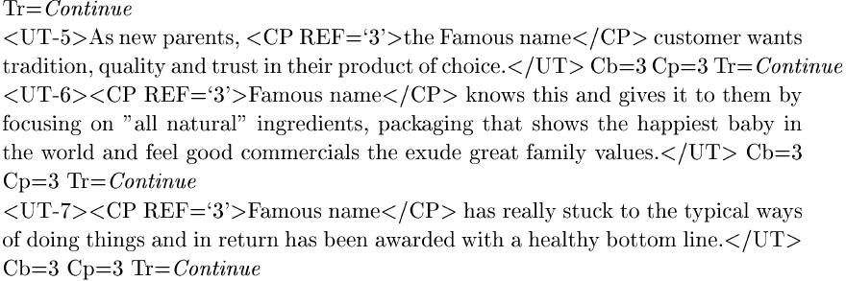
An example of coherent text
Automatic Essay Scoring

Slide 27
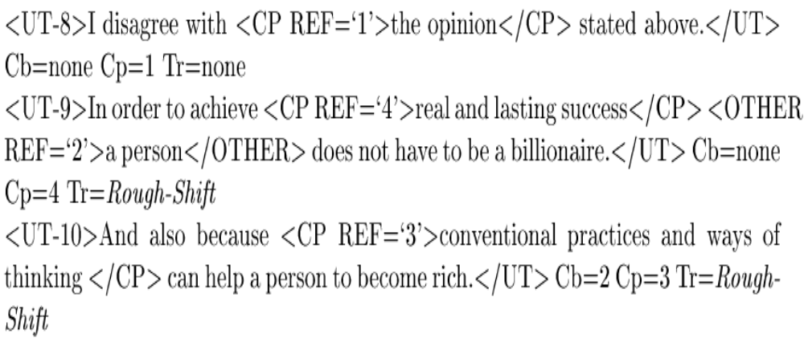
An example of incoherent text
Automatic Essay Scoring

Slide 28
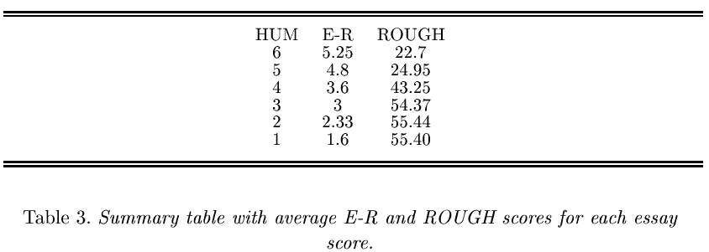
Study Results
Automatic Essay Scoring

Slide 29
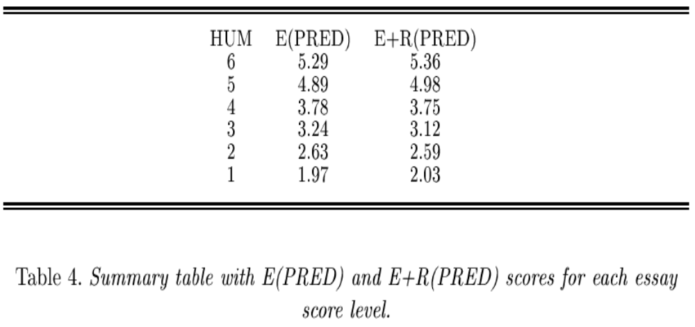
Study Results
Automatic Essay Scoring

Slide 30
Summary
Essay scoring systems provide the opportunity to test theoretical hypotheses in NLP
Local discourse coherence is a significant contributor to evaluation of essays
Centering theory’s Rough-shift transitions capture the source of incoherence in Essays
Rough-shifts reflect the incoherence perceived when identifying the topic of a discourse structure
Rough-shift based metric improves performance, provides capability of instructional feedback
Automatic Essay Scoring

Slide 31
References
E. Miltsakaki and K. Kukich: The Role of Centering Theory's Rough-Shift in the Teaching and Evaluation of Writing Skills. In: Proceedings of ACL 2000
E. Miltsakaki and K. Kukich: Evaluation of text coherence for electronic essay scoring systems, In: Natural Language Engineering 10:1, 2004
Hearst, M., Kukich, K., Hirschman, L., Breck, E., Light, M., Burge,J., Ferro, L., Landauer, T. K., Laham, D., and Foltz, P. W., The Debate on Automated Essay Grading, in IEEE Intelligent Systems (Sept/Oct 2000)
Automatic Essay Scoring

Slide 32
The End! Many thanks!!
Automatic Essay Scoring

