Slide 1
5G WIRELESS NETWORK TECHNOLOGY
Upgraded Generation Of
Wireless Comunication ……

Slide 2
Objetives
Introduction to 5G
What is 5G ?
What does 5G offer ?
Evolution of 1G to 5G
Architecture of 5G
Future Scope
Advantages and Disadvantages
Conclusion
References

Slide 3
What is 5G ?
5G Wireless : 5th generation wireless technology
Complete wireless communication with almost no limitations
Can be called REAL wireless world
Has incredible transmission speed
Concept is only theory not real
Mobile wireless industry had started its technology creation , revolution and evolution since early 1970’s.
5G technology most powerful and in huge demand in near future

Slide 4
What does it offer ?
Worldwide cellular phones
Extraordinary data capabilities
High connectivity
Low latency
More power & features in hand held phones
Large phone memory, more dialing speed, more clarity in audio and video

Slide 5
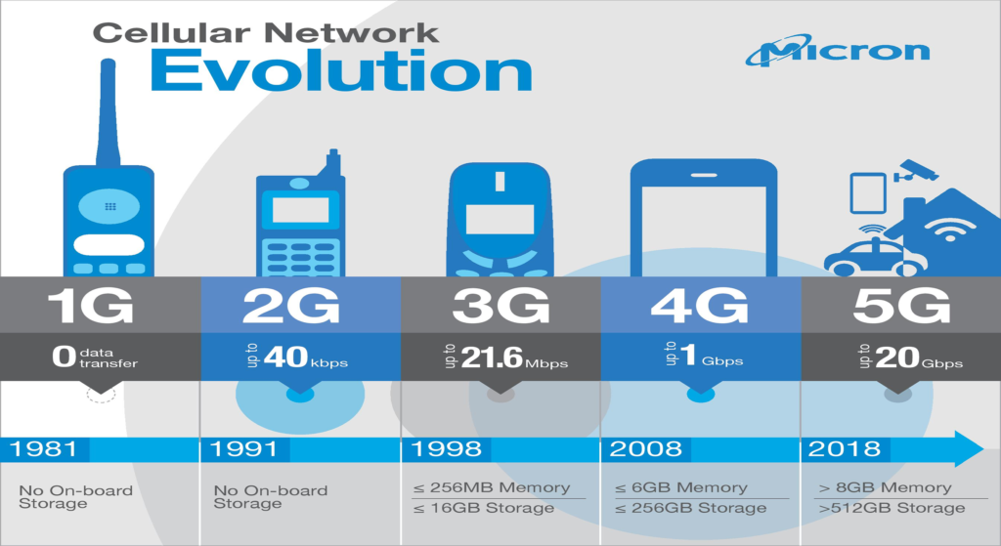
Evolution from 1G to 5G
1G
2G
3G
4G
5G
This Photo by Unknown Author is licensed under CC BY-ND

Slide 6
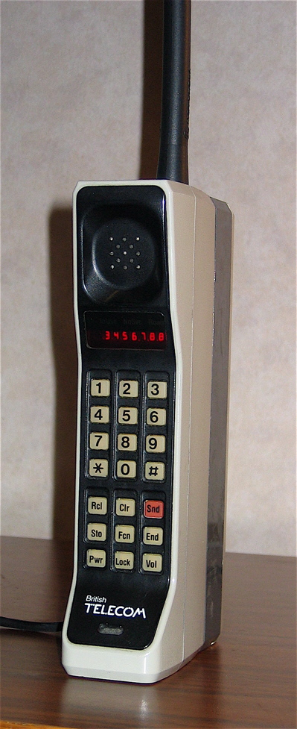
1G
Developed in 1980s and completed in early 1990s
Based on analog system
Speed up to 2.4 kbps
AMPS (Advance Mobile Phones System) was launched by the US and it was the 1G mobile system
Allows user to make voice calls in 1 country
This Photo by Unknown Author is licensed under CC BY-SA

Slide 7
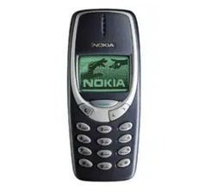
2G
Devloped in late 1980s & completed in late 1990s
Based on digital system
Speed up to 64 kbps
Services such are digital voice & SMS with more clarity
Semi global facility
2G are the handset we are using today , with 2.5G having more capabilities

Slide 8
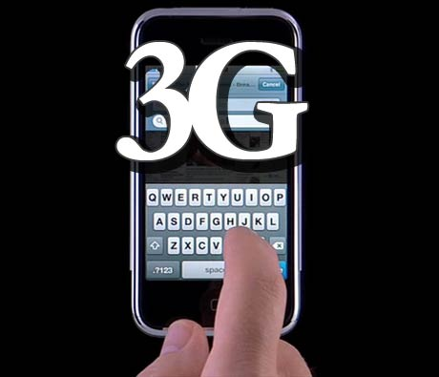
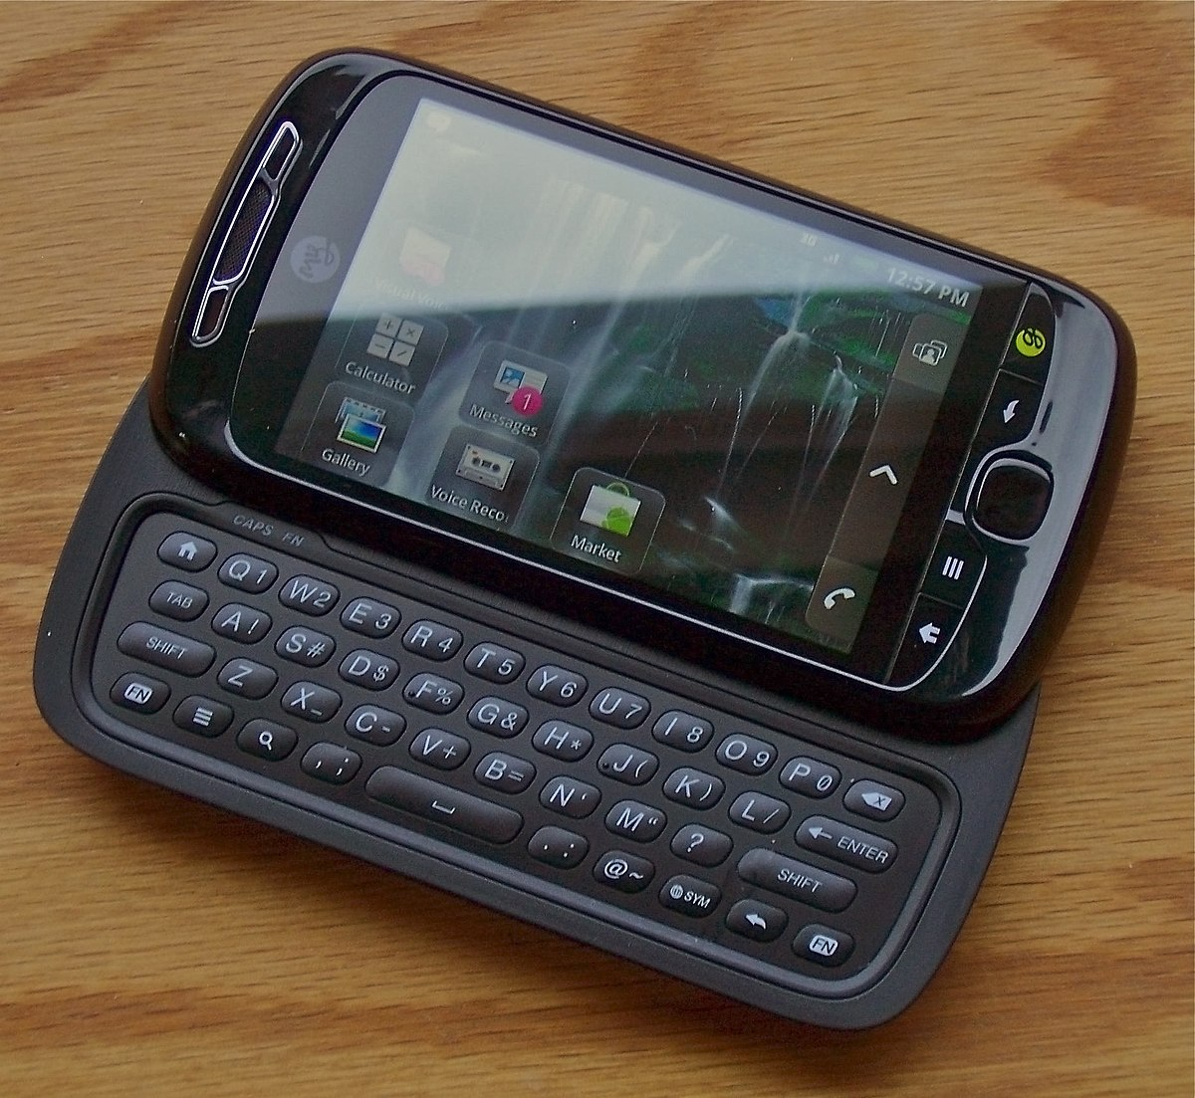
3G
Developed between late 1990s & early 2000s until present day
Transmission speed from 125 kbps to 2 Mbps
Superior voice quality
Good clarity in video conference
E-mail, PDA, information surfing, on-line shopping/banking, games, etc.
Global roaming

Slide 9
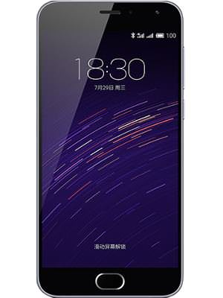

4G
Developed in 2010
Faster and more reliable
Speed up to 100 Mbps
High performance
Easy roaming
Low cost
This Photo by Unknown Author is licensed under CC BY-SA

Slide 10
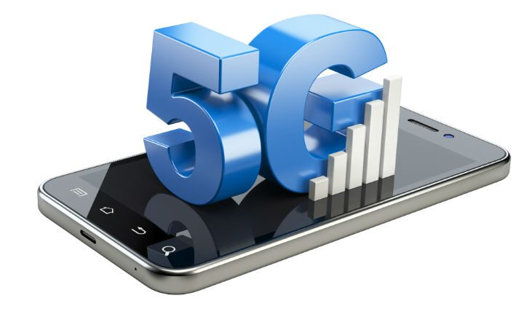
5G
Next major phase of mobile telecommunication & wireless system
10 times more capacity than others
Expected speed up to 1 Gbps
More faster & reliable than 4G
Lower cost than previous generation

Slide 11
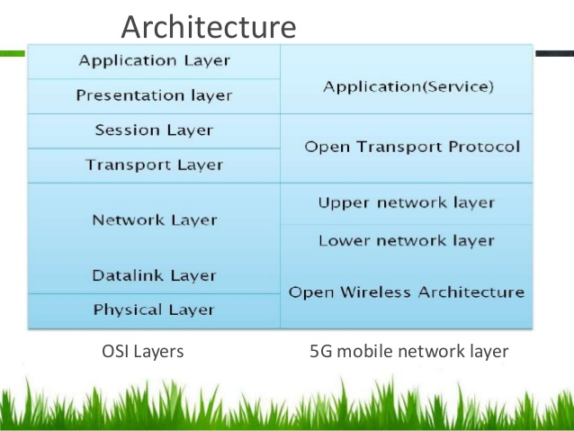
ARCHITECTURE OF 5G

Slide 12
Open Wireless Architecture
OSI layer 1 and OSI layer 2 define the wireless technology
For these two layers the 5G mobile network is likely to be based on open Wireless Architecture(OWA)
Physical layer + Data link layer = OWA

Slide 13
Network Layer
All mobile networks will use mobile IP
Each mobile terminal will be FA(Foreign Agent)
A mobile can be attached to several mobiles or wireless network at the same time
The fixed IPv6 will be implemented in the mobile phones
Separation of network layer into two sub-layers:
Lower network layer(for each interface)
Upper network layer(for the mobile terminal)

Slide 14
Open Transport Protocol (OTP)
Wireless network differs from wired network regarding the transport layer
In all TCP versions the assumption is that lost segments are due to network congestion
In wireless, the loss is due to higher bit error ratio in the radio interface
5G mobile terminals have transport layer that is possible to be download & installed – Open Transport Protocol(OTP)
Transport Layer + Session Layer = OTP

Slide 15
Service Layer
Provides intelligent QoS (Quality of Service) management over variety of networks
Provides possibility for service quality testing & storage of measurement information in information database in the mobile terminal
Select the best wireless connection for given services
QoS parameters, such as, delay, losses, BW, realiability, will be started in DB of 5G mobile
Presentation layer + Service layer = Application

Slide 16
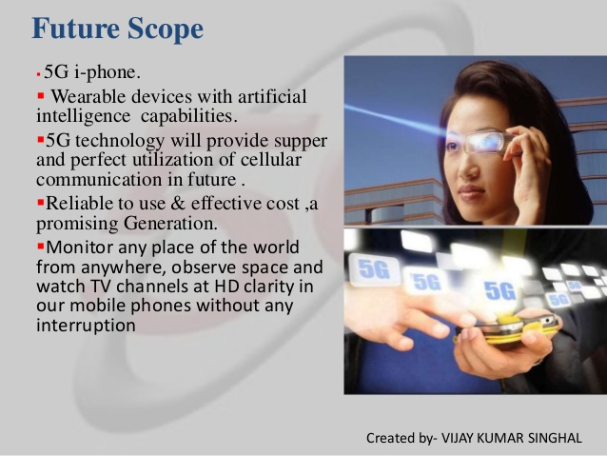

Slide 17
ADVANTAGES AND DISADVANTAGES OF 5G
Advantages:
Disadvantages:
Longer battery life.
Higher data rates.
More efficient.
High Security.
Technology is still under process and research on its viability is going on.
Developing infrastructure needs high cost.
Security and privacy issue yet to be solved.

Slide 18
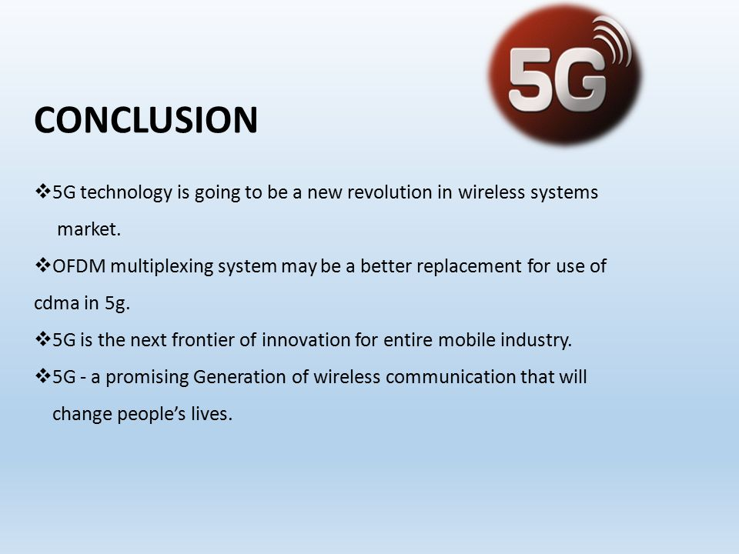

Slide 19
REFERENCES
https://www.electronics-notes.com/articles/connectivity/5g-mobile-wireless-cellular/technologybasics.php
https://www.qualcomm.com/invention/5g/what-is-5g
https://en.wikipedia.org/wiki/5G
https://www.thalesgroup.com/en/markets/digital-identity-and-security/mobile/inspired/5G
https://www.verizon.com/about/our-company/5g/what-5g
https://www.electronics-notes.com/articles/connectivity/5g-mobile-wireless-cellular/technologybasics.php

Slide 20


