Slide 1
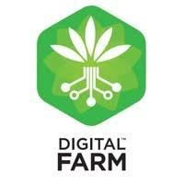
DIGITAL FARMING
Presented by :
Miss Vaishnavi R Nagarkar
Guided by:
Prof. Rasika T. Kalyane

Slide 2

"The ultimate goal of farming is not the growing of crops, but the cultivation and perfection of human beings."

Slide 3
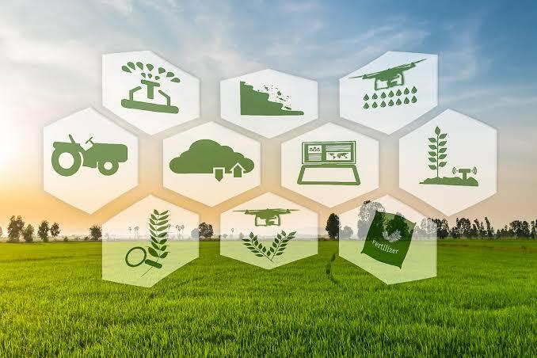
Contents :
What is Digital farming… ?
Agriculture industry should go digital….?
Some examples of Digitalizatation in farming
Android applications are the biggest source for this technology
Digital Agriculture companies
Web portals for digital farming
Equipments needed for digital farming
Advantages and Disadvantages
Conclusion

Slide 4
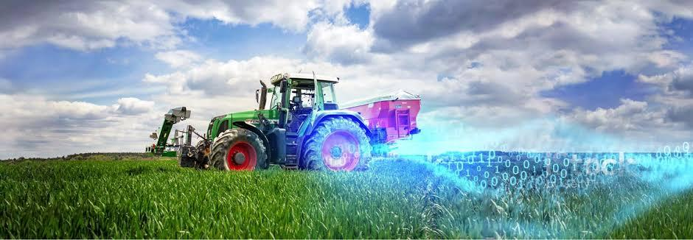
What is Digital farming… ?
Introduction
Sustainable development goals

Slide 5
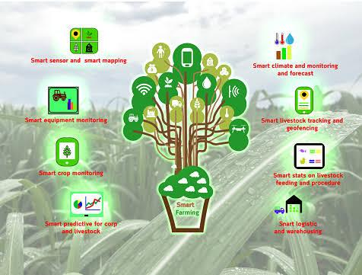
Agriculture industry should go digital… ?
Needs
Expedite Communication
Effective Monitoring
Easily input images &
attachments
Informed Decisions

Slide 6
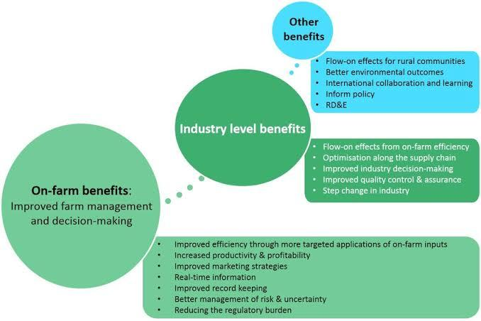
Some examples of Digitalizatation in farming….
Air farm
Agri Sync
Ignitia
Stable
WHAT PREVENTS DIGITALIZATION FROM MASS ADOPTION… ?

Slide 7
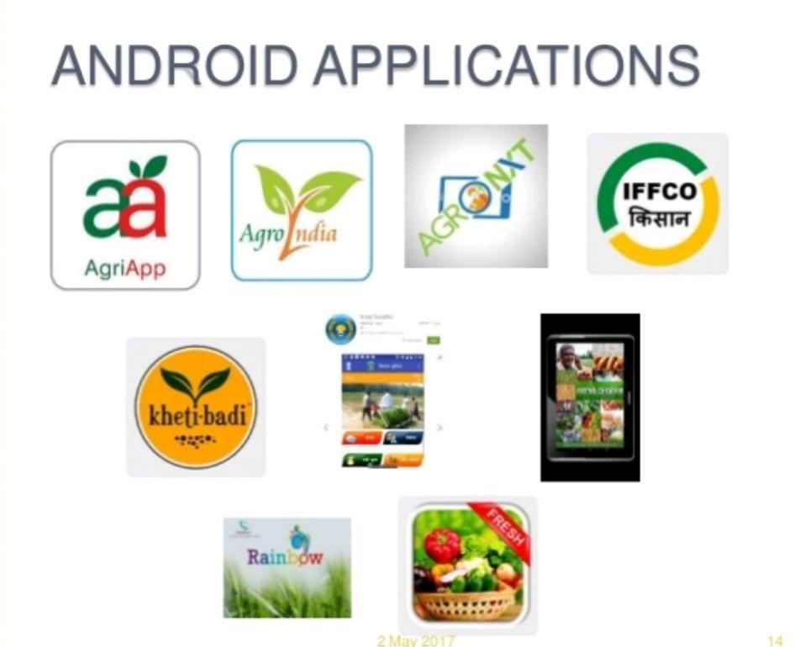
Android applications are the biggest source for this technology
Need of agriculture app
Different android applications:
AGRI APP
AGROINDIA APP
CORPSTREAM APP
FIELDCHECK APP
AGRI SYNC APP
How to use

Slide 8
Digital farming Companies
What role does that digital agri companies palys..?
Some of the top agriculture companies in India:
Terramera
Raven Industries
CropX
Agrowatcher

Slide 9
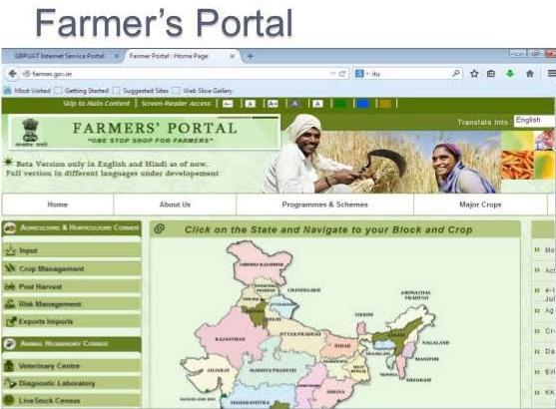
Web portals for digital farming:
Main moto
Some of the portals:
1] www.floret.com
2] wildwoodfarm.com
3] benziger.com
4]www.sill.com

Slide 10
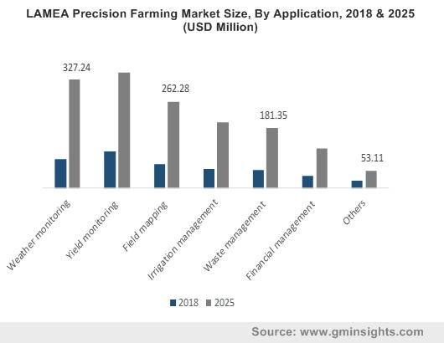
Equipments needed for digital farming
Technology essential for digitalizatation
Global Positioning System
Advance farm machinery
Remote sensing
Variable Rate Technology
Automated Steering System
Data Management System

Slide 11
Advantages:
Moniter soil (determine peak condition)
Help Automated field Management(sensors)
Reduces Manual efforts
Service has been improved
Topography(detection)
Less waste
Helt to detect weather
Remote senaing

Slide 12
Disadvantages:
Network issue
Financial Crisis
Lack of technical knowledge
Some negative effects can be possible
Challenges in using smart technologies
Can took several years for development
Waves can be harmful
Equipments are not affordable and can’t access easily

Slide 13
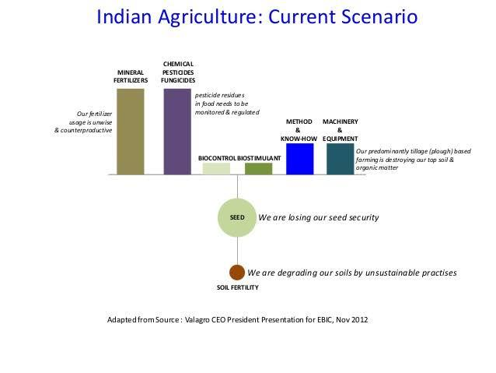
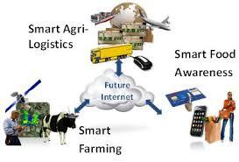
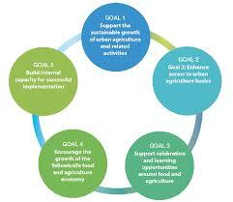

Slide 14
CONCLUSION
Agriculture technology investments-including “advanced” and “traditional” technologies practices are a game changer in terms of yield improvements and national and global food security.
While biophysical potential often exists to significantly increase yeields, institutions, governance system, political will, and poor rural infrastructure remain obstacles to achieving the full technological potential.

Slide 15
Thank you!

