Slide 1
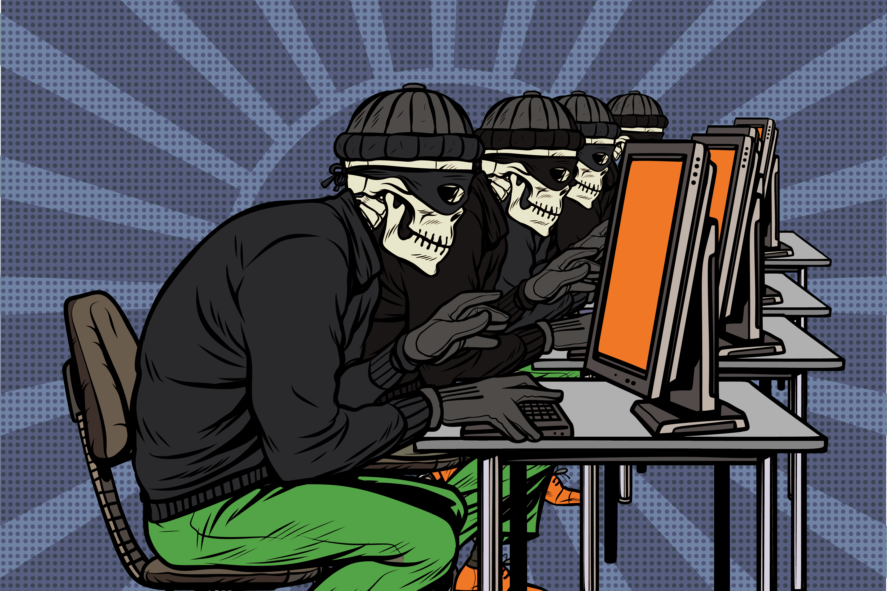
Cyber Crime Detection And Protection
If we can defeat them sitting at home……
who needs to fight with tanks and guns!!!!
Presented
By
Yogesh Sharad Patil
(10303320181124510061)

Slide 2
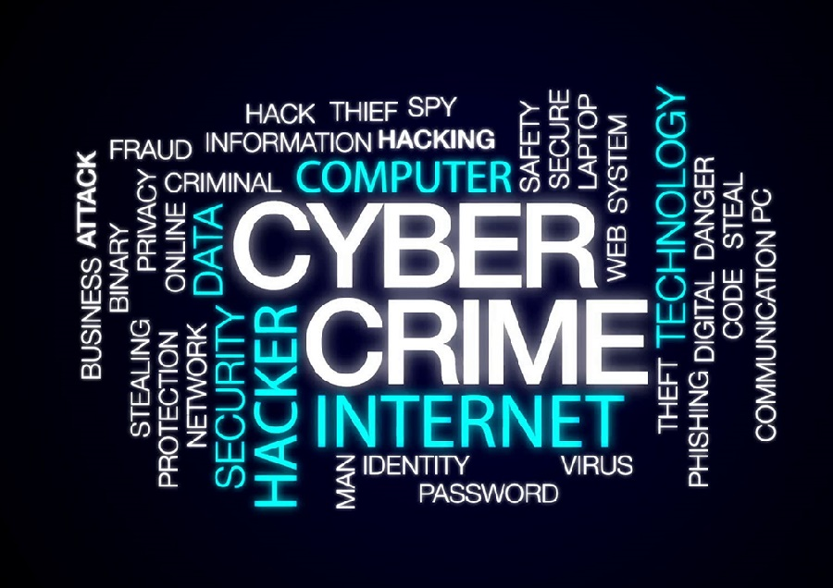
CONTENTS
Introduction
Definition
History
Characteristics of Cyber Crime
Types of Cyber Crime
What is Cyber Security
Why Cyber Security
Crime Detection techniques
Prevention
Conclusion

Slide 3
Introduction
The internet is growing rapidly. It has given rise to new opportunities in every field we can think of be it entertainment, business, sports or education.
There’re two sides to a coin. Internet also has it’s own disadvantages is Cyber crime- illegal activity committed on the internet.
we almost can’t live without computers, the expanding wave of Internet connectivity and digital technologies bring us a lot of convenience, at the same time they also offer criminals more chance to commit crime
Internet has brought a host of problems haunting all those concerned with national security, privacy, IP rights, social decency, child protection, fighting, detecting and prosecuting crime

Slide 4
Defining Cyber Crime
Crime committed using a computer and the internet to steal data or information.
Any illegal behavior directed by means of electronic operations that targets the security of computer systems and the data processed by them.
Cyber crime also referred as computer crimes, electronic crimes or e crimes.
Cyber crime is nothing but where the computer used as an object or subject of crime..
In general, Cyber-crime is typically understood to consist of accessing a computer without the owner's permission, exceeding the scope of one's approval to access a computer system, modifying or destroying computer data or using computer time and resources without proper authorization

Slide 5

History
The first recorded cyber crime took place in the year 1820
Joseph-Marie Jacquard, a textile manufacturer in France, produced the loom
This device allowed the repetition of a series of steps in the weaving of special fabrics.
This resulted in a fear amongst Jacquard's employees that their traditional employment and livelihood were being threatened
They committed acts of sabotage to discourage Jacquard from further use of the new technology

Slide 6
Characteristics of Cyber Crime
Silent in Nature: Computer crime could be committed in privacy without reaching to scene of crime physically i.e. no eye witnesses. There is no signs of physical violence or struggle.
Global in character: No national borders. By sitting comfortably far away from the country the entire economy of the country could be destroyed. As digital evidences are fragile in nature one has to respond quickly.
Nonexistence of Physical Evidence: No physical evidence to indicate that crime has been committed. Only on a closer look the trained person could find out the evidences which are not in the traditional format but are in digital format
Creates high Impact: Impact is severe and may be long term. It can damage the victim system permanently. Loss of good will.
High Potential and Easy to Perpetrate: A software developer who did not get enough money or good job would turn to criminal world for their survival. Therefore, the computer crimes have a potential to increase. Hence organized mafia groups have entered into this sector.

Slide 7
Types of Cyber Crime
Hacking
Denial of service attack
Virus Dissemination
Computer Vandalism
Software Piracy

Slide 8

What is Cyber Security
Cyber security means protecting information, equipment, devices, computer, computer resources, communication device and information stored therein from unauthorized access, use, disclosure disruption, modification or destruction.

Slide 9
Why Cyber Security
Computer security is important because it can provide the opportunity for the users to protect their important information present on the network and also in the system
It also helps in defending the computer system against different types of destructive technologies and protects the PC from damage (viruses, worms, bugs and bacteria)
It also helps in monitoring the network and protects it also from different threats. So, we should use computer security solution on some level to protect our data from different type of sniffing stolen problem.

Slide 10
Crime Detection techniques
Typically, electronic crimes are detected by one or more types of intrusion detection techniques
Tripwires: snooping
Operating system commands:
Configuration checking tools
Anomaly detection systems:

Slide 11
Prevention
General Online Safety Tools:-
Always keep your systems/devices (desktop, laptop, mobile) updated with latest patches.
Protect yourself from viruses by installing antivirus software and updating it regularly
Don’t open a file attached to an e-mail unless you are expecting it or know what it contains.
Never give out your address, telephone number, hangout spots or links to other websites

Slide 12
Prevention
Reduce Opportunities: Reduce Opportunities to the Criminals Develop elaborate system design so that hacker does not hack the computer, Accepts Application Security Instruction
Adopt Computer Security:Avail new sophisticated products and advice for computer crime prevention which is available free or paid in the market
Design Alert Systems: Design the alert system when there is actual intrusion
Install Original Software:As they contain many security measures. Pirated software’s do not contain many security

Slide 13
To Conclude...
Technology is destructive only in the hands of people who do not realize that they are one and the same process as the universe

