Slide 1

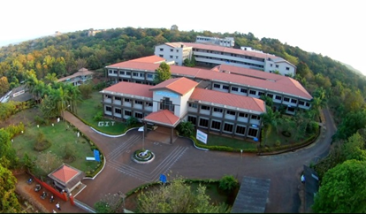
.
GHARDA INSTITUDE of technology
Topic: Car Racing Game
Guide Name :- Prof. Vijesh M. Nair
Group Members:
Aditya Indulkar
Satish Diwate
Vedang Pawar
Fahad Desai

Slide 2
.
IDEA/OBJECTVE
The Objective of the Project is to create a car Racing game which is:
User Friendly
Easy to play
The idea of selecting this topic was when we realized how popular Car Racing Games are.

Slide 3
About
Name: Car Racing Game
Platform/Coding Language: C++
IDE : Dev C++
Project type: Desktop Application

Slide 4
Car Racing game
Car Racing Game is a common genre of game in the game industry.
Car Racing is a popular Sport in real life having different types such as Car Rally Races, GT racing and Formula 1 racing.
As popular in the real word Car Racing is also popular in the virtual world.
Tech Giant Company like Microsoft has also developed Car Racing Game named Forza Horizon
In general car games have different categories such as Racing and Simulation.

Slide 5
Software And Hardware
The minimum RAM required is 256KB.
Minimum storage required is around 256KB.

Slide 6
. On The Screen
On the screen we will have a basic interface consisting of:
The Main Menu which will show the following options:
Start
Instructions
Quit
The Game Play interface will consist of:
The Center Car
The Enemy Car
Score

Slide 7
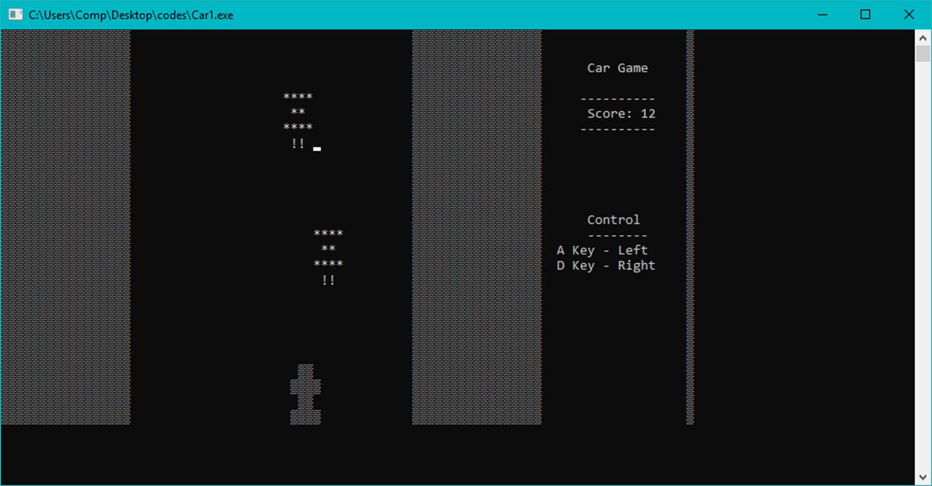
Image For Illustration Purpose

Slide 8
Code
char car[4][4] = { ' ','±','±',' ',
'±','±','±','±',
' ','±','±',' ‘,
'±','±','±','±' };
The above 2d array generates player car.
void drawEnemy(int ind){
if( enemyFlag[ind] == true ){
gotoxy(enemyX[ind], enemyY[ind]); cout<<"****";
gotoxy(enemyX[ind], enemyY[ind]+1); cout<<" ** ";
gotoxy(enemyX[ind], enemyY[ind]+2); cout<<"****";
gotoxy(enemyX[ind], enemyY[ind]+3); cout<<" !! ";
}
The above function generates enemy car.

Slide 9
gotoxy(WIN_WIDTH + 7, 2);cout<<"Car Racing Game";
gotoxy(WIN_WIDTH + 6, 4);cout<<"----------";
gotoxy(WIN_WIDTH + 6, 6);cout<<"----------";
gotoxy(WIN_WIDTH + 7, 12);cout<<"Control ";
gotoxy(WIN_WIDTH + 7, 13);cout<<"-------- ";
gotoxy(WIN_WIDTH + 2, 14);cout<<" A Key - Left";
gotoxy(WIN_WIDTH + 2, 15);cout<<" D Key - Right";
‘gotoxy’ function displays the text at the desired position.
gotoxy(10,5); cout<<" -------------------------- ";
gotoxy(10,6); cout<<" | Car Racing Game | ";
gotoxy(10,7); cout<<" --------------------------";
gotoxy(10,9); cout<<"1. Start Game";
gotoxy(10,10); cout<<"2. Instructions";
gotoxy(10,11); cout<<"3. Quit";
gotoxy(10,13); cout<<"Select option: ";
This is to show the menu bar.

Slide 10
Advantages
Car racing games have advantages of their own such as:
Improving Hand Eye Coordination.
Concentration and Focus
Decision Making
Car racing game makes you focus on more than one thing at a time, which helps you to multitask and also increase your concentration.

Slide 11
Conclusion
What we leaned in this project?
The project has helped us understand use of various pre-defined functions and also create new functions.
What is this Project For?
To have familiarity with the programming language.
To better understand the programming language.
To improve logical thinking.

Slide 12

.
Thank You

