Slide 1
TIC TAC TOE
GAME
Team Members :
1.Tanamay Bhuran
2.Vikas Rathod
3.Pranav Yadav

Slide 2
ABSTRACT
Tic-tac-toe is a fun game played by two players. Before starting the game, a 3x3 square grid is formed using two vertical and two horizontal lines. The player who succeeds in placing three of their marks in a horizontal, vertical, or diagonal row is the winner.

Slide 3
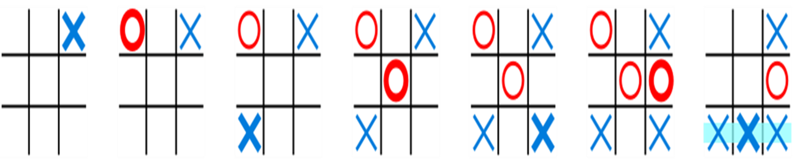
INTRODUCTION
In this course, we're going to learn how to build Tic Tac Toe . Just in case you're unfamiliar with the game, let's discuss the rules first. Tic Tac Toe is played on a 3 x 3 grid of available cells, and the goal of the game is to place three of your tokens (X or O) on the grid in a row, including diagonals.
The following example game is won by the first player, X:

Slide 4
ABOUT PROJECT PROJECT DETAILS
Project Name : TIC TAC TOE
Project Platform : C ++
Programming Language Used : C Programming laungage
IDE Tool (Recommended) : Dev C++
Project Type : Desktop Application
Database : stored data in .DAT file

Slide 5
ABOUT PROJECT
To play the game , we let the players mark their chosen cell. Whoever types in their name first, goes first . During a turn of the game , the players will pick a number that corresponding to a certain cell which declares that this is where they choose to place their respective character(X or o) .They would keep on playing up until one of them marks three of the same characters in a row. Whoever gets to complete an entire row first, wins. If either players wasn’t able to complete an entire row of the same character , it means that the game is a tie . This would prompt the players to reset the game and play again if they like.

Slide 6
ALGORITHAM
Step 1 : START
Step 2 : check winning moves for system (X). If there such moves and go to the step 7. Else go to step 3
Step 3 : Check winning moves for users (O). If there such moves , then blocks the player and go to the step 7. Else go to step 4
Step 4 : If there corner spaces i.e (1,3,7,9), take it and go to step 7
. Else go to step 5
Step 5 : If there is center position and go to the step 7 . Else go to step 6

Slide 7
Step 6 : If there are side position i.e (2,4,6,8) take it and go to the step 7
Step 7 : Ask users to take a moves and go to the step 7

Slide 8
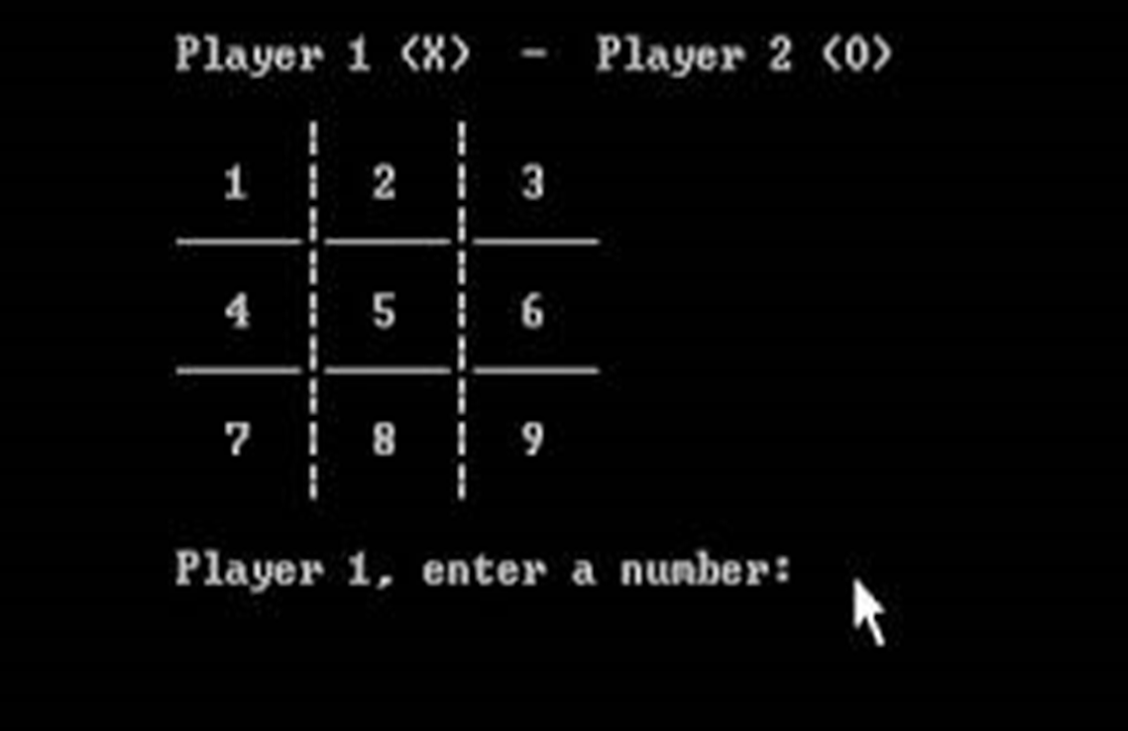
RESULT

Slide 9
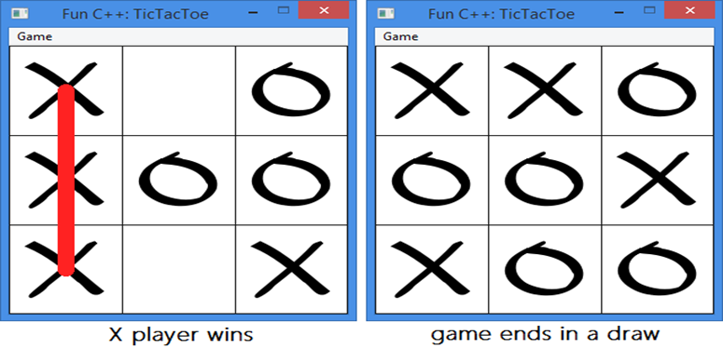
CONCLUSION
The group has successfully designed an c program which is the Tic Tac Toe game . We were able to implement the given requirement such as having an input output file , sorting algorithms and using classes . Based on the results generated by the tests conducted on the program , the Tic Tac Toe game ran smoothly.
FORTUNATELY,NO ERRORS CAME UP WHILE WE TESTED

Slide 10
REFERENCE
1. https://youtu.be/mD4dDRCmUvE
2. https://itsourcecode.com/free-projects/c-projects/tic-tac-toe- game-with-source-code/

Slide 11
THANK YOU !

