Slide 1

SE Computer
MINI PROJECT
Element Search Engine

Slide 2
CONTENT
1
GROUP MEMBERS
2
INTRODUCTION
3
DIAGRAM
4
HOW TO USE
5
COMMON POINTS OF EACH ELEMENTS
6
SOURCE CODE
7
OUTPUT
8
ADVANTAGES
9
CONCLUSION AND FUTURE SCOPE
10
REFERENCES

Slide 3


1
Group Members
NIRANJAN DHANYAKUMAR KOLPE Roll No. 33
SAISH DINESH GONDHALEKAR Roll No. 16
SAHIL PRAMOD KOKATE Roll No. 32
SEJAL CHANDRAKANT BHOSALE Roll No. 03
Guided by
Mrs. J. V. Khalkar

Slide 4
2
INTRODUCTION
The Modern Periodic Table is a systematic arrangement of the elements found in nature.
Also, many of these elements aresynthesized (created) in laboratories.
Our program will allow students as well as anyone interested in getting more knowledge about the elements to find detailed information about any element.

Slide 5
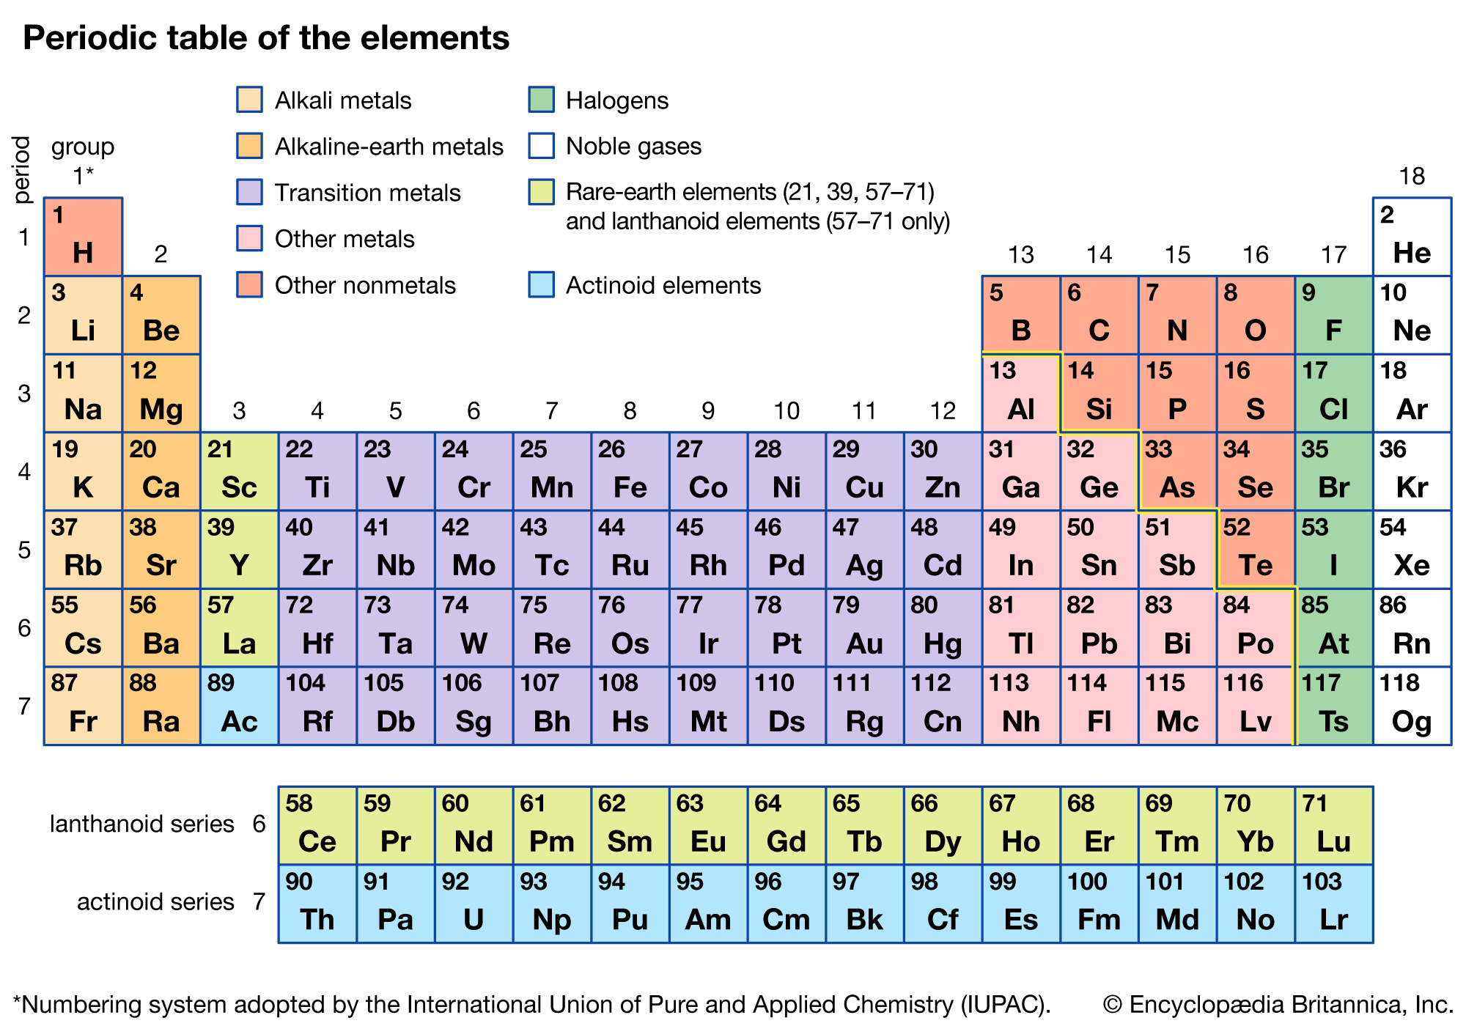
3
DIAGRAM

Slide 6
4
HOW TO USE
This program is easy to use .
All you have to do is just enter its name or its atomic number whatever you want then you get the information of related element
New Html page having detail information will open of entered element

Slide 7
5
COMMON POINTS OF EACH ELEMENTS
The information of an each element contains following points :
1
Basic introduction of an element
2
Chemical and Physical Properties
3
Image of an Element
4
Applications
5
Precautions

Slide 8
6
SOURCE CODE
package projects;
//Mini-Project: Element Search Engine
//Niranjan Kolpe
//Saish Gondhalekar
//Sahil Kokate
//Sejal Bhosale
import java.awt.Desktop;
import java.io.*;
import java.util.*;
class Element_Search_Engine {
public static void main(String[] args) throws Exception {
Scanner sc = new Scanner(System.in);
int a,b;
String c, d;

Slide 9
String name[] = {"No element","Hydrogen","Helium","Lithium","Beryllium","Boron","Carbon","Nitrogen","Oxygen","Fluorine","Neon","Sodium","Magnesium","Aluminium","Silicon","Phosphorus","Sulfur","Chlorine","Argon","Potassium","Calcium","Scandium","Titanium","Vanadium","Chromium","Manganese","Iron","Cobalt","Nickel","Copper","Zinc","Gallium","Germanium","Arsenic","Selenium","Bromine","Krypton","Rubidium","Strontium","Yttrium","Zirconium","Niobium","Molybdenum","Technetium","Ruthenium","Rhodium","Palladium","Silver","Cadmium","Indium","Tin","Antimony","Tellurium","Iodine","Xenon","Caesium","Barium","Lanthanum","Cerium","Praseodymium","Neodymium","Promethium","Samarium","Europium","Gadolinium","Terbium","Dysprosium","Holmium","Erbium","Thulium","Ytterbium","Lutetium","Hafnium","Tantalum","Tungsten","Rhenium","Osmium","Iridium","Platinum","Gold","Mercury","Thallium","Lead","Bismuth","Polonium","Astatine","Radon","Francium","Radium","Actinium","Thorium","Protactinium","Uranium","Neptunium","Plutonium","Americium","Curium","Berkelium","Californium","Einsteinium","Fermium","Mendelevium","Nobelium","Lawrencium","Rutherfordium","Dubnium","Seaborgium","Bohrium","Hassium","Meitnerium","Darmstadtium","Roentgenium","Copernicium","Nihonium","Flerovium","Moscovium","Livermorium","Tennessine","Oganesson"};

Slide 10
do
{
System.out.println("Enter choice to search:\n1. By name\n2. By atomic no\n3. Exit");
a = sc.nextInt();
switch(a)
{
case 1://To search by name
System.out.print("Enter the Name of element: ");
d = sc.next();
d = d.toUpperCase();
c = "D:\\SE Mini Project\\" + d + ".html";
File ft = new File(c);
Desktop.getDesktop().browse(ft.toURI());
break;

Slide 11
case 2://To search by atomic no.
System.out.print("Enter the Atomic No. of element: ");
b = sc.nextInt();
d = name[b];
d = d.toUpperCase();
c = "D:\\SE Mini Project\\" + d + ".html";
File fn = new File(c);
Desktop.getDesktop().browse(fn.toURI());
break;
case 3://Exit
System.out.println("Process Exited. Thank you!");
break;
}
}while(a!=3);
sc.close();
}
}

Slide 12
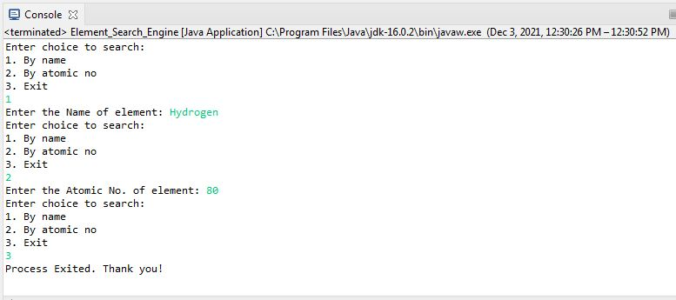
7
OUTPUT
Program Execution Output

Slide 13
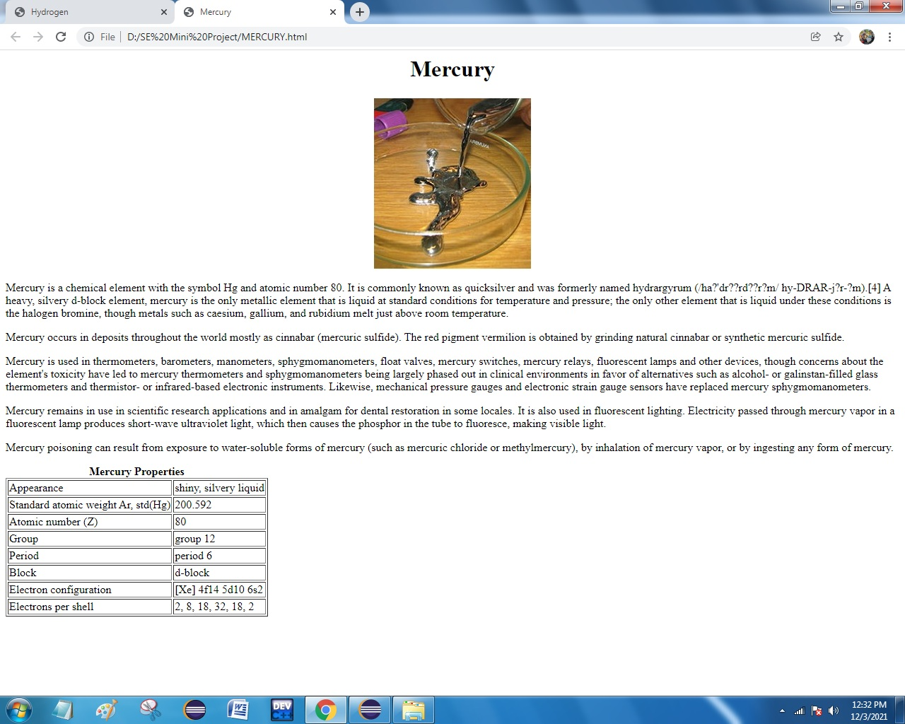
Search by Atomic Number.

Slide 14
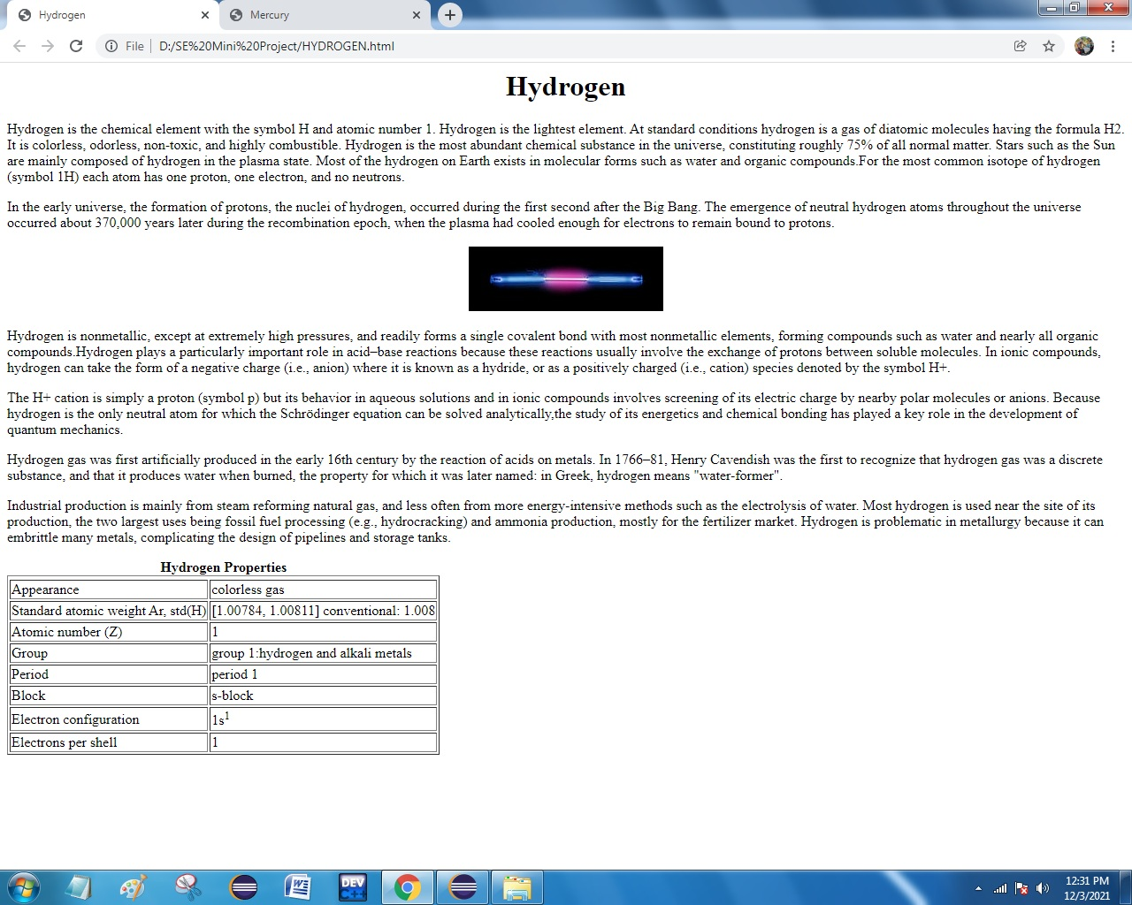
Search By Name

Slide 15
8
Advantages
While searching for an element on Google or Wikipedia you may have to visit separate webpage/website for every single element.
1
2
In our program you can find all the info in just one place.
3
To search for an element you can enter its name or just its atomic number.

Slide 16
9
CONCLUSION
This project is one of the sample projects on java and HTML. Though many difficulties were faced during the project as well as many errors occurred, we became succeed to compile and run the program. you will get a lot of knowledge about elements so that you can implement some more chemical reactions and newly received information about the element to this simple project .There may be some limitations on this project as well, so, in the near future we would like to be hopeful in further improvements. As well as, we are more hopeful for more advice, new ideas and inspiration to make more other projects. We have tried our best to include each.

Slide 17
FUTURE SCOPE
1
From this very project we were able to achieve various different concepts.
2
In future it can be re designed with 3D animated videos.
3
You can add newly received information about an element.
4
You can also add information about which scientist discovered the element.

Slide 18
10
REFERENCES
1
You tube and Google.
2
Wikipedia.

Slide 19
We hope , you like this project …..
THANK YOU

