Slide 1
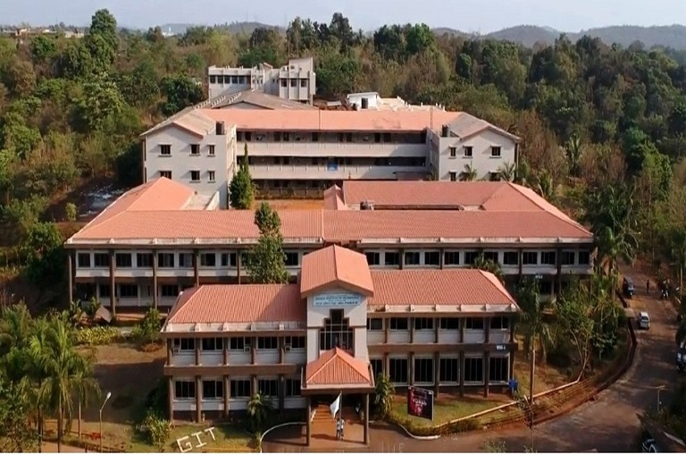
GHARDA INSTITUTE OF TECHNOLOGY
SE COMPUTER ENGINEERING
PROJECT NAME :- STUDENT RECORD MANAGEMENT SYSTEM
MINI PROJECT
2021-22

Slide 2
GROUP MRMBERS
ROLL NO | NAME
04 | BHURAN SAIRAJ SUNIL
39 | NACHARE JANAVI PRABHAKAR
46 | RANE MIHIKA SITARAM
48 | SAVARATKAR SHUBHAM SUBHASH
GUIDED BY :- Dr. RAMAN R. BANE SIR

Slide 3
Abstract
Students form a main part of any institution that concerns with. But the institutions find it difficult to keep details of so many students of the organization just in one stretch. It will involve a lot of pen paper work. Sometimes there will be some huge heap of files bundled up and kept together in some corner of the office. If you want any information regarding the particular student then it can be obtained by just entering the roll number or the name of the student to be searched. This Student record management system will make the work of storing the data in an organized way . The student record management system application will help in managing the student’s report, results and exams will become easier with one such system. It will also help in saving time and effect .The user interface must be user friendly and easy to understand. The information of the particular student will be obtained in just one mouse click .

Slide 4
Some of the features that it can include are as follows :
Student database management : The details of the students of the organizations can be stored in the database with the use this application
Results : The results of the students can also accessed and stored through this application
Security : The data that will be disclosed will be more secure since there will be no access to the unknown users
One – click access : You will obtain the details of the students by entering his her name or the roll number just in the one click
User interface : The user interface must be simple and easy to understand
Personal details : All the personal details of the students can be obtained in just one mouse click

Slide 5
INTRODUCTION
The “student Record Management system ” undertaken as a project is based on relevant technologies.
The main aim of this project is to develop software for managing student records.
This project has been developed to carry out the processes easily and quickly , which is not possible with the manuals systems ,which are overcome by this software .
This project is developed using ‘C’ language and hence it provides the complete solution for the current management system

Slide 6
ABOUT PROJECT PROJECT DETALIS
Project Name : Student record management system
Project Platform : C/C++
Programming Language used : C programming Language
IDE Tool ( Recommended ) : DEV C ++
Project Type : Desktop Application
Database : Stores data in . DAT F

Slide 7
Software and Hardware requirement
Software requirement :-
Complier : Dev C++
Operating System : Windows 10,7
Ram :- 4GB
Processor : intel core i3
Hard disk : 40GB or More
High resolution Screen , Mouse, Keyboard,

Slide 8
Advantages of software
It can display record of individual student.
It can search student record .
Search whole class record .
It can delete a specific record .
It working is easy.
Finding data becomes simple and helpful.

Slide 9
IntroductIon OF program
Student record management system
We can make this Student record management system in C language by using
Three or more than three header files or many data types such as:
#include<stdio.h> : this header file will contain Scanf() , Printf () And, there are many header files which are used in this program….
#include<conio.h>: this header file will contain Clrscr(); , Getch(); , and many more….
#include<string.h> : this header file will contain string function.

Slide 10
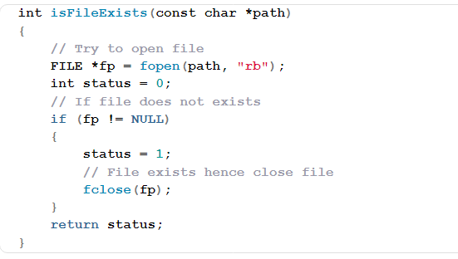
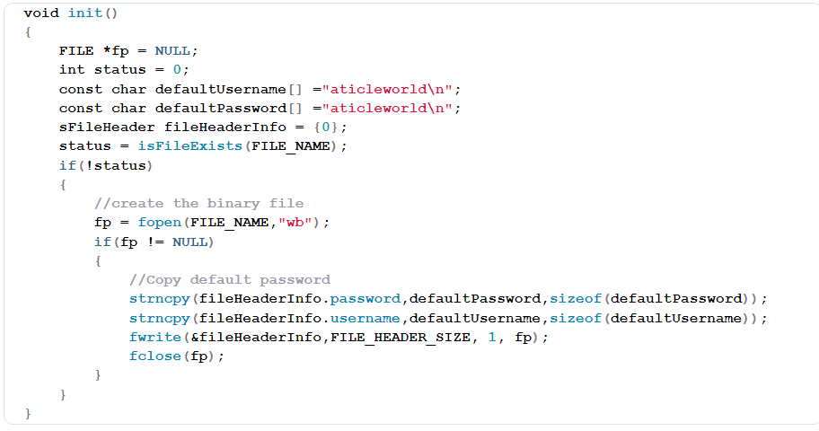
List of a function used in
Student Record Management System Project
init():
This function creates the file if not exist and copies the default password (“8888”) in file header structure.
Is FileExists():
This function verifies that a file has been created or not. If the file exists, the function return 1 otherwise returns 0.

Slide 11
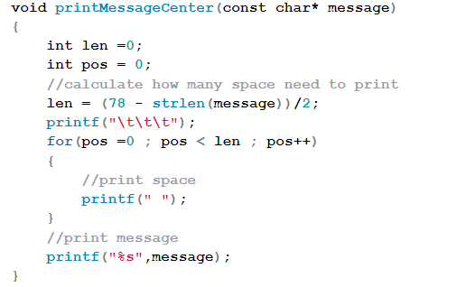
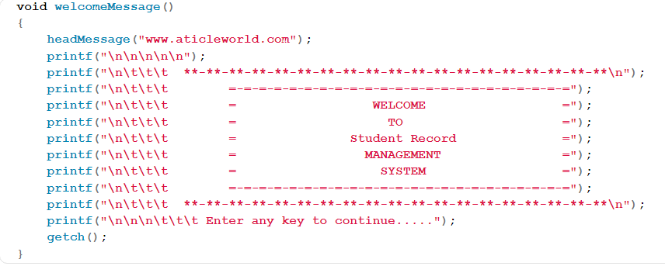
Print Message Center():
This function prints the message in the middle of the head massage. I have passed the message in this function as per the operation.
Head Message():
It prints the message on the top of the console and prints the message as per operation.

Slide 12
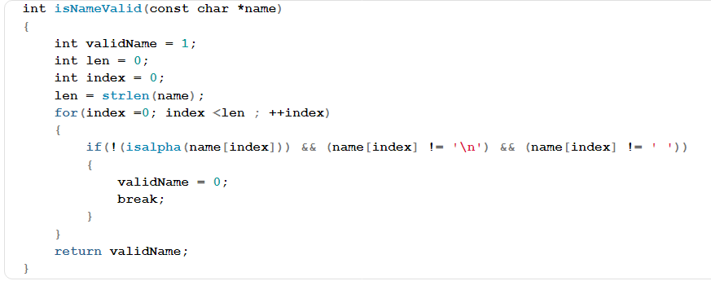
Is Name Valid():
It validates the user name, author name etc.
I have permitted this function to take the space in names.

Slide 13
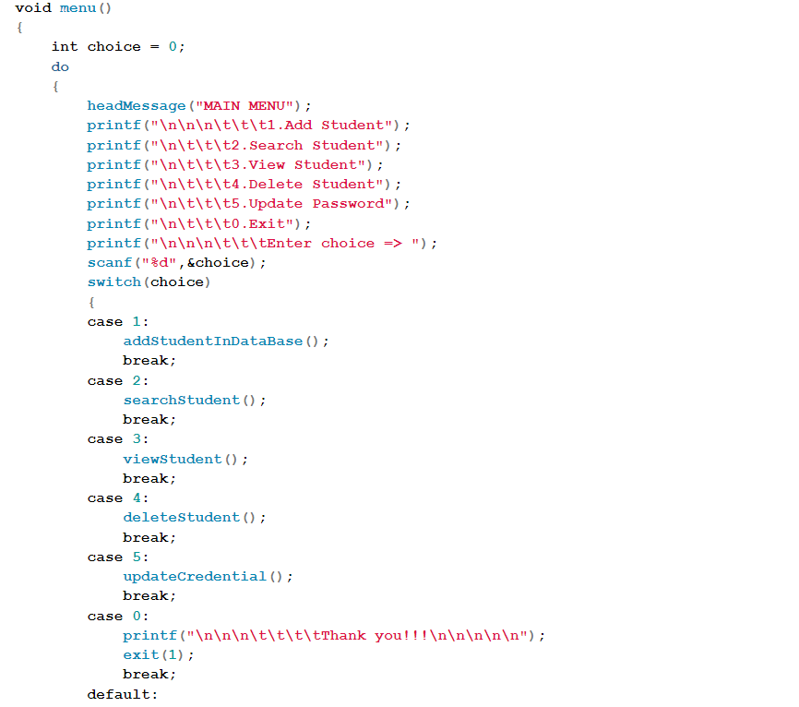
menu():
This function displays the library menu and asks the user to select the option. If the user selects 0, then the application will close.

Slide 14
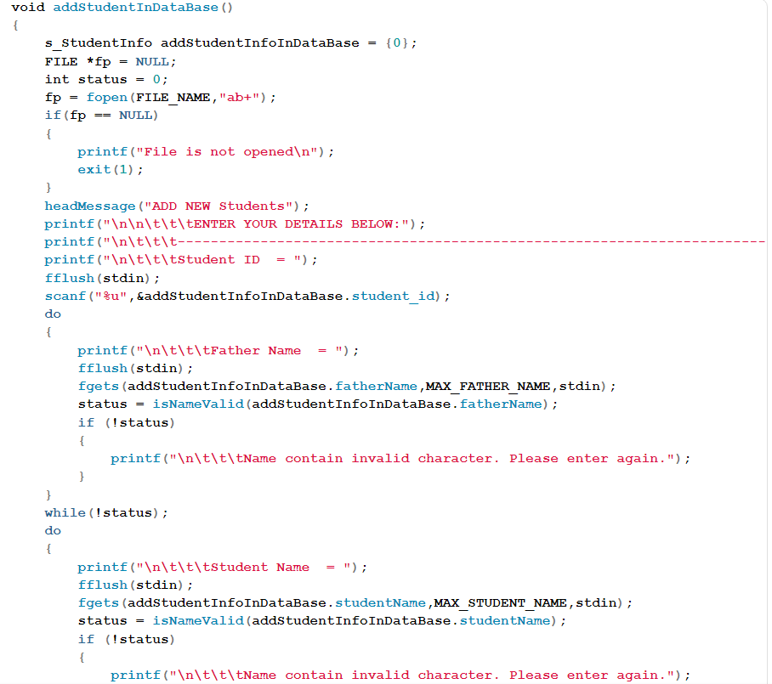
Add Student InDataBase():
This function opens the binary file in append mode and writes the student and the details.

Slide 15
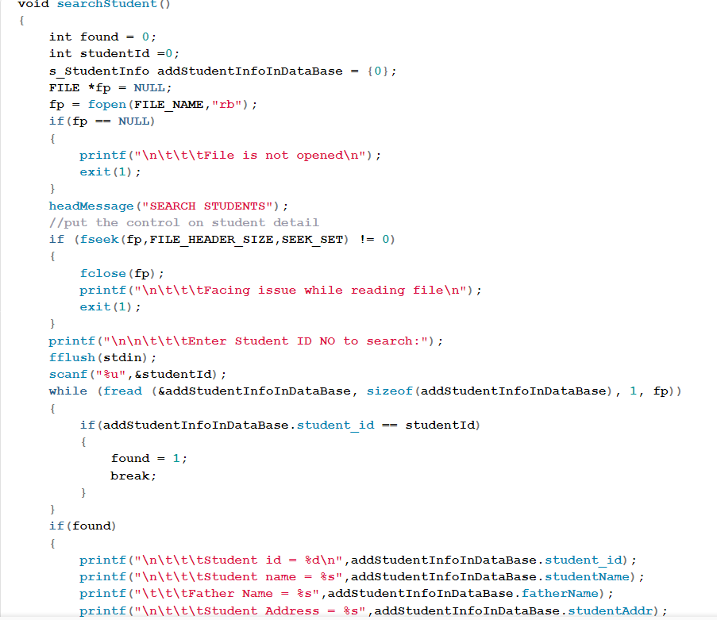
Search Student():
This function opens the binary file in reading mode and asks the user to enter the student id number which wants to search. If the student info is not available on the list, it shows the message student not find in records.

Slide 16
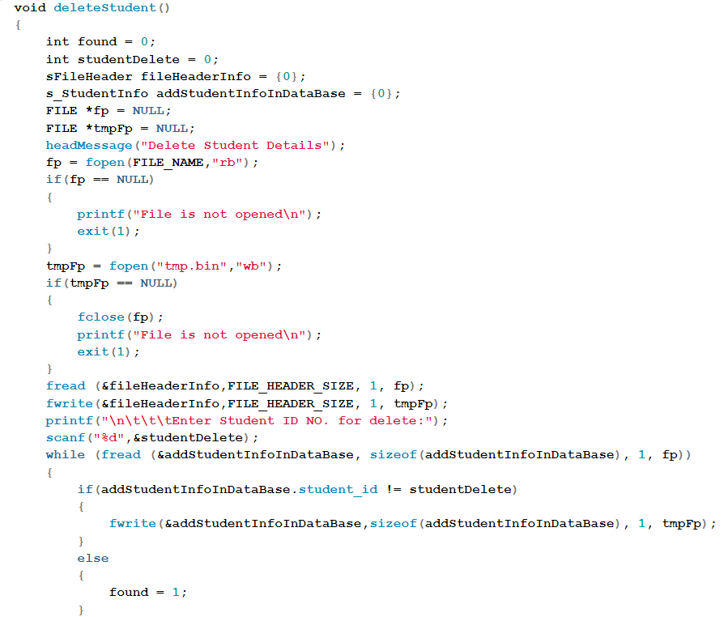
Delete Student():
This function asks the student id from the user for the student to want to delete. In this function, I am creating a temporary binary file and copy all the data from the existing file except the book whose student id entered by the user. In the last renamed the temporary bin file with an existing binary file.

Slide 17
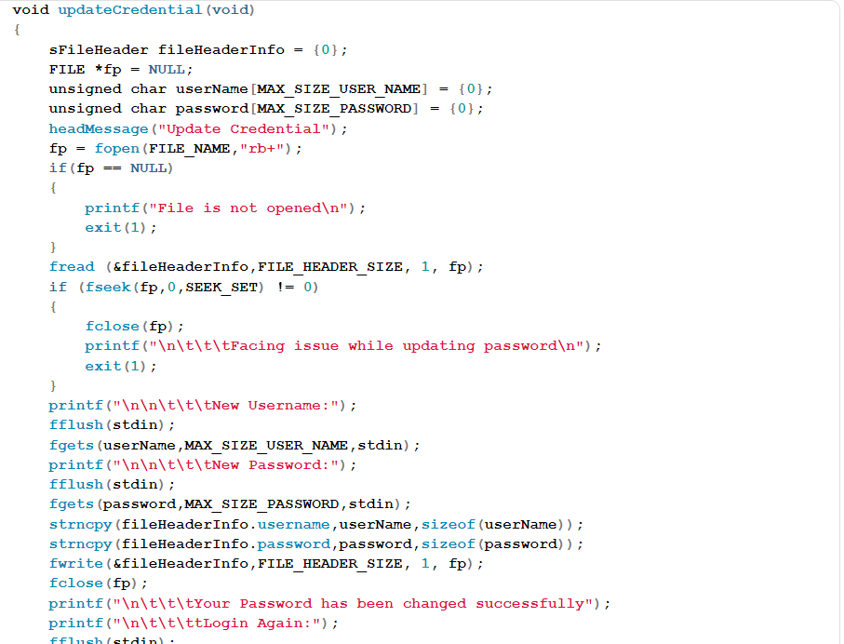
Update Credential( ):
This function opens the file in rb+ mode (reading and writing). It asks the user for the new username and password. After taking the password and username it closes the application. Now user can use the application with a new password and username.

Slide 18
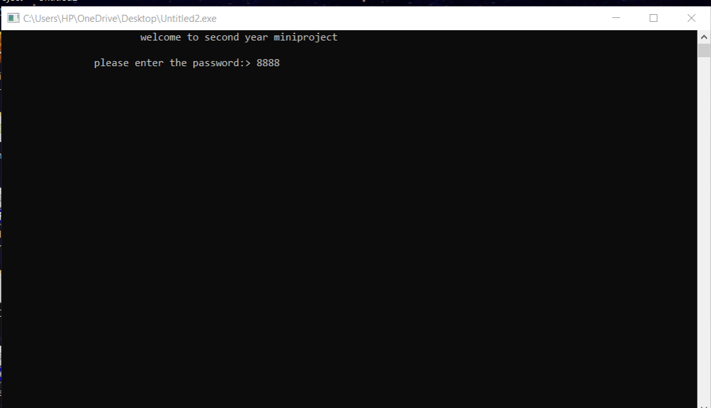
Output
This first output window show which take password to enter the software

Slide 19
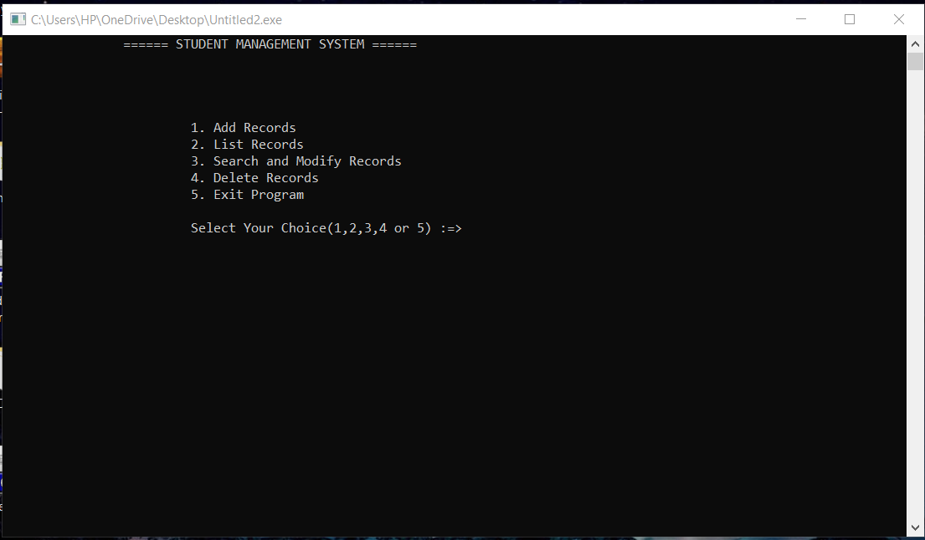
This is the second window whose show a main menu 1] add records
2] list record 3] search and modify records etc

Slide 20
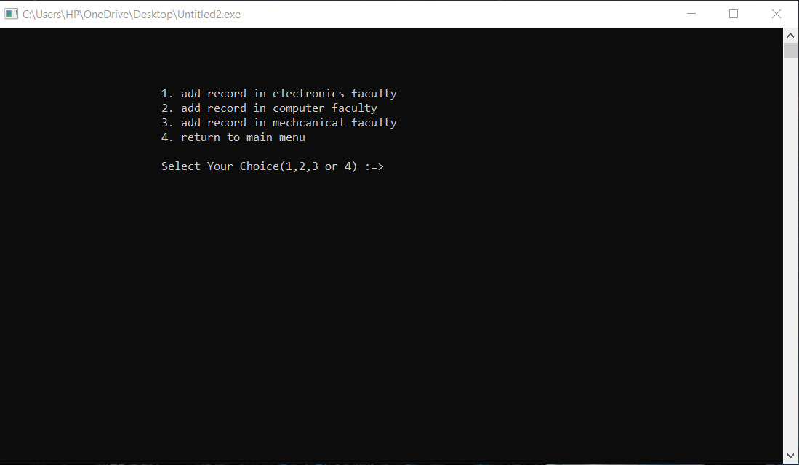
This third window which show the faculty to add student record

Slide 21
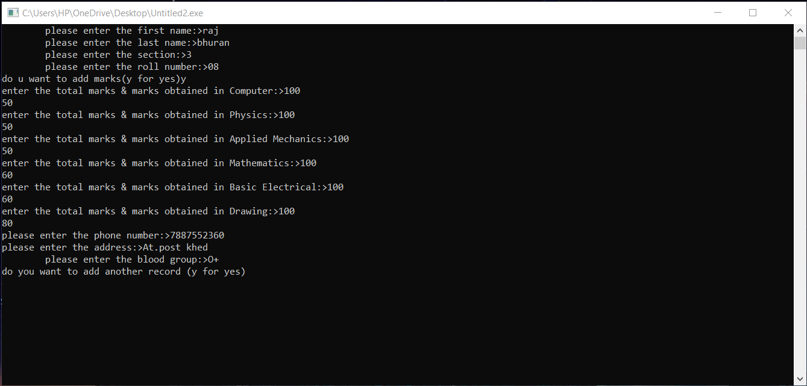
This window show we add the data in computer faculty student record

Slide 22
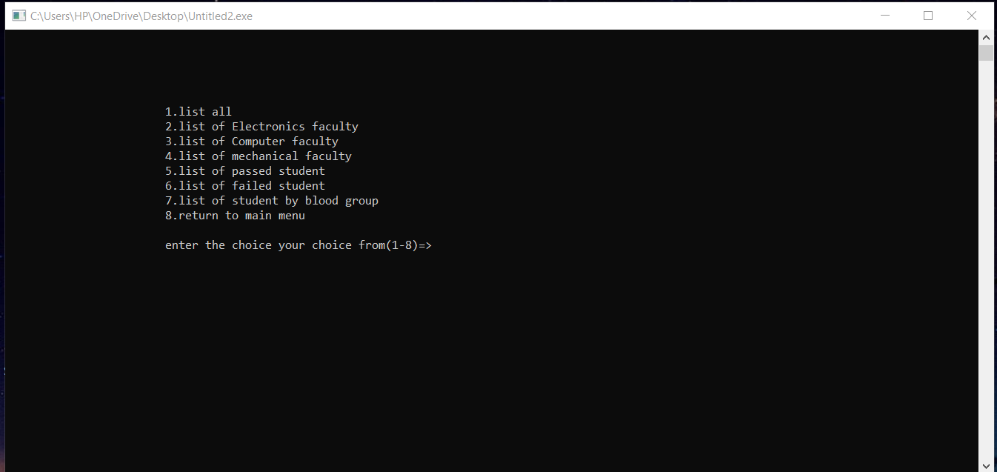
This window show the list menu whose check the faculty wise list , fail or pass student list

Slide 23
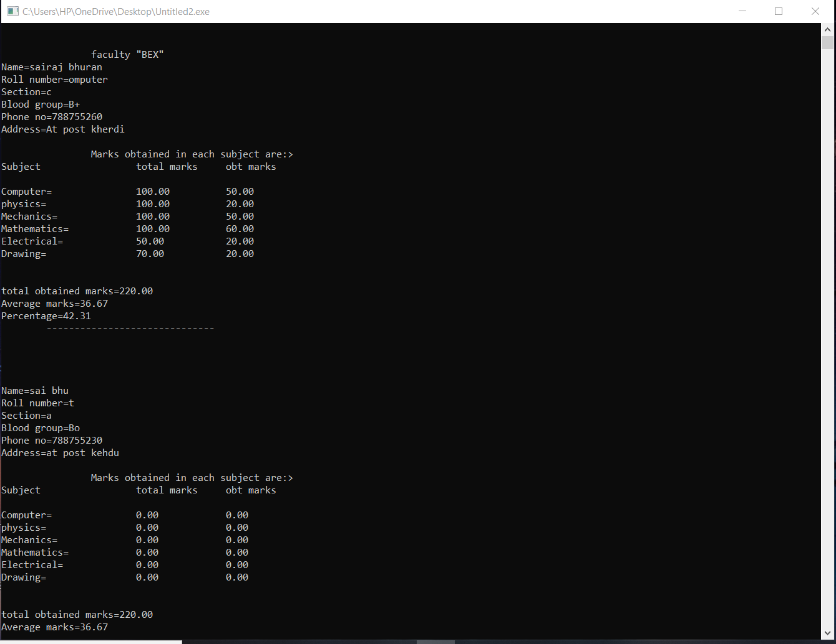
This window shot list of student with there information and marks

Slide 24
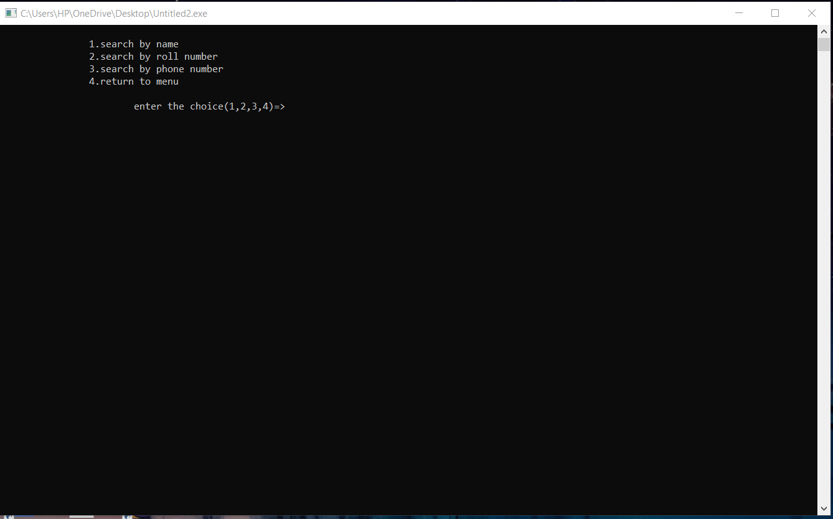
This window show the third main menu search and modify by using the roll no , name , phone number etc

Slide 25
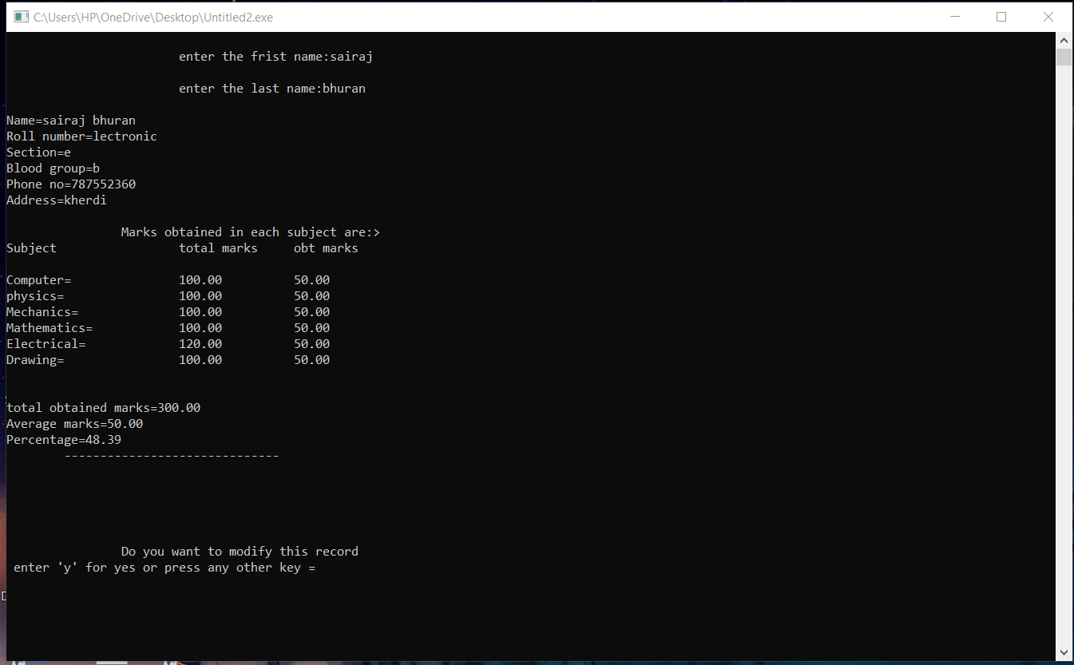
This window show the modify the record by using name

Slide 26
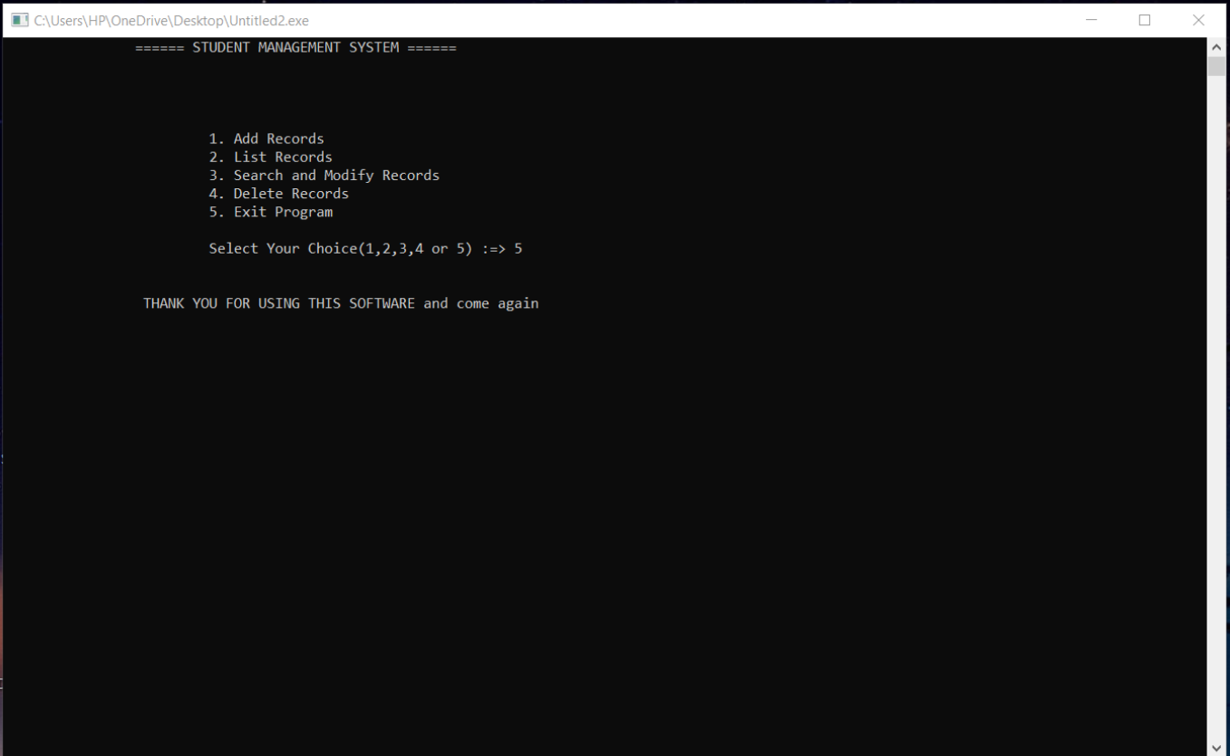
This window show last exit screen Thank you for using this software and come again

Slide 27
Future scope
In future one change can be done by adding the fingerprints of the student of which the record is entered.
And one more major change which can be done in this project is that to add the snaps of the student of which the record is entered. We can also add or subtract details of the individual

Slide 28
Conclusion
Hence we conclude in this project that we have used the ideologies of what we have learnt in past subjects and used it to create self adjusting software
Here by self adjusting we mean that it can be used for record analysis on any platform . Also starting from the playschool till the universities .
By using this software we don’t have to worry about misplacing of the record which was the great clash while storing the records in separate files

Slide 29
Thank –You !!!

