Slide 1

Gharda Institute Of Technology
Computer Engineering department

Slide 2
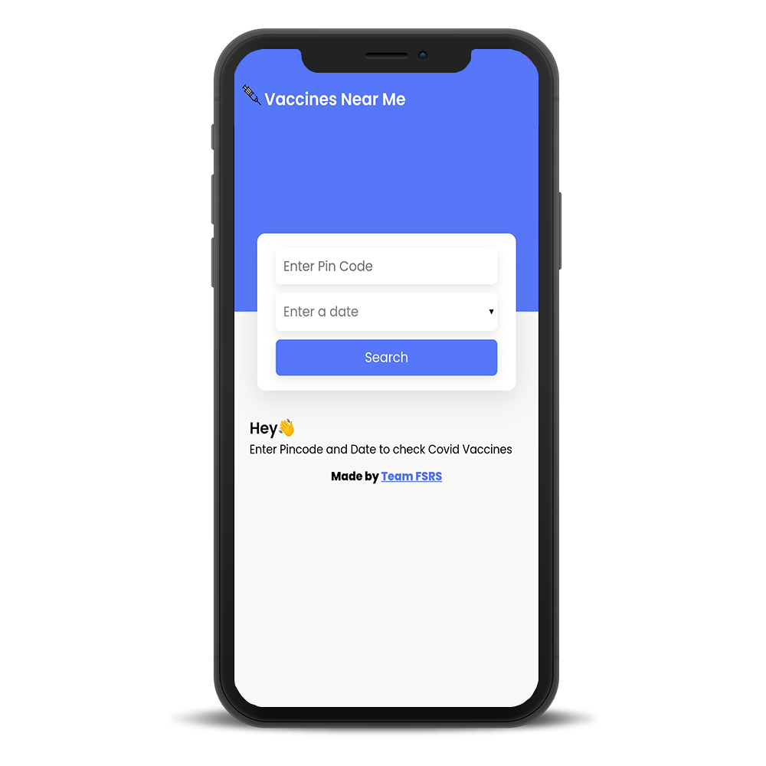
Team FSRS
Covid Vaccination Camp Locator
Find the nearest vaccination camp and be a
part of Safest India

Slide 3

Our Team
Vaccines Near Me
Rahul Nikam
Fouzan Sahibole
Sujeet Ghadge
Sanket Uteker
FSRS | VACCINES NEAR ME

Slide 4

Content
Outline
1
About Vaccines Near Me
2
Technologies used in this App
3
Advantages of this webApp
Topics for discussion
4
Mockup

Slide 5


FSRS | VACCINES NEAR ME
What is 'Vaccines Near Me'?
Vaccines Near Me is a Web App which helps us to get details of the nearest vaccination camp held by the Government.
This app can help many users around India to know about vaccination camps. This shows information such as Hospital Name, Complete Address, Vaccine Name, Fees, Age Limit, Timing, Stock for Dose 1 and 2.

Slide 6




Technologies Used in this App
HTML 5
CSS 3
JavaScript ES6
Firebase
CoWin API
FSRS | VACCINES NEAR ME

Slide 7

API
Firebase
API stands for Application programming interface it allows to have communication between two applications/software.
Firebase is cloud server provided by google to deploy projects like Website, Web Apps, Native Application, Games.

Slide 8

Advantages
User don't need to Login/Register.
All the data is Original and getting directly fetched from Government's Servers.
Quality information.
Saves the time.
Free to use.
Available for everyone - http://vaccinesnearme.web.app
FSRS | VACCINES NEAR ME

Slide 9
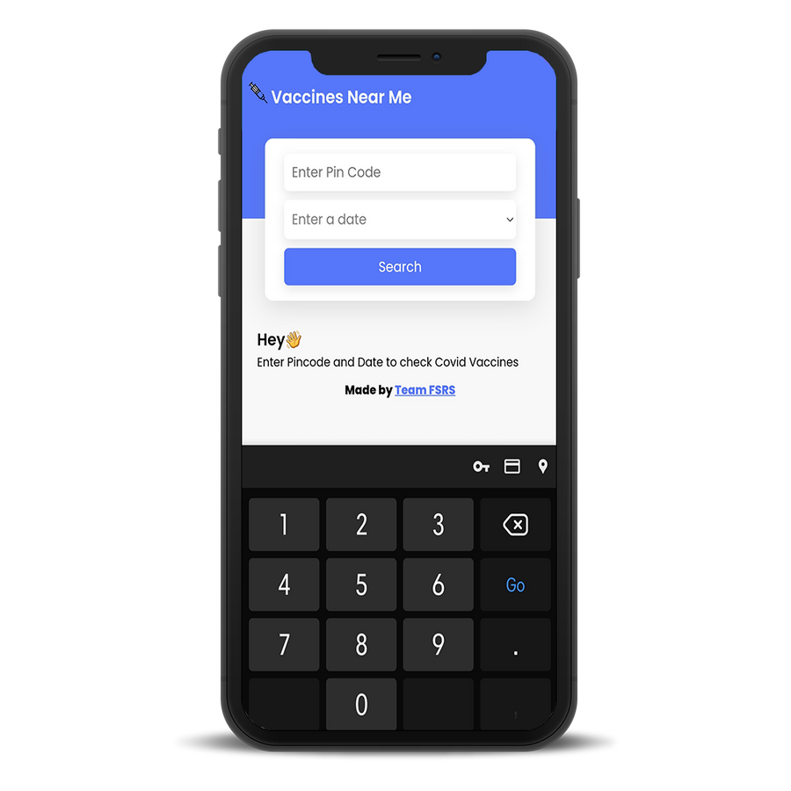
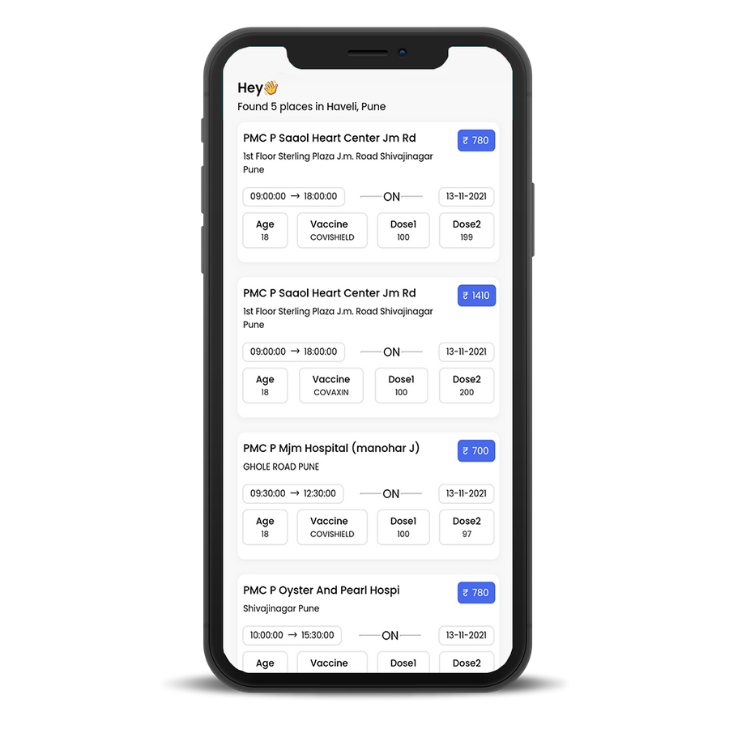
Product Mockups

Slide 10
Closure
Vaccines Near Me
So this is our complete app, this can be very helpful for all of us, as we have deployed it so everyone can visit to the link we provided.As we have prepared this app for covid vaccination, by making some changes, we can use this app for various vaccinations like polio,or any diseases like malaria, etc. which can be helpful for people to get the vaccines at ease.
FSRS | VACCINES NEAR ME

Slide 11
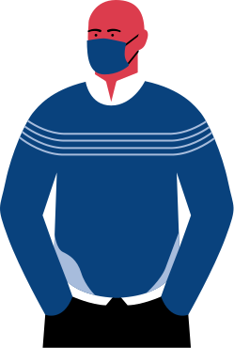
Thank You
FSRS | VACCINES NEAR ME

Slide 12
Questions or comments?
FSRS | VACCINES NEAR ME

