Slide 1


GHARDA FOUNDATION
GHARDA INSTITUTE OF TECHNOLOGY, LAVEL

Slide 2
MINIPROJECT - B
SECOND YEAR COMPUTER ENGINEERING
ACADEMIC YEAR 2020-21

Slide 3
LANGUAGE TRANSLATOR

Slide 4
GROUP MEMBERS
Siddhi Rewale 55
Mufeed kutarekar

Slide 5
INTRODUCTION:-
Language Translator using Google Translate API in Python –
Instantly translate texts, words, phrases from one language to another.
Translation enables communication between people from different regions.
A language translator is a tool to translate text,words , phrases from one language to any other language.It is like a dictionary where we can translate the text.

Slide 6
OBJECTIVE:-
The objective of this project is to translate text from one language to any other language in real-time with a button click. This project will be built using the Tkinter, googletrans libraries.
In this project, the user enters text in any language and get it translated in any other language by selecting the output language.

Slide 7
PROJECT PREREQUISITES:-
To implement this project, we will use:-
Tkinter,googletrans and pillow libraries.
Windows 10
Hard disk : 500GB ROM 8GB RAM
PYTHON 3.9.5 (64-BIT)

Slide 8
Installation
Following are the modules that are important to implement the project:-
1) Tkinter
2) Google trans
3) Pillow
In order to implement the project we need to install python inside our system and also we need to install tkinter library by executing the pip command and also we need to install google trans library

Slide 9
Simply go to terminal and use the pip installer to install the google trans as you would for any other Python library. To do this, type the following command in your terminal: Press Enter and it will get installed in your system.
pip install googletrans
To install the Tkinter library
pip install tkinter
Also to install pillow library
pip install pillow

Slide 10
WHAT IS GOOGLE TRANS?
It is a free and unlimited python library that implemented Google Translate API.The Google Translate API supports a variety of languages.The most basic use of the Google Translate API is, of course, translating words or sentences from one language into another.Google Translate is a tool with an API that helps you perform a lot of different translation-related functions.
API stands for Application Programming Interface. An API is a software intermediary that allows two applications to talk to each other. In other words, an API is the messenger that delivers your request to the provider that you're requesting it from and then delivers the response back to you.The API supports two endpoints, “detect” and “translate”. As the name suggests, one is for detecting the language, and the other is for translating from one language to another.

Slide 11
In this project we can use the keyword import to import the googletrans library.
and import Translator, LANGUAGES modules from googletrans library.

Slide 12
What is Tkinter?
Tkinter is the standard GUI library for Python. Python when combined with Tkinter provides a fast and easy way to create GUI applications.Python offers multiple options for developing GUI (Graphical User Interface). Out of all the GUI methods, tkinter is the most commonly used method.Tkinter is a GUI toolkit for python which is open-source and portable.

Slide 13
Creating a GUI application using Tkinter is an easy task. All you need to do is perform the following steps −
Import the Tkinter module.
As a next step, you initialize the window manager with the tkinter.Tk() method and assign it to a variable. This method creates a blank window with close, maximize, and minimize buttons on the top as a usual GUI should have.
Create the GUI application main window.
Add one or more widgets to the GUI application.
Enter the main event loop to take action against each event triggered by the user.

Slide 14
Tkinter Widgets Tkinter provides various controls, used in a GUI application. These controls are commonly called widgets.
Button SpinBox
Canvas PanedWindow
CheckButton
Entry
Frame
Label
Listbox
MenuButton
RadioButton
Scale
Scrollbar

Slide 15
Geometry Management
All widgets in Tkinter have some geometry measurements. These geometry measurements allow you to organize the widgets and throughout the parent frames or parent widget area.For this purpose, Tkinter provides us with three main geometry manager classes:
pack(): It organizes the widgets in a block manner, and the complete available width is occupied by it. It's a conventional method to show the widgets in the window. grid(): It organizes the widgets in a table-like structure. place(): Its purpose is to place the widgets at a specific position as instructed by the user in the parent widget.

Slide 16
ABOUT PILLOW LIBRARY:-
Pillow is built on top of PIL (Python Image Library). PIL is one of the important modules for image processing in Python.Pillow module gives more functionalities, runs on all major operating system and support for python . It supports wide variety of images such as “jpeg”, “png”, “bmp”, “gif”, “ppm”, “tiff”. You can do almost anything on digital images using pillow module.
To load the image, we simply import the image module from the pillow and call the Image.open(), passing the image filename.

Slide 17
PROJECT SOURCE CODE:-
from tkinter import * from tkinter import ttk
from PIL import Image,ImageTk,ImageDraw,ImageFont from googletrans import Translator , LANGUAGES root = Tk() root.geometry('1090x500') root.resizable(0,0)
root.title("Language Translator") image=Image.open("C:\\Python\\Pictures\\490164.jpg")
font1=ImageFont.truetype("arial.ttf",65)
title_text="Language Translator"
draw=ImageDraw.Draw(image)
draw.text((660,630),title_text,(300,240,220),font=font1)
image.show
photo=ImageTk.PhotoImage(image)
lbl=Label(root,image=photo)
lbl.pack(pady=0,padx=0) Label(root,text ="Enter text", font = 'Garamond', bg ='white smoke' ) .place(x=200,y=60)

Slide 18
Input_text = Text(root,font = 'arial 10', height = 11, wrap = WORD, padx=5, pady=5, width = 60) Input_text.place(x=30,y = 100) Label(root,text ="Output", font = 'Garamond', bg ='white smoke').place(x=810,y=60) Output_text = Text(root,font = 'arial 10', height = 11, wrap = WORD, padx=5, pady= 5, width =60) Output_text.place(x = 600 , y = 100)

Slide 19
language = list(LANGUAGES.values()) src_lang = ttk.Combobox(root, values= language, width =22) src_lang.place(x=20,y=60) src_lang.set('choose input language') dest_lang = ttk.Combobox(root, values= language, width =22) dest_lang.place(x=890,y=60) dest_lang.set('choose output language') def Translate(): translator = Translator() translated=translator.translate(text= Input_text.get(1.0, END) , src = src_lang.get(), dest = dest_lang.get())

Slide 20
Output_text.delete(1.0,END)
Output_text.insert(END, translated.text) trans_btn = Button(root, text = 'Translate',font = 'Candara',pady = 5,command = Translate , cursor="hand2" bg = 'Fuchsia', activebackground = 'Fuchsia') trans_btn.place(x = 490, y = 180) root.mainloop()

Slide 21
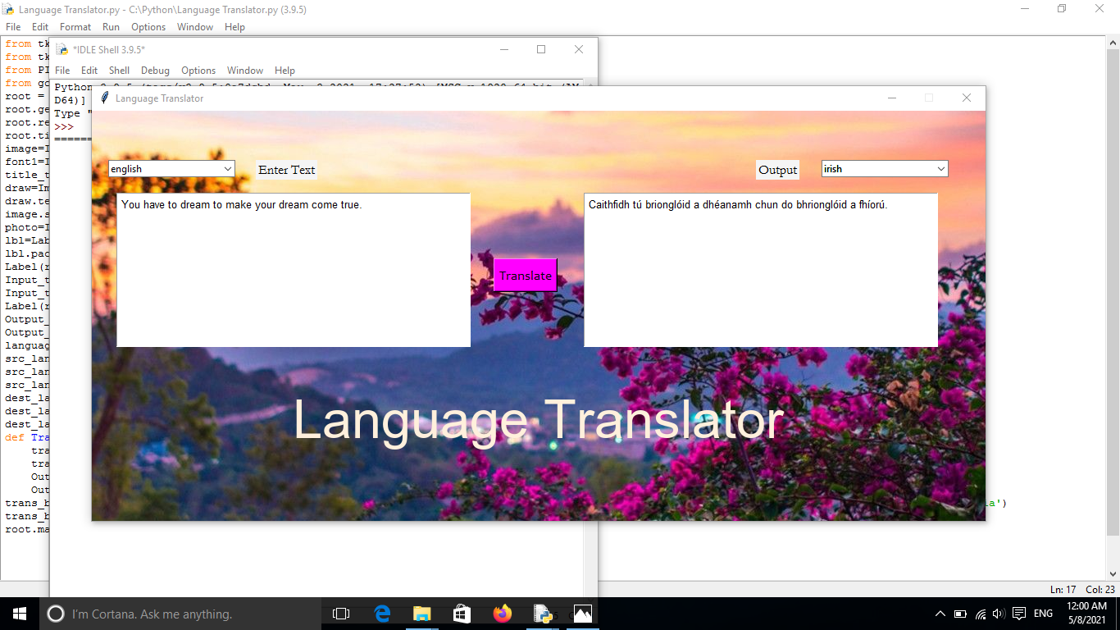
OUTPUT:-

Slide 22
STEPS TO BUILD LANGUAGE TRANSLATOR
Import required modules
Create a display window
Create input and output text widget
Define Combobox to select a language
Define function
Create a translate button

Slide 23
1. Import Modules
from tkinter import * from tkinter import ttk
from PIL import Image,ImageTk,ImageDraw,ImageFont from googletrans import Translator, LANGUAGES
We import
1)ttk modules from tkinter library
2)Image,ImageTk,ImageDraw,ImageFont from PIL library
3)Translator, LANGUAGES modules from googletrans library.

Slide 24
2. Create a display window
root = Tk() root.geometry('1090x500') root.resizable(0,0)
We use tkinter library to create a window where we’ll enter the text which we want to convert into another language.

Slide 25
Tk() :- Initialized tkinter which means window created.
geometry():- Set the width and height of the window.
resizable(0,0):- Set the fixed size of the window.

Slide 26
root.title("Language Translator")
image=Image.open("C:\\Python\\Pictures\\490164.jpg")
font1=ImageFont.truetype("arial.ttf",65)
title_text="Language Translator"
draw =ImageDraw.Draw(image)
draw.text(660,630),title_text,(300,240,220),font=font1)
image.show
photo=ImageTk.PhotoImage(image)
lbl=Label(root,image=photo)
lbl.pack(pady=0,padx=0)
title() :- used to set the title of the window Label() :- widget use to display one or more than one line of text that users aren’t able to modify.

Slide 27
root :- is the name which we refer to our window.
text:- which we display on the label.
font :- in which the text is written.
pack:- organized widget in block

Slide 28
3. Create an Input-output text widget
Label(root,text ="Enter Text", font = 'Garamond', bg ='white smoke').place(x=200,y=60) Input_text = Text(root,font = 'arial 10', height = 11, wrap = WORD, padx=5, pady=5, width = 60) Input_text.place(x=30,y = 100) Label(root,text ="Output", font = 'Garamond', bg ='white smoke').place(x=810,y=60) Output_text = Text(root,font = 'arial 10', height = 11, wrap = WORD, padx=5, pady= 5, width =60) Output_text.place(x = 600 , y = 100)
The above code creates two text widgets one for entering text and the other for displaying translated text.

Slide 29
Text():- widget is used for multiple text lines.
wrap = WORD will stop the line after the last word that will fit.
padx puts an extra bit of space to the left and right of the widget.
pady adds an extra bit of space to the top and bottom.

Slide 30
4. Define Combobox to select the language
language = list(LANGUAGES.values()) src_lang = ttk.Combobox(root, values= language, width =22) src_lang.place(x=20,y=60) src_lang.set('choose input language') dest_lang = ttk.Combobox(root, values= language, width =22) dest_lang.place(x=890,y=60) dest_lang.set('choose output language')
From the above code, users can pick a seperate language for both input data and to translate their data.

Slide 31
language :- gets all the values from the ‘LANGUAGES’ dictionary in the form of a list.
ttk.Combobox() :- widget is a class of ttk modules. It is a drop-down list, which can hold multi-value and show one item at a time. Combobox is useful to select one option from many option.

Slide 32
5. Define Function
def Translate(): translator = Translator() translated=translator.translate(text= Input_text.get(1.0, END) , src = src_lang.get(), dest = dest_lang.get()) Output_text.delete(1.0, END) Output_text.insert(END, translated.text)
The Translate function will translate the message and give the output. src gets the language selected as input text language

Slide 33
dest :- gets the language select to translate text gets the input text entered by the user.”1.0″ means that the input should be read from zero characters to line one.
The END part means to read the text until the end is reached.
translator = Translator() used to create a Translator class object.
Output_text.delete(1.0, END) delete all the text from line one to end.
Output_text.insert (END, translated.text) will insert the translated text in Output_text

Slide 34
6. Create a translate button
trans_btn = Button(root, text = 'Translate',font = 'Candara',pady = 5,command = Translate , cursor="hand2" bg = 'Fuchsia', activebackground = 'Fuchsia') trans_btn.place(x = 490, y= 180 ) root.mainloop()
When we click on the Translate button it will call the translate function.
Button() widget used to display button on our window

Slide 35
command is called when we click the button
activebackground sets the background color to use when the button is active
root.mainloop() is a method that executes when we want to run our program.

Slide 36
CONCLUSION
We have successfully developed the Language Translator python project. We used the popular tkinter library for rendering graphics on a display window, googletrans library to translate text from one language to another.
We learned how to translate text, how to create Combobox, buttons widget, and pass the function to the button. In this way, we build a Language Translator.

Slide 37
Thank you

