Slide 1
SCIENTIFIC CALCULATOR
Group Members :
Pratik Chandrakant Sonawane
Prof. : V. M. Nair

Slide 2
ABSTRACT
Java program to make a scientific calculator.
A scientific calculator can be made using a java program which is able to add, subtract, multiply and divide, sin, cos, tan, log, entered by the user.
This project work also focused principally on numbers and arithmetic operation. This researcher investigated the manual system in detail with a view to finding out the need to automate the system.
This project will help immensely in the following way. Easy calculating of tedious mathematical problems, easy to retrieval of errors and it will also be of a good assistance to any researcher on these topics.

Slide 3
CONTENTS
System Study
Implementation
Results
Conclusion
References

Slide 4
System Analysis
Existing System
Proposed System
Software and Hardware Requirements

Slide 5
Existing System
The project eliminates the paper work, human faults, manual delay and speeds up the process.
Easy calculating of tedious mathematical problems easy to retrieval of errors and it will also be of a good assistance to any researcher on these topics.

Slide 6
Proposed System
Problem statement was to design a module:
Which is user friendly.
Which will restrict the user from accessing other users data.
Which will help the administrator to handle all the changes.
The system will be completely menu driven so that the users will have no problems in using all the options.
The system will be efficient and fast in response.
The system will be customized according to the needs.

Slide 7
System Requirements
Hardware requirements:
RAM: 2GB(4GB+recommended)
Graphic card: basic GPU
Hard disk: 1GB free space (or above)
Display resolution: 1024x768 or higher
Input device: Standard keyboard
Software requirements:
Operating system: Windows 7 or above
Processor: Intel or compatible, 1.6GHz
Compiler: Android studio
Language: Java

Slide 8

BLOCK DIAGRAM
Input
Input
Calculator Functioning
Output

Slide 9
IMPLEMENTATION
Power: takes two numbers as inputs to the function and outputs the calculated exponent value with respect to the base.
Square: takes one numeric value as input and outputs the square result of it .
Sin: takes one numeric value as input and outputs the sine result of it .
Cos: takes one numeric value as input and outputs the cosine result of it .
Tan: takes one numeric value as input and outputs the tangential result of it .
Log: takes one numeric value as input and outputs the log result of it .
Base log: takes one numeric value as input and outputs the base 10 log result of it.

Slide 10
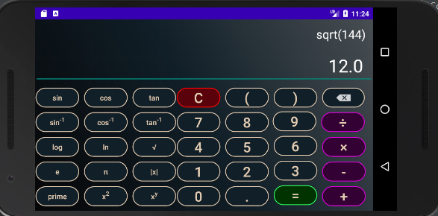
RESULTS

Slide 11
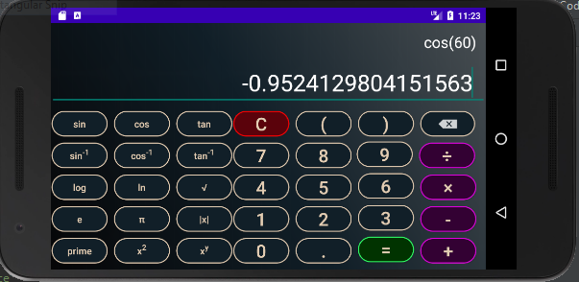

Slide 12
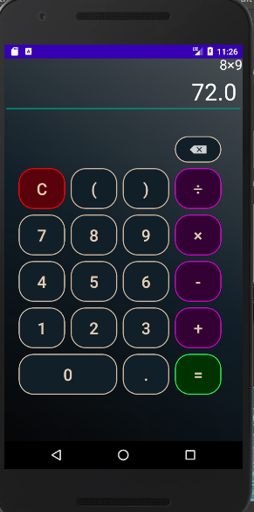

Slide 13


Slide 14
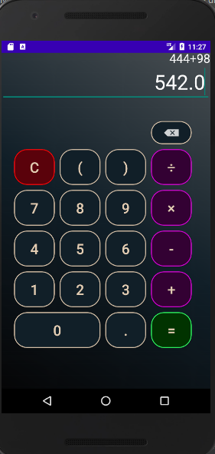

Slide 15
Conclusion And Future Scope
The scientific calculator provides a comprehensive interface to infer large calculations based on the input given by the user.
Our experimental study proves that our scientific calculator is a practical tool to have in computers of students pursuing streams in science and engineering fields.
This project can be extended by adding few more scientific functionalities for further expansion.

Slide 16
REFERENCES
Morton rosenstein, “computing with the scientific calculator ” in 1st edition, 1986 .
Susan brendel, eugene mcdevitt, “using a scientific calculator” 1996
Louis baker, “C mathematical function handbook”.

Slide 17
Thank You …

