Slide 1
GHARDA INSTITUTE OF TECHNOLOGY , LAVEL

Slide 2
Mini Project Second Year Computer Engineering Academic Year 2020-21

Slide 3
INDUSTRIAL VISIT MANEGEMENT SYSTEM
Project Mentor : Prof. Kranti Gajmal Ma’am

Slide 4
INDUSTRIAL VISIT MANAGEMENT SYSTEM
Group Members :
Shubhada Shailesh Chaugule
Akash Prashant Harchekar
Sahil Satish Pawar
Yogeshwari Yesappa Pujari

Slide 5
Introduction
Industry Visit Management System is a specific web based reservation system designed to make it easier for people or college to book industrial tour packages online.
In this project we are going to use HTML language .
Using this web based system ,users can chooses various packages to visit industry.

Slide 6
Vision
To be amongst the most innovative and useful to all industrial fields.
To provide a user friendly environment to book packages for industrial visit tour.
To give effective experience to user for booking a industrial visit tour.

Slide 7
Modules Of Project
Home
User Login
Admin Login
About Us

Slide 8
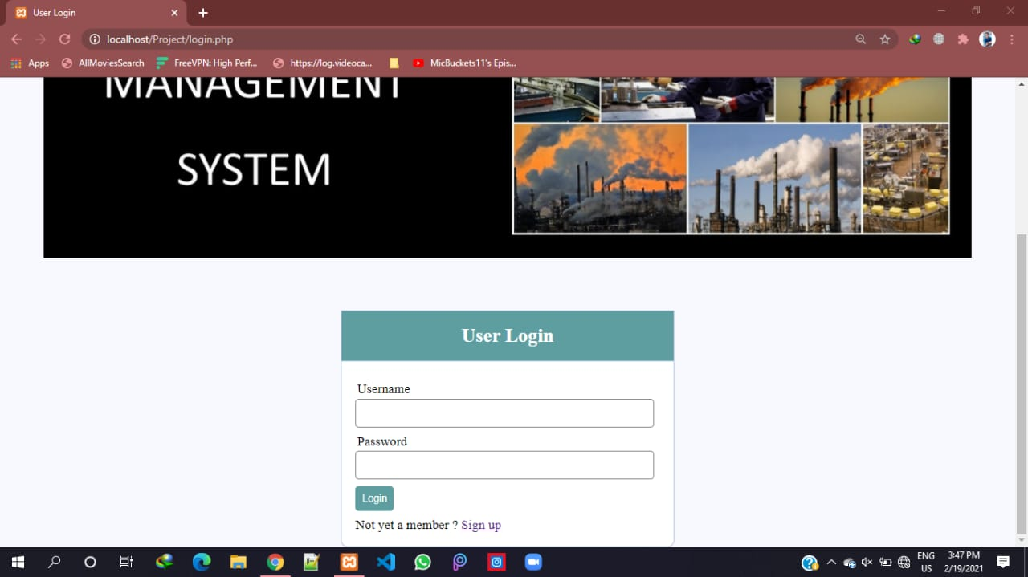
User Login

Slide 9
Sub Modules Of Users Login
View Details
Package Details
Confirm Package
Invoice Generation

Slide 10
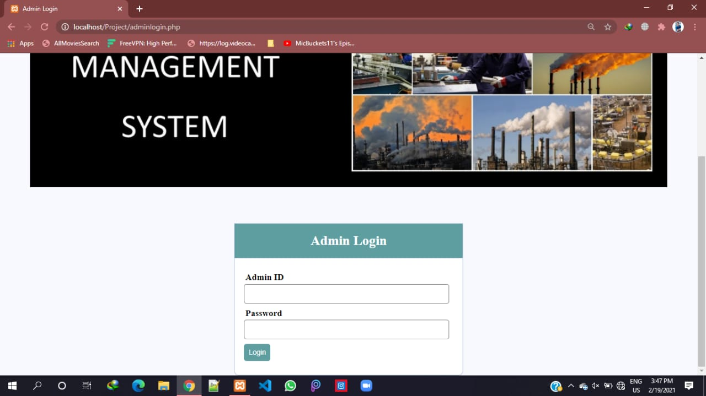
Admin Login

Slide 11
Sub Modules Of Admin
Booking Details
View All Details
TCS Details
Tech Mahindra Details
J.S.W Details

Slide 12
Editor And Programming Languages
Frontend : HTML,CSS
Backend : PHP
Database :SQL
Server :Xampp

Slide 13
Advantages
The Industrial visit management system works as a whole manager for visiting an industry for students in various fields.
These overcomes disadvantages of the traditional system of booking an tour for industrial visit.
The UI is very user friendly by which the user can easily access to various packages in the system.
Also it provides convenient manner for booking a package for visit. as the user can easily choose packages that user wants.

Slide 14
Conclusion
Helpful to perform paperless work and mange all data.
Is this project helpful to industrial environment and experience is undeniably one way for students appreciate their theoretical learning to more practical learning.

Slide 15
Thank You . . . . .

