Slide 1
GHARDA INSTITUTE OF TECHNOLOGY , LAVEL

Slide 2
Mini Project Second Year Computer Engineering Academic Year 2020-21

Slide 3
Library Management
System
Project Mentor : Prof. Bane Sir

Slide 4
Library Management System
Group Members :
Sanket Chandrashekhar Harvande (19)
Anand Sreenivas Kulkarni (31)
Aditya Dattaram Nivalkar (42)
Pritam Sham Lambade (34)

Slide 5
Introduction
A college library management is a project that manages and stores books information electronically according to students needs. The system helps both students and library manager to keep a constant track of all the books available in the library. It allows both the admin and the student to search for the desired book. It becomes necessary for colleges to keep a continuous check on the books issued and returned and even calculate fine. This task if carried out manually will be tedious and includes chances of mistakes. These errors are avoided by allowing the system to keep track of information such as issue date, last date to return the book and even fine information and thus there is no need to keep manual track of this information which thereby avoids chances of mistakes. Overall Web-based Library Management System is a project to help the students as well as the staff of the library to maintain the library in the best way possible and also to reduce the human efforts.

Slide 6
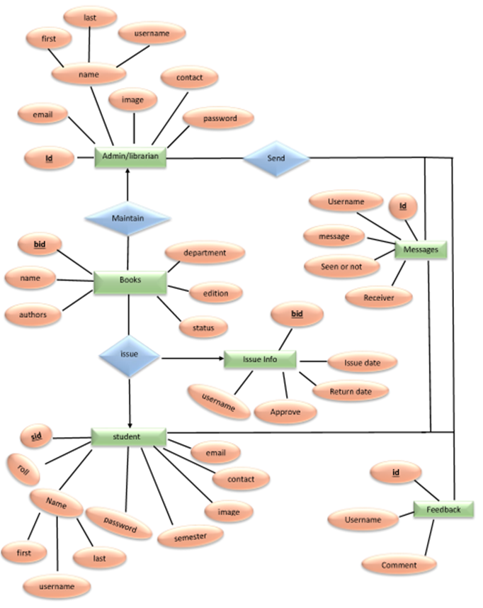
Flowchart

Slide 7
Methodology
The main objective of Online Library Management System is developing a computerized system to maintain all the daily work of the library. It has two sides –
User side (student / teacher) :
Admin side

Slide 8
Admin Site
This side contains following pages :
• Home page
• Registration page
• Login page
• Book page
• Add books page
• Book request page
• Approve page
• Issue Info Page

Slide 9
User Side
This side contains following pages :
• Home page
• Registration page
• Login page
• Book page
• Feedback Page
• Book request page
• Profile page

Slide 10
Experimental Work
Admin login: Admin is the one who administers the system by adding or removing e-books into and from the system respectively.
User login: Students have to register themselves into the system to create an account. After registering successfully, they can then login into the system by entering password and their email id.
Add and Update Books: The admin can add books to the system by entering the details of the books and can even update the details.
Search option: Admin and Students can even search for books by entering the name of the book

Slide 11
Objectives Of The Project
More Accuracy
Speed Improvement
The system will handle the maintainance of data.
The Administrator details of Books , Author and exixting member etc.

Slide 12
Advantages
Quick , easy , flexible generation of the members reports.
The data of the member would be entered in the database.
There would be a safe storage of information of the member in the database.
User friendly environment.
Admin can keep updating the system by providing the new books arrival in system and their availability thus students need not to go to library for issuing purpose.
The system has books well organized and systematically arranged in different categories in the system so that user can easily search and find the book.
Thus, it saves human efforts and resources.

Slide 13
Conclusion
Helpful to perform paperless work and manage all data.
Provides easy , accurate , unambiguous and faster data access.
The entire implemented system mainly demonstrates the concept of a Library Management System.

Slide 14
Thank You . . . . .

