Slide 1
GHARDA FOUNDATION
GHARDA INSTITUTE OF TECHNOLOGY, LAVEL.

Slide 2
MINI PROJECT - B
Second Year Computer Engineering
Academic Year 2020-21

Slide 3
PROJECT TOPIC : Basic Voice Assistant

Slide 4

GROUP MEMBERS :
TOPIC : BASIC VOICE ASSISTANT
Name Roll No.
Dhamane Gaurav Govind 13
Pawar Shouryan Ranjeet 47
Shinde Shubham Sunil 63
Mhatre Raj Vijay 37
Guide: Mr. Pratik V. Oak

Slide 5

PROBLEM STATEMENT
Creating a voice assistant which can take input from the user in form of voice processes it and give user the output in form of text, voice, perform action or doing web search.

Slide 6

OBJECTIVES
To create a voice assistant app which provides user to perform various actions with voice commands.
To provide user-friendly interface.

Slide 7
.
INTRODUCTION
Basic Voice Assistant is an Application/Software which will be helpful for everyone. We have come up with the idea of creating an app which can do user’s given tasks by voice commands, which will make certain things automated and help user for doing their tasks faster.

Slide 8

TOOLS & SOFTWARE USED
SOFTWARE :
VISUAL STUDIO CODE
PROGRAMMING LANGUAGE :
PYTHON (3.9)
GUI :
TKINTER (PYTHON IN-BUILT PACKAGE)

Slide 9
GUI is created using Tkinter which is already inbuilt package available in PYTHON.
CODE STRUCTURE:

Slide 10
from tkinter import *
import pyttsx3
import datetime
import speech_recognition as sr
import wikipedia
import webbrowser
import os
import random
# browser:
chrome_path = "C:\\Users\\Dell\\AppData\\Local\\Google\\Chrome\\Application\\chrome.exe"
webbrowser.register('chrome', None, webbrowser.BackgroundBrowser(chrome_path))
# All dir:
music_dir = 'D:\\Non Critical\\songs\\Favorite Songs2'
codePath = 'C:\\Program Files\\Microsoft VS Code\\Code.exe'
py_path = "C:\\Program Files\\JetBrains\\PyCharm Community Edition 2020.2.3\\bin\\pycharm64.exe"
pp = 'C:\\Program Files\\Microsoft Office\\root\\Office16\\POWERPNT'
word = 'C:\\Program Files\\Microsoft Office\\root\\Office16\\WINWORD'
c_path = 'C:\\Users\\Dell\\Desktop\\Apps\\control'
i_path = 'C:\\Program Files\\JetBrains\\IntelliJ IDEA Community Edition 2020.2.2\\bin\\idea64.exe'
SOURCE CODE:

Slide 11
# URL:
g_url = "https://www.google.com/search?q="
engine = pyttsx3.init("sapi5")
voices = engine.getProperty('voices')
engine.setProperty('voice', voices[1].id)
root = Tk()
# global var
# global var1
var = StringVar()
var1 = StringVar()
def update(ind):
frame = MI[ind % 51]
ind += 1
label.configure(image=frame)
root.after(50, update, ind)
def speak(audio):
engine.say(audio)
engine.runAndWait()

Slide 12
def wish_me():
hour = int(datetime.datetime.now().hour)
if 0 <= hour <= 12:
var.set("Good Morning")
root.update()
speak("Good Morning!")
elif 12 <= hour <= 18:
var.set("Good Afternoon")
root.update()
speak("Good Afternoon !")
else:
var.set("Good Evening ")
root.update()
speak("Good Evening !")
speak("How may I help you sir")
def take_command():
# It takes microphone input from the user and returns string output
r = sr.Recognizer()
with sr.Microphone() as source:
var.set("Listening..")
root.update()
# print("Listening..")
r.pause_threshold = 0.6
r.energy_threshold = 600
audio = r.listen(source)

Slide 13
try:
# print("Recognizing..")
var.set("Recognizing..")
root.update()
query = r.recognize_google(audio, language='en-in')
print(f"You said: {query}\n")
root.update()
except Exception as e:
# print(e)
var.set("Can you say that again?")
root.update()
var1.set(query)
root.update()
return query

Slide 14
def play():
wish_me()
while True:
query = take_command()
query= query.lower()
try:
if 'exit' in query:
var.set("Okay sir")
root.update()
speak("Okay sir if you want help just ask me")
break
elif 'wikipedia' in query:
speak('Searching wikipedia..')
query = query.replace("wikipedia", "")
results = wikipedia.summary(query, sentences=2)
speak("According to Wikipedia")
print(results)
var.set(results)
root.update()
speak(results)
continue

Slide 15
elif 'open youtube' in query:
var.set('opening Youtube')
root.update()
speak('opening Youtube')
webbrowser.get('chrome').open_new_tab('youtube.com')
btn2['state'] = 'normal'
continue
elif 'open google' in query:
var.set('opening google')
root.update()
speak('opening google')
webbrowser.get('chrome').open_new_tab('google.com')
btn2['state'] = 'normal'
continue
elif 'hello' in query:
var.set('Hello Sir')
root.update()
speak("Hello Sir")
elif ('play music' in query) or ('change music' in query):
var.set('Here are your favorites')
root.update()
speak('Here are your favorites')
songs = os.listdir(music_dir)
n = random.randint(0, 32)
os.startfile(os.path.join(music_dir, songs[n]))
btn2['state'] = 'normal'
continue

Slide 16
elif 'the time' in query:
str_time = datetime.datetime.now().strftime("%I:%M %p")
var.set(f"Sir, the time is {str_time}")
root.update()
speak(f"Sir, the time is {str_time}")
elif 'the date' in query:
str_date = datetime.datetime.today().strftime("%d %m %y")
var.set("Sir today's date is %s" % str_date)
root.update()
speak("Sir today's date is %s" % str_date)
elif 'thank you' in query:
var.set("Welcome Sir")
root.update()
speak("Welcome Sir")
elif 'open pycharm' in query:
var.set("Opening Pycharm")
root.update()
speak("Opening Pycharm")
os.startfile(py_path)
btn2['state'] = 'normal'
break

Slide 17
elif 'open intellij idea' in query:
var.set("opening intellij idea")
root.update()
os.startfile(i_path)
speak('opening intelliJ IDEA')
btn2['state'] = 'normal'
break
elif 'open PowerPoint' in query:
var.set("opening powerpoint")
root.update()
os.startfile(pp)
speak('Opening Microsoft PowerPoint')
btn2['state'] = 'normal'
break
elif 'open Word' in query:
var.set("opening word")
root.update()
os.startfile(word)
speak('Opening Microsoft Word')
btn2['state'] = 'normal'
break

Slide 18
os.startfile(py_path)
btn2['state'] = 'normal'
btn0['state'] = 'normal'
break
elif 'open intellij idea' in query:
var.set("opening intellij idea")
window.update()
os.startfile(i_path)
speak('opening intelliJ IDEA')
btn2['state'] = 'normal'
btn0['state'] = 'normal'
break
elif 'open PowerPoint' in query:
var.set("opening powerpoint")
window.update()
os.startfile(pp)
speak('Opening Microsoft PowerPoint')
btn2['state'] = 'normal'
btn0['state'] = 'normal'
break

Slide 19
elif 'open Word' in query:
var.set("opening word")
window.update()
os.startfile(word)
speak('Opening Microsoft Word')
btn2['state'] = 'normal'
btn0['state'] = 'normal'
break
elif 'open chrome' in query:
var.set("Opening Google Chrome")
window.update()
speak("Opening Google Chrome")
os.startfile(chrome_path)
btn2['state'] = 'normal'
btn0['state'] = 'normal'
break
elif 'open control panel' in query:
var.set("opening control panel")
window.update()
os.startfile(c_path)
speak('Opening control')

Slide 20
elif 'open chrome' in query:
var.set("Opening Google Chrome")
root.update()
speak("Opening Google Chrome")
os.startfile(chrome_path)
btn2['state'] = 'normal'
break
elif 'open control panel' in query:
var.set("opening control panel")
root.update()
os.startfile(c_path)
speak('Opening control Panel')
btn2['state'] = 'normal'
break
elif 'none' in query:
continue
else:
var.set("Searching for " + query)
root.update()
speak('Searching for ' + query)
webbrowser.get('chrome').open_new_tab(g_url + query)
btn2['state'] = 'normal'
# break
except Exception as e:
print(e)

Slide 21
label2 = Label(root, textvariable=var1, bg='black', fg='cyan')
label2.config(font=("Open Sans", 20))
var1.set('')
# label2.place(relx= 0.0, rely= 0.0 ,anchor='nw')
label2.pack()
label1 = Label(root, textvariable=var, bg='black', fg='cyan')
label1.config(font=("Open Sans", 20))
var.set('Welcome')
# label2.place(relx= 0.0, rely= .0 ,anchor='nw')
label1.pack()
MI = [PhotoImage(file="final.gif", format=f'gif -index {i}') for i in range(51)]
root['bg'] = 'black'
root.title('ELSA')
root.iconbitmap(r'app_icon.ico')
label = Label(root, bg='black', width=400, height=500)
label.pack()
root.after(0, update, 0)

Slide 22
# buttons
btn1 = Button(text='PLAY', width=20, command=play, bg='black', fg='cyan')
btn1.config(font=("Open Sans", 12))
btn1.pack()
btn2 = Button(text='EXIT', width=20, command=root.destroy, bg='black', fg='cyan')
btn2.config(font=("Open Sans", 12))
btn2.pack()
root.mainloop()

Slide 23
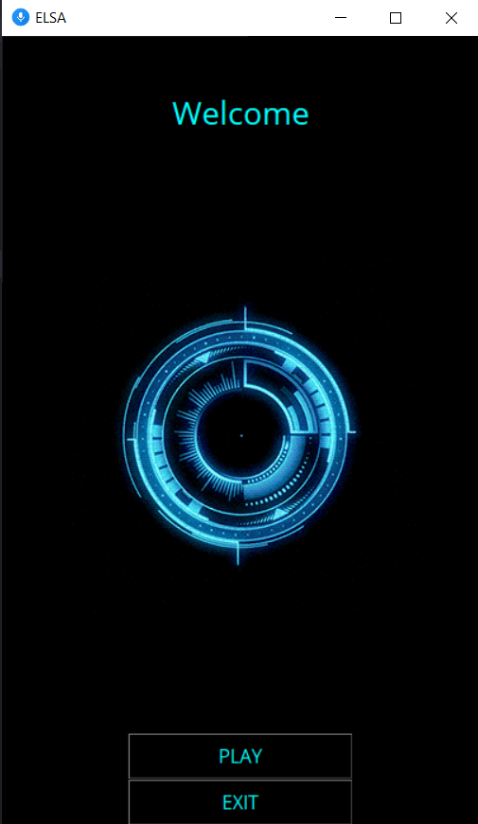
GUI :

Slide 24
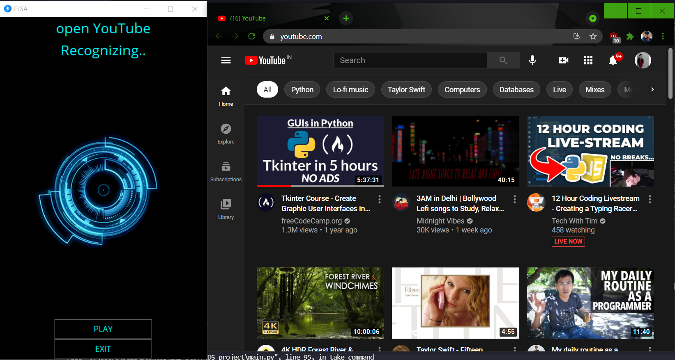
Example :

Slide 25
ADVANTAGES
It is very time efficient
It has various features to perform actions
It is also very User-friendly
It has very simple User-Interface

Slide 26

CONCLUSION
We can conclude that we have achieved the main objective of the project and have successfully implemented User-friendly environment and performed all the following operations successfully:
Opening system applications
Searching Wikipedia
Date and time
Play music
Google search

Slide 27

FUTURE SCOPE
Rating system can also be imbedded according to the user’s satisfaction.
2. It can also be made for ANDROID and IOS users.
3. We can add some more commands to make some things automated.

Slide 28
THANK-YOU

