Slide 1
GHARDA INSTITUTE OF TECHNOLOGY, LAVEL

Slide 2
MINIPROJECT ENGINEERING MATHEMATICS-Iv

Slide 3
Application of Residue Theorem to evaluate real integrations
Name of students Roll no
1.Shreya Chandrakant Malavde 35
2.Punam Subhash Pawar 45
3. Tejaswini suresh Pawar 48
4. Sakshi Rajendra Sawant 60
5.Rutwik suhas sakpal. 56
6. Siddharaj bharat karambe. 29

Slide 4
Introduction
In complex analysis, a discipline within mathematics, the residue theorem, sometimes called cauchy's residue theorem, is a powerful tool to evaluate line integrals of analytic functions over closed curves; it can often be used to compute real integrals and infinite series as well. It generalizes the cauchy integral theorem and cauchy's integral formula. From a geometrical perspective, it can be seen as a special case of the generalized stokes' theorem.
In this project we want to see how the residue theorem can be used to computing definite real integrals.

Slide 5
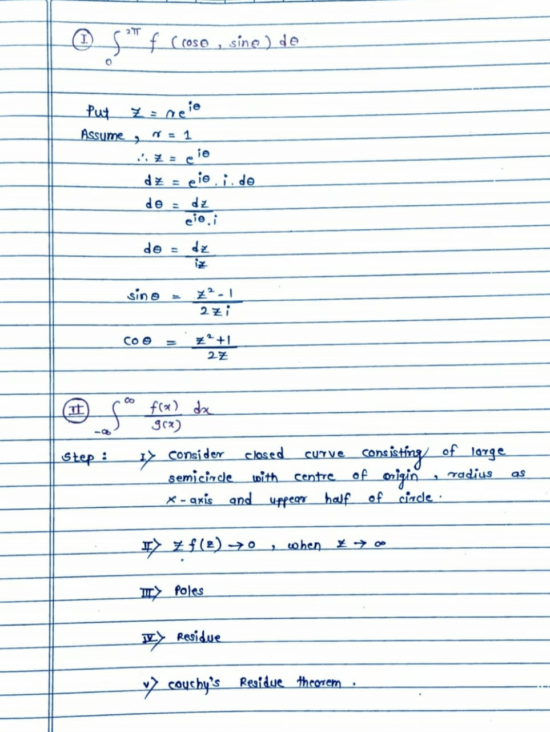
Important formulas

Slide 6
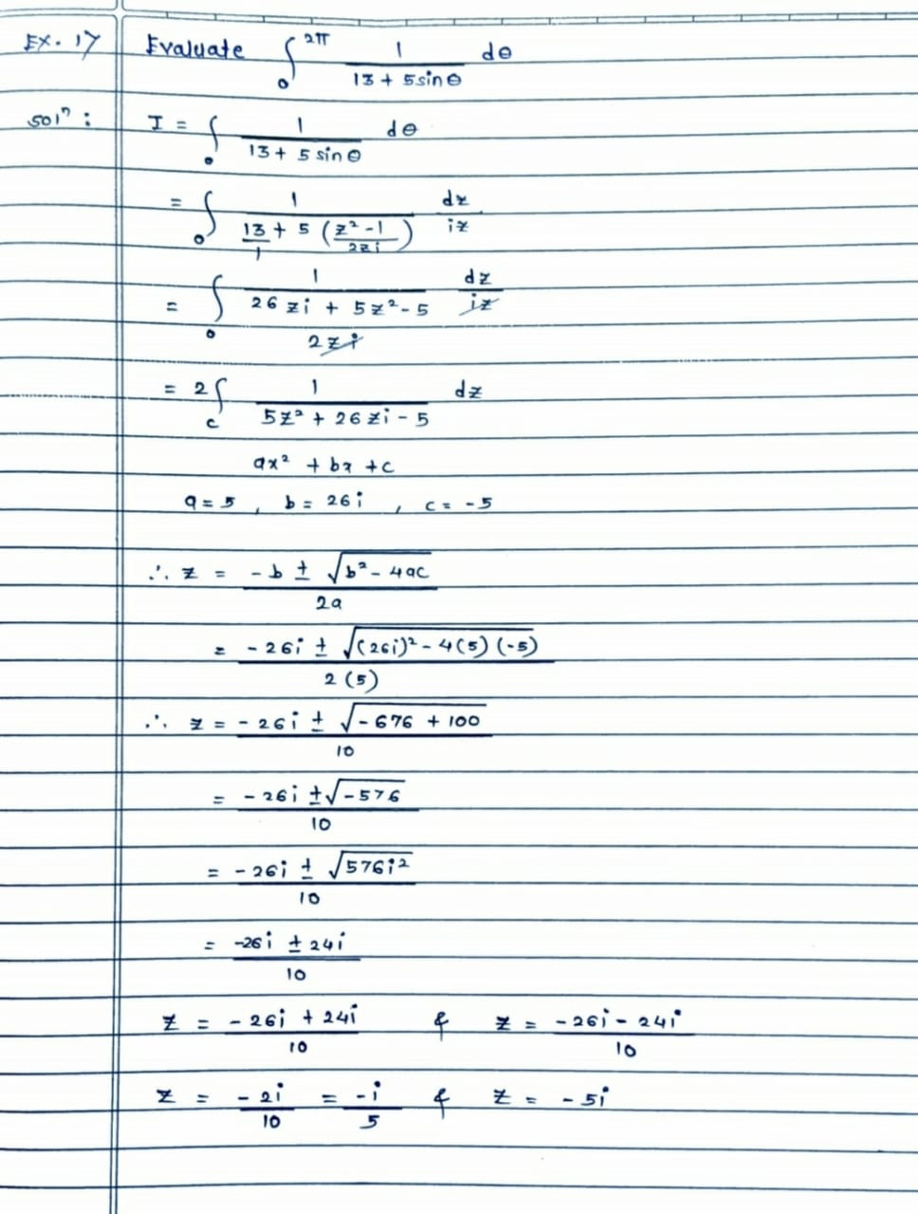
Examples

Slide 7
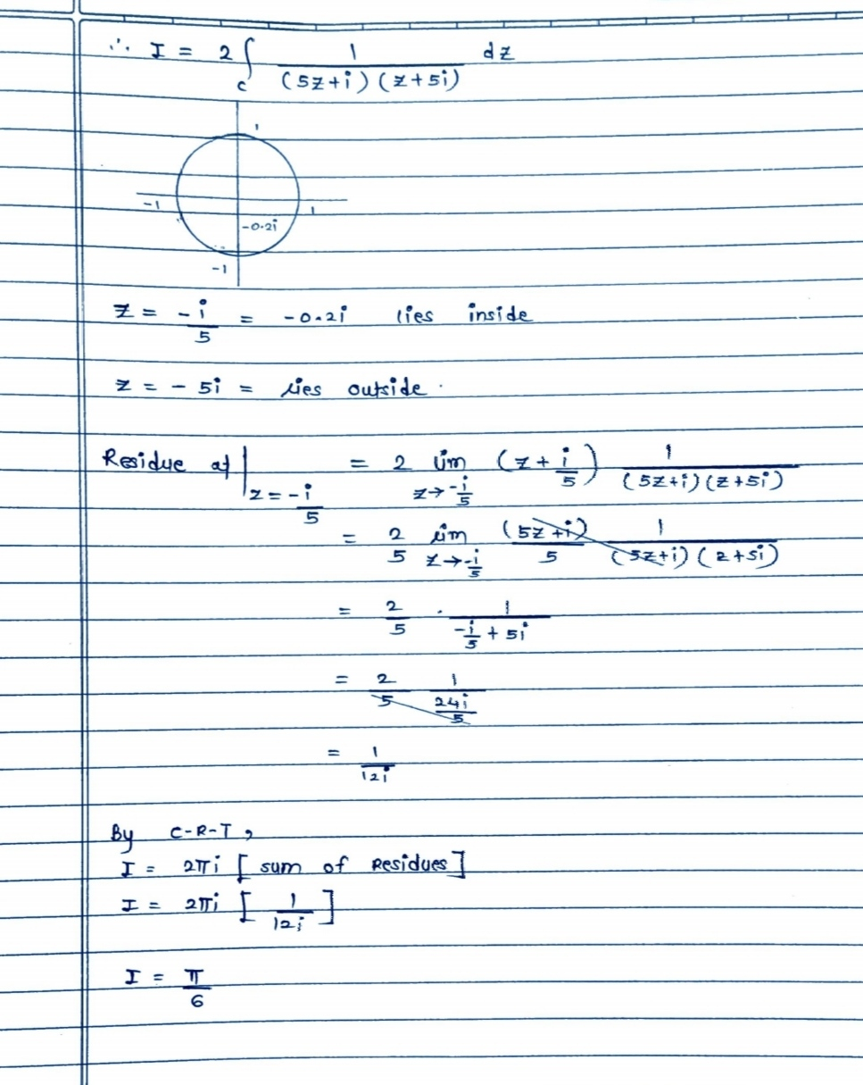

Slide 8
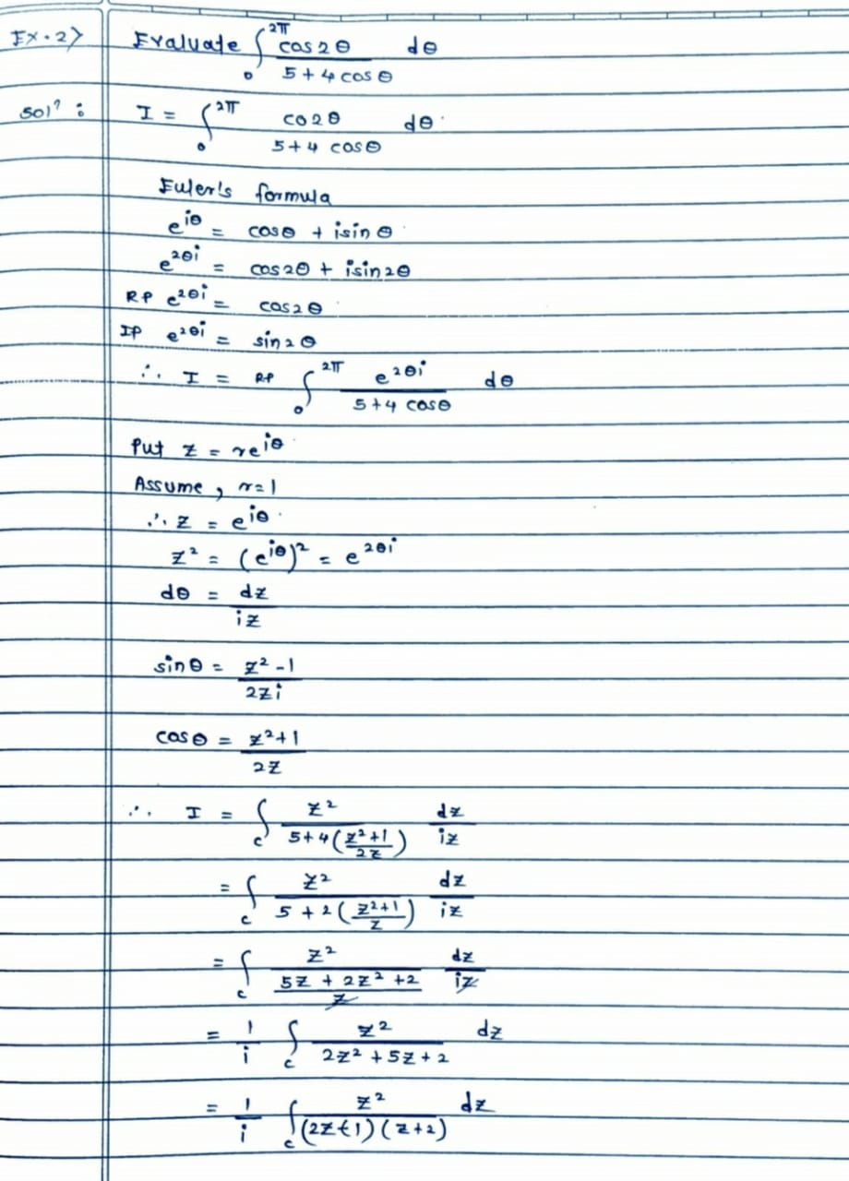

Slide 9
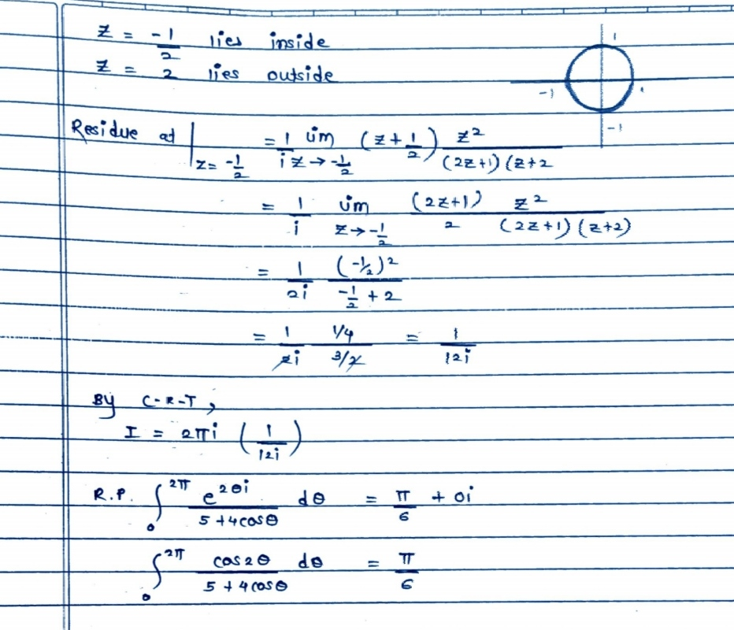

Slide 10
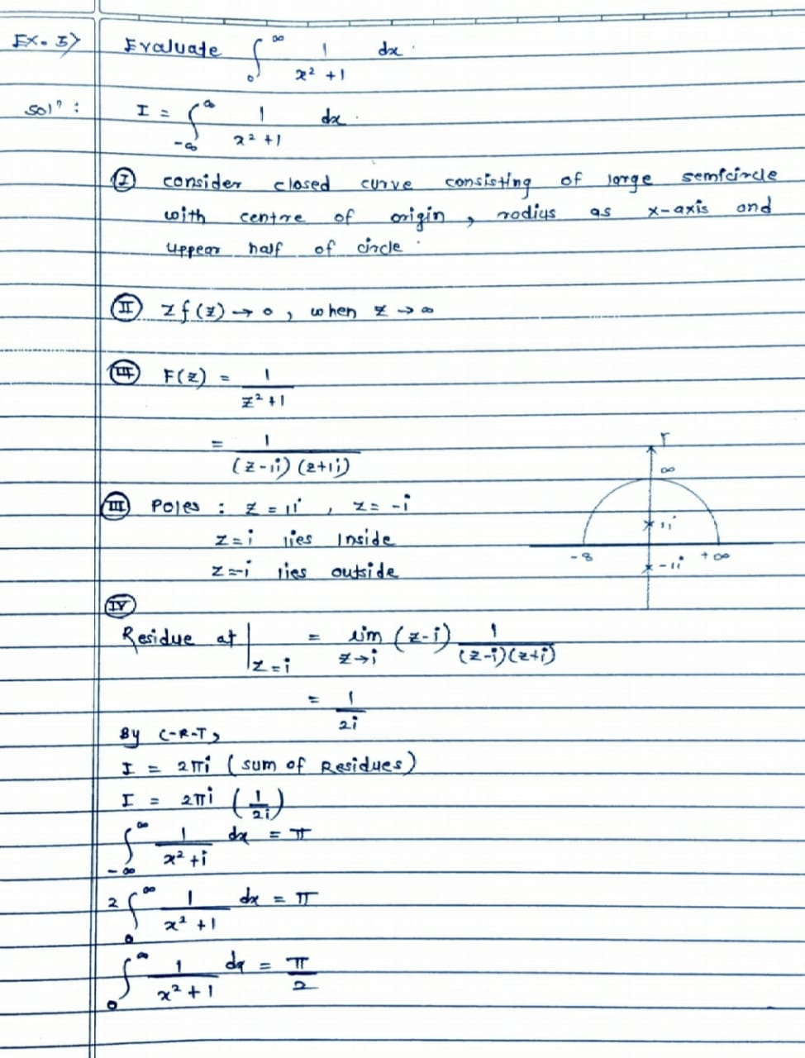

Slide 11
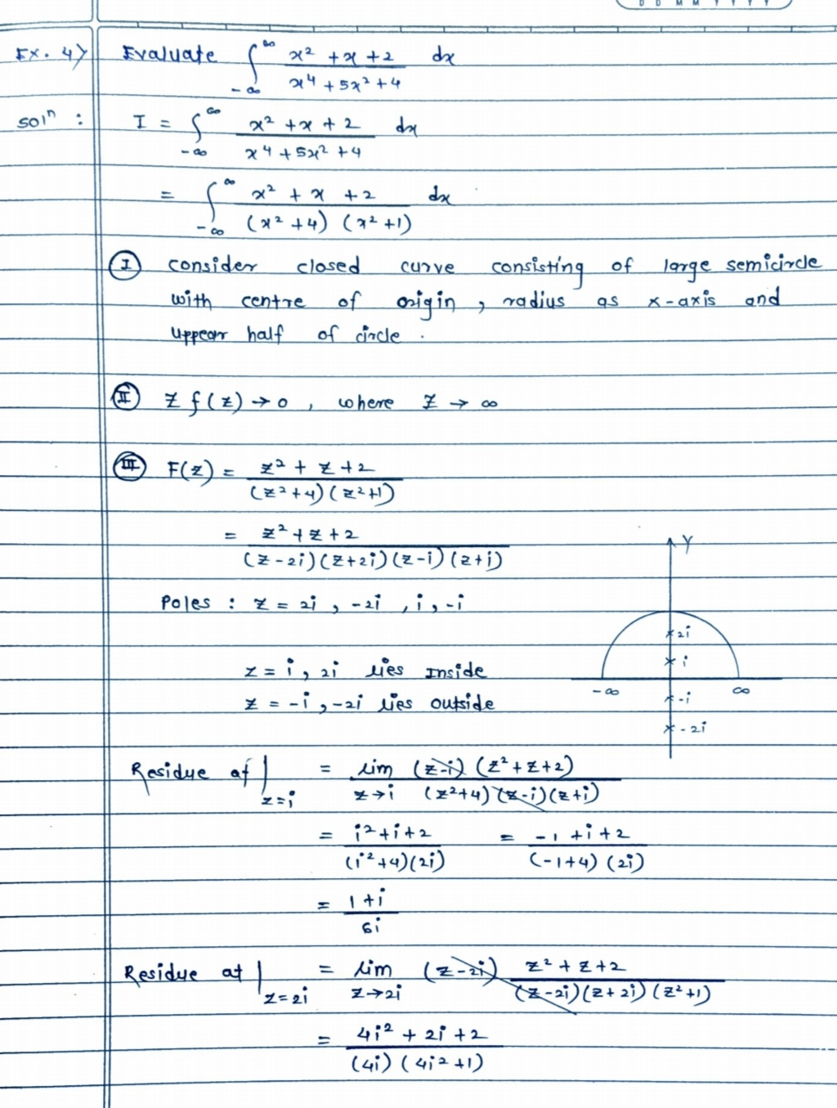

Slide 12
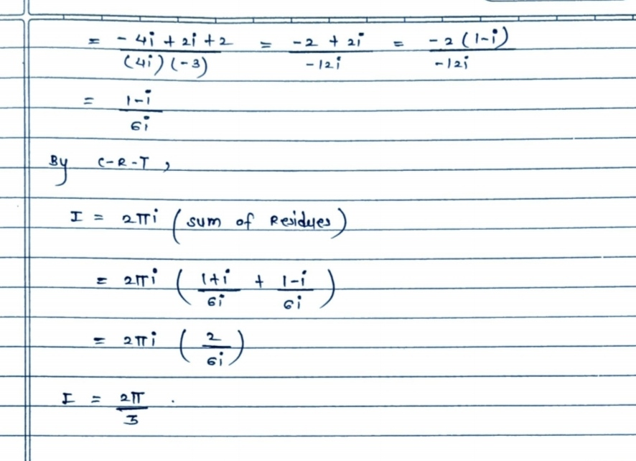

Slide 13
Application
The residue theorem has applications in functional analysis, linear algebra, analytic number theory, quantum field theory, algebraic geometry, Abelian integrals or dynamical systems. In this section we want to see how the residue theorem can be used to computing definite real integrals.

Slide 14
Conclusion
In this study, we had concluded that the residue therom had definite and infinite poles of higher order with constant numerator. A general form of residues of these functions of high orders were also investigated.
Our numerical results in computing the residues for improper integrals of definite and infinite poles on the x-axis were well defined

Slide 15
Thank you

