Slide 1


PONG GAME USING PYTHON
GHARDA FOUNDATION’S
GHARDA INSTITUTE OF TECHNOLOGY A/P:-LAVEL, TALUKA: KHED,DIST. RATNAGIRI, STATE:MAHARASTRA, PIN:- 415 708
TELEPHONE NO:- 02356-262795/97/98 FAX NO :- 02356-262795
Group Member : 06 Sagar Hiraman chaughule
Under the guidance of
Prof-Mr. Londhe sir
Academic year-2020-2021

Slide 2
Index
Sr.No | Content
1 | Introduction
2 | Aim of Project
3 | Code
4 | Conclusion and Future Scope
5 | References

Slide 3
Introduction
The project entitled as “PONG GAME USING PYTHON” is developed by S.E Computer Department students of Gharda
Institute of Technology [GIT].
The project is based on “python” language .The main work of these project is to play the pong game.
The softwares used to construct this project are listed below:
visual studio code
These game is totally depend on the pygame module which is in the python language.
How the pygame works:
Every pygame code consists of two parts.
First part where you setup all your code ,you need for the game . classes ,functions , variables are consists logic of the game.
To actually run the game you need the loop which is second part. Inside of these pygame continuously cycles through a while loop, updates the code and draws the resulting pictures and since that happens many times per second we precive these as a moving image.

Slide 4
Aim of the Project
With the help of the project “pong game using python" the user can play and enjoy the pong game.
The project is made using the pygame module, hence the project used by anyone, the user dose not need any programming Knowledge.

Slide 5
Code
import pygame,sys,random
def ball_animation():
global ball_speed_x,ball_speed_y,player_score,opponent_score,score_time
ball.x += ball_speed_x
ball.y += ball_speed_y
if ball.top <= 0 or ball.bottom >= screen_height:
ball_speed_y *= -1
if ball.left <= 0:
player_score += 1
score_time = pygame.time.get_ticks()

Slide 6
if ball.right >= screen_width:
opponent_score += 1
score_time = pygame.time.get_ticks()
if ball.colliderect(player) or ball.colliderect(opponent):
ball_speed_x *= -1
def player_animation():
player.y += player_speed
if player.top <= 0:
player.top=0
if player.bottom >= screen_height:
player.bottom=screen_height

Slide 7
def opponent_ai():
if opponent.top < ball.y:
opponent.top += opponent_speed
if opponent.bottom > ball.y:
opponent.bottom -= opponent_speed
if opponent.top <= 0:
opponent.top=0
if opponent.bottom >= screen_height:
opponent.bottom=screen_height
def ball_restart():
global ball_speed_x,ball_speed_y,score_time

Slide 8
current_time = pygame.time.get_ticks()
ball.center = (screen_width/2,screen_height/2)
if current_time - score_time < 700:
number_three = game_font.render("3", False, light_gray)
screen.blit(number_three,(screen_width/2-10,screen_height/2 +20))
if 700 <current_time - score_time < 1400:
number_two = game_font.render("2", False, light_gray)
screen.blit(number_two,(screen_width/2-10,screen_height/2 +20))
if 1400 <current_time - score_time < 2100:
number_one = game_font.render("1", False, light_gray)
screen.blit(number_one,(screen_width/2-10,screen_height/2 +20))

Slide 9
#---game rectangles---
ball=pygame.Rect(screen_width/2 - 15, screen_height/2 - 15, 30, 30)
player= pygame.Rect(screen_width - 20, screen_height/2 - 70, 10, 140)
opponent = pygame.Rect(10, screen_height/2 - 70, 10, 140)
bg_color=pygame.Color('red')
light_gray=(200,200,200)
blue=(500,500,500)
#game variables
ball_speed_x=7 * random.choice((1,-1))
ball_speed_y=7 * random.choice((1,-1))
player_speed=0
opponent_speed=7

Slide 10
#------score timer-----
score_time = True
#-----text variables----
player_score = 0
opponent_score = 0
game_font = pygame.font.Font("freesansbold.ttf", 32)
while True:
#handeling the input
for event in pygame.event.get():
if event.type==pygame.QUIT:
pygame.quit()
sys.exit()
if event.type == pygame.KEYDOWN:
if event.key == pygame.K_DOWN:
player_speed += 7
if event.key == pygame.K_UP:
player_speed -= 7

Slide 11
if event.type == pygame.KEYUP:
if event.key == pygame.K_DOWN:
player_speed -= 7
if event.key == pygame.K_UP:
player_speed += 7
#-----game logic----
ball_animation()
player_animation()
opponent_ai()
#------visuals---
screen.fill(bg_color)
pygame.draw.rect(screen, light_gray, player)
pygame.draw.rect(screen, light_gray, opponent)
pygame.draw.ellipse(screen, light_gray, ball)
pygame.draw.aaline(screen, light_gray, (screen_width/2,0), (screen_width/2,screen_height))

Slide 12
if score_time:
ball_restart()
player_text = game_font.render(f"{player_score}",False,light_gray)
screen.blit(player_text,(630,340))
opponent_text = game_font.render(f"{opponent_score}",False,light_gray)
screen.blit(opponent_text,(600,340))
# updating the window
pygame.display.flip()
clock.tick(60)

Slide 13
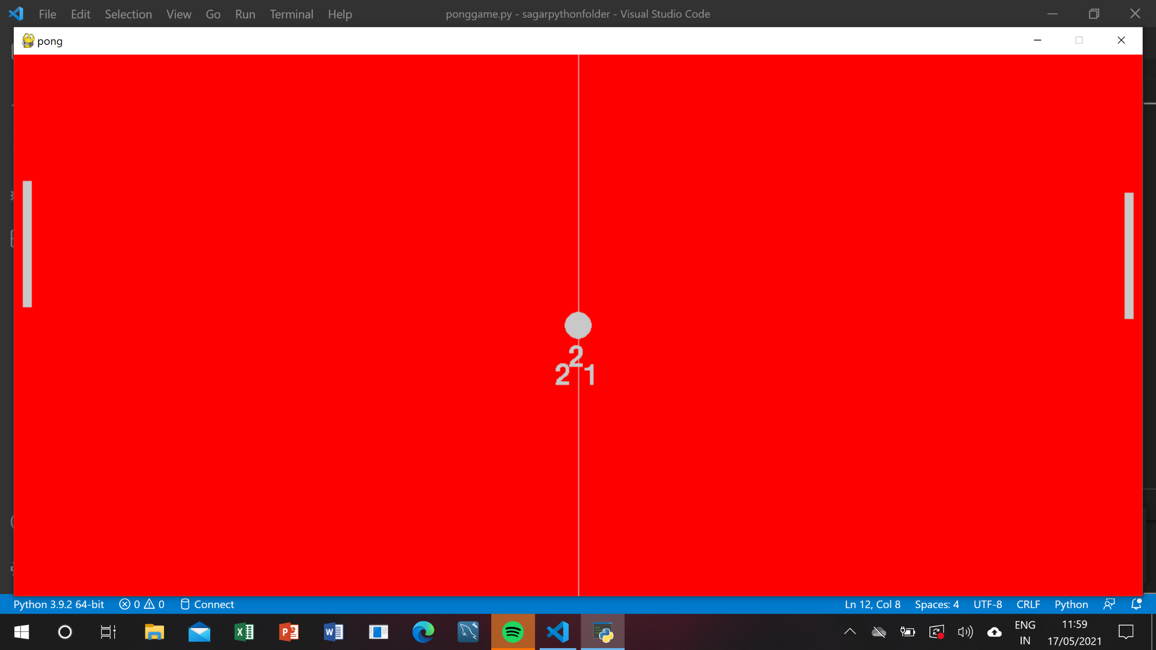
Output

Slide 14
Conclusion and Future Scope
We can conclude that we have achieved the main objective of the project and have successfully
implemented the project of ‘pong game using python’.
The Future Scope of this project is listed below:
1. That project will help the any user to paly and enjoy the game.

Slide 15
Reference
www.Google.com
www.Youtube.com

