Slide 1

DEPARTMENT OF COMPUTER ENGINEERING
Academic Year 2020-21
By
Amisha A. Modak
Anushka P. Shitap
Priyanka S. Inamdar
Rutvi S. Kadam
Under the Guidance of
Mr. Mahesh Khandke sir
HOD
Dr. R. R. Bane sir

Slide 2
Soil Moisture Sensor with IOT based
Irrigation System
___________________________

Slide 3
Introduction
The Smart irrigation System has wide scope to automate the complete irrigation system.
we are building a IoT based Irrigation System using ESP8266 NodeMCU Module and DHT11 Sensor.
It will not only automatically irrigate the water based on the moisture level in the soil but also send the Data to ThingSpeak Server to keep track of the land condition.

Slide 4
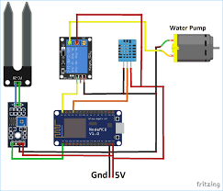
Architecture

Slide 5
Procedure
First deep the soil sensor in pot.
When the soil becomes dry, sensor will send signal to ESP8266 NodeMCU
ESP8266 NodeMCU gives command to relay module.
Further Relay module gives command to motor and motor releases water into soil.
When soil become wet motor automatically cut the water supply.
With the help of Blynk App we can control the switch.

Slide 6
Results
https://drive.google.com/file/d/10GT5LcBjbZvEpeRDBXJxnseW2PUTj7j/view?usp=sharing
This is our project demo video link.

Slide 7
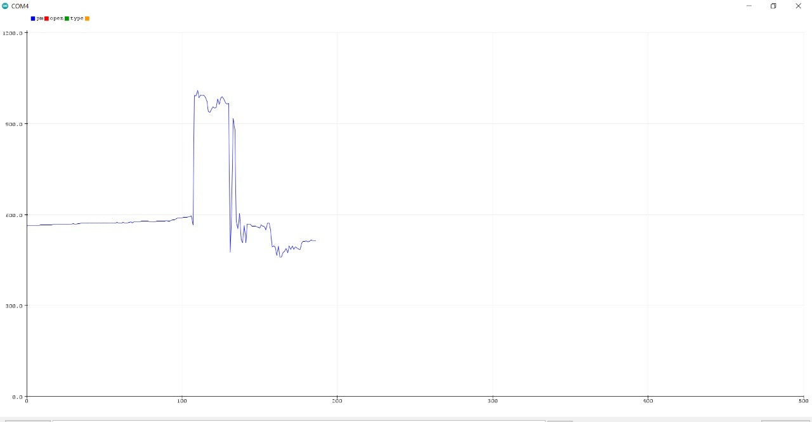
This graph shows the soil status. When it is increases, it means that the dryness of soil is increase.
When it goes down it means water level is maintained.

Slide 8
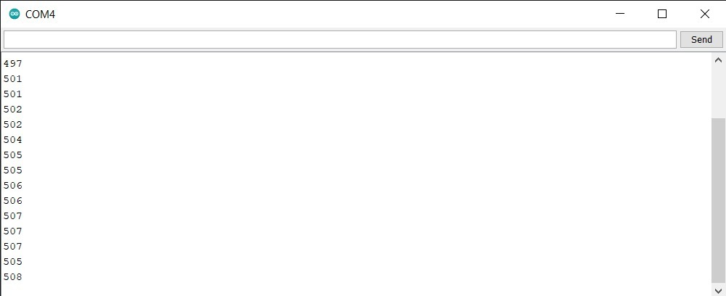

Slide 9
Conclusion
This proposed work includes an embedded system for automatic control of irrigation.
This project has wireless sensor network for real-time sensing of an irrigation system. This system provides uniform and required level of water for the agricultural farm and it avoids water wastage.

Slide 10
Thank you

