Slide 1


MINI PROJECT- b
SECOND YEAR COMPUTER

Slide 2

TOPIC
Web based Tech Quiz App

Slide 3
MEMBERS
Supervisor
Mr. R.B. Pawar
Head of Department
Prof. Raman Bane
Saurabh Rajendra Jadhav 24
Somya Kumari 66
Samiksha Danawle 09
Sahil Sanjay More 40

Slide 4





The Problem
Lack of space
Filing
Filtering
Time-consuming
Processing
Space to keep the sheets of paper being generated as a result of the ongoing discussion
Filing the documents categorically is a time consuming and tedious exercise.
Hard to filter relevant documents from the irrelevant ones .
Process done manually at the centers and records are maintained on the papers
Result processing is slow due to paper work and requirement of staff.

Slide 5




Solution
Automation
Authorize
Security
Automation of the entire system improves the efficiency.
It gives appropriate access to the authorized users depending on their permissions.
System security, data security and reliability are the striking features.
On-line examinations contents providers to focus on creating effective assessment questions and focusing on exam’s feedback delivery to students.

Slide 6




Objectives
Flexible
Information
Access at any particular time to give exams and view results
Inserting, Deleting, Updating of information becomes easier.
GUI
Communication
To use Python and a web frame work 'Django' with a database, to create a web-based Tech Quiz App.
Provides a friendly graphical user interface.
Effectively overcomes the delay in communications.

Slide 7

Project Design
For designing and implementing TechQuiz applications we used HTML, CSS, Django, SQLite and Python.
Index
Login Pages
Dashboard Pages
Add Exam
Take Exam
Marks

Slide 8
Index

Slide 9
Index

Slide 10
Login Pages

Slide 11
Login Pages

Slide 12
Dashboard Pages

Slide 13
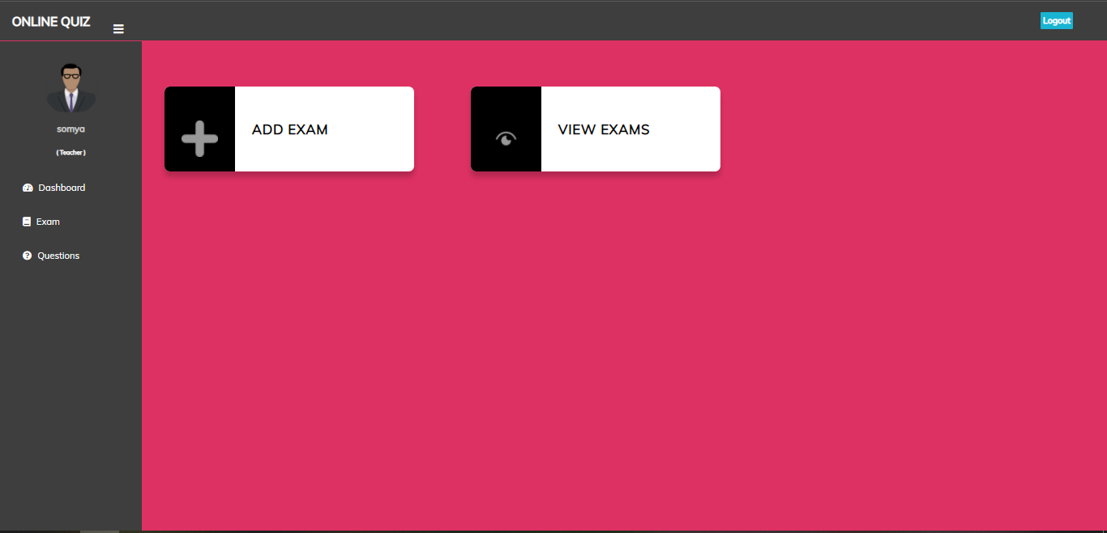
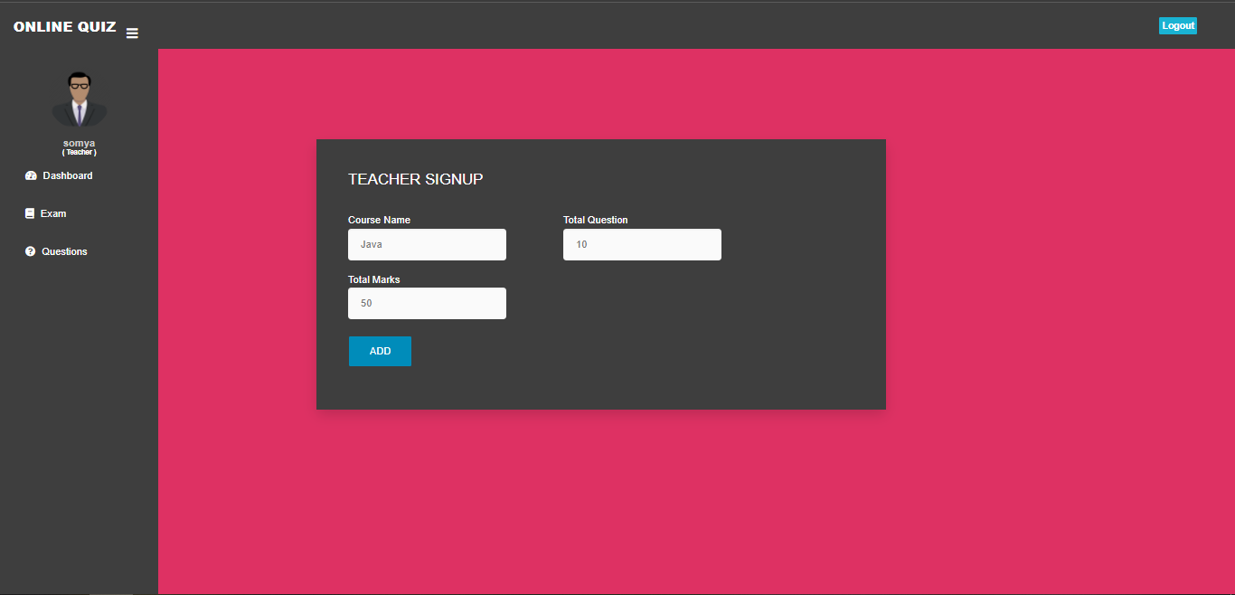
Add Exam

Slide 14
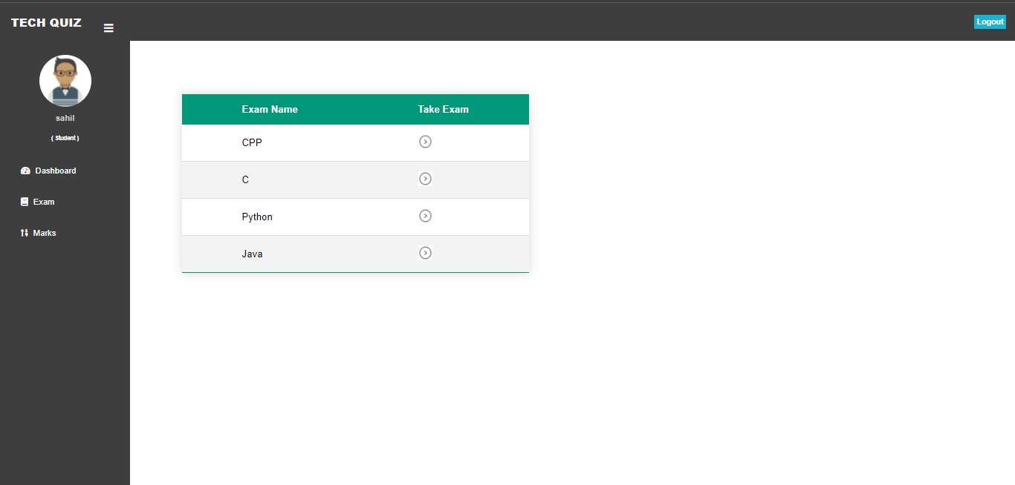
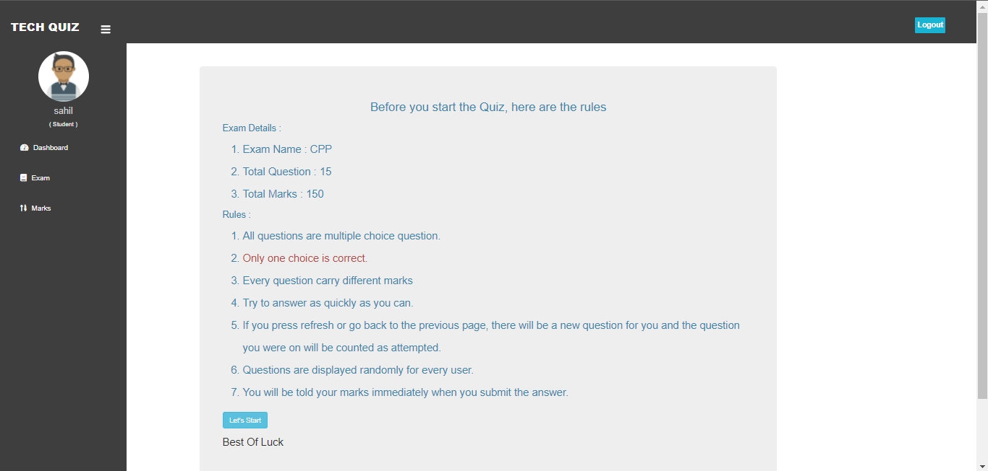
Take Exam

Slide 15
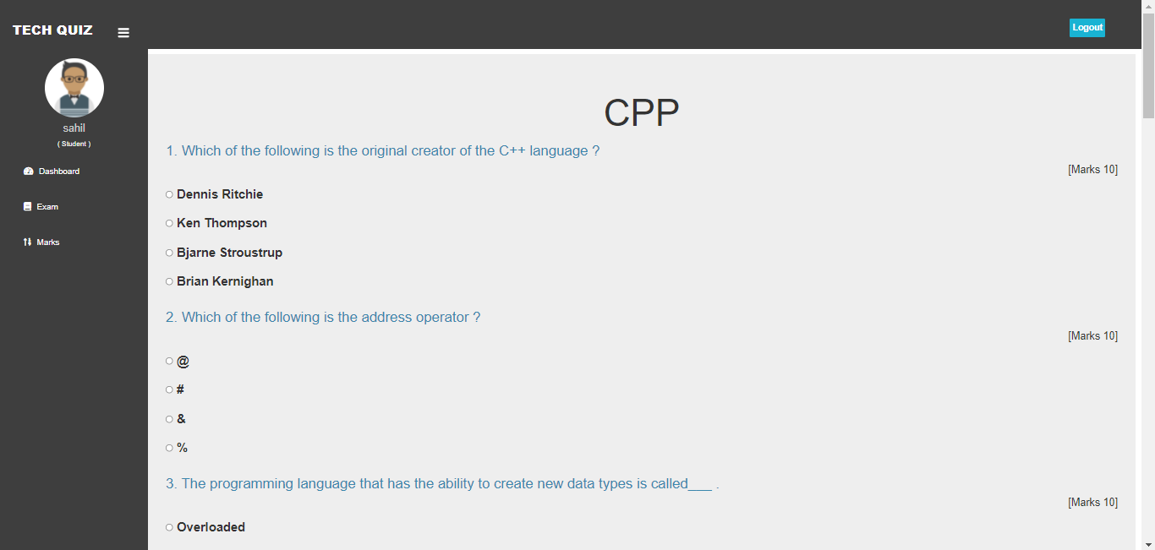
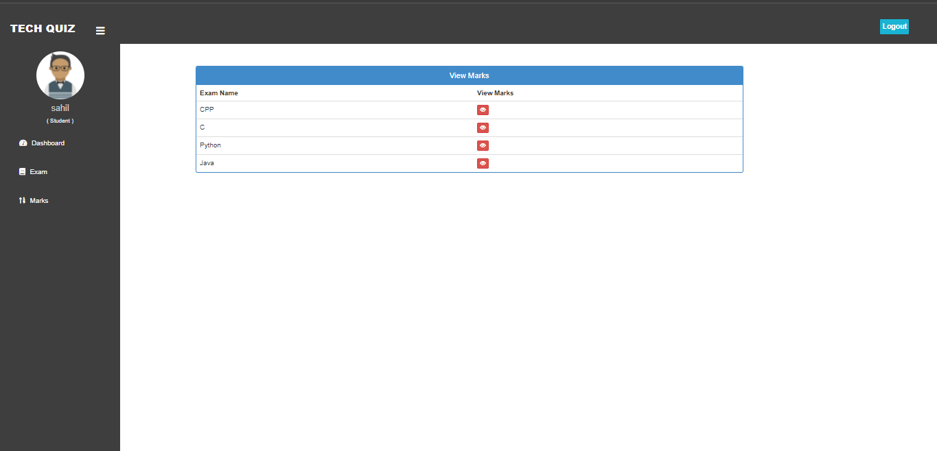
Take Exam

Slide 16
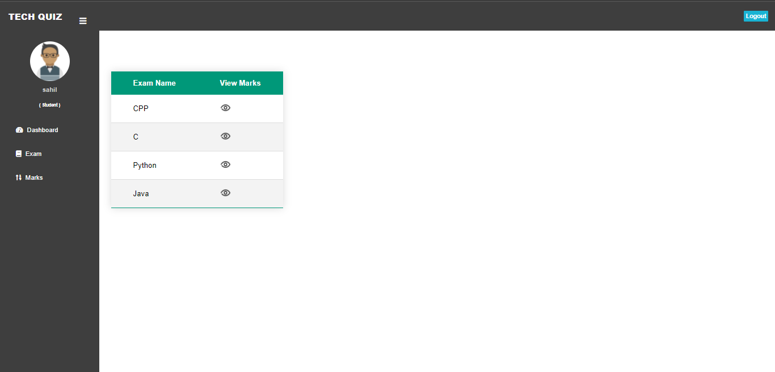
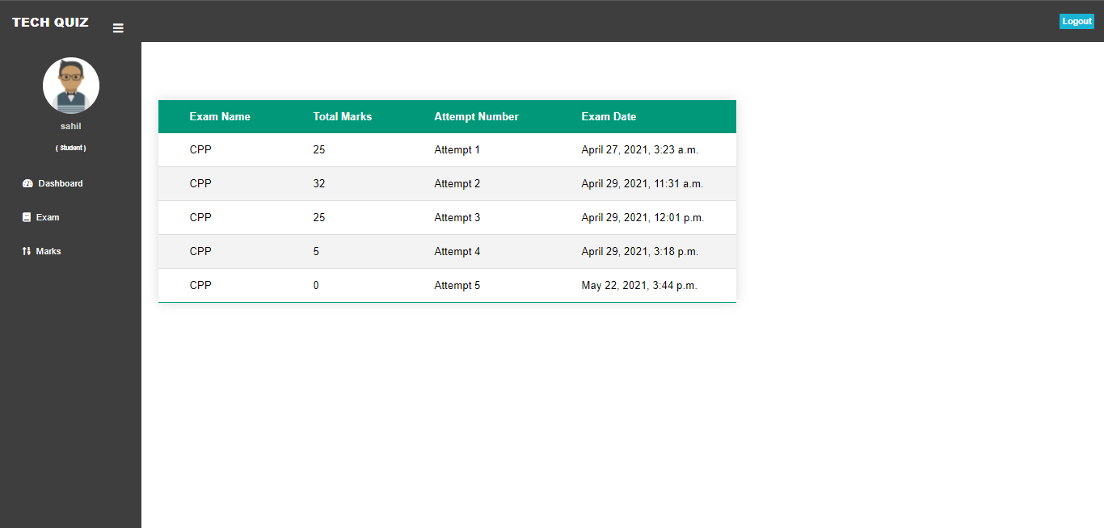
Marks

Slide 17
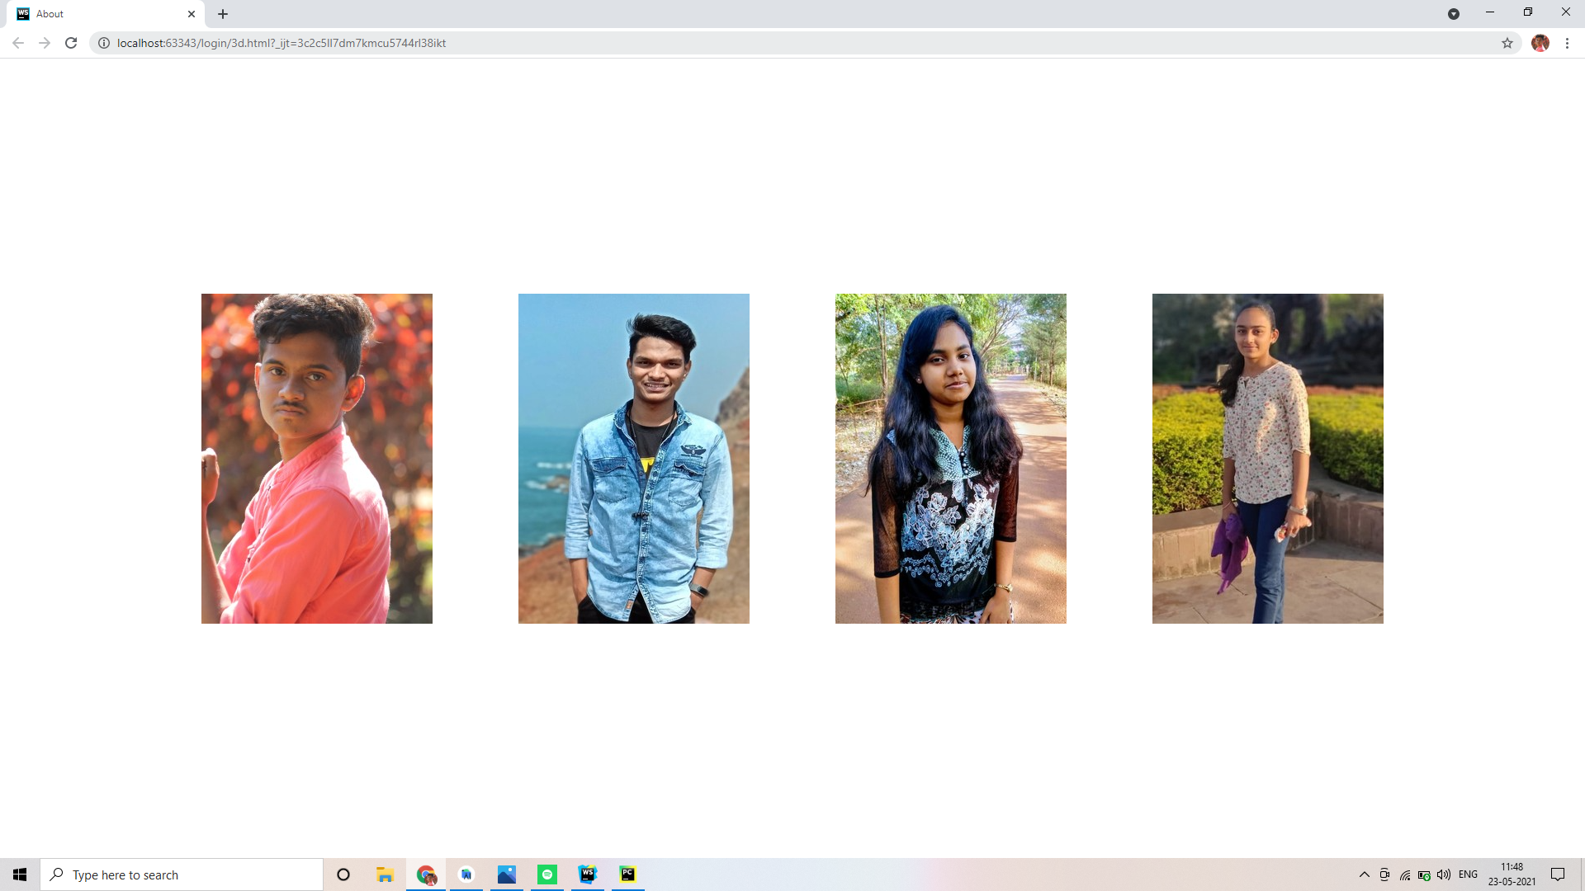
Team

Slide 18
Summary
Engages students in a unique and fun way and connect them to learning material.
Taking online quizzes makes it possible to have a large number of participants. It doesn’t matter at what kind of location they take the online quiz as long as they are connected to the Internet.
The participants are able to view on what kind of section they have to improve themselves.
Quizzes can be given without an instructor, which saves money and time.
Also, teachers can use it to create their own set of questions.
The Application was designed in such a way that future modifications can be done easily.

Slide 19

Thank You

