Slide 1

Waste Management System
Submitted in partial fulfillment of the requirements of the degree
BACHELOR OF ENGINEERING IN COMPUTER ENGINEERING
By
1. Swarupa Damodar Kulkarni 25
Project guide
Prof. Mahesh.A.Khandke
DEPARTMENT OF COMPUTER ENGINEERING
Gharda Institute of Technology
A/P: Lavel, Tal: Khed, Dist: Ratnagiri, 415708
Mumbai University
[2020-21]

Slide 3
Abstract
Smart cities integrate multiple mobile or web solutions to build a comfortable human habitation. One of these solutions is to provide an environmentally friendly, efficient and effective waste management system. The current garbage collection system includes routine garbage trucks doing rounds daily or weekly, which not only doesn’t cover every zone of the city but is a completely inefficient use of government resources. This paper proposes a cost-effective mobile or web based system for the government to utilize available resources to efficiently manage the overwhelming amounts of garbage collected each day, while also providing a better solution for the inconvenience of garbage disposal for the citizens. This waste management System topic to decrease the waste issues, by creating this app. In this app we or user have to click the photo of garbage area and upload into the app with location of image. This app is very useful to clean our village or city and in this way we can be little part for cleansing.

Slide 4
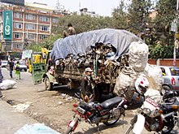
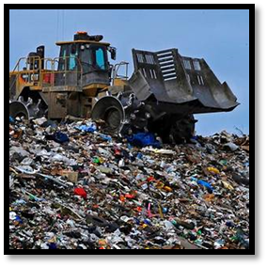
1. Introduction
Garbage is any substance that is discarded when primary use, or it’s chaffed, defective and of no use. Examples embrace municipal solid waste (household trash/refuse), venturesome waste, sewer water (such as waste matter, that contains bodily wastes (fasces and urine) and surface runoff), radioactive material, and others land dumping site additionally called a tip, dump, waste-yard, traditionally as a midden may be a site for the disposal of waste materials by burial and therefore the oldest variety of waste treatment through the funeral half is modern; traditionally, refuse was only left in piles or thrown into pits. Traditionally, landfills are the first standard technique of organized waste disposal and stay thus in several places around the world. Our system is made for such org which want to take the garbage from the people home and take it to the dumping yard where it can be stabilized and made harmless. For this one user will request to pick the garbage from home at a particular time and then system staff will come to them with their vehicles and load the garbage into it and take some cost and bump it to the dumping area. Hence this system helps in making the environment clean.
Fig 1.1 Fig 1.2

Slide 5
Motivation
In nature many of things are god gifted ,but there are some criteria which become harmful to nature which is very disappointing. Mainly the waste factor is consider in every place and which is becoming so important factor now days .So our aim is to that to make waste management app that help to all . If in future this app is apply then our country become waste free.

Slide 6
Problem Overview
The main problem of the existing solid waste collection process and management system as follows
Lack of the information about the collecting time and area.
Lack of the proper system for monitoring and tracking.
There is no quick response to urgent cases like too much odour from garbage.
There is no quick way to response to peoples complaints about uncollected waste.

Slide 7
Problem Statement And Objective
Problem Statement:
To developed “Waste Management System” using python.
Objectives:
The waste management has to be done instantly else it leads to irregular management which will have adverse effect on nature. The Smart waste management is compatible mainly with concept of smart cities. The main objectives of our proposed system are as follows:
1. Monitoring Smart waste management is a idea where we can control lots of problems which disturbs the society in pollution and diseases the waste management.
2. Providing a smart technology for waste system.
3. Avoiding human intervention.
4. Reducing human time and effort 5. Resulting in healthy and waste ridden environment. This project falls under the category of embedded systems and android app

Slide 8
Literature Review Survey areas
For this project we make little village survey to understand how the condition of garbage in village is so here are some sample survey that we had taken.
Location:-Kolgaon Tal= Sawantwadi
Village information
Kolgaon is a large village located in Sawantwadi Taluka of Sindhudurg district, Maharashtra with total 624 families residing. The Kolgaon village has population of 2618 of which 1296 are males while 1322 are females as per Population Census 2011

Slide 9
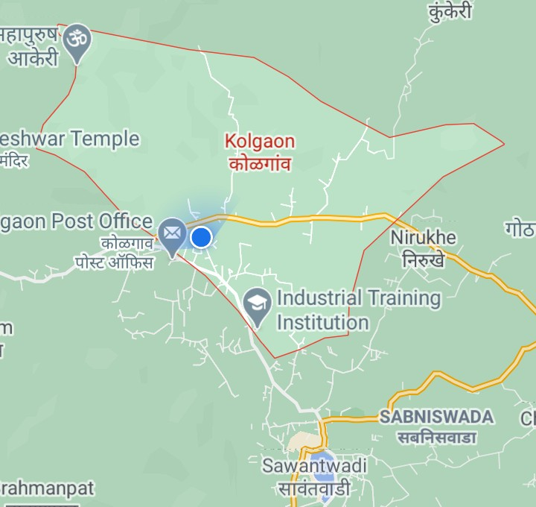
Map of village Fig 2.1 Satellite Map of Kolgaon Village

Slide 10
Some basic questions regarding village
What measures are implemented in the village for waste management?
Garbage is cleaned in public places once in three months
Does garbage truck come every day?
No, peoples create their own dustbin and they throw all in it
Is there garbage boxes in village?
No, but we are planning for that.
In village do people thrown garbage in the right place?
No, in village some people can create any place as a dustbin
Where is collected waste thrown?
On dumping ground but ground was not authorised.
Are there any actions taken against those people who throw out garbage?
not decided yet, We are action for that
How many workers are there for waste management?
No workers.

Slide 11
survey areas
Location 2:-Bharane Tal=Khed
Village information
The total number of households in Bharane village are 744. It rely on the total population of 3336 people. As far as male population concern the number of population is 1669 of the village Bharane and the total female population number is 1667. The reference taken to publish these data is of year 2009. The source of data is Census of India.

Slide 12
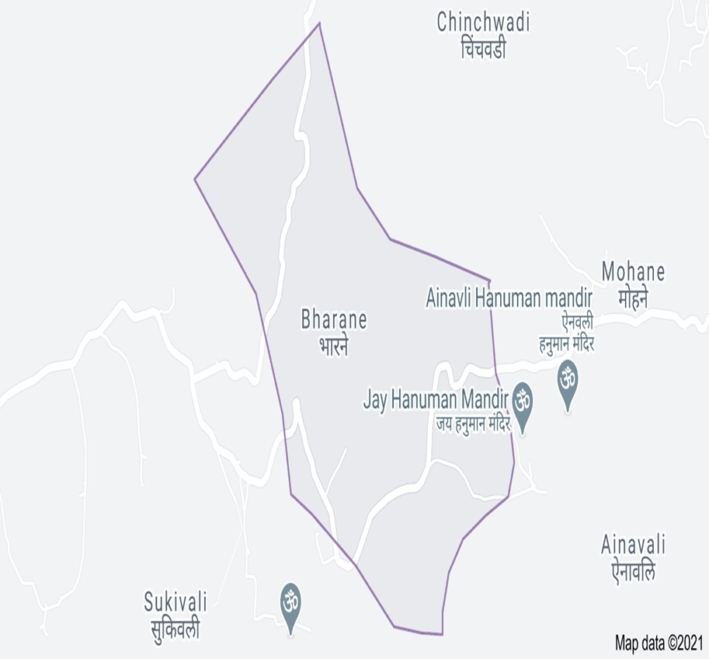
Map of village Fig 2.2 Satellite Map of Bharane

Slide 13
Some basic questions regarding village
What measures are implemented in the village for waste management?
We decided some plans like organic manure and wormy compost.
Does garbage truck come every day?
Yes
Is there garbage boxes in village?
Yes
Generally how much waste collected every day?
Nearlly,500kg waste collected every day.
In village do people thrown garbage in the right place?
No, in village some people can create any place as a dustbin
Where is collected waste thrown?
On dumping ground but ground was not authorised.
Are there any actions taken against those people who throw out garbage?
Yes , there is 500rs fine for that people.
How many workers are there for waste management?
There are 8 workers for collecting waste.

Slide 14
survey areas
Location 3:- Lavel Tal=Khed
Village information
The Lavel village has total 480 families residing. The total population of Lavel village is 2073. In that total population of male is 1023 and total population of female is 1060. This information is given as per population census 2011.

Slide 15
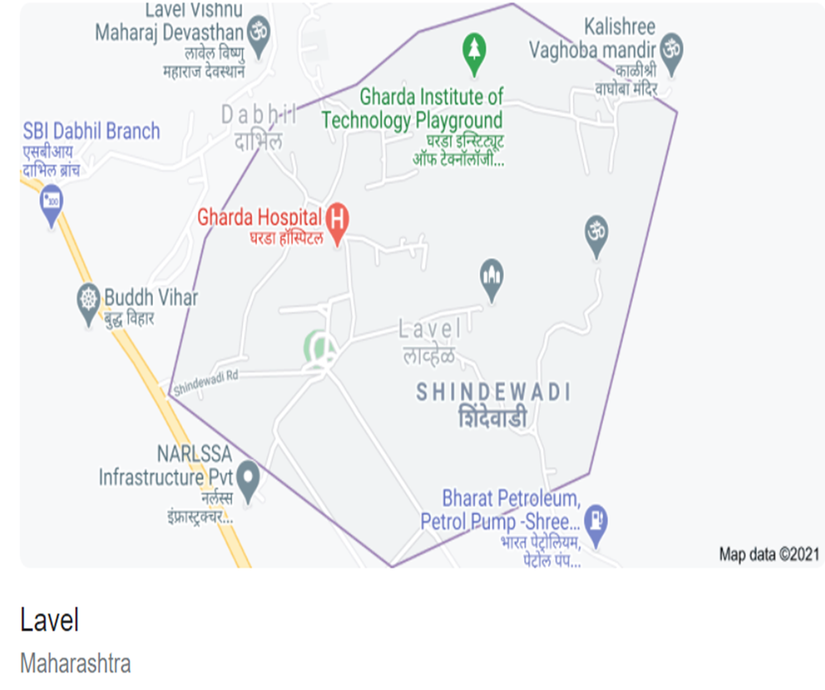
Map of village Fig 2.3 Satellite Map of Lavel

Slide 16
Some basic questions regarding village
What measures are implemented in the village for waste management?
not yet ,but gram panchayat will taken decision on it.
Does garbage truck come every day?
No peoples create their own dustbin and they throw all in it.
Is there garbage boxes in village?
No ,but we are planning for that.
In village do people thrown garbage in the right place?
No, in village some people can create any place as a dustbin
Where is collected waste thrown?
On dumping ground but ground was not authorised.
Are there any actions taken against those people who throw out garbage?
Yes , there is 200rs fine for that people.
How many workers are there for waste management?
There are 4 workers for collecting waste.

Slide 17
survey areas
Location 4:- Chinchghari , Tal= Chiplun.
Village information
The total number of households in Chinchghari village are 650. It depends upon the total population of village which is among 2,750 peoples. As far as male population concern the number of population is 1,382 of the village Chinchghari and the total female population number is 1,368. The reference taken to publish these data is of year 2011. As per 2019 stats, Chinchghari villages comes under Chiplun assembly& Ratnagiri- Sindhudurg parliamentary constituency. The source of data is census of India.

Slide 18
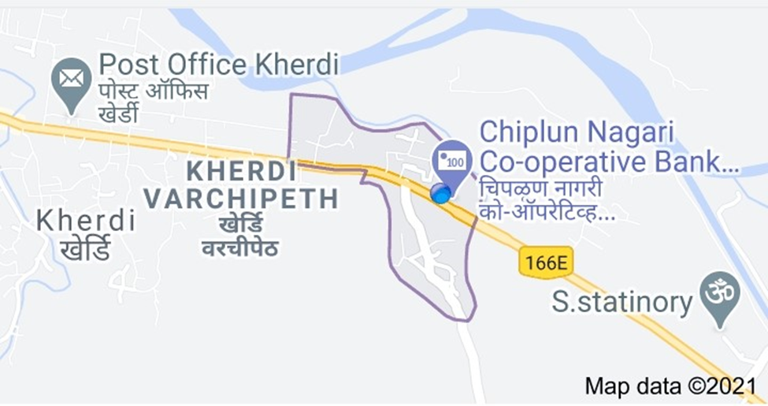
Map of village Fig 2.4 Satellite Map of Sati

Slide 19
Some basic questions regarding village
Does garbage truck come every day?
No.
Is there other any facilities to dispose the garbage?
No.
The when you throw the garbage?
On the river.
Do you have the permission to throw garbage in the river??
No.
Anyone of you have gone to the grampanchyat of chinchghari?
Yes, many time, but there is no response from their side
But you don`t know to throw the garbage in the river is very harmful to fish and also water?
Yes, we know it, then where should we throw the garbage.
Is the river suffocated every day?
Yes
Is the river get overflow every year?
No ,because in every monsoon the river is full due to waste.

Slide 20
Point of interest
By seeing all this survey it is seen that many of places were surrounded by garbage, so it can harm to the nature as well as water animals. So for considering all this points we decided to create online waste management. Once everyone know about this app, so they can use this change happen slowly. But good thing is that using this app our country will become clean.

Slide 21
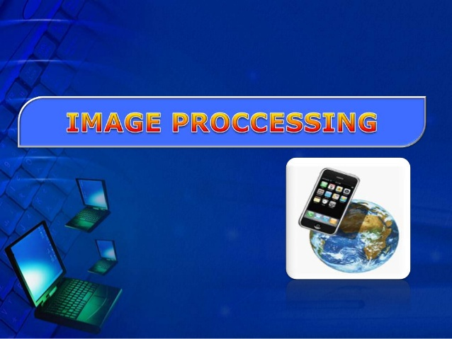
Proposed System
Introduction
Image processing is the process of transforming an image into digital form and performing certain operations to get some useful information form it. The image processing system usually treats all images as 2D signals when applying certain predetermined signal processing methods.

Slide 22
Algorithm
First click the photo of garbage through gps map camera, so we can get longitude, latitude with date and times.
This photo will be uploaded through code, through image processing.
User will upload the photo and send it through app.
Through this photo, administrator can take action.

Slide 23
4 Result And Analysis
4.1 Program Code:
1.1 User Code:-
from tkinter import *
from PIL import ImageTk, Image
from tkinter import filedialog
import os
root = Tk()
root.geometry("550x300+300+150")
root.resizable(width=True, height=True)
def openfn():
filename = filedialog.askopenfilename(title='open')
return filename
def open_img():
x = openfn()
img = Image.open(x)
img = img.resize((300,300))
img = ImageTk.PhotoImage(img)

Slide 24
Administrator Code:
from PIL import Image
im=Image.open("garbage 3.jpg")
im.save('garbage 3.jpg')
im.show('garbage 3.jpg')

Slide 25
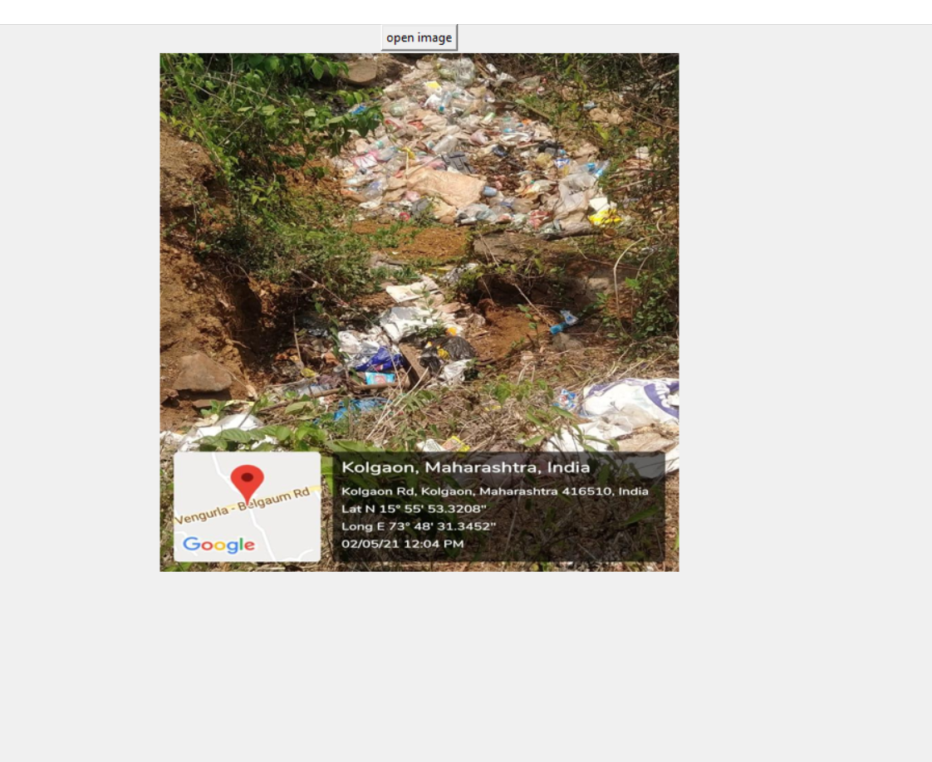
Output
1.1 User Code
Link
https://drive.google.com/file/d/1S6435qYH12js8vO8bw6CGvfVnw9e2VUI/view

Slide 26
5 Conclusion And Future Scope
Conclusion:
From this above survey it is seen that in many of the village there is no facility to decompose the garbage. Also in many village the garbage truck doesn`t come everyday, so many of the people throw the garbage in river or any open side, which is strictly wrong . So our aim is that to make online app for waste management and in this app people should take the photo of that garbage and upload into that app, so workers get understand there is garbage and then they pick up it.
Future Scope:
By using this app no one can face the garbage problem regarding collection. Many times waste dustbin is overflow and many animals like rat or dog enters inside or near to dustbin. This creates bad scene. Due timely inform to authority we can overcome this problem.

Slide 27
6 Reference
Book: - Anurag Gupta, G.P.Biswas, “Python Programming”, McGraw-Hill
https://en.wikipedia.org/wiki/Waste_management
http://spoken-tutorial.org
www.simplilearn.com/image-processing-article
https://youtu.be/dkp4wUhCwR4

