Slide 1
Youtube video downloader
Group Members :
1. Jayesh Jadhav
2. Harshal Umasare
3. Amey dhotre
4. Akshay tikudave

Slide 2
INTRODUCTION
The Youtube downloader project is a python project. The objective of this project is to download any type of video in a fast and easy way from youtube in your device.
In this python project, user has to copy the youtube video URL that they want to download and simply paste that URL in the ‘Enter the URL of the video’ section and click on the download button, it will start downloading the video. When video downloading finishes, it shows a message ‘Download Completed’ popup on the window below the download button.
The downloaded video will be stored in file were your python code for this project is there .

Slide 3
Project Prerequisites
To implement this project we use basic concept of python, tkinter, pytube .
Tkinter is a standard GUI library and it is one of the easiest ways to build a GUI application .
Pytube used for downloading videos from youtube .
For installing this both tkinter and pytube we used pip installer command on command line which are :
1. pip install tkinter
2. pip install pytube

Slide 4
Literature survey
In this project we will use the popular Tkinter library that used for rendering graphics. We will use pytube library to download videos from YouTube .
References :
https://www.geeksforgeeks.org/pytube-python-library-download-youtube-videos/
https://wiki.python.org/moin/TkInter
Some e-books .

Slide 5
Methodology
We took several steps for developing this project they are :
Import libraries
Create display window
Create field to enter link
Create function to start downloading .
We will import the Tkinter and pytube module .
For creating display we will use Tk() .
For storing and getting input from user we will use link which is string type variable that stores YouTube video link and Entry() widget to create an input text field .
For downloading we will use three function get(),
Str(), stream.first()

Slide 6
Technical tools used
In this project we will use the following attributes and function :
Tk() used to initialize tkinter to create display window
geometry() used to set the window’s width and height
resizable(0,0) set the fix size of window
title() used to give the title of window
Label() widget use to display text that users can’t able to modify.
root is the name of the window
text which we display the title of the label
font in which our text is written
pack organized widget in block

Slide 7
Technical tools used
link is a string type variable that stores the youtube video link that the user enters.
Entry() widget is used when we want to create an input text field.
width sets the width of entry widget
textvariable used to retrieve the value of current text variable to the entry widget
place() use to place the widget at a specific position
text which we display on the label
font in which the text is written
bg sets the background color
command is used to call the function

Slide 8
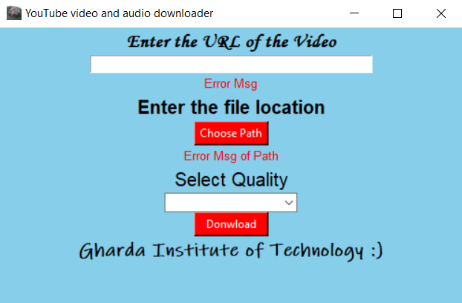
Output

Slide 9
Thank you !!!!!!!!!!!!

