Slide 1
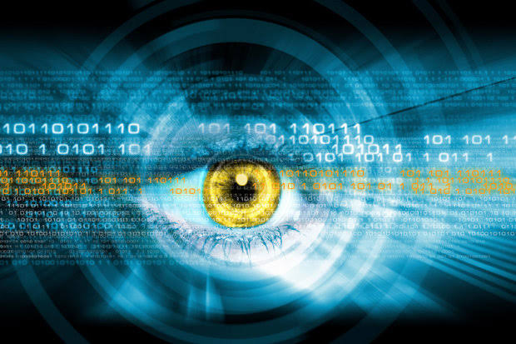
Seminar On
Smart Online Voting
System Using Iris Recognition
Guided By :
Prof. – M. D. Laddha
By – Tushar Sharad Karale
PRN - 10303320181124510019

Slide 2
Content
1. Introduction To Seminar Topic
2. Existing Voting System
2.1 Steps Taken During Current Voting Process
2.2 Problems With Existing Voter Registration System
3. Proposed Voting System
3.1 Goals Of Proposed System
4. Methodology
4.1 Daughman’s Algorithm For Iris Scanning
4.2 Advantages Of Iris Based Voting System
5. Conclusion

Slide 3
1.Introduction To Seminar Topic:
- The election system is the pillar of the every democracy.
- The voting system has observed many effective changes.
- It is also a very delicate process that is the subject of various distrubances,such as inactive citizens,attempts of fraud,etc.
- We will discuss some of these problems starting from the current voting system with the recently proposed voting system.
- Propose a smart solution in terms of iris recognition based voting system.
- The aim of the study.

Slide 4
- In today’s world it should be necessary to upgrade the traditional voting system.
- Iris recognition is used because it is highly unique, stable, cannot be duplicated and easily captured.
- The concept of Iris Recognition was first proposed by Dr. Frank Burch in 1939.
- Dr. John Daughman created the algorithms for it.
- Iris recognition is a method of biometric authentication that uses pattern recognition techniques based on high-resolution images of the irises of an individual’s eyes.

Slide 5
2.Existing Voting System:
2.1 Steps Taken During Current Voting Process:
- The person has to reach the voting booth.
- Voter id is verified.
- Person has to search his name in the list.
- The person has to sign the register.
- An inedible ink will mark on the left forefinger of the person.
- The person will give vote to candidate that he/she is willing to.
- A beep sound comes indicating that the vote is successfully recorded.

Slide 6
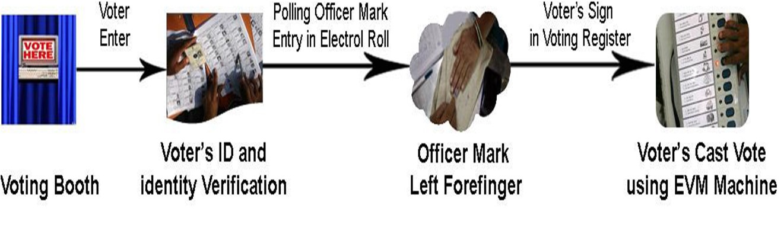
Fig. - (Current Voting System)

Slide 7
2.2 Problems With Existing Voter Registration System:
(i) Expensive and Time Consuming :-
(ii) Too Much Paper Work :-
(iii) Errors During Data Entry :-
(iv) Loss Of Registration Forms :-

Slide 8
3.Proposed Voting System:
- Voter’s information can be gathered from the AADHAR card database.
- This information will be stored in the PC.
- For voting the person has to reach the voting booth.
- Voter’s eye is scanned through the iris scanner. Iris scanner Capture the iris image and compare or match to database.
- Arduino will scan particular person’s iris and send the data to aadhar database.
- Iris scanner will check the person detail after and it will consider if the person is valid or invalid.
- A voting process completed message will be displayed on the screen.

Slide 9
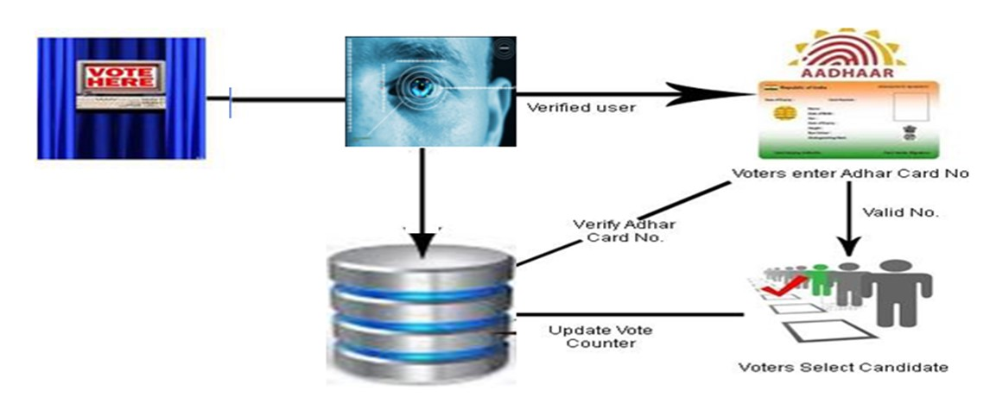
Fig. – (Proposed Voting System)

Slide 10
3.1 Goals Of Proposed System:
(i) Eliminates The Dummy Voter :-
(ii) Voter Cannot Register More Than One Place :-
(iii) Man Power Required Less :-
(iv) No Need To Mark The Inedible Ink :-

Slide 11
4.Methodology:
4.1 Daughman’s Algorithm For Iris Scanning:
- The iris image of each person is the input to PC.
- In PC the iris image is compared with existing image from voters database.
- If the image is matched, the person is valid and if it not matched, it gives an alarm and display an error msg.
- Iris and pupil boundary are detected from rest of the eye image
- Features of the iris were encoded to produce a bit-wise biometric template.
- The Hamming distance was chosen as a matching metric
- Iris recognition system consist of five stages.

Slide 12
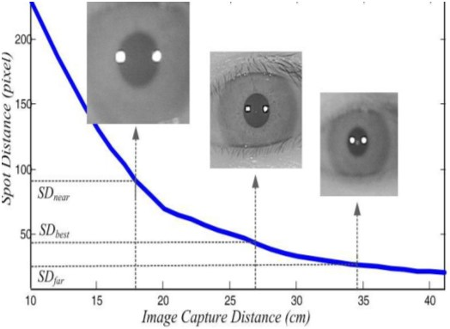
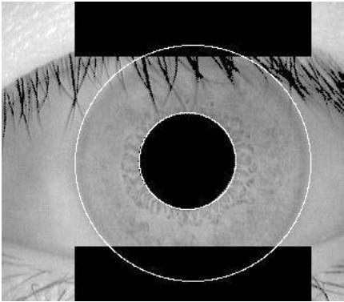
Image Acquition :-
It deals with capturing of a high quality image of
the iris and Obtain images with sufficient
resolution and sharpness. The voter should sit
3 meter away from the lens in front of the iris
system for scanning its eye.
Iris Localization :-
Iris localization is a process to isolate the iris region
from the rest of the acquired image. Iris can be
approximated by two circles, one for iris/sclera
boundary and another for iris/pupil boundary.

Slide 13
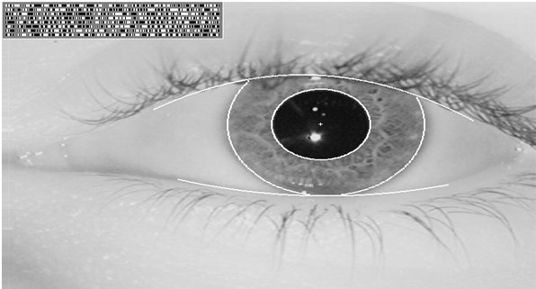
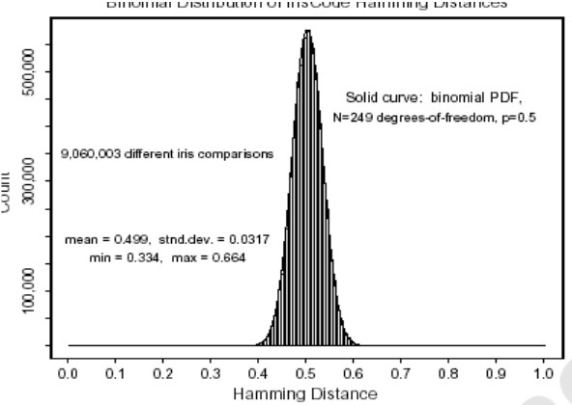
(iii) Feature Extraction :-
Feature encoding was implemented by convolving
the normalized iris pattern with 1D Log- Gabber
wavelet. 2D normalized patterns are broken up
into a number of 1D signal. Features are extracted
in codes of 0 and 1.
(iv) Template Matching :-
For matching, the Hamming distance was chosen
as a metric for recognition. The result of this
computation is then used as the goodness of match,
with smaller values indicating better matches. If two
patterns are derived from same iris, the hamming
distance between them will be close to 0 due to
high correlation.

Slide 14
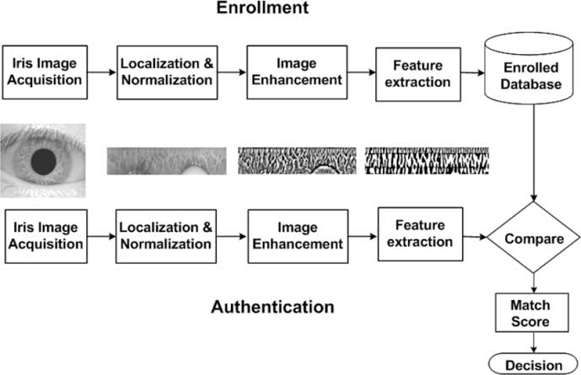
(v) Authenticate/Imposter :- It is to decide whether the person is authorized person for vote or not.

Slide 15
4.2 Advantages Of Iris Based Voting System:
(i) Uniqueness :-
(ii) Stability :-
(iii) Scalability :-
(iv) Security :-

Slide 16
5.Conclusion:
Many biometric methods are available but iris recognition has high accuracy rate. The iris pattern of person is obviously unique.Even genetically identical individuals the same have completely independent iris textures.
By application of this project into real time we can avoid malfunctions, Time maintenance system, Automatic counting of votes. In this system the security of the voter is discussed and in general the focus is on making the voting system more robust and reliable by eliminating dummy voters. Also we have discussed Daughman’s Algorithm based segmentation technique, which corresponds to a success rate of around 83% will increase the percentage of voting. Manual counting is not required. So by this we will get the very prominent, clear and fast result. By using this newly developed system we can overcome many problems of existing system. This system is more efficient than the existing one. So as compared to fingerprint, face detection iris is considered to be the most secure.

