Slide 1
SECURE COLLEGE DATA ACCESS SCHEME USING IMAGE BASED PASSWORD PROTECTION
Presented By: Batul Fakir
1

Slide 2
INTRODUCTION
The design of the college information management system includes the design of the home page which provides the way for all the user to access the system.
Every user of the system has a unique image based password for accessing the secure files from server.
The home page mainly contains a login form through which a new user can register, or an existing user can login to the system by entering the username and password.

Slide 3
Problem Definition
Exploitation of password is one of largest issues in cyber security as it is an easy way to gain the unauthorized access from the attacker. Today’s process is the single widespread form of attack that penetrates the network, system, or resource with or without the use of tools to unlock the resource that has been secured with a password is known as password cracking. There are many reasons that make passwords cracking possible, These reason include human factors such as short or easily-guessing passwords, usage of weak algorithms. So our proposed system is based on the data protection using the encryption and steganography technique. In this system we generated the secure image based password to access the all files from the server.

Slide 4
LITERATURE REVIEW
Sr. No | Title | Author | Year | Advantages | Limitation
1 | A Study of Prevention of Phishing Threats using Visual Cryptography | Sneha M. Shelke, Prof. Prachi A. Joshi | 2016 | The different perspectives on visual cryptography such as types of access structures, types of shares of secret images are discussed in this paper | Here fishing method based on visual cryptography has been studied.
2 | Online Payment System using Steganography and Visual Cryptography | Souvik Roy and P. Venkateswaran | 2014 | In this paper Proposed method minimizes customer information sent to the online merchant. | Here author only study the how to avoid the phishing attack on banking transaction.

Slide 5
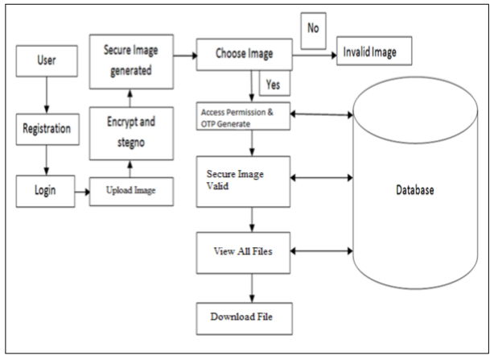
Methodology

Slide 6
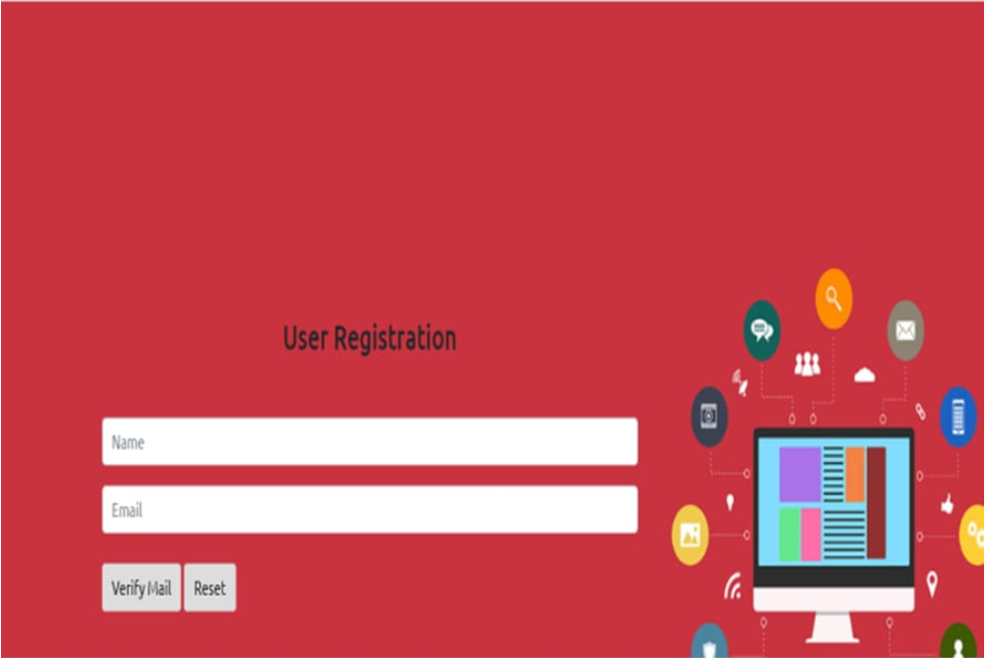
Result Till Date
User Registration Page :-
We have creating users registration page.

Slide 7
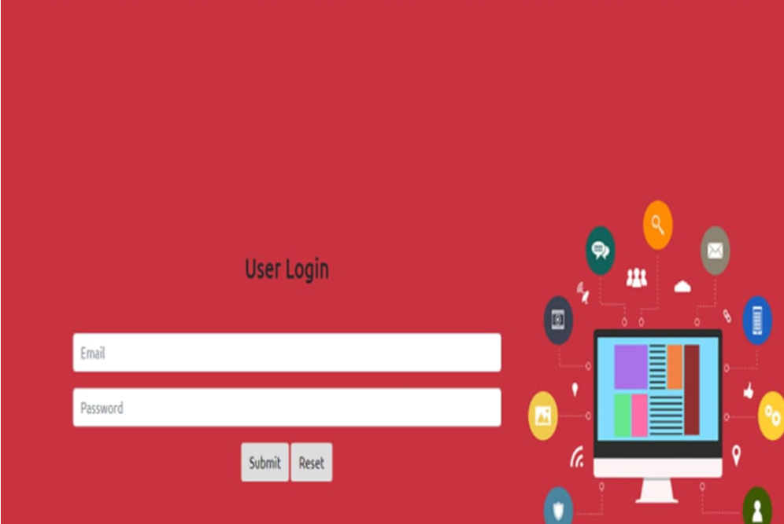
User login page :-
We have creating users login page.

Slide 8
Expected implementation before joining next semester
We have aim to create database for user registeration.
OTP verification of user email and phone number.

Slide 9
Reference
Abdulghader.A.Ahmed, Hadya.S.Hawedi Online Shopping and the Transaction Protection in E-Commerce: A case Of Online Purchasing,2012.
C. Vanmathi, S. PrabuA Survey of State of the Art techniques of Steganography,2013.
Joel Lee, Lujo Bauer, Studying the Effectiveness of Security Images in Internet Banking,2014.

Slide 10
THANKS

