Slide 1
A presentation on
Augmented reality based clothing

Slide 2
Introduction
This is advanced generation where everything is going digital nowadays.
Online clothing has taken tremendous growth in last few years but people still prefer to go the garment shops.
The main reason behind this is the reliability and satisfaction of shopping where customer can try out those clothes by himself/herself before buying it.
Here we are introducing an application where there is no need of trying the clothes physically.
Just use this application where a 3D prototype of that cloth is used to check whether it suits to the customer or not.
This will save shopkeeper’s as well as customer’s time

Slide 3
Problem Statement
In traditional approach customer goes to the garment shop and selects the clothes which he/she wants to buy. Then he/she goes to the trial room to try out those clothes and then selects those clothes which he/she is going to buy. This is the time consuming process and furthermore customer have no idea how much times that cloth is tried before by so many customers. This is the biggest disadvantage of traditional system. We are trying to overcome this problem by introducing an application where we are going to use Augmented reality for the outfit try-on.

Slide 4
Objectives
The objective of “Augmented reality based clothing” is to provide 3D models for each and every cloth so that shopkeeper can use it for trials.
It will help the garment shops to save the time as well as finding the perfect outfit for customers without trying it physically.

Slide 5
Abstract
There is a continuous and constant transformation in the field of Augmented Reality (AR), both in the Retail, and the Manufacturing sector. It has started to influence everything from fashion runway shows to online shopping. the ways becoming more dominant than the old observant ones- the simple buying experience no longer satisfies them . This technological change starts with the consumer where Augmented Reality is being used to make fashion more accessible to the people. There is a lot of potential for AR not only in fashion merchandising on online platforms but also in the showrooms . Hence the Augmented reality for the offline garment shops will surely make a difference there is no longer need to follow the traditional approaches for shopping where lot of time is wasted in selecting and trying out those outfits . this technology will be surely helpful as it will bring new experience to the customers

Slide 6
Methodology
Methodology will consist of creating 3D models, feature extraction and data processing, 3D model mapping.
3D models are created for the different outfits,
feature extraction and data processing includes retrieving body measures of the customer to find available outfits in that size. it will retrieve the models from the database
3D model mapping means mapping that model on the customer to see how that outfit looks on the body of customer

Slide 7
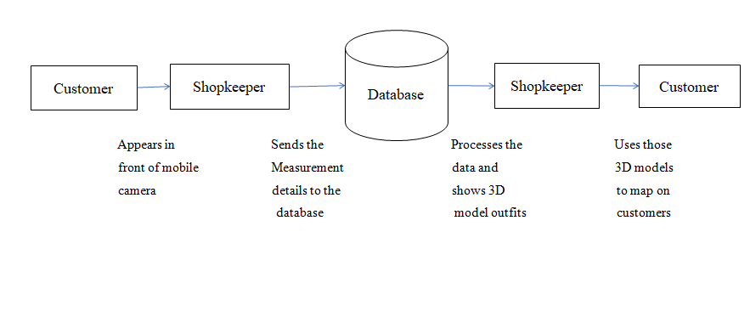
Data-flow diagram

Slide 8
Literature survey
SR NO | Title | Author | Publisher & YOP | Methodology | Conclusion
1. | A Mixed Reality Virtual Clothes Try-On System | Miaolong Yuan, Ishtiaq Rasool Khan, Farzam Farbiz, Senior Member, IEEE, Susu Yao, Arthur Niswar, and Min-Hui Foo. | IEEE December 2013 | The system physically simulates the selected virtual clothes on the user’s body in real-time and the user can see virtual clothes fitting on the her mirror image from various angles as she moves | In this paper, we described a mixed reality based virtual clothes try-on system using one consumable RGB-D camera. it can be more effective in enabling customers’ purchase decision.

Slide 9
Literature survey
SR NO | Title | Author | Publisher & YOP | Methodology | Conclusion
2. | Image Processing Design Flow for Virtual Fitting Room Applications used in Mobile Devices | Cecilia Garcia, Nicolas Bessou , Anne Chadoeuf and Erdal Oruklu | IEEE 2012 | We propose a three stage algorithm: detection and sizing of the user’s body, detection of reference points based on face detection and augmented reality markers, and superimposition of the clothing over the user’s image. | The main objective to obtain a real time, platform independent application was Achieved. this application can be used by retail companies for increasing their online presence and boosting their sales.

Slide 10
Literature survey
SR NO | Title | Author | Publisher & YOP | Methodology | Limitations
3. | Sensitivity of Image based Augmented Reality Fitting Simulation | Sanghee Hah, Jun Park, Jong-deok Kim | IEEE October 2011 | New design techniques that may satisfy users’ perception Sensitivity Image Artistic Expression Sensitivity based design techniques | The major point of AR based fitting service is not on providing realistic and well-fitting images on top of the users’ body parts. It is rather on new and innovative shopping experience that may enhance users’ shopping desire.

Slide 11
Conclusion
The most important challenge is real-time application of this project, which needs to achieve good accuracy. It is important for the system to give accurate body measures in order to suggest perfect outfit. The system should be efficient enough to switch among different 3D models. We will need to take lot of efforts in order to match the user expectations.

Slide 12
References
A Mixed Reality Virtual Clothes Try-On System Miaolong Yuan, Ishtiaq Rasool Khan, Farzam Farbiz, Senior Member, IEEE, Susu Yao, Arthur Niswar, and Min-Hui FooIEEE TRANSACTIONS ON MULTIMEDIA, VOL. 15, NO. 8, DECEMBER 2013.
Image Processing Design Flow for Virtual Fitting Room Applications used in Mobile Devices Cecilia Garcia, Nicolas Bessou , Anne Chadoeuf and Erdal Oruklu 978-1-4673-0818-2/12/$31.00 ©2012 IEEE.
Sensitivity of Image based Augmented Reality Fitting Simulation Sanghee Hah, Jun Park, Jong-deok Kim IEEE International Symposium on Mixed and Augmented Reality 2011 Science and Technolgy Proceedings 26 -29 October, Basel, Switzerland978-1-4673-0059-9/10/$26.00 ©2011 IEEE.

