Slide 1
Domain-based ERP for Training Institute using Java
Group Members Name:
Vaishnavi Jagdish Bhoir
Guide Name :
Prof.Sameer.S.Tathare

Slide 2
Abstract
This project is entitled as "Domain-based ERP for training institute using Java".
Help to store all the details of those students which are admitted in this institute.
Two entities namely:
1) Admin- Login with their valid login credentials ,to access the ERP.
2) Student- Login with their valid login credentials ,to view their details.
Storing information about various departments.
Attendance of students.
Details about fees.
Keywords: Domain-based ERP ,Institute, Student, Admin

Slide 3
Introduction
We are designing a Domain-based ERP for Unitech Computer.
Its a sponsored project.
The software contains:
Fees details, admission details,remarks,student attendance details, department details which are available over there.
Proposed system is accesed by two entities:
1.Admin
2.Student

Slide 4
Literature Survey
Paper | Year | Author | Methodology & Remark
1. Next Era of Enterprise Resource Planning System | 2017 | Ming Jia Lee , Whee Yen Wong, Meei Hao Hoo | Difference between Traditional On-Premise ERP and Cloud Based ERP
2. The relationship between ERP software selection criteria and ERP success | 2009 | W.-H. Tsai , P.-L. Lee, Y.-S. Shen , C.-C. Yang | This paper shows the importance of the selection criterion in pre-implementing ERP phase and the delivered ERP success.
3.A Comparison of Database Performance of MariaDB and MySQL with OLTP Workload | 2016 | Sasalak Tongkaw , Aumnat Tongkaw | A Comparison of Database Performance of MariaDB and MySQL with OLTP Workload

Slide 5
Software requirements:
Front End :
AngularJS
CSS
Back End
Java
MySQL

Slide 6
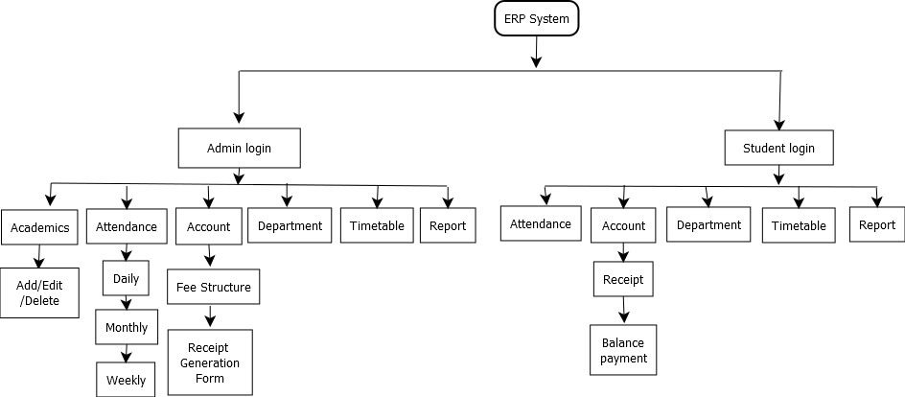
Flowchart

Slide 7
Difference Between Java and other Languages
Parameters | Java | Python
1)Performance | Faster | Slower than Java
2)Compatibility | Equipped for high level projects. | Not fully equipped for high level projects
3)Flexibility | High | Lower than Java
4)Database access | No limitations | It has limitations
Parameters | Java | .net
1)Operating System | Multiple | Windows
2)Performance | Faster | Slower
3)Concept | It is OOP language | It is framework

Slide 8
Differences
Parameters | MySQL | MongoDB | PostgreSQL
1)Description | RDBMS | Document oriented | RDBMS
2)Database schema | Yes | No | Yes
3)XML support | Yes | No | Yes
4)Server side script | Yes | Javascript | User-defined function

Slide 9
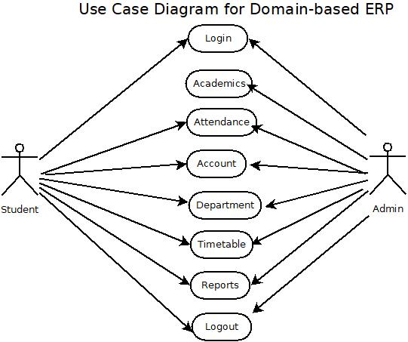
Use case diagram for Domain-based ERP

Slide 10
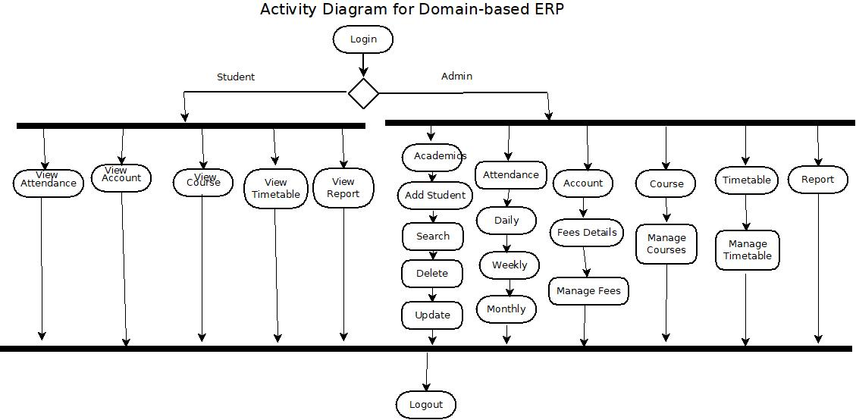
Activity diagram for Domain-based ERP

Slide 11
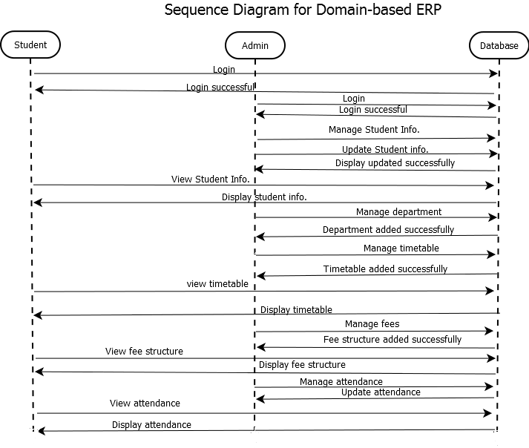
Sequence diagram for Domain-based ERP

Slide 12
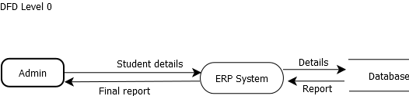
Data Flow Diagram for Domain-based ERP
DFD Level 0

Slide 13
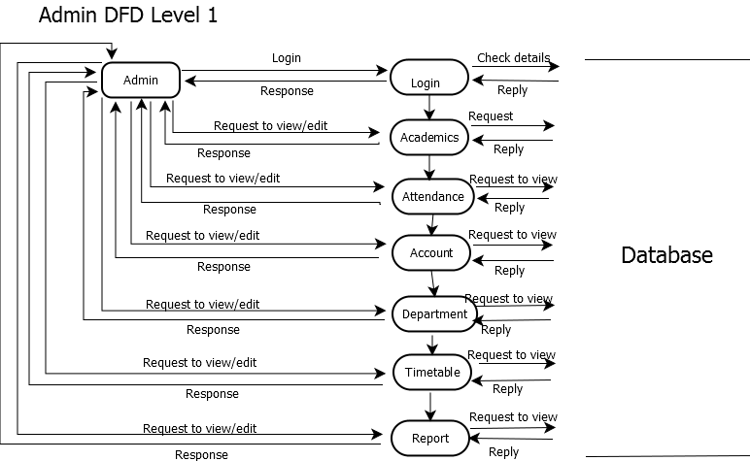
Data flow diagram
Admin DFD Level 1

Slide 14
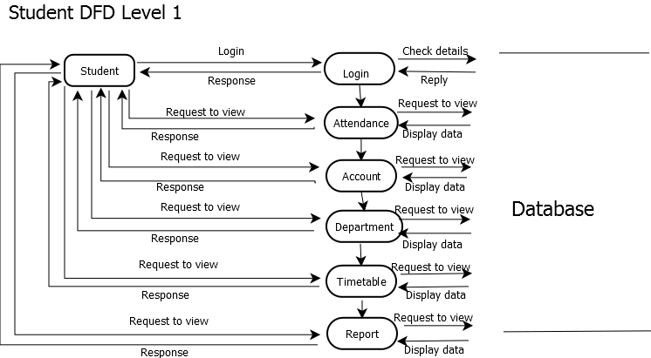
Data flow diagram
Student DFD Level 1

Slide 15
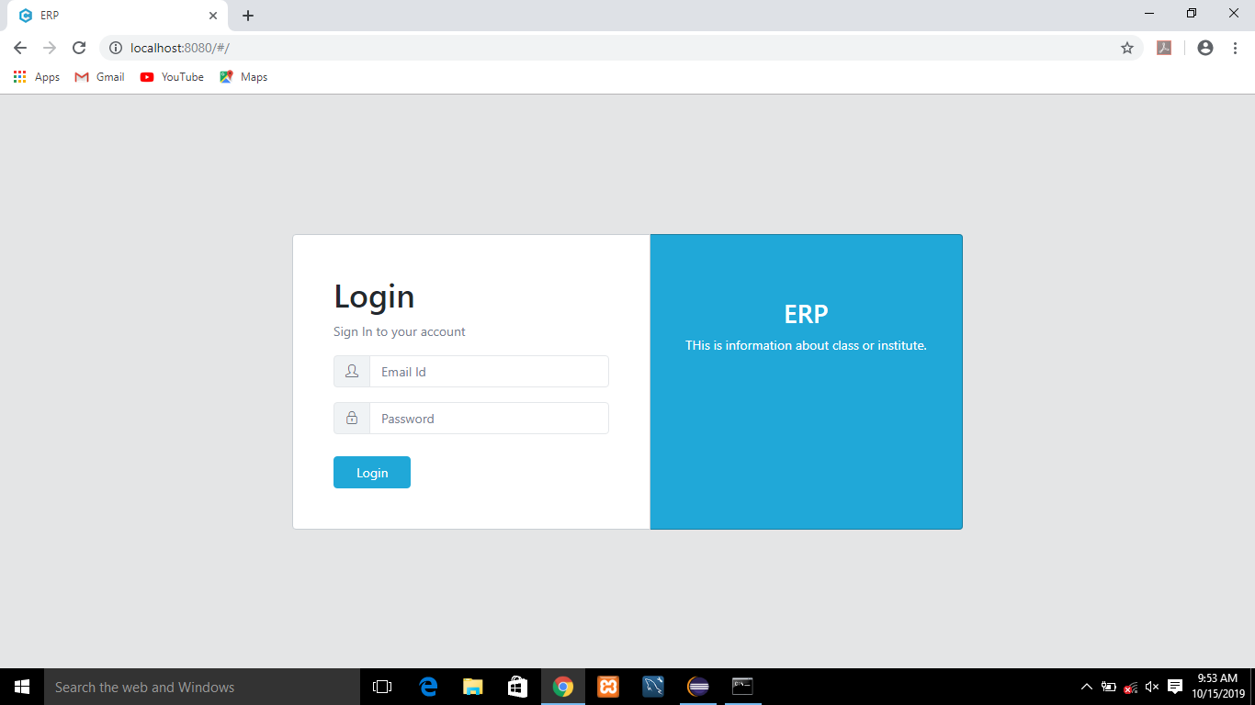
Login page

Slide 16
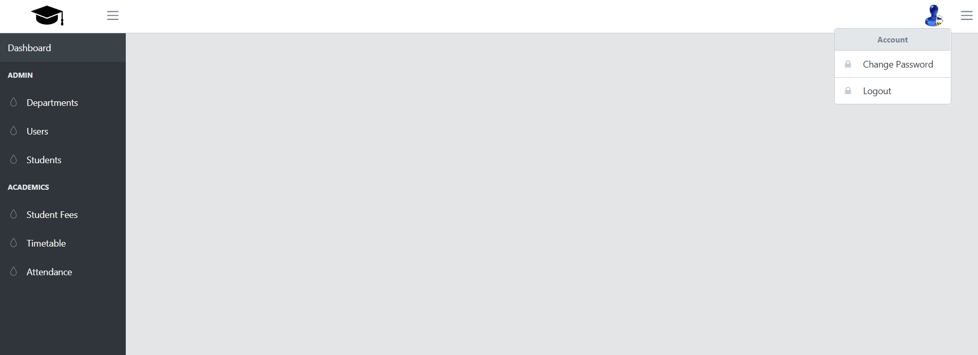
Home page

Slide 17
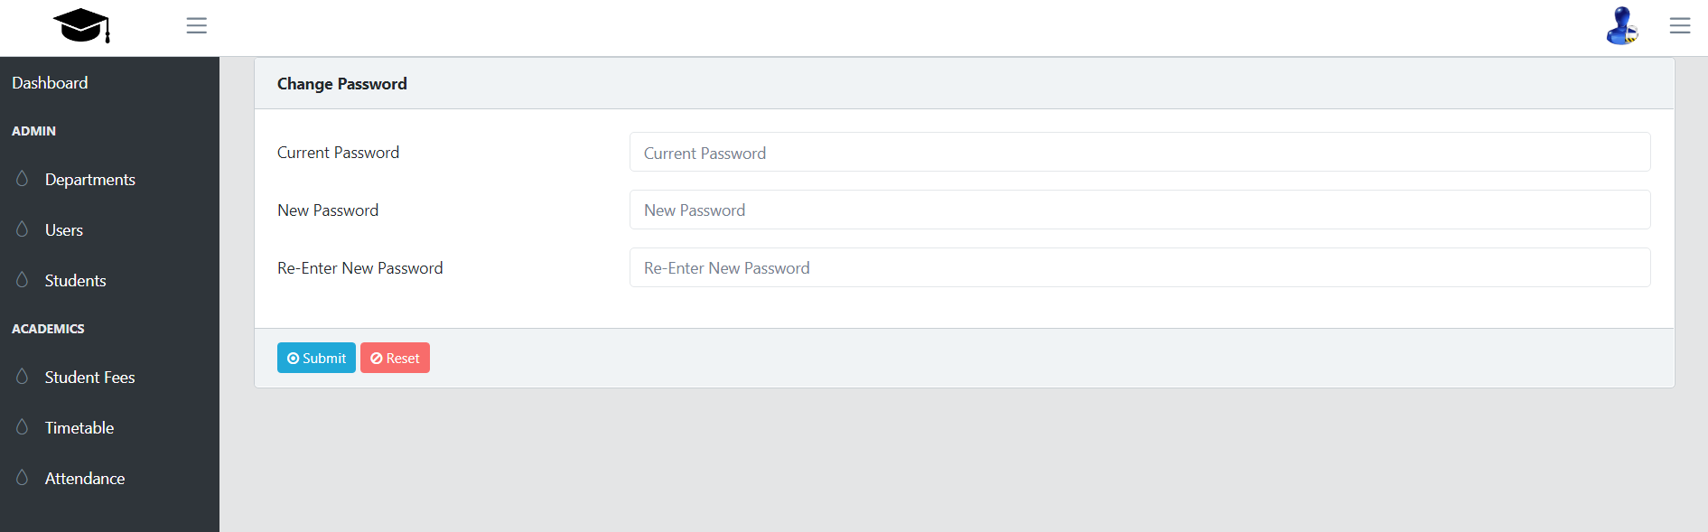
Change password

Slide 18
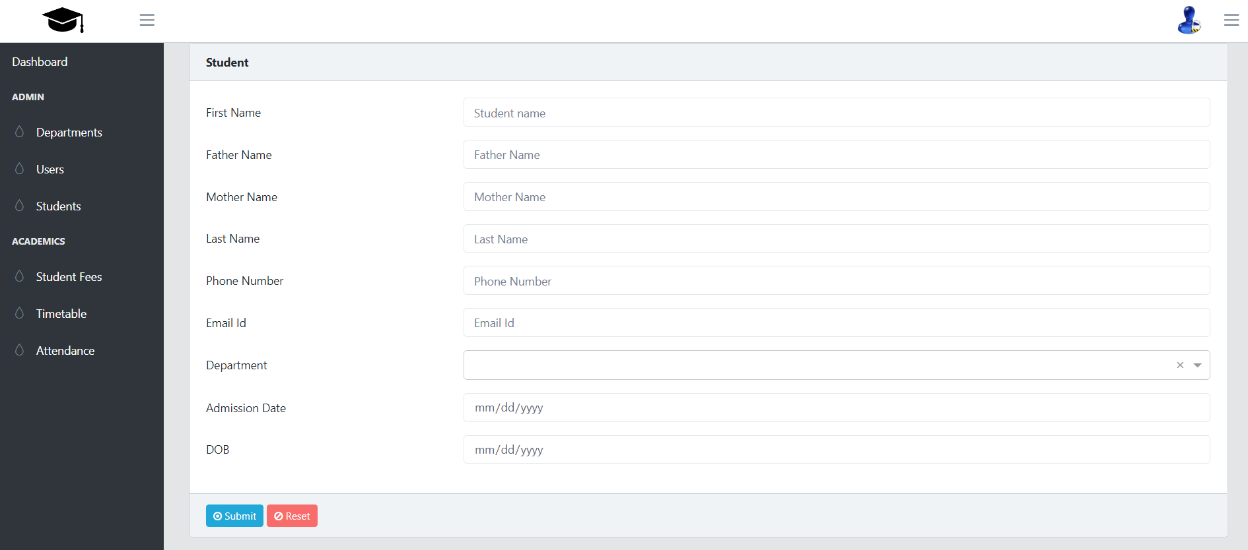
Student Information Page

Slide 19
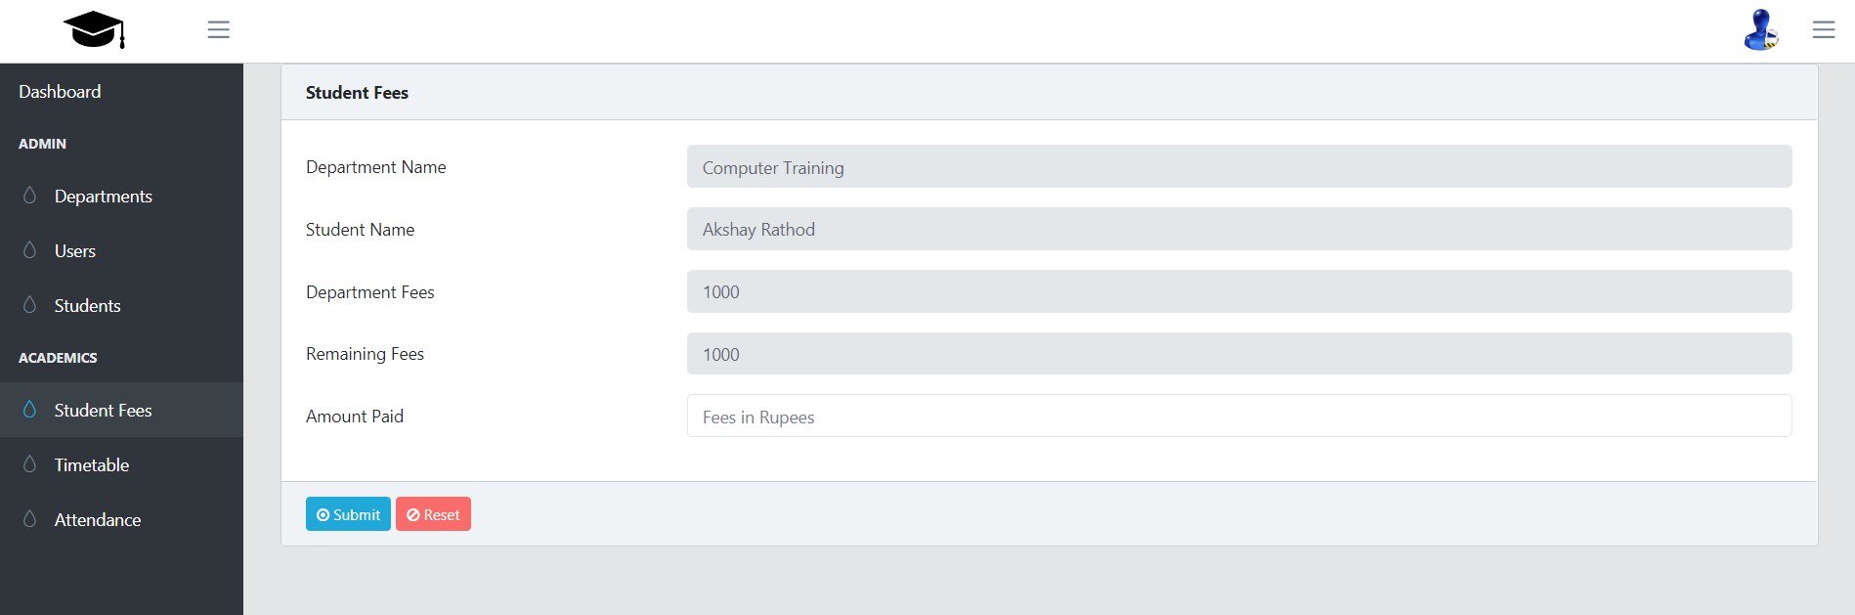
Student fees Page

Slide 20
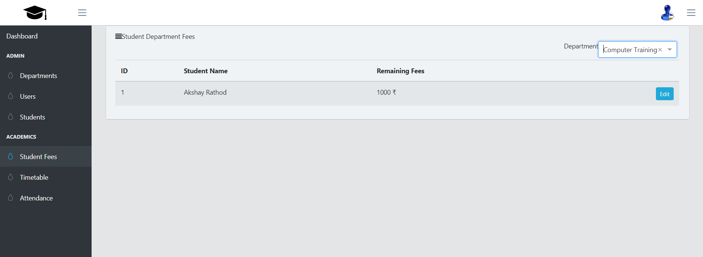
Student fees Page

Slide 21
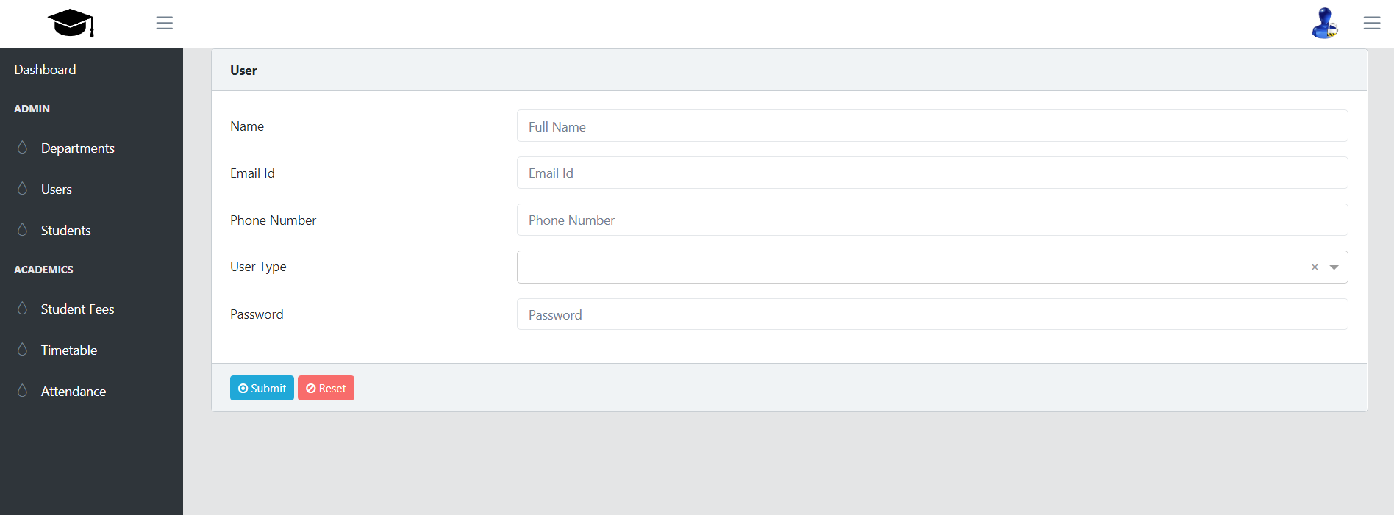
User Page

Slide 22
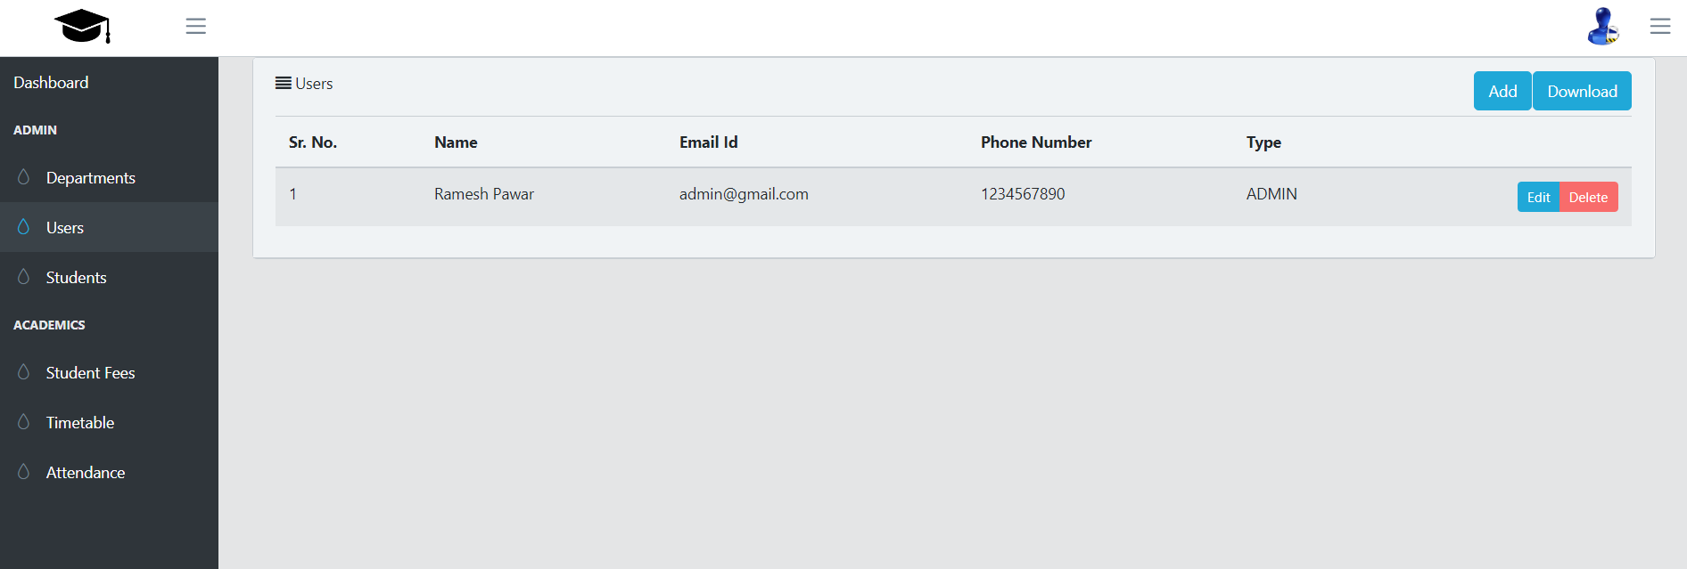
User Page

Slide 23
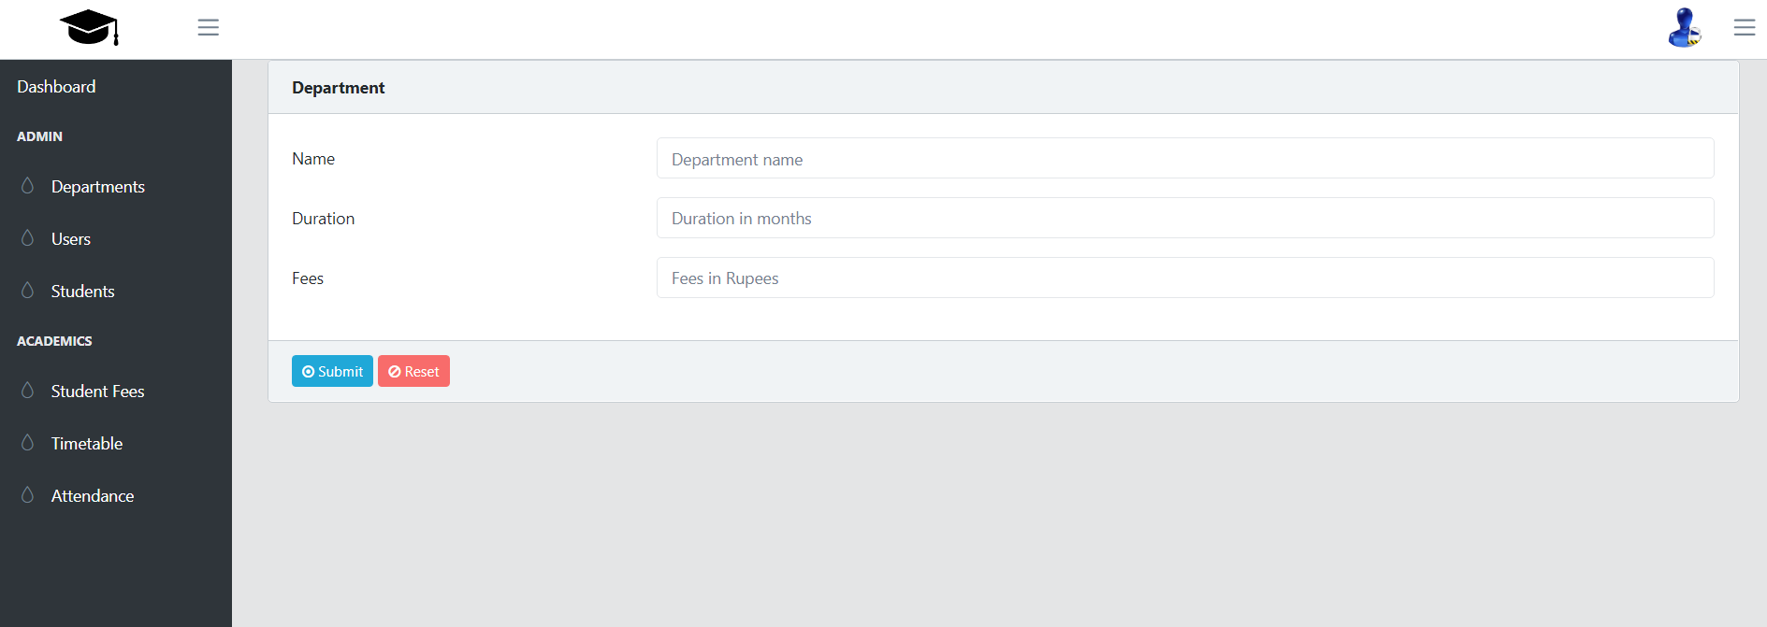
Department Page

Slide 24
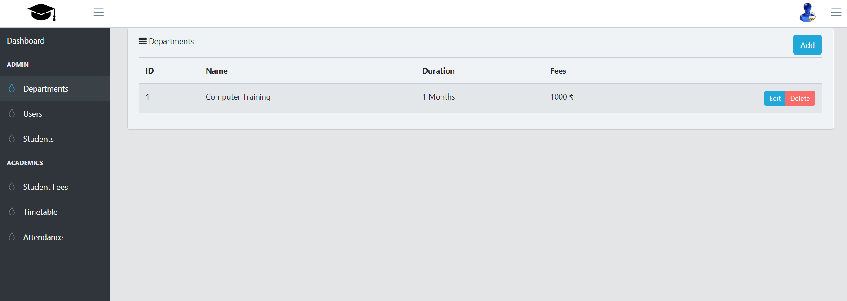
Department Page

Slide 25
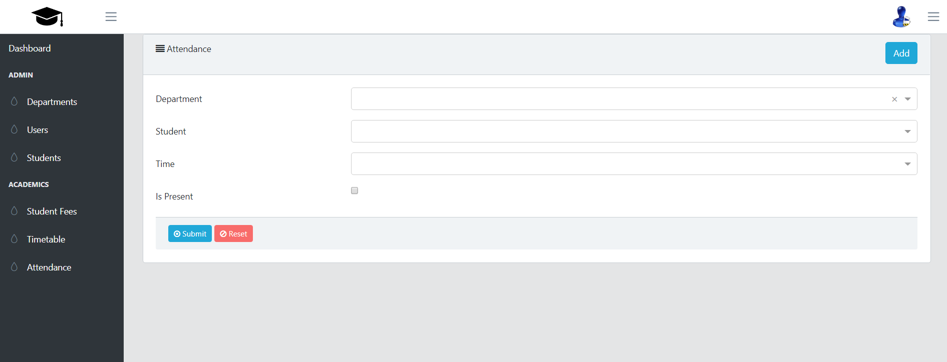
Attendance Page

Slide 26
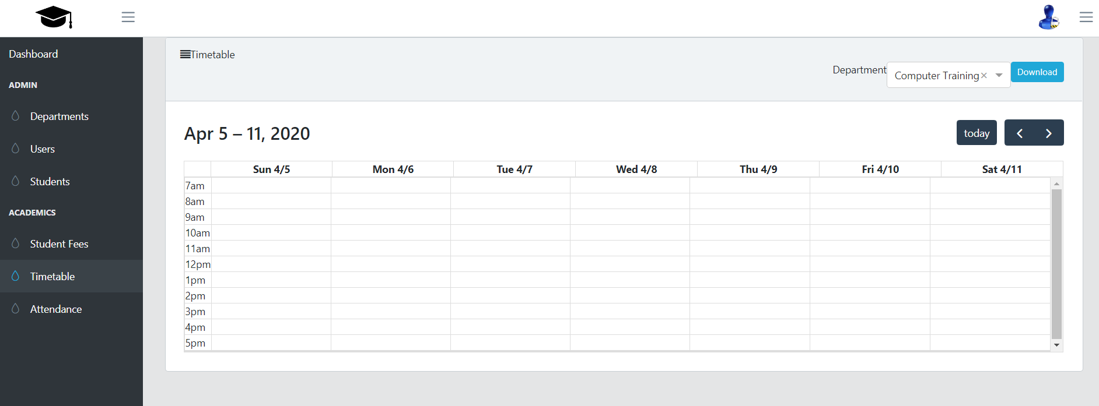
Timetable Page

Slide 27
References
[1] | Ming Jia Lee , Whee Yen Wong, Meei Hao Hoo, “Next Era Rf Enterprise Resource Planning System“, 2017 IEEE Conference on Systems, Process and Control (ICSPC 2017), 15–17 December 2017, Melaka, Malaysia , December 2017
[2] | W.-H. Tsai1 , P.-L. Lee1*, Y.-S. Shen1 , C.-C. Yang1,2,“The relationship between ERP software selection criteria and ERP success”, Proceedings of the 2009 IEEE IEEM , 2009
[3] | Monika Sharma, Vishal Deep Sharma, Mahesh M. Bundele,“Performance Analysis of RDBMS and No SQL Databases: PostgreSQL, MongoDB and Neo4j”, 3rd International Conference and Workshops on Recent Advances and Innovations in Engineering, 22-25 November 2018,Nov 2018

Slide 28
Thank You!!!

