Slide 1
Smart Application For Housing Society
Project members : Project Guide:
Divya Jagannath Ingale Prof. V. M. Nair
Rushikesh Kamlakar Mhashilkar
Mayuresh Vasant Tawade

Slide 2
Abstract
The project entitled “Android application for smart society” provides user friendly interface. Through automation & timely information, the proposed system helps to reduce time, effort & manual errors, leading to lowering the overall costs of managing the complex. This system facilitates complaint logging and online payment in more ubiquitous manner. For online transaction, choose type of bill like water bill, maintenance bill, etc & pay securely using popular payment options based on the respective region. System enables user for online access and get information accordingly. We use android version 4.0 with front end XML and back end java to achieve a high level security without sacrificing efficiency.
Keywords:-Android application, user friendly, online payment, security, complaint logging

Slide 3
Introduction
This Application is developed to manage day-to-day activities of any co-operative housing society.
We are designing an android application for Nature’s Harmony Apartment ,chiplun.
This project provides login access to registered users. User will get the online alert of the due payment and can pay their bills.
Proposed system controls, maintains and manages information of each and every society member with user friendly interface.
Proposed system is accessed by three roles:
1. Admin
2. User
3.Watchman

Slide 4
LITERATURE REVIEW
Sr. no. | Title of Paper | Author Name | Conference preceding , Date, Month , Year | Relevance of the Project
1. | Instant Secure Mobile Payment Scheme | M. Obaid, Z. Bayram and M. Saleh | IEEE Access, vol. 7, pp. 55669-55678, 2019. DOI: 10.1109/ACCESS.2019.2913430 | Online payment through mobile phones via PayPal Gateway.
2. | Multipurpose Android Based Mobile Notifier | Saurabh Malgaonkar , Vivek Maurya, Mukul Kulkarni, Gurtej Singh Majithia | 2014 International Conference on Advances in Electronics Computers and Communications, Bangalore, 2014, pp. 1-4. DOI: 10.1109/ICAECC.2014.7002408 | GCM is push notification service framework for android mobile.
3. | The Android Application Development College Challenge | B. Peng, J. Yue and C. Tianzhou | 2012 IEEE 14th International Conference on High Performance Computing and Communication & 2012 IEEE 9th International Conference on Embedded Software and Systems, Liverpool, 2012, pp. 1677-1681. doi: 10.1109/HPCC.2012.248 | Information about Android development platform, about android.

Slide 5
4 | Implementation of an Android Application for Management of a Housing Society | Omkar Singh1, Aditee Lakhan2, Jyoti Gupta3 | International Journal of Engineering And Computer Science ISSN:2319-7242 Volume 4 Issue 6 June 2015, Page No. 12383-12389 | Information about How to pass information between the application and the database server.
5 | Web Portal: Housing Society Management System | Kushal Patadia, Keshav Manjrekar Tejal Zope, Pranav Patil, | Kushal Patadia et al Int. Journal of Engineering Research and Applications www.ijera.com ISSN : 2248-9622, Vol. 4, Issue 2( Version 1), February 2014, p.547-551 | How to members of the society an easy access to the society happenings and on goings.
6 | Society Management Application on Android | RahulvBhagwat, Aashay Bharadwaj, Vivek Harsode, Anurag Chawake, Mrs. Deepali Bhanage | International Research Journal of Engineering and Technology (IRJET) e-ISSN: 2395-0056 Volume: 05 Issue: 05 | May-2018 www.irjet.net p-ISSN: 2395-0072 © 2018, | Online Payment, Society Maintenance Amount
7 | Online Housing Society Management System | Prachi Pakhale, Shweta Shirke, Swsati Dhake | International Journal for Research in Applied Science & Engineering Technology (IJRASET) International Journal for Research in Applied Science & Engineering Technology (IJRASET) | Online billing system and push notification

Slide 6
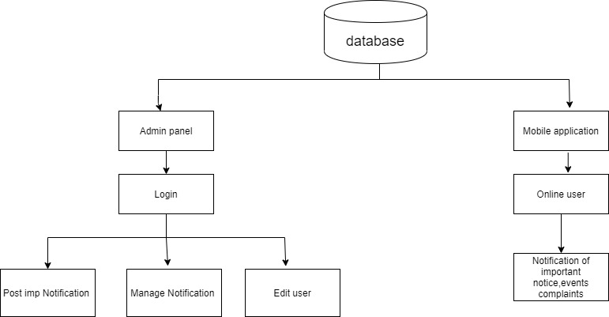
Design and Architecture

Slide 7
Methodology
Basically there are three types of roles in the system. The roles are
Administrator
Manage Maintenance Record
Account details
Reply complaint
Notifications
Society Member
View Society Member Details
Register Complaint
View Complaint Status
Receive Event Notification
Pay Maintenance bills
Receive Alert Message
Watchman
Victors update
9.3 Watchman
Visitor updates

Slide 8
Hardware and Software detail
Software details
Android studio
Front End: XML
Back End: Java
Firebase
Hardware details
Mobile phone

Slide 9
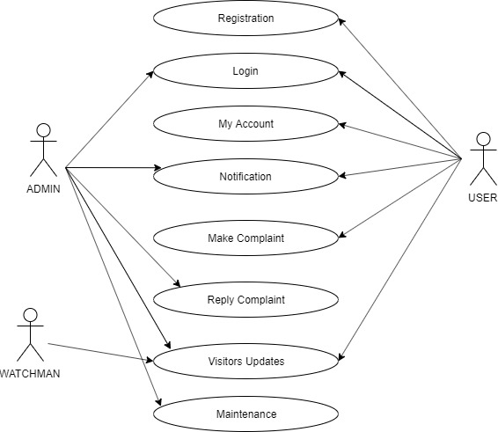
Use case Diagram

Slide 10
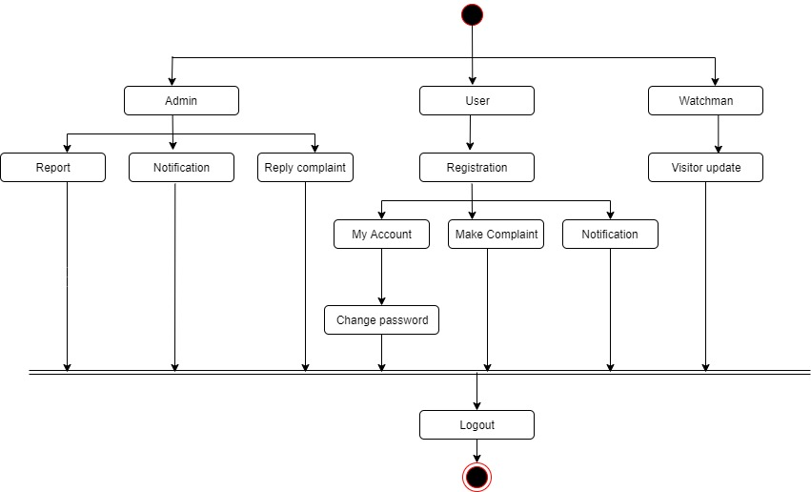
Activity Diagram

Slide 11
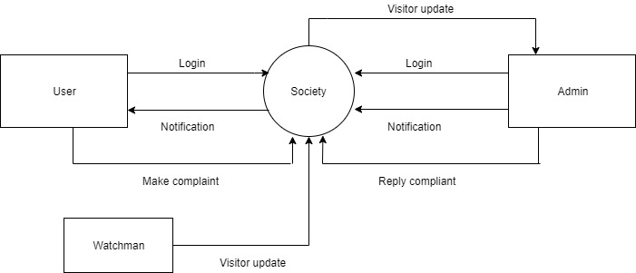
Data Flow Diagram-0

Slide 12
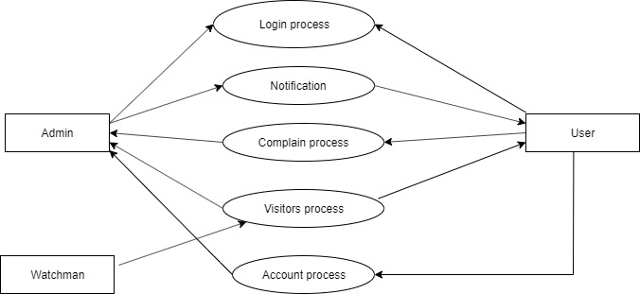
Data Flow Diagram-1

Slide 13
Conclusion
We are developing an android application for housing society management to reduce the human efforts and errors to increase crystal clear transparency between society members and management. It also helps to reduce the time and efforts for manual communication in society by providing the notifications and important information to the society members in the reliable and transparent way.

Slide 14
Thank you…!!!

