Slide 1
DATA MINING
Headed by, Presented by,
Prof. M. D. Laddha ISHA G. SHENDE
PRN:- 10303320181124510022

Slide 2
INTRODUCTION
What is data mining?
Why data mining?
Data Mining: On what kind of data?
Data mining functionality
Are all the patterns interesting?
Classification of data mining systems
Major issues in data mining.

Slide 3
What is Data Mining ?
Data mining: The task of discovering interesting patterns from large amounts of data.
It is concerned with the discovery of hidden knowledge.
Usually works on large volumes of datas useful in making critical organisationnal decisions, particularly those of strategic nature.
Alternative name:
Knowledge discovery in databases (KDD).

Slide 4
Why Data Mining?
Data, Data everywhere yet …
I can’t find the data I need
I can’t get the data I need
I can’t understand the data I found
I can’t use the data I found
We are drowning in data, but starving for knowledge!

Slide 5
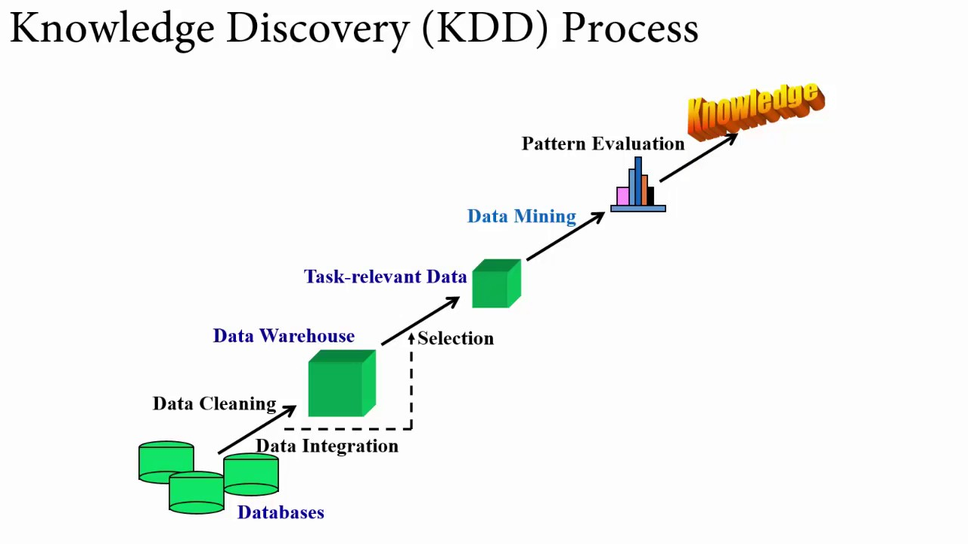
Data Mining: A KDD Process

Slide 6
Steps of Data Mining
Data integration
Data selection
Data cleaning
Data transformation
Data mining
Pattern evaluation
Knowledge presentation

Slide 7
Steps of a KDD Process
Learning the application domain.
Relevant prior knowledge and goals of application.
Creating a target data set: data selection.
Data cleaning and preprocessing: (may take 60% of effort!).
Data reduction and transformation.
Finding useful features, dimensionality/variable reduction.
Choosing functions of data mining.
Summarization, classification, regression, association, clustering.

Slide 8
Choosing the mining algorithm(s).
Data mining: search for patterns of interest.
Pattern evaluation and knowledge presentation.
Visualization, transformation, removing redundant patterns, etc.
Use of discovered knowledge.

Slide 9
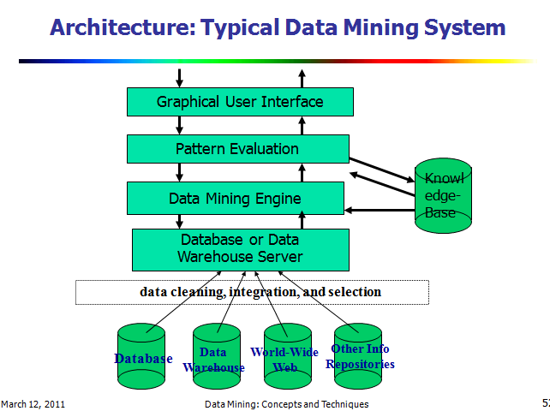

Slide 10
Data Mining: On What Kinds of Data?
Relational database.
Data warehouse.
Transactional database.
Advanced database and information repository:
Spatial and temporal data.
Time-series data.
Multimedia database.
Text databases & WWW.

Slide 11
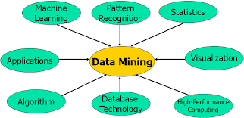
Data Mining: Confluence of Multiple Disciplines

Slide 12
Applications of Data Mining
Industry Application
Finance Credit Card Analysis
Insurance Claims, Fraud Analysis Telecommunication Call record analysis
Transport Logistics management Consumer goods Promotion analysis
Scientific Research Image, Video, Speech
Utilities Power usage analysis

Slide 13
Data Mining Tools
Microsoft SQL Server 2005
Microsoft SQL Server 2008
Oracle Data Mining
DBMiner

Slide 14
Issues and Challenges of Data Mining
Data mining methodology
Mining different kinds of knowledge from diverse data types, e.g., bio, stream,Web.
Performance: efficiency, effectiveness, and scalability.
Pattern evaluation: the interestingness problem.
Incorporation of background knowledge.
Handling noise and incomplete data.
Parallel, distributed and incremental mining methods.
Integration of the discovered knowledge with existing one: knowledge fusion.

Slide 15
Market Analysis And Management
Where does the data come from?
Credit card transactions, loyalty cards, discount coupons, customer complaint calls, etc.
Target marketing:
Find clusters of “model” customers who share the same characteristics.
Determine customer purchasing patterns over time.
Cross-market analysis:
Associations/co-relations between product sales, & prediction based on such association.

Slide 16
Market Analysis And Management (cont…)
Customer profiling:
What types of customers buy what products (clustering or classification).
Customer requirement analysis:
Identifying the best products for different customers.
Predict what factors will attract new customers.
Provision of summary information:
Multidimensional summary reports.
Statistical summary information (data central tendency and variation).

Slide 17
Fraud Detection & Mining Unusual Patterns
Applications: Health care, retail, credit card service, telecommunications
Auto insurance: ring of collisions.
Money laundering: suspicious monetary transactions.
Medical insurance:
Professional patients, ring of doctors, and ring of references.
Unnecessary or correlated screening tests.

Slide 18
Telecommunications: phone-call fraud
Phone call model: destination of the call, duration, time of day or week.
Analyze patterns that deviate from an expected norm
Retail industry
Analysts estimate that 38% of retail shrink is due to dishonest employees.
Anti-terrorism.
Approaches: Clustering, model construction, outlier analysis, etc.

Slide 19
THANK YOU.

