Slide 1

Dr.Babasaheb Ambedkar Technological University, Lonere
Name:- Kiran Kailas Abhinav
PRN:- 10303320181124510012

Slide 2
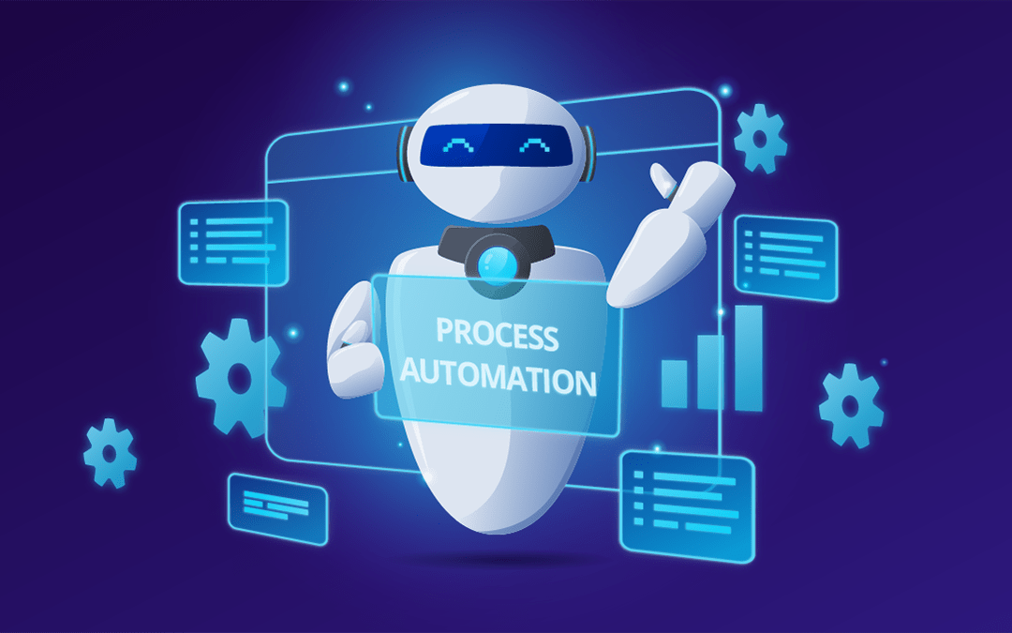
Robotics Process Automation (RPA)

Slide 3
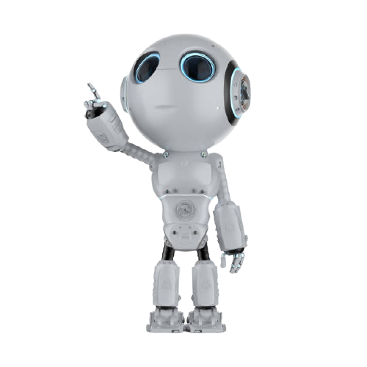
Index :-
What is Robotic Process Automation(RPA)
Evolution of RPA
Robotic process automation tools
Applications of RPA
Disadvantages of RPA
Myths Of RPA
Where the Robotic Process Automation Market is going.

Slide 4
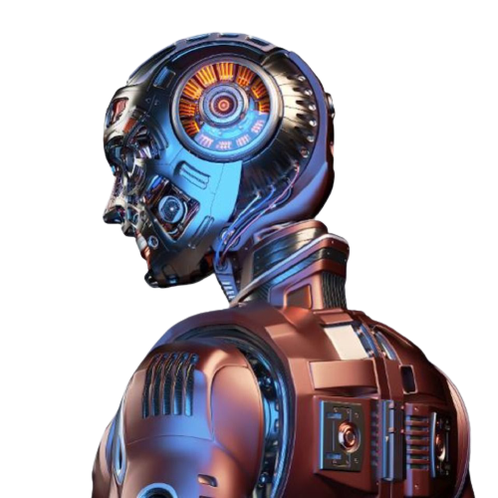
What is Robotic Process Automation
Robotic process automation (RPA) is the use of software with artificial intelligence (AI) and machine learning capabilities to handle high-volume, repeatable tasks that previously required humans to perform. These tasks can include queries, calculations and maintenance of records and transactions
RPA technology, sometimes called a software robot or bot, mimics a human worker, logging into applications, entering data, calculating and completing tasks and logging out
RPA software is not part of an organization's IT infrastructure. Instead, it sits on top of it, enabling a company to implement the technology quickly and efficiently all without changing the existing infrastructure and systems.

Slide 5
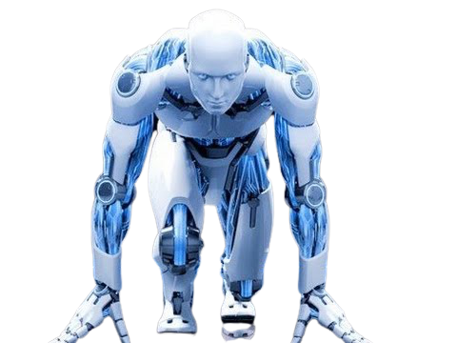
Evolution Of RPA
Although the term "robotic process automation" can be traced to the early 2000s, it had been developing for a number of years previously.
1959 machine learning-Sir Arthur Samuel
ML performs complex tasks
1960’s NLP combined with AI to establishing the interaction between computer and human language.
The history of RPA tells that there were three key predecessors of Robotic Process Automation that are given below:.
Screen scraping:- This technology is used to extract data from web, programs, and documents, which is further displayed by another application.

Slide 6

The advantages of workflow automation software, which eliminates the need for manual data entry and increases order fulfillment rates, include increased speed, efficiency and accuracy.
Lastly, artificial intelligence involves the ability of computer systems to perform tasks that normally require human intervention and intelligence.

Slide 7
How RPA Works:-
The most common examples of RPA is the 'automated creation of invoices'.
A customer requests for an invoice through mail.
The operator checks the mail and opens the relevant billing software.
Information is copied from the email into the billing software.
The invoice is created using the given information and saved.
The original sender is informed that the process is complete.
All these steps can be automated with the help of the RPA tool. As soon as the customer generates an email request, all these steps will be performed automatically by RPA bots, and there will be no need for human input. Preparing and cleansing data in a structured format helps the software bots to easily copy and paste data from one field to another without oversight.
In case of incomplete, inaccurate, or missing data, these software bots can send the acknowledgment to the original sender and request for the correct data. It prevents all kinds of mistakes that may arise as a result of user error

Slide 8
RPA Tools
Selection of RPA Tool should be based on following 4 parameters:
Data: Easy of reading and writing business data into multiple systems
Type of Tasks mainly performed: Ease of configuring rules-based or knowledge- based processes.
Interoperability: Tools should work across multiple applications
AI: Built-in AI support to mimic human users Popular

Slide 9

Blue Prism
Blue Prism RPA tools help business operation to be agile and cost effective by automating, manual, rule-based back repetitive office processes. The tool provides a flow chart like a designer with drag and drops feature to automate various business processes.
Features :
Platform independent so that it can be used onany platform
Robust and feature-rich analytics suite
The tool is based on a C-sharp programming language
Formed in 2001 and follows a Top-Down approach
Blue prism offers a visual designer with no recorder, scripts or any intervention

Slide 10

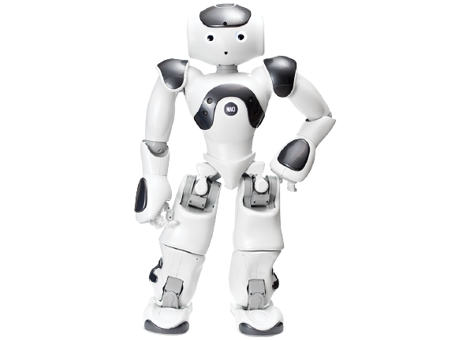
UiPath
UiPath is a highly extensible Robotic Process Automation (RPA) tool for automating any desktop or web apps. It allows global enterprises to design, deploy a robotic workforce for their organization.
Features:
Uipath can be hosted in virtual terminals or cloud environments. It comes with the community edition which is free for lifetime and has the functionality of the studio version.
Provide support for a high range of applications to work with, which includes web and desktop applications
Auto-login features to run the bots.
Scraping solution which works with .Net, Java, Flash, PDF, Legacy, SAP, with absolute accuracy

Slide 11
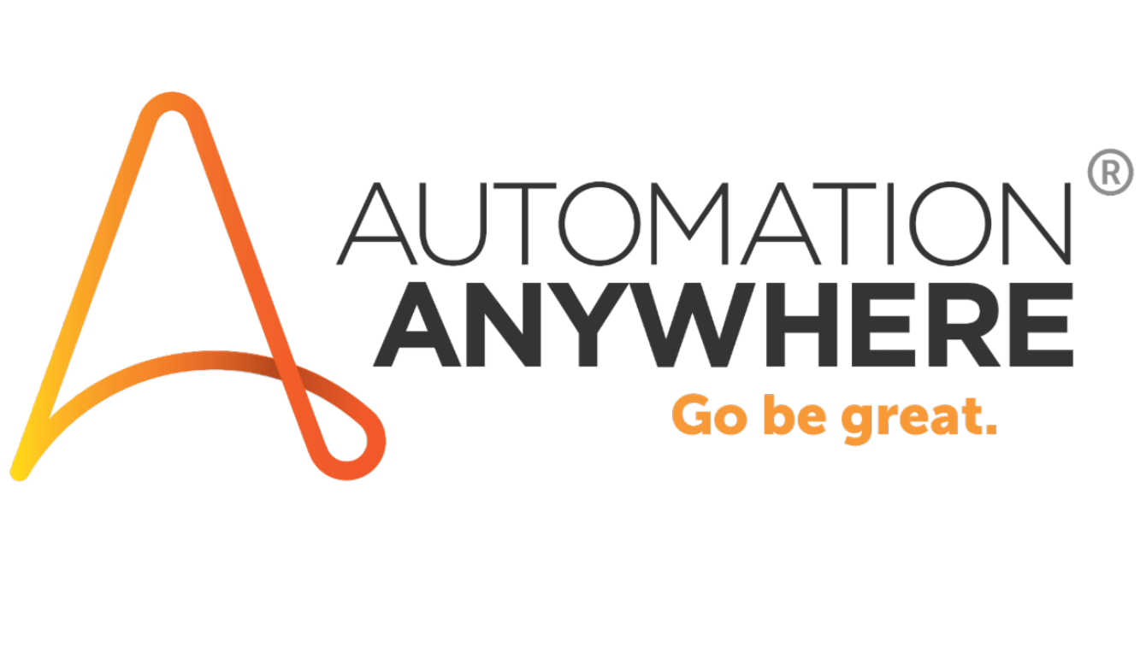
Automation Anywhere
Automation Anywhere is an RPA tool whose motive is to provide its users scalable, secure and resilient services.
Features:
Intelligent automation for business and IT operations
Uses SMART Automation Technology
Rapidly Automates complex and complicated tasks
Distribute tasks to multiple computers
offers script less automation

Slide 12
Applications of RPA
Robotic process automation technology can help organizations on their digital transformation journeys by:
1) Enabling better customer service.
2) Ensuring business operations and processes comply with regulations and standards.
3) Allowing processes to be completed much more rapidly.
4) Providing improved efficiency by digitizing and auditing process data.
5) Creating cost savings for manual and repetitive tasks.
6) Enabling employees to be more productive.

Slide 13

Insurance
Form Registration
Policy Cancellation
Policy cancellation involves many transactional tasks such as tallying cancellation date, inception date, policy terms, etc. With RPA in Insurance, policy cancellation can be carried out in just one-third of the time.
Telecom
Responding to partner queries
Software robots are smart enough to interpret emails, respond to simple questions, and forward complex ones to humans. This is particularly useful for telecom companies, which usually rely on partners like independent brokers to sell their services.
Reducing manual sales order processing effort

Slide 14

Health care
Member enrollment
The need for healthcare insurance keeps growing every year. Payers have to process a huge influx of new member enrollment requests. It is a manual process that involves a tone of paper work, the physical movement of paperwork, and tremendous attention to detail through human eyes. RPA can automate the entire process seamlessly, and bring down the processing errors and incomplete applications; subsequently reducing the turnaround of enrollment cycle times.
Medical billing
The medical billing process, performed by healthcare providers, is a multi-step process that involves the use of medical codes, claim processing with payers, and recovery of out-of-pocket expenses from the patient. It requires the collaboration of both internal and external stakeholders, with the manual collection of data from each stakeholder. RPA can combine all of the sub-processes performed by each stakeholder into a seamless, centralized process. Medical billing service providers, with the help of RPA, automate the billing process for their healthcare provider customers, which will result in significant time savings.

Slide 15
Disadvantages Of RPA
Potential Job Losses
Loss is by far the most significant opposition frequently brought against the use of robots in the manufacturing industry. Industry workers of all levels, from entry-level to veterans, worry about the security of their employment status, and the ability of their job to be replaced by a robot. This panic is more widespread in this industry compared to others because of the closer immanence of a robot takeover in manufacturing.
Macro effects
Are another topic that usually comes up with job loss. More “big picture” thinkers wonder how the national and eventually global economy will be affected when manufacturing workers’ jobs are displaced. How can this mass unemployment possibly be compensated for, and how can the robots’ presumed success be limited from seeping into other industries? CNN offered an incredibly poignant parallel, saying that horses to cars are what human workers are to robots. The horse population peaked in the US about a century ago since they were the main form of transportation. But these numbers have steadily declined ever since cars hit the mainstream. Jobs that do not require as much human analytical thought are more vulnerable because they are easier for machines to handle, with the replacement of EZ Pass toll operators being a good example.

Slide 16
Increased investment costs
Are a financial counterpoint to industrial robots, with the idea that manufacturing companies will rack up their debt investing in robotic technology. Firms that do not have the funding might even go bankrupt in an effort to keep up with industry trends rather than continue on with normalized operations.
Hiring Skilled Staff
Many organizations believe that to work with RPA, the staff must have significant technical knowledge of automation as robots may require programming skills and an awareness of how to operate them. It further forces organizations to either hire a skilled staff or train existing employees to expand their skills.
An automation company can be a little beneficial during initial installation and set-up. But the skilled staff can only adopt and manage the robots in the long-term.

Slide 17
Myths Of RPA
Coding is required to use RPA software
That’s not true. To use Robotics Process Automation tools, one needs to understand how the software works on the front-end and can how they can use for automation.
RPA software does not require human supervision
This is an illusion because humans are needed to program the RPA bot, feed them tasks for automation and manage them.
Only large big companies can afford to develop RPA
Small to medium-sized organizations can deploy RPA to automate their business. However, initial costing will be high but can be recovered in 4-5 years.
RPA is useful only in industries that rely heavily on software
RPA can be used to generate automated bills, invoice, telephone service, etc. which are used across industries irrespective of their software exposure.

Slide 18
Where the RPA market is going:-
A Global Market Insights Inc. report expects the RPA market to reach $5 billion by 2024.
The increased adoption of RPA technologies
by organizations to enhance their capabilities
and performance and boost cost savings will reportedly drive the growth of the robotic
process automation market most during that time.

Slide 19
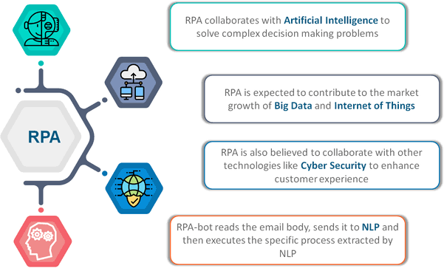

Slide 20
THANK
YOU…!!!!!

