Slide 1

Serverless computing
The Seminar Presentation by Krishna Suryakant Mangnale
PRN: 10303320181124510064
Year: Third Year
Branch: Department Of Computer Engineering
Dr. Babasaheb Ambedkar Technological University,Lonere-402103

Slide 2
Content -
Introduction
History Of Serverless Computing
What is Serverless Computing?
Relation Diagram
Serverless computing with iot, Edge & cloud computing
Traditional Vs Serverless
Benefits of Serverless computing

Slide 3
Introduction:
the original author of serverless computing is austen collins and it was fisrtly created on node.js
Large tech companies such as amazon, Google and Microsoft offer serverless platform under various brand names. Although the specifics of the services may differ but the essential idea behind the offered services is almost same.
Serverless computing enables developers to build applications faster by eliminating the need for them to manage infrastructure with serverless applications, the cloud service provider automatically provisions, scales and manages the infrastructure required to run the code.
Server less computing is a method of providing backend services on an as-used basis servers are still used,but a company that gets backend services from a serverless vendor is charged based on usage,not a fixed amount of bandwidth or number of servers.

Slide 4
History of Serverless computing:
The modern age of serverless computing began with the launch of AWS Lambda, a platform based on Amazon's cloud service, in 2014. Microsoft followed suit with Azure Functions in 2016. Google Cloud Functions, which had been in beta since 2017, finally reached production status in July 2018.
Google released Google App Engine in 2008. For the first time, a developer was able to develop a program and launch it to run on Google’s cloud without having to be concerned with details like how the server was provisioned or if the operating system required patches.
Amazon launched a similar service, Lambda in 2015. Now, developers could create software and not have to worry about hardware, operating system maintenance, scalability or locality.
. Although these are two of the bigger providers, there are a great number of serverless providers today, all supporting various technologies at different price points. Additionally, software is available for on-premises deployment for companies that don’t want to go to the cloud but want some additional flexibility.

Slide 5
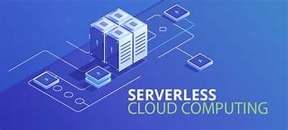
2. What is serverless computing?
Serverless computing is an execution model for the cloud in which a cloud provider dynamically allocates—and then charges the user for—only the compute resources and storage needed to execute a particular piece of code. ... Serverless functions are event-driven, meaning the code is invoked only when triggered by a request.

Slide 6
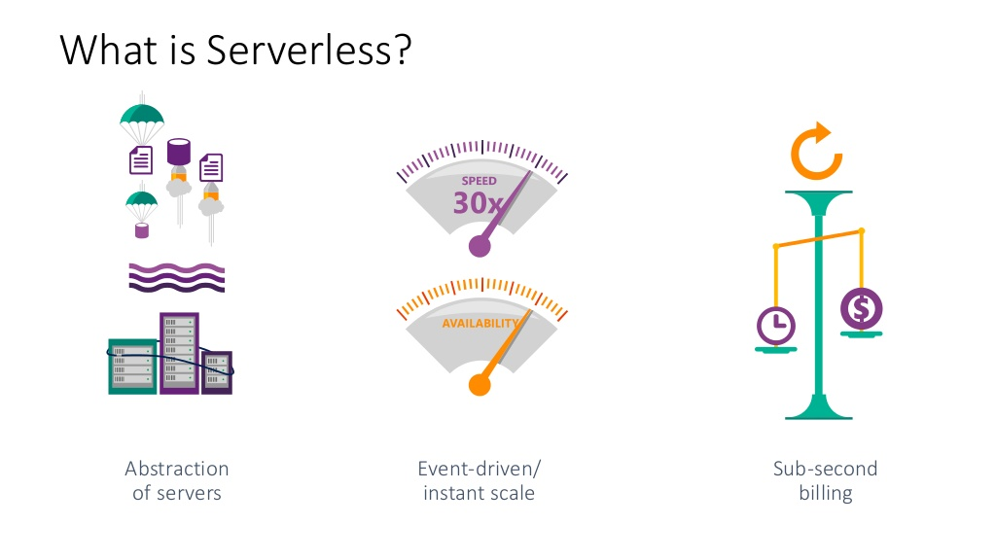

Slide 7
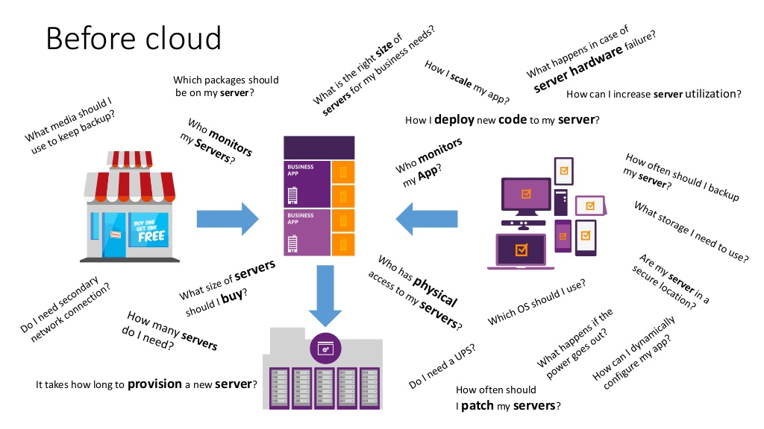

Slide 8
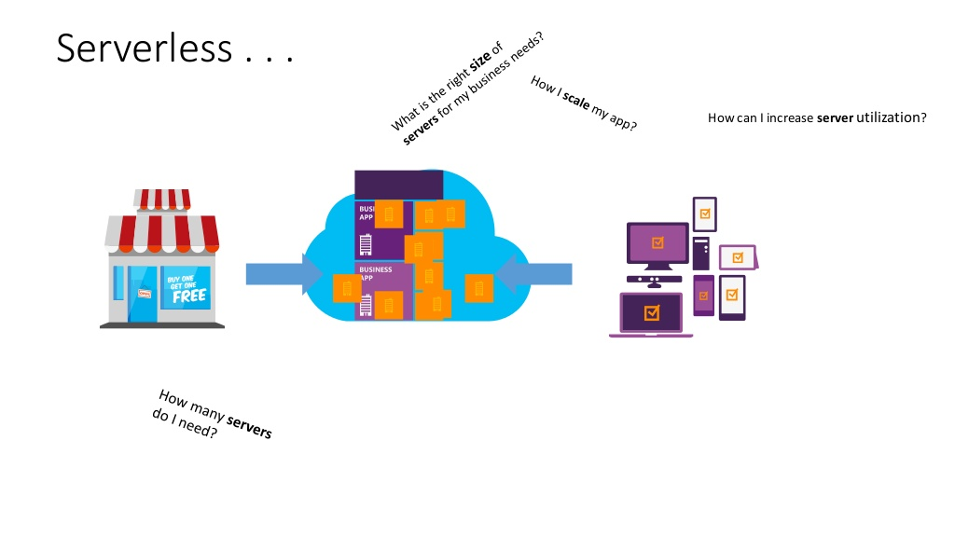

Slide 9
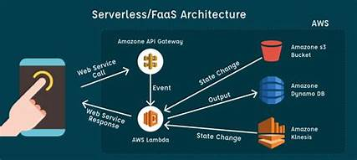
Relation Diagram:
consumer
Service provider
Back end operations done
By service provider
Response
Fig 1.

Slide 10
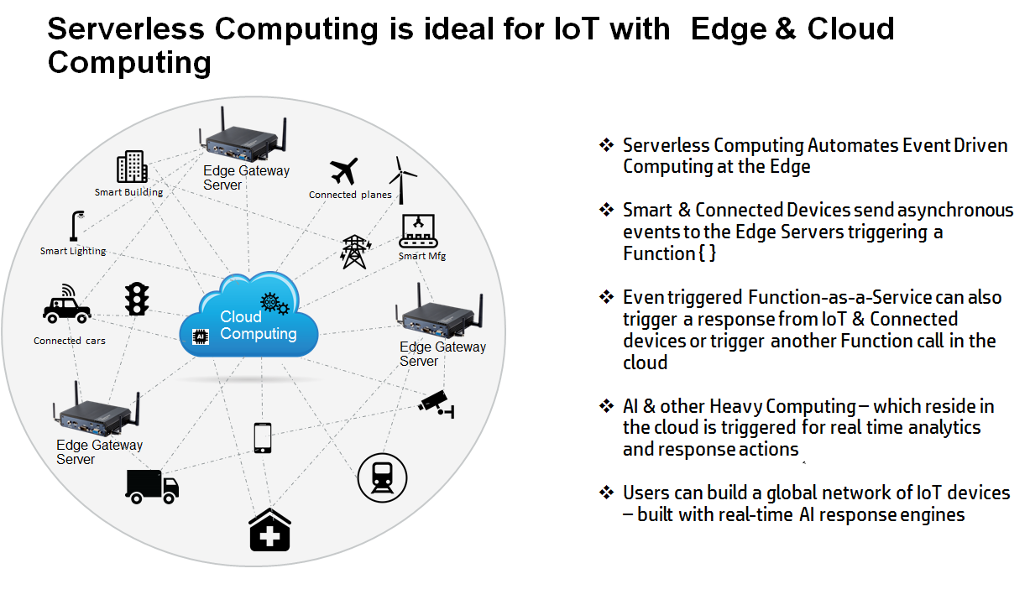

Slide 11
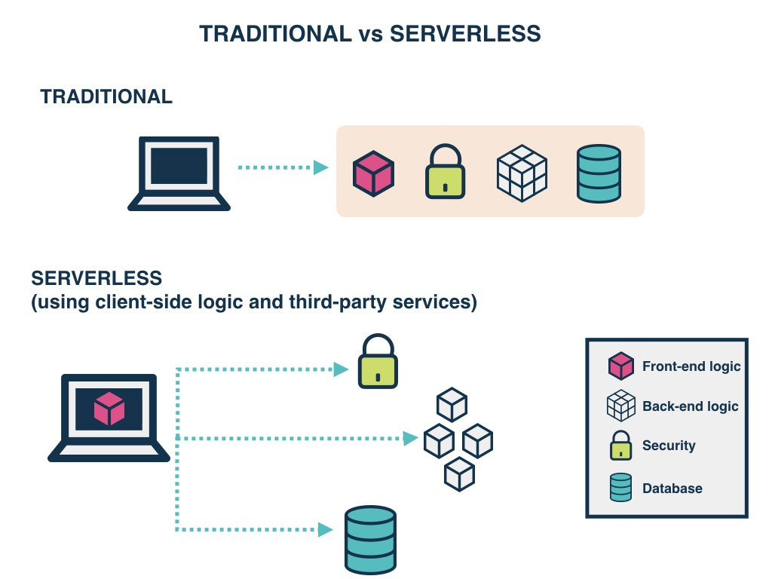

Slide 12
Serverless Computing (FaaS)
Function as a Service (Azure Functions)
Platform to develop, run, and manage application
Without the complexity of building and maintaining the infrastructure
Similar Technologies
AWS Lambda
Google Cloud Functions
Open Whisk (IBM)

Slide 13
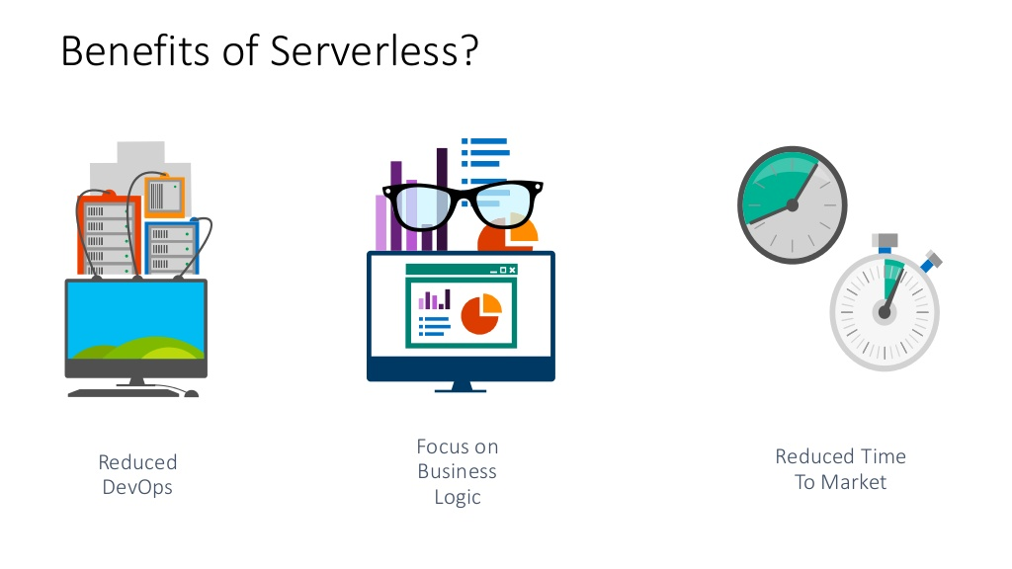

Slide 14


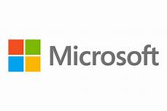

Big Companies giving serverless computing services
Alphabet’s Google
cloud
Amazone’s
aws lambda
Microsoft Azure

Slide 15
conclusion
In this ppt we discuss some besics about serverless computing.
The deference between traditional and serverless computing
new opportunities and potentials that serverless computing offers to us

Slide 16
thank you !

