Slide 1

Dr.Babasaheb Ambedkar Technological University, Lonere
Name:- Kshitij Ratnakar Jadhav
PRN:- 10303320181124510071

Slide 2
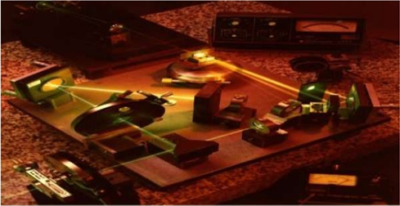
Holographic Data Storage

Slide 3
Index
Introduction
What is Holographic Memory
History
Reasons for Developing Holographic Storage
Holographic Versatile Disk(HVDs)
Components
The HVD system
Why has it taken so long to develop an HDSS ?
Advantages
Limitations
Applications
Conclusion

Slide 4
Introduction
Data storage has been a fundamental part of computing from the beginning
currently dominated data storage methods are Optical data storage and Magnetic data storage
In order to increase storage capabilities new Optical storage is introduced called Holographic Memory.
Holographic storage is capable of recording and reading millions of bits in parallel, enabling data transfer rates greater than those attained by traditional optical storage.

Slide 5
What is Holographic Memory
Holographic memory is a three-dimensional data storage system that can store information at high density inside the crystal or photopolymer.
It is a memory that can store information in the form of holographic image (hologram).
It can store up to 1-4 TB of information in a sugar cube sized crystal.

Slide 6
History
Holography is invented in 1947 by the Hungarian-British physicist Dennis Gabor, who won a Nobel Prize for his invention in 1971.
Scientist Pieter J. Van Heerden proposed the idea of holographic memory in 1960s.

Slide 7
Reasons for Developing Holographic Storage
Replacement as a backup media
Higher data density than tape and current Hard Drives
Data is stable for an estimated 50 years without degrading
Faster read and write speeds

Slide 8
Replacement for DVD
Higher data density than Blu-Ray
Faster read and write speeds
Higher ceiling for max data storage capability
Increasing resolutions for TVs will require more storage for movies and games

Slide 9
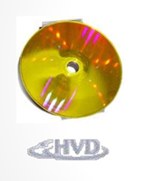
Holographic Versatile Disk(HVDs)
Capacity: 3.9 terabyte (TB) of information, which is approximately 6,000 times the capacity of a CD-ROM, 830 times the capacity of a DVD, 160 times the capacity of single-layer Blu-ray-Discs.
The HVD also has a transfer rate of 1 gigabyte/s

Slide 10
Components
Basic components that are needed to construct an HVD system
Blue-green argon laser
Beam splitter to split the laser beam
Mirrors to direct the laser beam
Spatial light modulator (SLM)
Lances to focus the laser beam
Lithium-niobate crystal or photopolymer
Charged coupled device camera (CCD)

Slide 11
The HVD system: writing data
When the blue-green argon laser is fired ,a beam splitter creates two beams, a signal beam and a reference beam.
The signal beam passes through a SLM where digital information, organized in a page(2-D plane) like format of ones and zeroes, is modulated onto the signal beam as a two dimensional pattern of brightness and darkness.
When the two beams intersect, the interference pattern is created which stores the data carried by the signal beam. The stored data is called hologram.

Slide 12
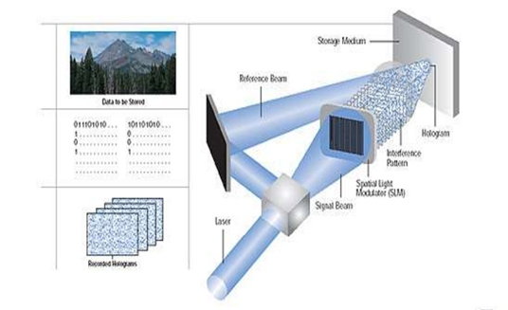
Continue…

Slide 13
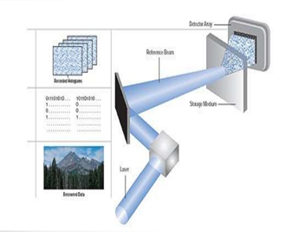
The HVD system: reading data
To retrieve data, the reference beam is focused on the hologram at a particular angle ; this will retrieve the modulated data stored at the same angle of interference

Slide 14
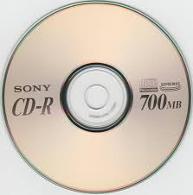
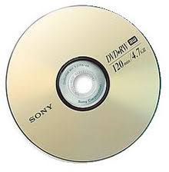
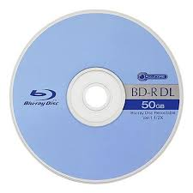
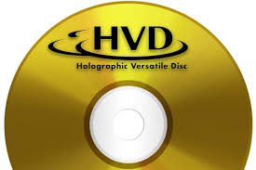
Comparison
CD
Capacity:700mb
DVD
Capacity:4.7Gb
Blu-ray
Capacity:50Gb
HVD
Capacity:1-4Tb

Slide 15
Why has it taken so long to develop an HDSS ?
Lack of components.
Components that are supposed to be used were much larger and more expensive
For example
Laser would have been 6 feet long
CCD was not available until last decade
LCDs were not developed until 1968

Slide 16
Advantages
Resistance to damage - If some parts of the medium are damaged, all information can still be obtained from other parts
Efficient retrieval -All information can be retrieved from any part of the medium.
Theoretical data storage of >1TB/cubic centimeter
Current technology can store approximately 4TB on a DVD sized disc(HVDs)
Data longevity

Slide 17
Data security
WORM (Write-once read-many) prevents data from being overwritten
Faster Read/Write speeds
Data can be read and written in parallel instead of Linearly
Higher speeds are necessary as storage amounts increase

Slide 18
Limitations
Not a guaranteed market leader
If another technology becomes the industry standard then read/write equipment will be hard to find
Expensive development
Existing technology is becoming better and cheaper
It is difficult to market a product that is more expensive per GB of storage.

Slide 19
APPLICATIONS
A) Petaflop Computing
B) Data Mining
C) Future Computing System

Slide 20
CONCLUSION
In conclusion, Holographic Storage has the advantage over other storage mediums as it relates to:
Storage Capacity
Transfer Rate
Backup
Its main disadvantage is its cost of ownership.
Keep in mind, when Blu-ray was Introduced in 2006, a 25gigabyte disc cost nearly $1 a gigabyte. Its about half the cost now. Overtime, the overall cost of holographic data storage should decrease to an acceptable amount

Slide 21
Thank You

