Slide 1
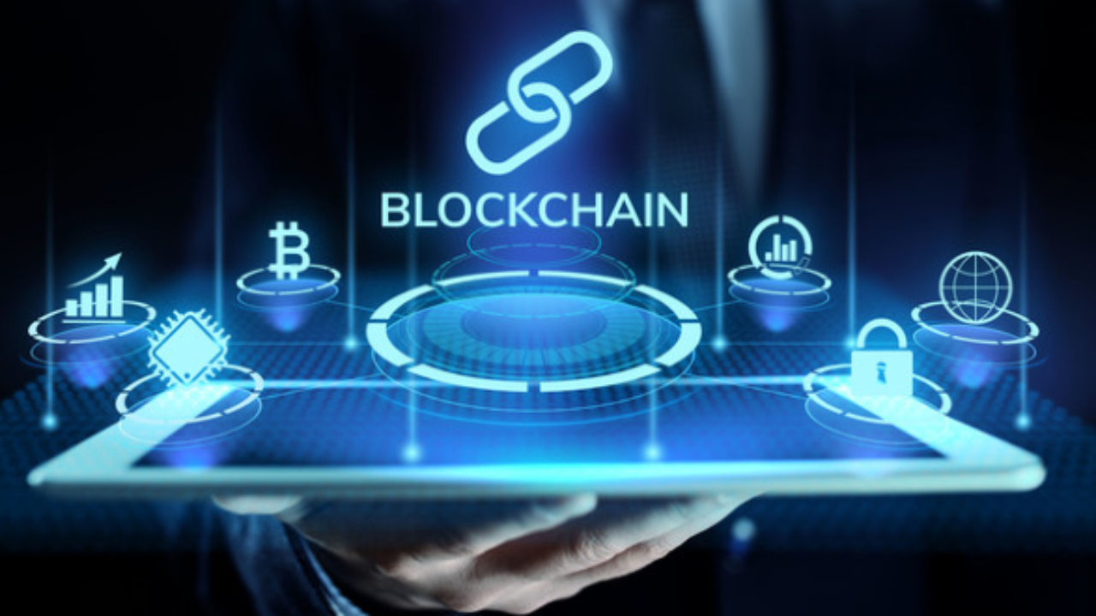
Seminar on Blockchain Technology
under the guidance of:
Kavita C. Aher
Submitted by:
Manasi Rajendra Ghodake

Slide 2
Content
Introduction
What is Blockchain ?
Inside of Blockchain
Need of Blockchain
Features Of Blockchain
How Blockchain works ?
Blockchain Vs Bitcoin
Applications Of blockchain
Advantages
Disadvantages
Programming Languages for Blockchain
Blockchain Wheel of opportunities
Future Scope
Conclusion

Slide 3
Introduction
The 21st century is all about technology. With the increasing need for modernization in our day-to-day lives, people are open to accepting new technologies. Technologies like augmented reality and IoT that have gained pace in the past decade and now there’s a new addition to the pack i.e. Blockchain Technology.
Blockchain- The revolutionary technology impacting different industries miraculously was introduced in the markets with its very first modern application Bitcoin.
There’s a common misconception among people that Bitcoin and Blockchain are one and the same, however, that is not the case. Creating cryptocurrencies is one of the applications of Blockchain technology and other than Bitcoin, there are numerous applications that are being developed on the basis of the blockchain technology.
https://www.blockchain.com/

Slide 4
What is Blockchain ?
Blockchain can be described as a data structure that holds transactional records and while ensuring security, transparency, and decentralization.
Blockchain technology allows all the network participants to reach an agreement, commonly known as consensus. All the data stored on a blockchain is recorded digitally and has a common history which is available for all the network participants. This way, the chances of any fraudulent activity or duplication of transactions is eliminated without the need of a third-party.
A Blockchain is defined as peer to peer distributed ledger forged by consensus,combined by system of smart contracts.
-Hyperledger,Linux Foundation

Slide 5
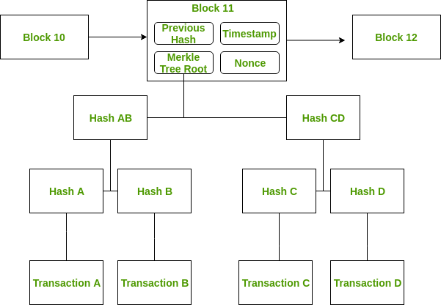
Inside of Blockchain

Slide 6
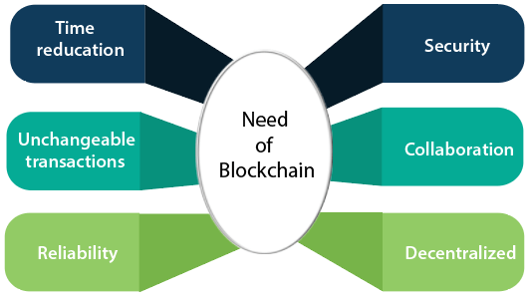
Need of Blockchain

Slide 7
Features
Cannot be corrupted
Decentralized Technology
Enhanced Security
Distributed ledger
Consensus
Faster settlements

Slide 8
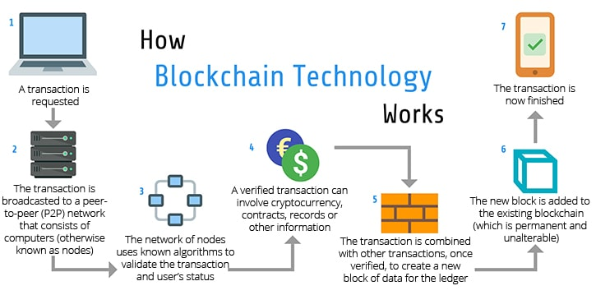
Working

Slide 9
Blockchain Vs Bitcoin
Bitcoin is a cryptocurrency, while blockchain is a distributed database.
Bitcoin is powered by blockchain technology, but blockchain has found many uses beyond Bitcoin.
Bitcoin promotes anonymity, while blockchain is about transparency. To be applied in certain sectors (particularly banking), blockchain has to meet strict Know Your Customer rules.
Bitcoin transfers currency between users, while blockchain can be used to transfer all sorts of things, including information or property ownership rights.

Slide 10
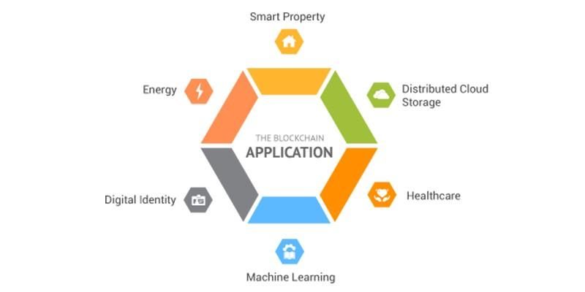
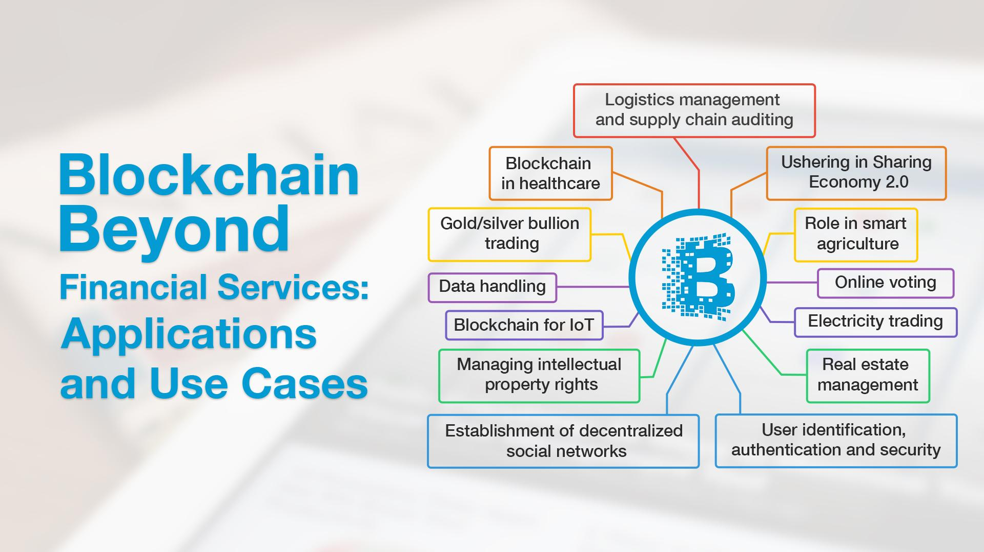
Applications of Blockchain
Blockchain is newly emerged technology which improve the legacy systems and digital processes in terms of transactions and record-keeping technology in favor of more flexible and efficient structures. Here are some applications/uses of blockchain listed below:

Slide 11
Advantages
It is Decentralized System.
The Blockchain is Transparent.
The Blockchain is More Secure .
It is Immutable.
Ease of use
It can Record Historical and Current Records in one place.
User Empower.
No Downtime.
Peer 2 peer network.
It offers lower transaction cost
It provides faster processing of transactions

Slide 12
Disadvantages
1. Blockchain can slow down when there are too many users on network.
2. Some solutions consumes too much of energy.
3. Blockchains are sometimes inefficient due to how they operate.
4. Blockchain implementation is a sometime costly process.
5. Blockchain does not offer interoperability as of now.
6. Blockchains are harder to scale due to their consensus method.
7. Blockchain cannot go back as data is immutable.

Slide 13
Programming languages used for blockchain development
C++
Java
Python
Ruby
Solidity
Go
C#
Javascript
Rust
Php

Slide 14
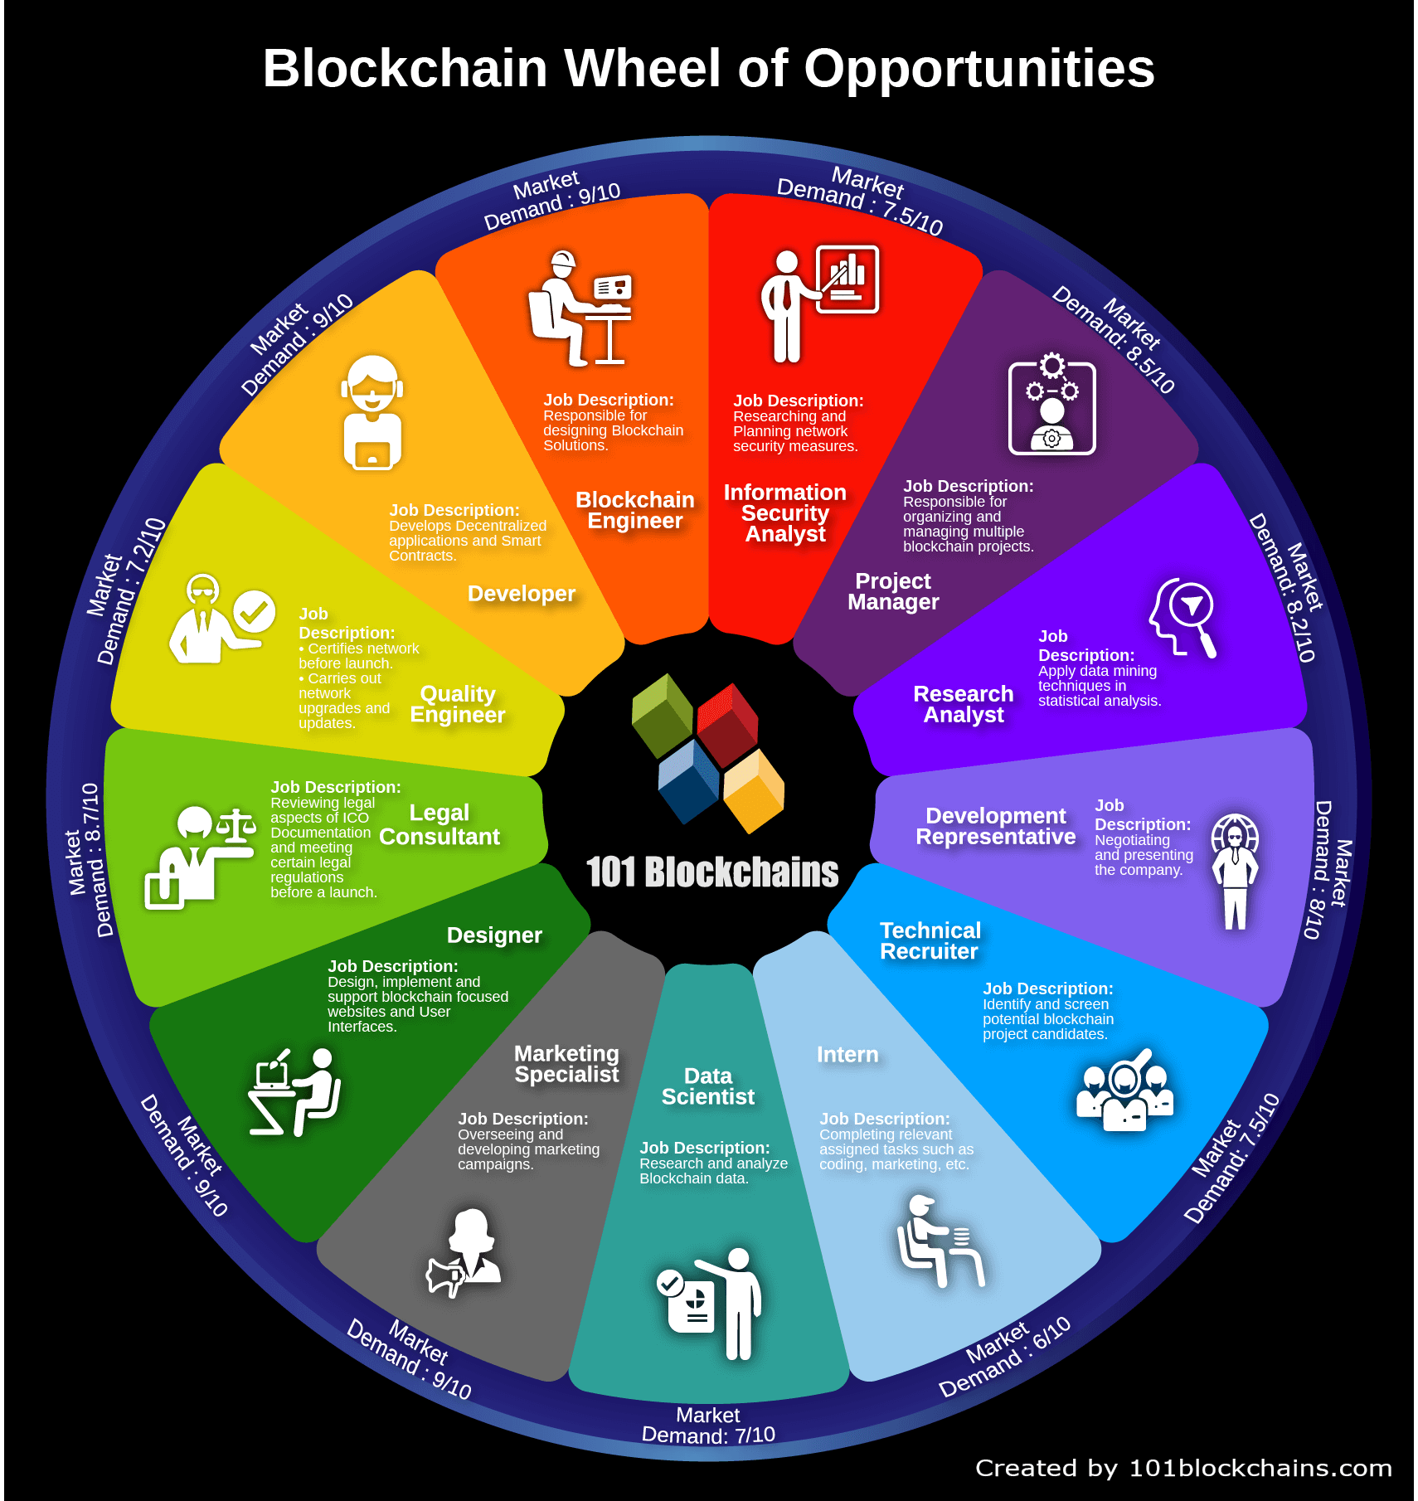
Blockchain Wheel of Opportunities

Slide 15
Future Scope
It has a fantastic future in different sectors such as supply chain management, digital advertising, forecasting, cyber security, Internet of things, networking, etc.
Blockchain technology also has a huge prospective to provide the new openings for occupation in the industry.
In the current day and age, there are endless opportunities for blockchain developers as umpteen number of jobs with handsome salaries are available.
The demand for blockchain developers is now at an all-time high.
Being considered as the second most demanded skill in the market after robotics specialists, blockchain development/engineering will only grow higher in popularity. This is not just speculation.
With blockchain technology becoming more and more in demand in industries such as business and finance, the companies in these sectors want to hire blockchain developers and architects to provide them with an edge over their competitors.

Slide 16
Conclusion
The Application of blockchain concept and technology has grown beyond its use for bitcoin generation and transactions.The properties of its security ,privacy ,traceability ,inherent data provenance time-stamping has seen its adoption beyond its initial application areas.
The blockchain itself and its variants are now used to secure any type of transactions,whether it be human-to-human communications or machine-to-machine.Its adoption appears to be secure especially with the global emergence of the Internet of Things.
The Blockchain has been especially identified to be suitable in developing nations where ensuring trust is a major concern.
Thus the invention of blockchain can be seen to be vital and much needed additional component of the internet that was lacking in security and trust before

Slide 17
Thank You

