Slide 1

Dr.Babasaheb Ambedkar Technological University
Lonere
Seminar
On
Quantum Computing
Guided by: Submitted By:
Mr.Pramod Patil Swapnil Tayade

Slide 2
Content
Introduction
History
Why quantum computer
What special about quantum computer
Applications of quantum computer
Problems
Conclusion

Slide 3
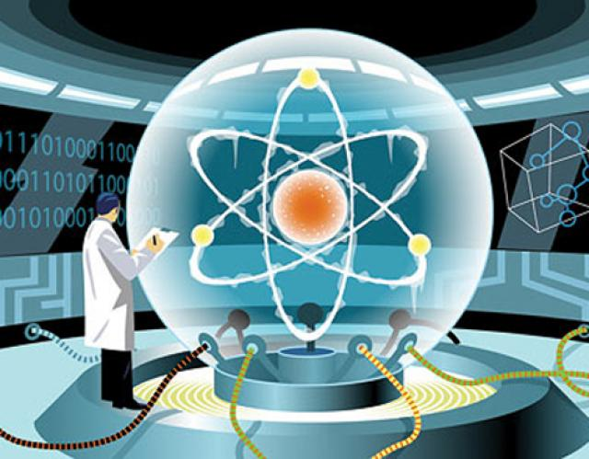
INTRODUCTION: Quantum computers
Quantum computers use atoms to perform calculation
Here computation depends on principle of quantum theory
Qubit

Slide 4
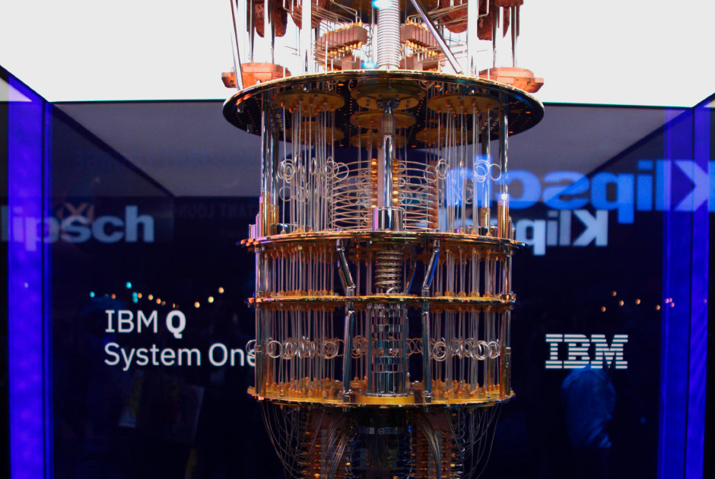
First Quantum Computer

Slide 5
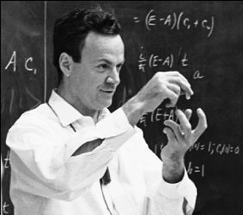
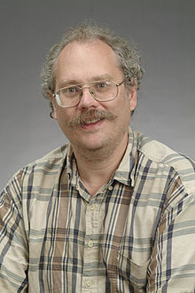
HISTORY
1982 - Feynman proposed the idea of creating machines based on the laws of quantum mechanics instead of the laws of classical physics.
1985 - David Deutsch developed the quantum Turing machine, showing that quantum circuits are universal.
1994 - Peter Shor came up with a quantum algorithm to factor very large numbers in polynomial time.
1997 - Lov Grover develops a quantum search algorithm with O(√N) complexity

Slide 6
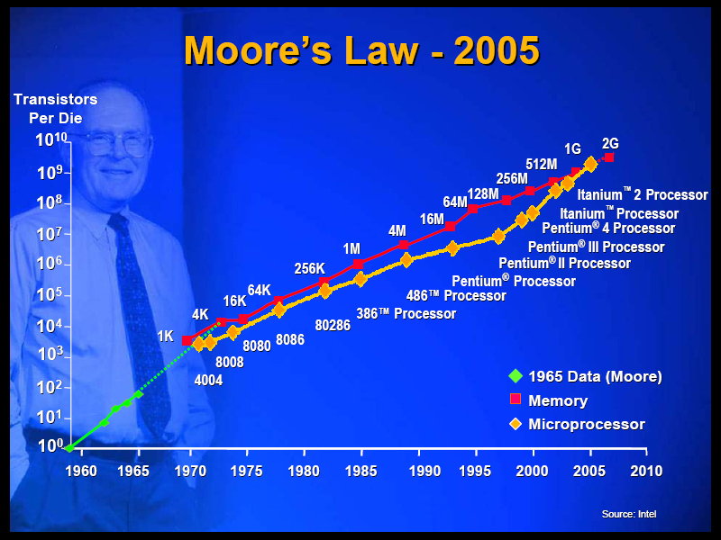
Why quantum computer
Moore’ law slowing down in 2020 it is flattened out.
Transistor cannot be made smaller due to the laws of Quantum mechanics starts to take over
Post silicon era

Slide 7
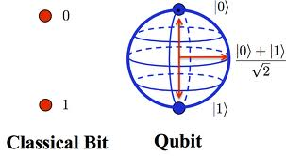
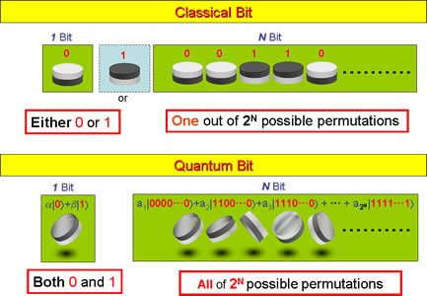
What special about Quantum computer

Slide 8
What special about Quantum computer
To give an idea about how this coin experiment works:
Quantum Computer plays a move but it is not revealed to the Opponent.
Opponent[Human] plays a move and it is also not revealed to the Quantum Computer.
Finally Quantum Computer plays a move.
Results are shown. If its heads, then Quantum Computer wins. Else, Opponent wins.
Quantum computer is tracking something low level in hardware. So, it knows every time, what did the opponent played.
Superposition and the third state is just a way, to not consider Opponent's Move (i.e. Ignoring Opponent's move). So, it is actually all the moves of Quantum Computer. So, it knows how to win. If this is the case, then actually there is no randomness or uncertainty added in the game by Opponent.

Slide 9
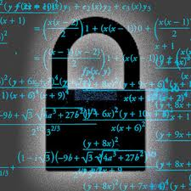
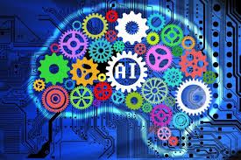
APPLICATIONS
Cryptography:Quantum computers can perform such factoring exponentially more efficiently than digital computers, meaning such security methods will soon become obsolete. New cryptography methods are being developed, though it may take time: in August 2015 the NSA began introducing a list of quantum-resistant cryptography methods that would resist quantum computers, and in April 2016 the National Institute of Standards .
Artificial intelligence:Quantum artificial intelligence (QAI) is an interdisciplinary field that focuses on building quantum algorithms for improving computational tasks within artificial intelligence, including sub-fields like machine learning.

Slide 10
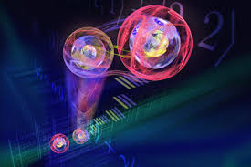
APPLICATIONS
Teleportation: Quantum teleportation is a process in which quantum information (e.g. the exact state of an atom or photon) can be transmitted (exactly, in principle) from one location to another, with the help of classical communication and previously shared quantum entanglement between the sending and receiving location.

Slide 11
Problems
Decoherence
Error correction
Output observance
Cost

Slide 12
Conclusion
A quantum computer thus has the theoretical capability of simulating any finite physical system and may even hold the key to creating an artificially intelligent computer.

Slide 13
Reference
www.google.com
www.wikipedia.org
www.physicsoftheuniverse.org
www.scientificamerican.org
www.forbes.org
www.w3school.org
www.tutorialpoint.org
www.geeksforgeeks.org

Slide 14
THANK YOU

Slide 15
Queries?

