Slide 1

INTERNET OF THINGS
SMART CITY
Presented by-
Rohini R.Salvi
Guided by-
Mr. Vinayak Mukkawar

Slide 2
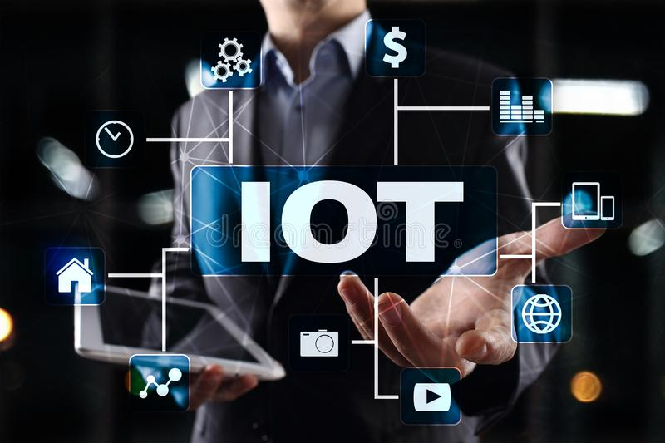

Slide 3
Iot applications and usecases
Smart home
Wearable
Smart city
Smart grids
Industrial internet
Connected cars
Connected health
Smart retail
Smart supply chain
Smart farming

Slide 4
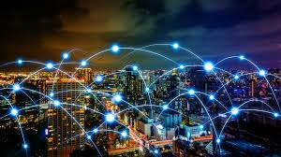
Smart city The concept
SMART CITY
THE CONCEPT

Slide 5
FRAMEWORK
Technology framework
Human framework

Slide 6
THE STRATEGY
RETROFITTING
GREENFIELD DEVELOPMENT
REDEVELOPMENT
PAN-CITY DEVELOPMENT

Slide 7
BASIC INFRASTRUCTURE
ASSURED ELECTRICITY SUPPLY.
SANITATION , INCLUDING SOLID WASTE MANAGEMENT.
EFFICIENT URBAN MOBILITY AND PUBLIC TRANSPORT.
AFFORDABLE HOUSING ESPECIALLY FOR POOR.
ROBUST IT CONNECTIVITY AND DIGITALIZATION.
GOOD GOVERNANCE ,ESPECIALLY E-GOVERNANCE AND CITIZEN PARTICIPATION.
SUSTAINABLE ENVIRONMENT.
SAFETY AND SECURITY OF CITIZEN , PARTICULARLY WOMEN ,CHILDREN AND ELDERLY.
HEALTH AND EDUCATION. ADEQUATE WATER SUPPLY.
http://smartcitydehradun.uk.gov.in

Slide 8
CITY WIDE SMART SOLUTIONS
E-governance, citizen services
Waste management
Water management
Energy management
Urban mobility

Slide 9
E-governance And Citizen Services
Public information, grievance redressal
Electronic service delivery
Citizen engagement
Citizens-city’s eyes and ears
Video crime monitoring

Slide 10
Waste Management
Waste to energy and fuel
Waste to compost
Waste water to be treated
Recycling and reduction of C&D waste

Slide 11
Water Management
Smart meter and managements
Leakage identification and preventive maintenance
Water quality monitoring

Slide 12
Energy Management
Smart meter and managements
Renewable sources of energy
Energy efficient and green buildings

Slide 13
Urban Mobility
Smart parking
Intelligent traffic managements
Integrated multi-modal transport

Slide 14
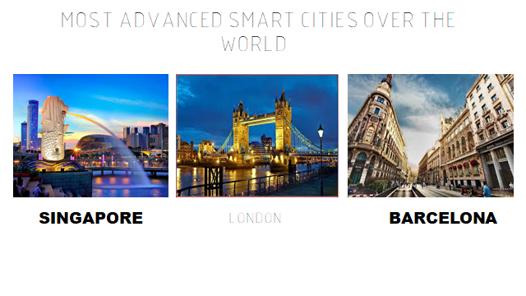
THE MOST ADVANCED CITIES OVER THE WORLD
LONDON

Slide 15
SOME DISADVANTAGES
Privacy concerns for its citizens
Security and safety concerns
Cost of living
Awareness of citizens
Battery replacement and charging issues

Slide 16
India as an emerging smart nation
THE ‘100 SMART CITIES’ MISSION
LAUNCHED BY PRIME MINISTER MR. NARENDRA MODI ON 25 JUNE 2015
mission like AMRUT(atal mission for rejuvention and urban transformation) AND SWACHH BHARAT MISSION
FUNDS OF ABOUT 50,000 CRORERORE

Slide 17

THANKS YOU

