Slide 1

Amazon Web Services
Presented
Samiksha S. Sankar
Guide
Prof. Rasika T. Kalyane

Slide 2

Content
What Is AWS ?
Why AWS ?
Cloud Computing Models
Cloud Deployment Models
Compute Services
Databases
Developer Tools
Storage Services
Conclusion
Scope
Bibliography

Slide 3
What Is AWS ?
Amazon Web Services (AWS) is a secure cloud services platform, offering compute power, database storage, content delivery and other functionality to help businesses scale and grow.
In simple words AWS allows you to do the following things-
Running web and application servers in the cloud to host dynamic websites.
Securely store all your files on the cloud so you can access them from anywhere.
Using managed databases like MySQL, PostgreSQL, Oracle or SQL Server to store information.
Send bulk email to your customers.

Slide 4
Why AWS ?
Easy to use
Flexible
Cost-Effective
Reliable
Scalable and high-performance
Secure

Slide 5
Cloud Computing Models
Infrastructure as a Service (IaaS)
Platform as a Service (PaaS)
Software as a Service (SaaS)

Slide 6
Cloud Deployment Models
Public Cloud
Private Cloud
Hybrid Cloud

Slide 7
Compute Services
Elastic Compute Cloud (EC2)
Auto Scaling
Amazon Elastic Container Registry (ECR)
Amazon Elastic Container Service (ECS)
Amazon Elastic Kubernetes Service (EKS)
AWS Fargate
AWS Lambda

Slide 8
Databases
RDS (Relational Database Service)
DynamoDB
Neptune
QLDB (Quantum Ledger Database)
Timestream
DocumentDB

Slide 9
Developer Tools
CodeCommit
CodeBuild
CodeDeploy
CodePipeline
CodeStar
Cloud9
X-Ray

Slide 10
Storage Services
Simple Storage Service (S3)
Elastic Block Store (EBS)
Glacier
Storage Gateway

Slide 11
Conclusion
AWS is the leading solution in the public cloud offering.
AWS saves us a lot of money
AWS provides building blocks that you can assemble quickly to support virtually any workload.
Moving to AWS has forced us to build better applications and follow better IT practictice.

Slide 12
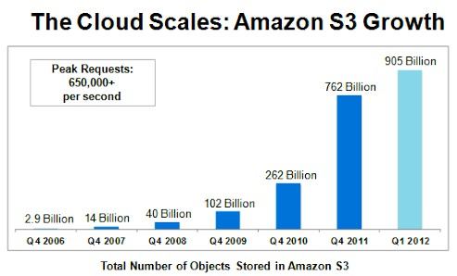
Scope
As it proves that it has future, Azure seems to be more expensive and also the service provided by Azure is less when compared to AWS.
AWS has placed several data centers worldwide and especially in North America so the performance will be good when we compared to Azure.
AWS is everywhere in the world and it has been providing more than 100+services in various types.

Slide 13
Bibliography
AWS Architecture Center
AWS Architecture Blog
AWS Documentation
Getting Started with AWS

Slide 14
Thank You

