Slide 1
Name :- suhas balasaheb bachate
PRN:-10303320171124510073

Slide 2
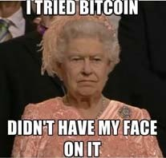
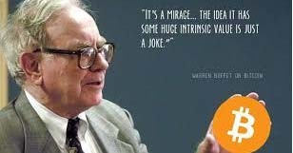
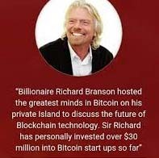
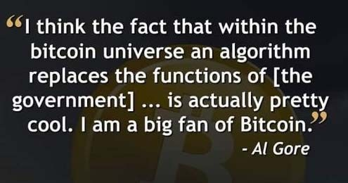

SURVEY : WITH OR AGAINST
Crypto-Currencies :
A Revolution or a Hoax ?
Do you believe in the future of crypto-currencies ? Are you an investor ?
Blockchain :
Technology of the future ?
ICO :
Successful model for raising funds ?
WHAT THE FAMOUS THINK

Slide 3
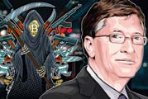
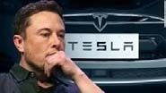
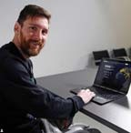
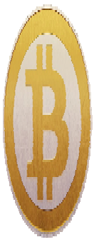
WHAT THE FAMOUS THINK
“Cryptocurrencies are used for buying Fentanyl and other drugs so it is a rare technology that has caused deaths in a fairly direct way. I think the speculative wave around ICOs and cryptocurrencies is super risky for those who go long,” “Yes, anonymous cash is used for these kinds of things but you have to be physically present to transfer it which makes things like kidnapping payments more difficult.”
Tesla CEO Elon Musk recently made a statement that his piggy bank has a very modest stock of cryptocurrency – only 0.25 BTC. But asking what can be done with Ethereum.
Messi joins the world of cryptocurrencies
WHAT IS A CRYPTO-CURRENCY
Anti-system, anti- financial institution currency
Its value is not based on any known economic indicator
Designed to be free from government manipulation and control
Has no physical, tangible existence
Purpose :
Perform financial transaction outside the existing financial system
Lower cost of transactions
Is not issued by a central authority
Concern :
Transaction security
Is not submitted to any market authority regulation
Trust :
Previously was provided by financial institutions
Now provided by the users themselves

Slide 4

WHAT IS A CRYPTO-CURRENCY
Systematically under attack
No CEO
Bad publicity
Open source
Peer to Peer
Rare – Not rare
No frontier
Near anonymity
Trusted or Untrusted
No company
No single point of failure
No brand
DEFINITION OF VIRTUAL CURRENCY
In 2014, the European Bank Authority defined virtual currency as :
“A digital representation of value that is neither issued by a central bank or a public authority, nor necessarily attached to a fiat currency, but is accepted by natural or legal persons as a means of payment and can be transferred, stored or traded electronically.”

Slide 5
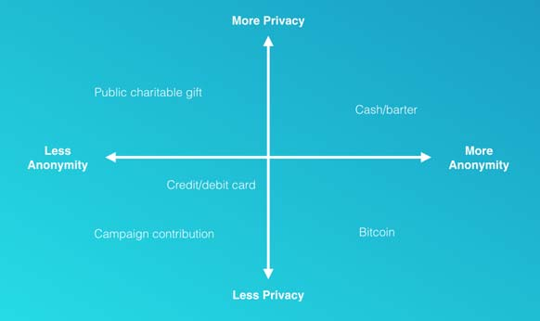








CRYPTO-CURRENCY : ANONYMITY V/S PRIVACY
A transaction is “anonymous” if no one knows who you are.
A transaction is “private” if what you purchased & for what amount, are unknown
MAIN CRYPTO-CURRENCIES
https://coinmarketcap.com/all/views/all/
Crypto- Currency | Symbol | Logo | Date of Release | Programming Language
Bitcoin | BTC XBT, ₿ |  | 2008 | C++
Ethereum | ETH |  | 2015 | C++, Go
Ripple | XRP |  | 2013 | C++
Litecoin | LTC |  | 2011 | C++
Monero | XMR |  | 2014 | C++
Dash | NEO |  | 2014 | C++
Zcash | ZEC |  | 2016 | C++
Petro | XPD |  | 2018 | C++
Namecoin | NMC |  | 2011 | C++
Swiftcoin | STC |  | 2011
Bytecoin | BCN |  | 2012
Peercoin | PPC |  | 2012 | C++
Stellar | XLM |  | 2014 | C, C++

Slide 6
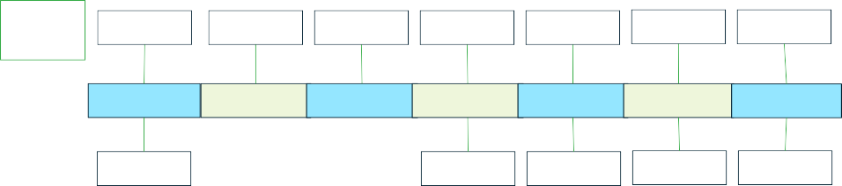
CRYPTOCURRENCIES IN FIGURES
# of Cryptos
590
796
1,128
1,345
2,018
2,111
2,209
Feb. 2017 May 2017 Sept. 2017 Jan. 2018 Nov. 2018 Mar. 2019 May 2019
Capital Market
140B$
850B$
185B$
141B$
251B$
Capital Market Value :
~251B$ Cryptomarket
~30 Trillion $ NYSE
BITCOIN - HISTORY
Bitcoin.org domain
Genesis block 50 BTC
Parity with US Dollar
Sept. 2008
Oct. 2008 Jan. 2010 May 2010 Feb. 2011 Sept. 2012
Paper on Bitcoin by Satoshi Nakamoto
2 pizza bought with 10,000BTC
Bitcoin Foundation

Slide 7
BITCOIN : WHO IS BEHIND IT
2008 :
Satoshi Nakamoto published the Bitcoin white paper.
Blockchain technology as we know it today gained then significance.
2014 :
Article published in the Newsweek “The Face Behind Bitcoin”.
Claiming that Dorian Nakamoto, a computer engineer, as the inventor of blockchain technology and bitcoin.
37 years old Japanese man living in California whose real name is Satoshi Nakamoto.
BITCOIN : WHO IS BEHIND IT
2013 :
Nick Szabo was Satoshi Nakamoto.
A decentralized currency enthusiast.
YYYY :
Hal Finney was a cryptographic pioneer prior to bitcoin.
Other than Nakamoto, he was the first person to use bitcoin blockchain, make improvements and file bug reports.
He was Dorian Nakamoto’s neighbor.
2014 :
Craig Steven Wrught, an Australian has claimed to be Nakamoto.
Dsmissed as a hoaxer for not producing sufficient evidence to link him to bitcoin blockchain.
All those who have been suspected to be Nakamoto have denied it,
2019 :
Craig Steven Wright : filed a copyright registration for the original bitcoin white paper. 110% rise in 1 hour of the BitcoinSV.
The U.S. Copyright Office does not recognize it.

Slide 8
BITCOIN - HISTORY
A distributed digital currency
White paper released by Satoshi Nakamoto in 2008
Transactions started in 2009
Limited and finite supply of 21 million Bitcoins
What after the 21 million Bitcoins ?
The protocol / algorithm may be changed.
No more supplies of Bitcoins. That may increase the price.
No fear as the last Bitcoin will be mined around year 2140, because of the constantly reduced block reward.
Only the future will tell.
BITCOIN – FINANCIAL INFO
Info | Value
Rate at launch | = 0.0000 US$
Highest rate | ~19,300US$, end of 2017
Current rate | ~8,734US$ - (30 May 2019)
Number of bitcoins already mined | 17.731 million
Current market capitalization | 154.9 billion US$
Maximum market capitalization reached | 321.3 billion US$
Average time between blocks | 10 minutes
Bitcoin generated per day | ~1,800
Purchased 1,000 Bitcoins at 10$ each for a total of 10,000$ ?
You would have been a multi-millionaire if you sold them at 19,000$ each.

Slide 9
BITCOIN – HOW TO GET THEM
BITCOIN – HOW TO GET THEM
3 Ways
Mine them
3 Ways
Mine them
Buy them
Hack them
Mining :
Powerful computers to solve complex algorithms.
Miners get rewarded by a number of Bitcoins.
Over time, the reward halves, and then halves again.
Very hungry in power consumption.
Buy them
Hack them
Mining :
Powerful computers to solve complex algorithms.
Miners get rewarded by a number of Bitcoins.
Over time, the reward halves, and then halves again.
Very hungry in power consumption.
Buying :
Open e-wallet (bitcoin wallet).
Use regular money to buy Bitcoin (credit card, bank transfer, debit card,…).
Bitcoin balances are kept using public and private “keys”.
Public key = IBAN
Private key = ATM PIN.
Hacking:
Mt.Gox, 2011, 2,609 BTC
Mt.Gox, 2014, 750,000BTC
BitFloor, 2012, 24,000BTC
Poloniex, 2014, 97 BTC
Bitstamp, 2015, 19,000BTC
Bitfinex, 2016, 120,000BTC
Parity Wallet,19.06.2017, 30M$ stolen
Parity Wallet 19.06.2017, 182M$ frozen
DAO, 17.06.2018 50M$
Buying :
Open e-wallet (bitcoin wallet).
Use regular money to buy Bitcoin (credit card, bank transfer, debit card,…).
Bitcoin balances are kept using public and private “keys”.
Public key = IBAN
Private key = ATM PIN.
Hacking:
Mt.Gox, 2011, 2,609 BTC
Mt.Gox, 2014, 750,000BTC
BitFloor, 2012, 24,000BTC
Poloniex, 2014, 97 BTC
Bitstamp, 2015, 19,000BTC
Bitfinex, 2016, 120,000BTC
Parity Wallet,19.06.2017, 30M$ stolen
Parity Wallet 19.06.2017, 182M$ frozen
DAO, 17.06.2018 50M$
BITCOIN – MINING REWARDS
BITCOIN – MINING REWARDS
Year | Value
2009 | 50
2012 | 25
2016 | 12.50
2020 – reward drop | 6.25
Inside a Chinese Bitcoin Miners
A look Inside America's Largest Bitcoin Mining Operation

Slide 10

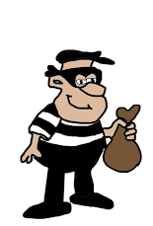
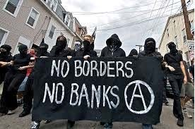
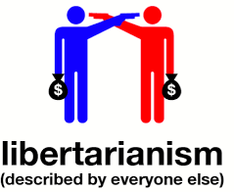
BITCOIN – EARLY USERS
Computer Geeks Anarchists Criminals Libertarians
BITCOIN BELONGS TO
How many bitcoins Satoshi Nakamoto own ?
980,000 – 1,000,000 bitcoin
Presumed to be lost forever !!!!! What could be the impact ?
A world leader able to govern ?
Manipulating everything ? Regulating the market ?

Slide 11
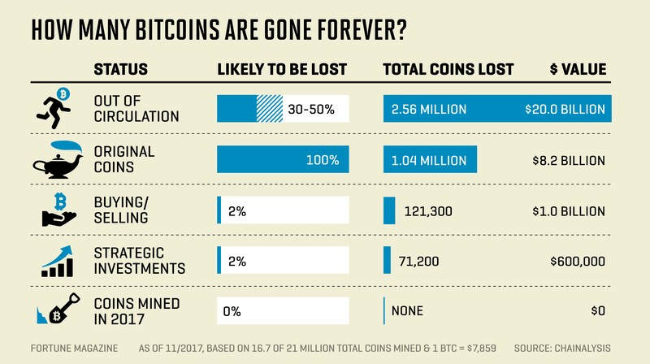
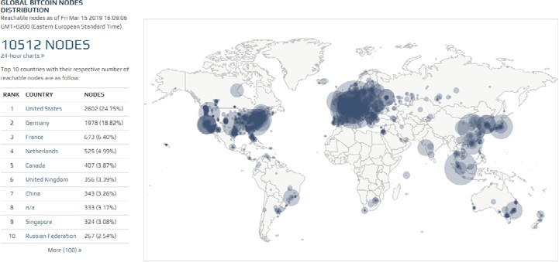
BITCOINS LOST
Nearly 4 Million Bitcoins Lost Forever, New Study Says
BITCOIN NODES

Slide 12
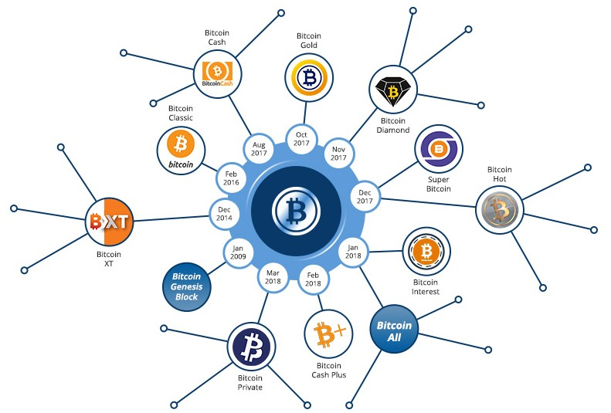
BITCOIN FORK HISTORY
BITCOIN V/S BANK
 | Bitcoin | Bank
Loss of Credentials | Loss of Money | Physical Access to Money
Money Loss Due to Fraud | No Legal Redress | Regulators Guarantee
Mistakes with Software / Security Breach | No Legal Redress | Legal Redress
Miners Decide to Pack-up | No Transactions | Legal Obligation for the Bank to Operate
Legal Enforcement | Impossible | Possible
Not Eligible for Bank Account | Send / Receive Money | No Money
International Transfer | Very Cheap | Expensive
Time to Transfer Money Intl’ | Minutes | Days
Risk of Converting Currencies | High / Moderate | Moderate / Low
Trust | Miners | Banks
 | Unregulated Miners | Regulated banks
 | Anybody Could be a Miner | Banks need to be approved

Slide 13
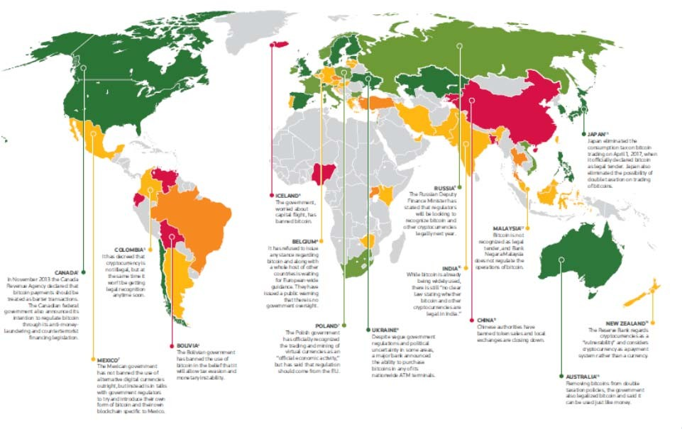
CROSS BORDERS TRANSFERS
CROSS BORDERS TRANSFERS
Institution | Transactions per Second
Bitcoin | 3 to 10
Ethereum | 20
Paypal | 193
VISA | 1,667
Institution | Transactions per Second
Bitcoin | 3 to 10
Ethereum | 20
Paypal | 193
VISA | 1,667
BITCOIN & THE WORLD

Slide 14



ALT COINS
 | Crypto- Currency | Current Rate | Highest | Market Cap | Supply | Max Supply
 | Ripple | ~0.387$ | ~2.5$ | 16.3B$ | ~42B | 100B
 | Ethereum | ~252$ | ~1,377$ | 26.8B$ | 106M
 | Litecoin | ~101$ | ~366$ | 6.3B$ | 61.9M | 84M
 | Crypto- Currency | Current Rate | Highest | Market Cap | Supply | Max Supply
 | Monero | ~86.8$ | 494$ | 1.47B$ | 17M
 | Zcash | ~72.85$ | 876$ | 481M$ | 6.60M
 | Dash | ~157$ | 1,600 | 1.38B$ | 8.8M | 18.9M
ETHEREUM
It is a public blockchain platform. Perform transactions in currency Ether. Run smart contracts.
Run general software applications.
Use Solidity as programming language that enables write and run Ethereum applications.

Slide 15
BITCOIN V/S ETHEREUM
BITCOIN V/S ETHEREUM
Bitcoin | Ethereum
Cryptocurrencies transactions only | Cryptocurrencies transactions and running code
Slow transactions validation (~10 min.) | Fast transactions validation (~14 sec.)
Single price for transactions | Different prices for transactions and running of programs
Bitcoins | Ether / creation of new tokens
All coins are minted by miners | Crowd funded / coins are minted
Bitcoin | Ethereum
Cryptocurrencies transactions only | Cryptocurrencies transactions and running code
Slow transactions validation (~10 min.) | Fast transactions validation (~14 sec.)
Single price for transactions | Different prices for transactions and running of programs
Bitcoins | Ether / creation of new tokens
All coins are minted by miners | Crowd funded / coins are minted
BITCOIN V/S MONERO
Bitcoin | Monero
Sender ID is public/known | Sender ID is private/unknown
Recipient can see how much money the sender has | Recipient cannot know how much money the sender has
You can buy it directly through a credit card or bank account | You can only buy it by converting Bitcoin
Mining
SHA-256 Algorithm | Cryptonight Algorithm
Needs special hardware (ASIC) | Can happen on user PC
Maximum block size – limit – slows down transactions during peak time. | Adaptive block size limit – changes based on transaction volume. A new block every 2min.

Slide 16
FACEBOOK AND CRYPTOCURRENCIES
Facebook’s cryptocurrency secretive plan : GlobalCoin FB Coin, or Libra
Help Facebook develop an entirely new revenue stream aside from advertising.
Zuckerberg met with Central Bank of England Governor, MasterCard, Visa, Western Union,...
As much as $19 billion in additional revenue in its “upside case” for Facebook by 2020 if its secretive cryptocurrency plans work out.
Launched in around 12 countries.
Conservatively, an incremental $3 billion in revenue from a successful cryptocurrency implementation.
Developing a cryptocurrency to use for peer-to-peer payments, tied to the value of traditional currencies and available to use through WhatsApp
Stablecoin : would likely be less attractive to and targeted by speculators, such as hedge funds, because of its fixed price tied to a currency like the U.S. dollar.
Facebook will want to be in control to gather data and simplify administration.
CRYPTOCURRENCIES – ALTERNATIVES TO GET THEM
Why not by playing / gambling : https://www.bustabit.com/play Every 250 bits = ~1$

Slide 17
CRYPTOCURRENCIES – HOW TO TRADE
Through the sections :
Fiat to Crypto Trading.
Storing Cryptocurrencies.
Crypto to Crypto Trading.
HOW TO TRADE
Fiat to Crypto :
You have money to invest.
Chose an exchange :
Make sure that the exchange / trader is available / allowed in Lebanon.
Check reputation
Check exchange rates
Check required documents / safety
Create an account.
Wallet :
You must have one.
Cryptocurrencies deposited in & protected by a wallet.
It saves your private and public keys which helps you store, send, and receive cryptocurrencies.
Private key :
Gives you the right to access and send money.
Confidential and private.
Public key :
The address where everyone will send you money.
Public, to be given to others.

Slide 18
HOW TO TRADE
Storing your Crypto :
Hot storage.
Cold storage.
Hot storage :
Like the wallet you carry around in your pocket.
It gives you easy access to your cash.
But, it is pretty vulnerable.
Cold storage :
Like your savings account.
Highly impractical for day-to-day use.
But, extremely safe.
HOW TO TRADE – CRYPTO TO CRYPTO
Open accounts in exchanges that enables crypto-to-crypto trading.
Check what cryptocurrencies are accepted, some allow you to buy using Bitcoin only.
Preferably better different than the one used to buy crypto from fiat.
Like traditional fiat currencies trading, with its charts, indicators,…

Slide 19
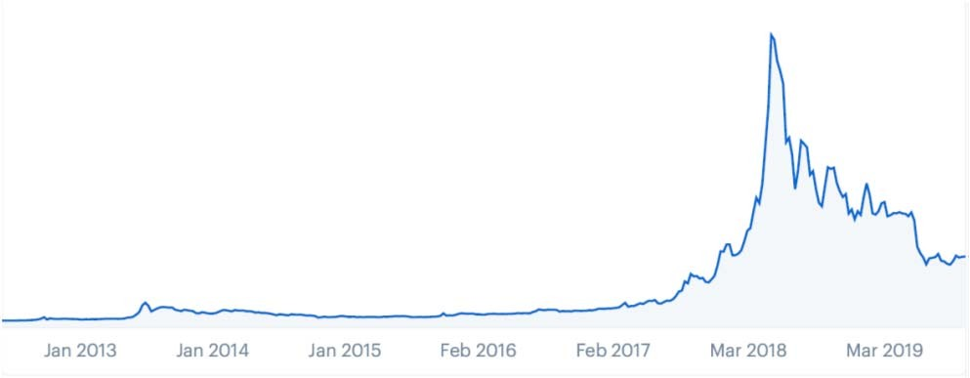
POSSIBLE FUTURE OF CRYPTO-CURRENCIES - BITCOIN
Bitcoin 2.0
Bitcoin 1.0
POSSIBLE FUTURE OF CRYPTO-CURRENCIES - BITCOIN
What to expect ?
By following the pattern : Rise in November 2021 By 1,300%
Value ~40k$
Market capitalization : ~800B$.
Nothing compared to the dot.com bubble in 2001 of 9.6T$.

Slide 20
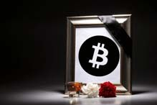
POSSIBLE FUTURE OF CRYPTO-CURRENCIES - BITCOIN
Other see it more likely at ~100$.
Bitcoin is like lottery tickets that might pay off in future
Near anonymity :
Take it away and no one will want to use it;
Keep it and advanced-economy governments will not tolerate it.
Many crypto-evangelists insist that bitcoin is “digital gold,” in part because the long- term supply is algorithmically capped at 21 million.
Unlike gold – which has always had other purposes and today is employed widely in new technologies from iPhones to spacecraft – bitcoin has no alternative use. And even if bitcoiners manage to find a way to lower the phenomenal energy cost of verifying transactions, the very nature of decentralised ledger systems makes them vastly less efficient than systems with a trusted central party like a central bank.
Real question : if and when global regulation will stamp out privately constructed systems that are expensive for governments to trace and monitor.
In the end, advanced economies will surely coordinate on cryptocurrency regulation, as they have on other measures to prevent money laundering and tax evasion.
POSSIBLE FUTURE OF CRYPTO-CURRENCIES - BITCOIN
What is it waiting for to disappear ?
Bitcoin has died 348 times
Most Recent Death : March 02, 2019 Oldest Death : December 15, 2010 Deaths by Year:
2019 (10)
2018 (93)
2017 (124)
2016 (28)
2015 (39)
2014 (29)
2013 (17)
2012 (1)
2011 (6)
2010 (1)

Slide 21
POSSIBLE FUTURE OF CRYPTO-CURRENCIES - BITCOIN
This 10-years old technology pretends to replace the 4,000 years old fiat currency.
POSSIBLE FUTURE OF CRYPTO-CURRENCIES – COUNTRIES
The Banque du Liban closing in on the launch of its own crypto-currency. Launch of a new 100% ‘made in Lebanon’ crypto-currency in the near future.
The currency will be a “virtual Lebanese pound” destined exclusively for local use. Its goal is to ease payment methods, to implement a technological transformation of financial institutions and to lower the costs borne by consumers.
However, many risks have still to be taken into consideration.
First off, there are concerns about money laundering and cyber security.
Lebanon was the first country in the Middle East to issue an official warning regarding their trade.
Tunisia has already launched its e-DINAR in 2015, followed by the e-CFA in Senegal at the end of 2016, both based on blockchain technology.
Other states are in a trial phase such as Uruguay, Dubai with its emCash, Iran, which is looking to bypass American sanctions, and Singapore.
The Swiss company X8 has received a “sharia-compliant” certificate awarded by the Shariyah Review Bureau for its “stablecoin”.

Slide 22


