Slide 1
Virtual Reality
Shreyansh Shital Patil
10303320181124510013

Slide 2
Points To be Covered:
Introduction to VR
History of VR
Types Of Virtual Reality
Applications Of VR
Benefits
Challenges and Risk
Conclusion

Slide 3
Introduction:
What is VR: Virtual Reality is a computerized simulation of natural or imaginary reality. Often the user of VR is fully or partially immersed in the environment. Full immersion refers to someone using a machine to shield herself from the real world.
Partial immersion happens when a person can manipulate a VR environment but isn’t tucked or locked away in a machine. It is the technology that displays the environment with the help of simulations that look real to the user.
The Virtual Reality is computer-generated simulation of a three-dimensional image or environment that can be interacted with in a seemingly real or physical way by a person using special electronic equipment, such as a helmet with a screen inside or gloves fitted with sensors.

Slide 4
History of VR:
Invented in the 1950s, VR's development has experienced peaks and troughs. The first VR head-mounted display (HMD) system, The Sword of Damocles, was invented in 1968 by computer scientist Ivan Sutherland and his student Bob Sproull. Meanwhile, the term “virtual reality” was popularized by Jaron Lanier in the 1980s.Nowadays computer Graphics is used in many domains of our life. At the end of 20th century it is difficult to imagine an architect, engineer, or interior designer working without a graphics workstation. In the last year of the stormy development of microprocessor technology brings faster and faster computers to the market. These machines are equipped with better and faster graphics.
Moreover, the world of three dimensional graphics has neither borders nor constraints and can be created and manipulated by ourselves as we wish we can enhance it by a fourth dimension.

Slide 5
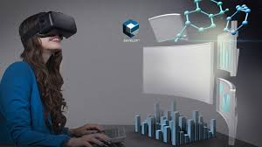
Types Of Virtual Reality:
1. Immersive Virtual Reality:
Immersive VR places users directly into the media content, potentially making the experience very vivid and real for children Immersive VR can provide users with multisensory experiences that replicate reality or create scenarios that are impossible or dangerous in the physical world.

Slide 6
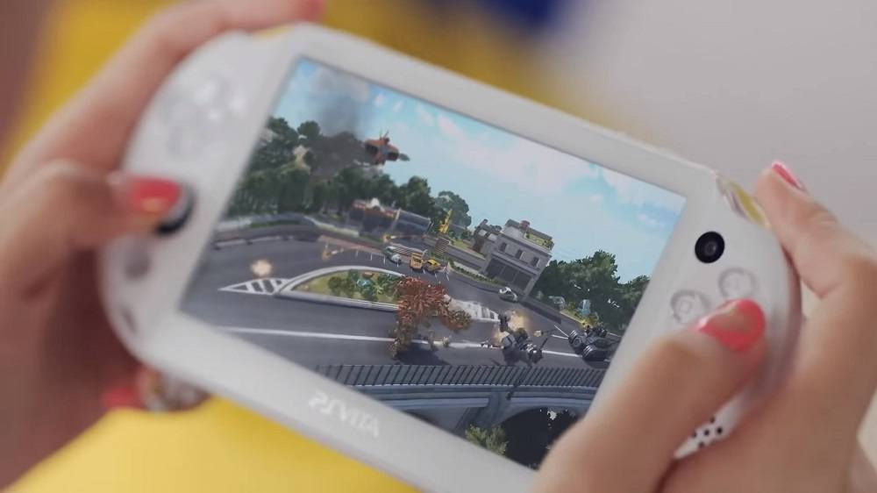
Non- Immersive Virtual Reality:
Technology that provides users with a computer-generated environment without a feeling of being immersed in the virtual world. Using various input devices, users can interact with digital content on a display.

Slide 7
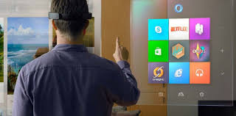
Window on World Virtual Reality:
Some systems use a conventional computer monitor to display the visual world. This sometimes called Desktop Window on a World VR . This concept traces its lineage back through the entire history of computer graphics. Window on Word reality is used in complex medical procedures such a surgeries or colonoscopies.

Slide 8
Application of VR:
Useful applications of VR include :
Training in a variety of areas(like, military, equipment operation, etc).
Education and design evaluation.
Architectural walk-through.
Human factors and ergonomic studies.
Medical Fields

Slide 9
Benefits:
Little/no risk.
Safe, controlled area.
Realistic scenarios.
Can be done remotely saving time and money.
Improves retention and recall.
Simplifies complex problems/situations.
Suitable for different learning styles.
Innovative and enjoyable.

Slide 10
Challenges and Risk:
There has been increasing interest in the potential social impact of new technologies, such as virtual reality. Virtual Reality will be integrated into daily life and activity and will be used in very human ways . Techniques will be developed to influence human behavior, interpersonal communication and cognition.
The design of virtual environments may be used to extend basic human rights into virtual space, to promote human freedom and well being and to promote social stability as we move from one stage in socio-political development to the next.
Whether, virtual reality will have positive or negative implications on the social structure is debatable, but one thing is certain – VR will play an increasingly important role in public and private life as we move towards the Future.
The idea of virtual reality faces humankind with a completely new phenomenon , which are the practical consequence of inhabiting a different reality.

Slide 11
Conclusion:
After 30 years, we are still at beginning of Virtual reality.
Every year, new, lighter, cheaper and more powerful devices get into market.
Sound and specially speech recognition and synthesis reinforce symbiosis between human and the machine.
Computers are advancing on gestures recognition.
Improvements on touch simulation thanks to use of new materials on data gloves.
Use of artificial noses and odor generators are being developed.
Exoskeleton are being introduced to the market and used on simulation of complex force feedback.
THANK YOU….!

