Slide 1

DR.BABASAHEB AMBEDKAR TECHNOLOGICALUNIVERSITY LONERE,RAIGAD
NAME Shriram Anant Hake
PRN 10303320181124510010
TOPIC Search engine

Slide 2
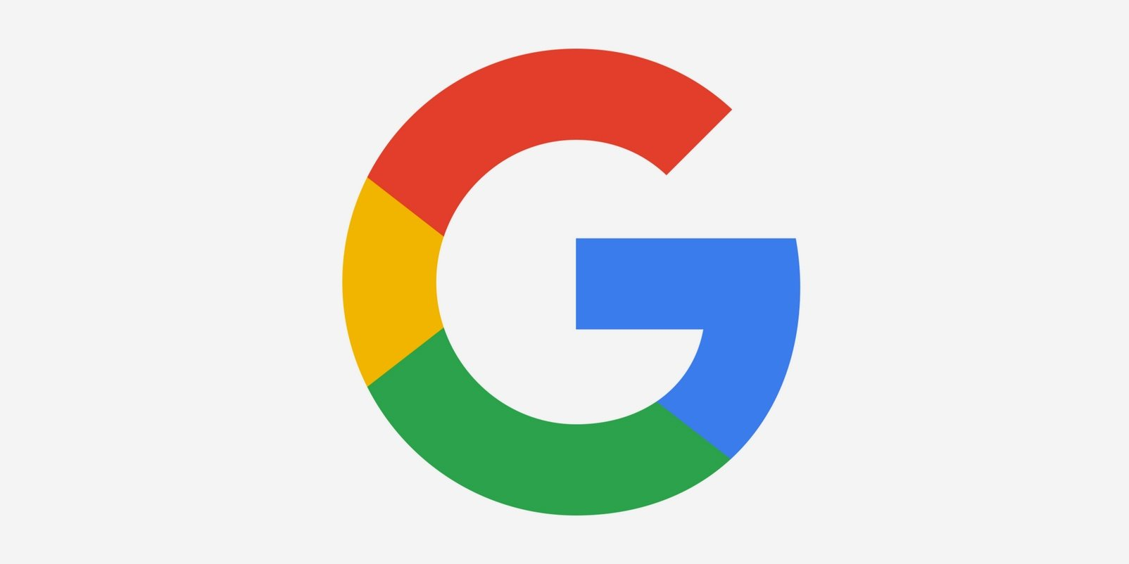
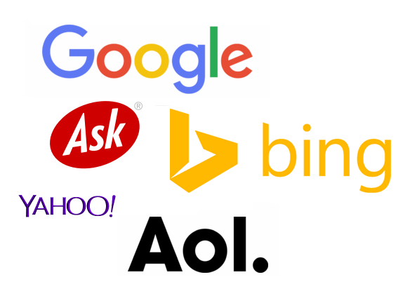
SEARCH ENGINE

Slide 3
INDEX
What is search engine
01
Types of search engine
04
02
Purpose of search engine
05
crawling
03
How do search engine works
indexing
06

Slide 4
Search engine working illustration
07
Advantages and disadvantages

Slide 5

What is search engine .
Search engine are complex computer software programmes designed to search an information on the world Wide Web and provide users the best results in fastest possible way .
A search engine is a web-based tool that enables users to locate information on the World Wide Web. Popular examples of search engines are Google, Yahoo!, and MSN Search. ... The information gathered
by the spiders is used to create a searchable index of the Web.
An estimate 70% to 80% internet user use Google as search
Engine and 30% to 20% internet users use other search engines.

Slide 6

What is the purpose of search engines?
Search engines allow users to search the internet for content using keywords. Although the market is dominated by a few, there are many search engines that people can use.
Who invented the search engine?
Alan Emtage
Alan Emtage invented the world's first search engine, but he didn't earn a single cent from his groundbreaking invention

Slide 7

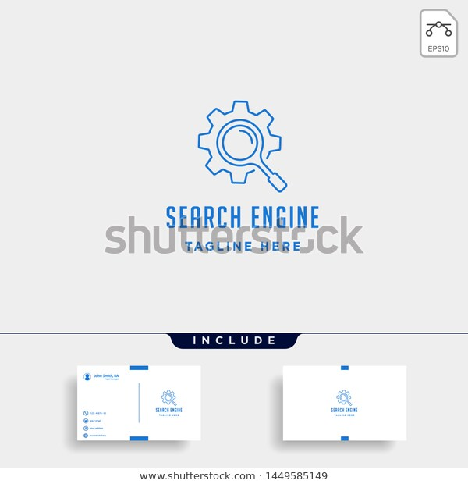
HOW DO SEARCH ENGINE WORK
Search engines work by crawling hundreds of billions of pages using their own web crawlers. These web crawlers are commonly referred to as search engine bots or spiders. A search engine navigates the web by downloading web pages and following links on these pages to discover new pages that have been made available
The searcher types a query into a search engine
Search engine software quickly sorts through literally millons of pages in its databases to find matches to this query.
The search engine’s result are rank in order of relevancy.

Slide 8

Search engines are classified into the following three categories based on how it works.
1> Crawling .
2> Indexing .
3> Ranking .
Other special search engines.

Slide 9
Crawling.
Search engine have numbers of computer programmes that are responsible for finding information that is publicly available on internet & these programmes are also known as crawlers.
These program scan the web and create a list of all the websuites .
Then they visit each page of the website and by reading the HTML code they try to understand :-
The structure of a page .
The type of a content .
The meaning of a content .
When it was created or updated.

Slide 10
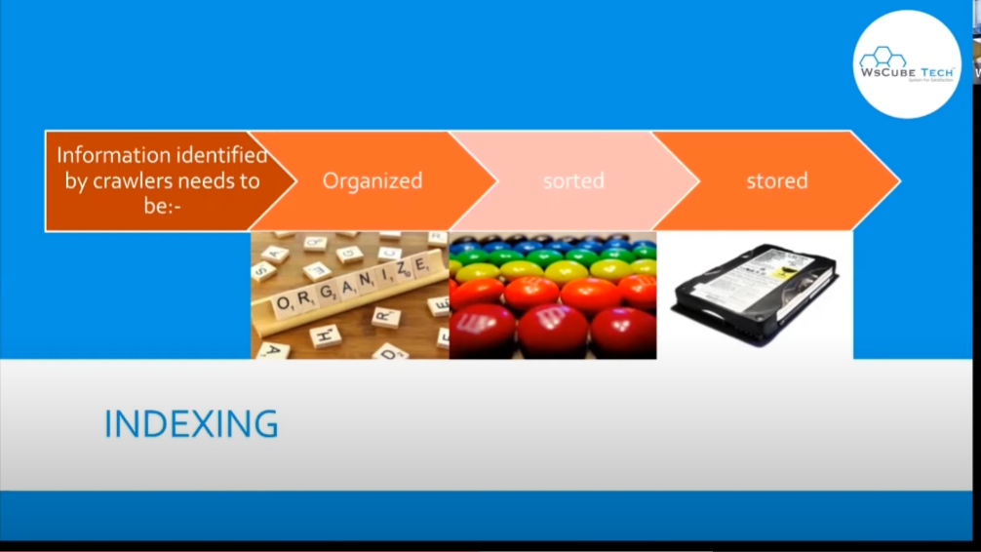
2>.INDEXING

Slide 11
WHY INDEXING IMPORTANT
If your website is not on index it will not appear in any searches.
Search engine don’t store all information on their index but they keep things like
Title and description of the page
Type of content
Assosiated keywords
No. of incoming &outgoing links
INDEXING

Slide 12
They are In change to decide which page to show & in what order .
Algorithm working process.
Analyze users query
Finding matching pages.
Present the results to users.
SEARCH ENGINE ALGORITHMS

Slide 13
RANKING ALGORITHM RULE
Google
Ranking algorithm
Takes more than
255
Rules into
Account
To rank
A page.

Slide 14
ANALYZE USER QUERY
To do that they
Analyze by breaking down in number of keywords
The first step
Is to understand what kind of
Information users is looking
For.

Slide 15
In this search engines look into their index
A page that matches best with the keyword
Some important factor in matching :-
Relevancy of content & title with users query .
Type of content.
Webpages quality .
Date of publication .
Popularity of page .
FINDING MATCHING
PAGES

Slide 16
PRESENT RESULT
A typical result page includes 10 organic results.
These results are enriched with other elements like :-
Paid google ads
Direct answers
Strories & tweets for news related element queries.
Videos
Related searches

Slide 17
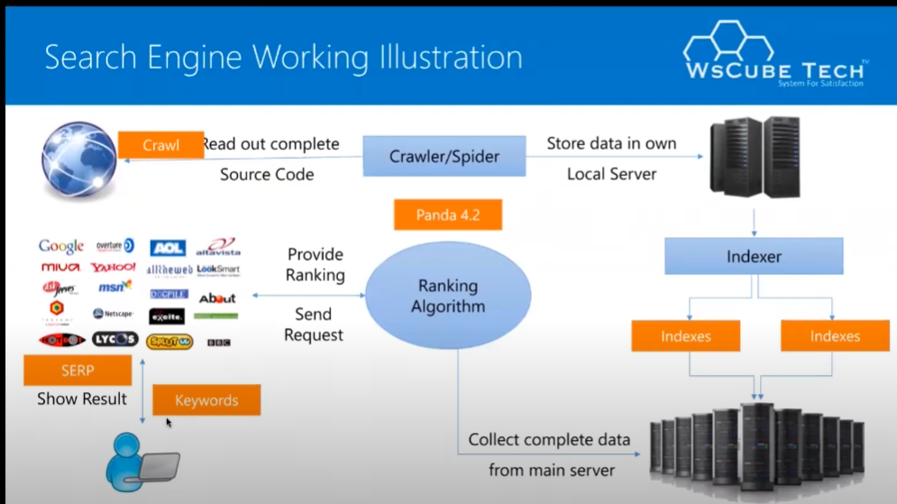
SEARCH ENGINE WORKING ILLUSTRATION

Slide 18
Advantages of search engine
• Easy to acquire different information from different topics
• determine specifically information
• Sorting and adding value to the information

Slide 19
Disadvantages of search engine
• Too many websites visitors
• Too many websites leads/sales

Slide 20

Thank you

