Slide 1
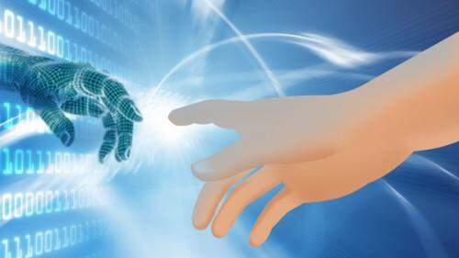
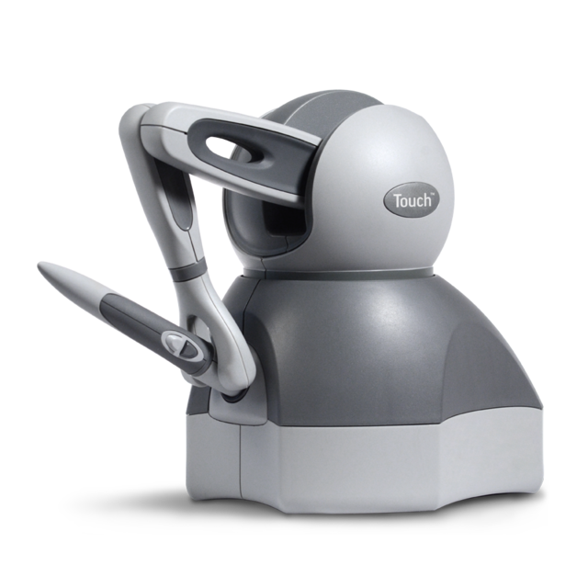
HAPTIC TECHNOLOGY

Slide 2


Seminar on
HAPTICS TECHNOLOGY
Under the guidance of
Prof. Kavita Aher
Submitted By
Shrutika Vijay Korvar

Slide 3
CONTENT
INTRODUCTION
WHAT IS HAPTICS…??
HISTORY OF HAPTICS
BASIC SYSTEM CONFIGURATION
HAPTIC INFORMATION
TYPES OF HAPTIC DEVICES
HAPTIC DEVICES
HAPTIC RENDERING
APPLICATIONS OF HAPTICS
ADVANTAGES
DISADVANTAGES
LIMITATIONS
FUTURE SCOPE
CONCLUSION

Slide 4
WHAT IS HAPTICS…??
Derived from greek word „haptikos‟ meaning “ABLE TO COME INTO CONTACT WITH”
Haptics = Touch = Connection
Haptics , is the technology of adding the sensation of touch and feeling to computers.
When virtual objects are touched, they seem real and tangible.
Of the five senses, touch is the most proficient, the only one capable of simultaneous input and output

Slide 5
HISTORY OF HAPTICS
Scientists used term haptics to label the subfield of their studies that addressed human touch-based perception and manipulation
By 70‟s and 80‟s research efforts in a completely different field, robotics also began to focus on manipulation and perception by touch building a dexterous robotic hand
In the early 1990s a new usage of the word haptics began to emerge
The confluence of several emerging technologies made virtualized haptics, or computer haptics possible

Slide 6
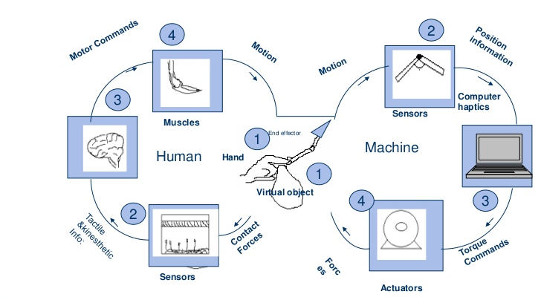
BASIC SYSTEM CONFIGURATION

Slide 7
HAPTIC INFORMATION
Combination Of :
Tactile Information
Refers to the information acquired by the sensors connected to the body
Kinesthetic Information
Refers to the information acquired by the sensors in the joints

Slide 8
TYPES OF HAPTIC DEVICES
1) VIRTUAL REALITY/ TELEROBOTICS BASED DEVICES
EXOSKELETONS AND STATIONARY DEVICES
GLOVES AND WEARABLE DEVICES
POINT SOURCES AND SPECIFIC TASK DEVICES
LOCOMOTION INTERFACES
2) FEEDBACK DEVICES
FORCE FEEDBACK DEVICES
TACTILE DISPLAY DEVICES

Slide 9
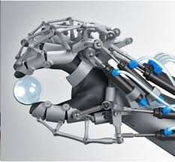
HAPTIC DEVICES
PHANTOM INTERFACE
CYBER GRASP SYSTEM

Slide 10
COMMONLY USED HAPTIC DEVICES
PHANTOM
providing a 3D touch to the virtual objects
provides 6 d.o.f
when the user move his finger, then he could really feel the shape and size of the virtual 3D object that has been already programmed
virtual 3 dimensional space in which the phantom operates is called haptic scene

Slide 11
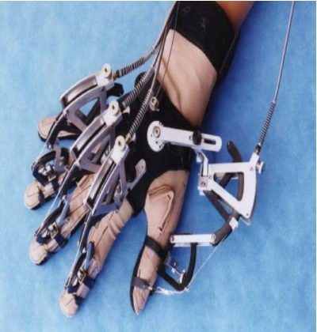
2. CYBER GRASP
• The CyberGrasp system fits over the user's entire hand like an exoskeleton and adds resistive force feedback to each finger
• Allows 4 dof for each finger
• Adapted to different size of the fingers
• Located on the back of the hand

Slide 12
HAPTIC RENDERING
PRINCIPLE OF HAPTIC INTERFACE
Interaction occurs at an interaction tool that mechanically couples two controlled dynamical systems :
haptic interface with a computer
human user with a central nervous system
CHARACTERISTICS
Low back-drive inertia and friction
Balanced range, resolution and bandwidth of position sensing and force reflection, minimal constraints on motion
Symmetric inertia, friction, stiffness and resonant frequency properties,proper ergonomics

Slide 13
APPLICATIONS OF HAPTICS

Slide 14
MEDICAL APPLICATIONS
• sense of touch is crucial for medical training
• various haptic interfaces for medical simulation may prove especially useful for training
MILITARY APPLICATIONS
For certain applications, for example where terrain or texture information needs to be conveyed, haptics may be the most efficient communication channel.

Slide 15
MUSEUM DISPLAY
for 3D digitization of priceless artifacts and objects from their sculpture and decorative arts collections, making the images available via CD-ROM
ENTERTAINMENT
Haptics is used to enhance gaming experience
software also allows you to program force feedback sensations to your game controller button press
"Submarines" is a PHANTOM variant of the well known battleship game

Slide 16
HOLOGRAPHIC INTERACTION
The feedback allows the user to interact with a hologram and receive tactile response as if the holographic object were real
Ultrasound waves to create a phenomenon called acoustic radiation pressure which provides tactile feedback as users interact with the holographic object.

Slide 17
ADVANTAGES
Digital world can behave like the real world.
Working time is reduced.
Medical field simulators allow would be surgeons to practice digitally.

Slide 18
disADVANTAGES
The precision of touch requires a lot of advance design.
Haptics applications require highly specialized.
Hardware and considerable processing power and hence it is complex.
Debugging issues.

Slide 19
LIMITATIONS
High cost involved
Large weight and size of haptic devices (especially wearable ones)
Haptic interfaces can only exert forces with limited magnitude and not equally well in all directions
haptic-rendering algorithms operate in discrete time whereas users operate in continuous time

Slide 20
FUTURE SCOPE
1.Holographic Interaction
The feedback allows the user to interact with a hologram and
actually receive tactile response using acoustic radiation pressure
2.Medical Application
Use of a central workstation from which surgeons would perform
operations in various locations; with machine setup and patient
preparation performed by local nursing staff
3. Textile Industry
User could study and feel the texture and quality of materail during
the sale of cloth through internet

Slide 21
CONCLUSION
Continued implementation of tactile devices to aid people with disabilities will advance further
Currently limited to consumers
Future generations of mobile devices and game console accessories will implement more haptic feedback
Perhaps also in desktop computers and laptops
Still embroyonic when compared to full fledged VR simulations

Slide 22
THANK YOU

