Slide 1
Cyber Terrorism
A seminar on

Slide 2

A Seminar Presentation on Cyber Terrorism by Sumedh Santosh Divekar. Roll no.:-10303320191124510056 under guidance of Prof. Sanil Gandhi sir. Dr. Babasaheb Ambedkar Technological University Lonere, Mangaon Raigad-402103.

Slide 3
Abstract
Cyber terrorism is comprised of two words Cyber: characteristics of culture of computers, information technology, and virtual reality. Terrorism: the unofficial or unauthorized use of violence and intimidation in the pursuit of political terms. As the internet grows day by day, traditional concepts and methods of terrorism have taken new dimensions. Individuals of groups can use the autonomy afforded by cyberspace to threaten citizens, specific groups, communities, political parties, and event governments of countries.

Slide 4
Key Points :-
Introduction
What is Cyber Terrorism
Impact of Cyber Terrorism
Common attacking methods
Ip Spoofing
Ddos attacks
Secrete information appropriation and data theft
Phishing
Network damage and disruption
Other methods
Preventions and Protections
How to deal with cyber attacks
Conclusion
References

Slide 5
Introduction
Computer security is an issue of global concern to those who use internet for educational purpose or any kind of use .
Threats of terror attack have been concerned about seriously by many governments, media and the public since very long.
The terror attack is planned and issued by the human being and its hazard origin - the terrorist organizations have their own self-determination.
Recent years have witnessed the widespread use of information technology by terrorist-type organization.
This has led to the emergence of a new class of threat, which has been termed ‘cyber terrorism’.

Slide 6
What is Cyber Terrorism
Cyber terrorism is phrase used to describe the use of internet-based attacks in terrorist activities, including acts of deliberates, large scale disruption of computer networks, especially of personal computers attached to the internet by the means of tools such as computer viruses, etc.
Cyber Terrorism is the convergence of “terrorism and cyber space” .
By the basic definition we can say that cyber terrorism is the terrorist activities held by the use of cyber space or internet.

Slide 7
Impact of Cyber Terrorism
Cyberterrorism is a controversial term. Experienced cyberterrorists, who are very skilled in terms of hacking can cause massive damage to government systems, hospital records, and national security programs, which might leave a country, community or organization in turmoil and in fear of further attacks.
Cyber terrorism denotes unlawful attacks and threats of attack against computers, networks and information stored therein to intimidate or coerce a government or its people for propagating hidden political or unlawful social and religious agendas.
Cyber terrorism is capable to harm society and perform destructive events or at least have ability to spread or generate fear among peoples .
Cyber terrorism is been a concern among individual peoples to governments and entire world.

Slide 8
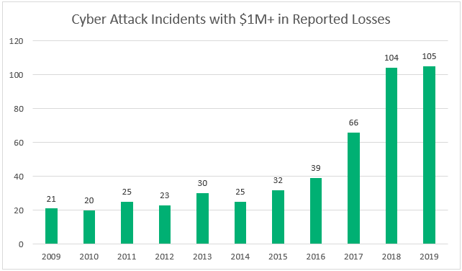
Impact of Cyber Terrorism the cyber attack have kept increasing for last decade and still increasing, causing greater losses .

Slide 9
Common Attacking Methods
Ip Spoofing
Ddos attacks
Secrete information appropriation and data theft
Phishing
Network damage and disruption
Etc.

Slide 10
Ip spoofing attack
Sending and receiving IP packets is a primary way in which networked computers and other devices communicate, and constitutes the basis of the modern internet.
All IP packets contain a header which precedes the body of the packet and contains important routing information, including the source address
IP spoofing is the creation of Internet Protocol (IP) packets which have a modified source address in order to either hide the identity of the sender, to impersonate another computer system, or both. The ability to spoof the addresses of packets is a core vulnerability exploited by many DDoS attacks.

Slide 11
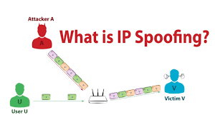
Ip spoofing attack Ip spoofing is generally used to hide the source address means to hide the senders identity .

Slide 12
Ddos attack
Ddos attack is short of “Distributed Denial of Services Attack”.
It is done by use of Ip spoofing.
The cyber terrorists use ddos method to overburden the servers of victims such as websites or government servers .
This is made possible by first infecting unprotected devices (computers and other devices those are connected to internet) by way of virus attacks and the tacking control over them . These devices acts as a BOTnet .
After tacking control over these devices , they are made to send requests or data in such a large number that the server cannot handle and hence collapses and denies any kind of service.

Slide 13
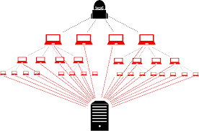
Ddos attack attacker server this can also be used to check if the servers can handle large number of traffic or not

Slide 14
Secrete information appropriation and data theft
The information technology can be misused for appropriating the valuable government secrets and data of private individuals or company secrets.
This private information can be used by terrorists to facilitate their activities , including destruction of property.
This data can be misused in many forms and terrorists can use it to archive extortion of money or other wills.
Terrorists ca target to government secrets and can cause great losses to country

Slide 15
Secrete information appropriation and data theft examples
Downloads and copies any data, computer data base or information from such computer, computer system or computer network including information or data held or stored in any storage medium
Data theft is the act of stealing information stored on computers, servers, or other devices from an unknowing victim with the intent to compromise privacy or obtain confidential information. Data theft is a growing problem for individual computer users as well as large corporations and organizations.

Slide 16
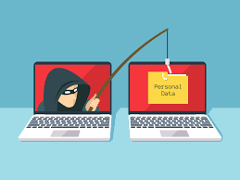
Phishing Attack
Phishing is a cybercrime in which a target or targets are contacted by email, telephone or text message by someone posing as a legitimate institution to lure individuals into providing sensitive data such as personally identifiable information, banking and credit card details, and passwords.
The goal is to trick the victim into believing that the message is something they want or need, a request from their bank, for instance, or a note from someone in their company , and to click a link or download an attachment.
Phishing victims are tricked into disclosing information they know should be kept private. However, because they trust the source of the information request and believe that party is acting with the best intentions.
Cybercriminals send phishing emails that include links to fake websites, such as the mobile account login page for a known mail provider, asking the victim to enter their credentials or other information into the fake site’s interface. The nefarious website will often leverage a subtle change to a known URL to trick users

Slide 17
Network damage and disruption
The main goal of cyber terrorists activities is to cause networks damage and their disruptions.
This process may involve a combination of computer getting virus attacks, hacking, etc.
The main goal is to collapse the network and that results in systems to crash.
This can cause great loss and important data can be get corrupted.

Slide 18
Serval other forms of cyber attacks
Man in middle attack
Black out days
Bank servers attack
Hijacking systems connected to internet
Etc.

Slide 19
How to deal with cyber terrorism (tools against cyber attacks)
Preventions and protections management.
Digital signatures.
Encrypting data.
Security audits.
E-discovery investigations
Implementing cyber security methods.

Slide 20
Conclusion
In conclusion, to combat terrorism effectively requires an understanding of threats, reliable information, teamwork on the part of many segments of society, organizational entities capable of implementing actions, and good supporting analyses.
It is crucial to remain vigilant and to defend ourselves against such potentially devastating attacks . Even though in past years a lot of development is occurred to counter cyber attack events and a lot of security products are available, still these attacks remains very dangerous possibilities in future so we always need to be conscious about them.

Slide 21
References
Seminar guide prof. Sanil Gandhi sir
IEEE research paper on
1) National Information Infrastructure Security and Cyber terrorism in process of industrialization.
2) Cyber Terrorism.

Slide 22


Slide 23


