Slide 1

MOCK INTERVIEW SYSTEM

Slide 2

INTRODUCTION
Interview are an intricate part of each & every professional career, one might be very good in studies but without the much needed interview skills finding a job may be very difficult.
Helps students to develop their technical knowledge
Design for increasing students’ confidence and overall skills
Developing virtual reality based tool for interview practice.

Slide 3

PROBLEM STATEMENT
The project “MOCK INTERVIEW SYSTEM” consist of many features that will help the user the real life problem such as anxiety, fear low confidence. Thus this system will help to develop the knowledge, self confidence.
The proposed system is a professional system focused on enhancing your knowledge through set of specific expert questions. Based on real life survey, the system truly focuses on how to improve every aspect of your intelligence.
In the existing system, the user can experience the following features:
Principles in achieving success
Building self confidence and finding inner peace
Things to improve your life and avoiding self improvement
Creating attitude of gratitude
Top tips to improve yourself

Slide 4

LITERATURE REVIEW
Sr. no. | Name of the Author | Year of Publication | Publication Name | Findings
1 | Gary Feng , Mohammed (Ehsan) Hoque | January 2017 | Automated Video Interview Judgment on a Large-Sized Corpus Collected Online | Research efforts in developing automated video interview judgment systems have emerged
2 | A. Hiemstra and E. Derous, | 2015 | Video resumes portrayed: Findings and challenges | Employee recruitment, selection, and assessment: Contemporary issues for theory and practice
3 | M.I.Tanveer,D. Gildea, and M.E. Hoque | June 2015 | Proc. of Automatic Face and Gesture Recognition (FG), 2015. | Automated prediction and analysis of job interview performance
4 | Franciska De Jong | June 2008 | Access to Recorded Interviews: A Research Agenda | Natural Language Processing —Speech recognition and synthesis, text analysis, a coherent research agenda is proposed.

Slide 5
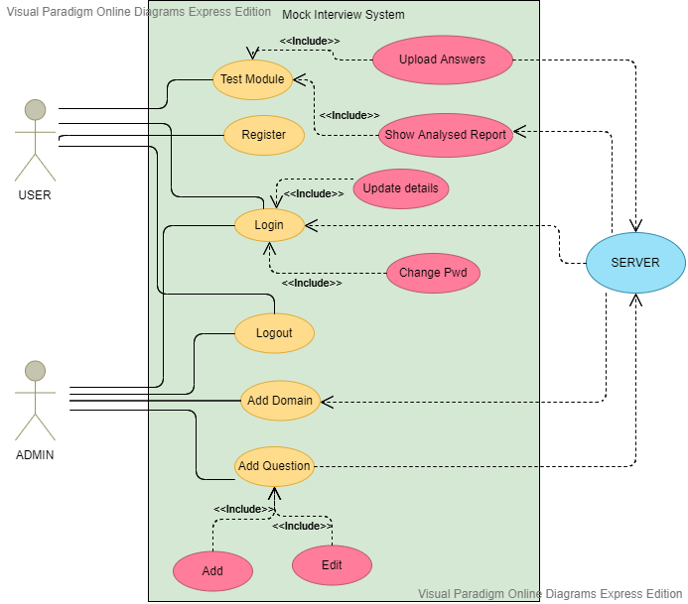
METHODOLOGY

Slide 6

RESULTS TILL DATE
Database: -
50 questions each from various domains with answers
Frequently asked questions in interview
Actual Implementation: -
Homepage
Login page
Signup page &
Registration for the test

Slide 7
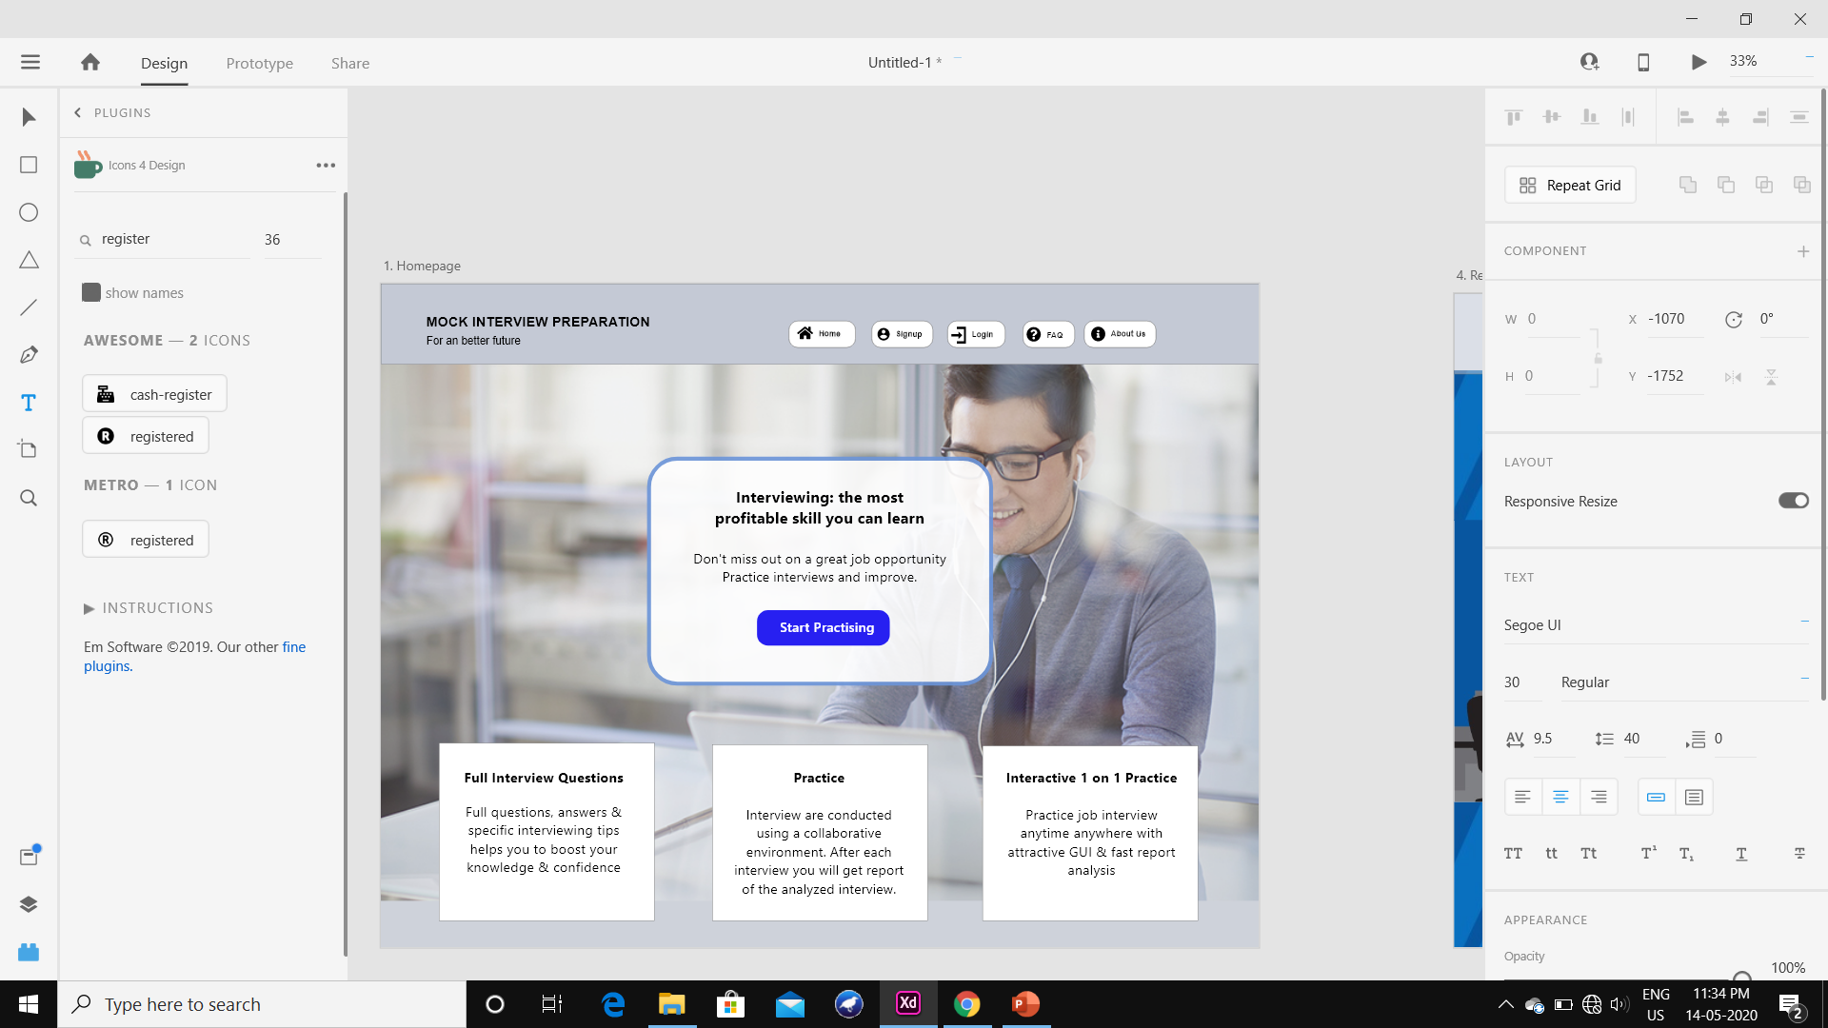
IMPLEMENTATION SNAPSHOTS 1. HOMEPAGE
Data A
Data B
Data C

Slide 8
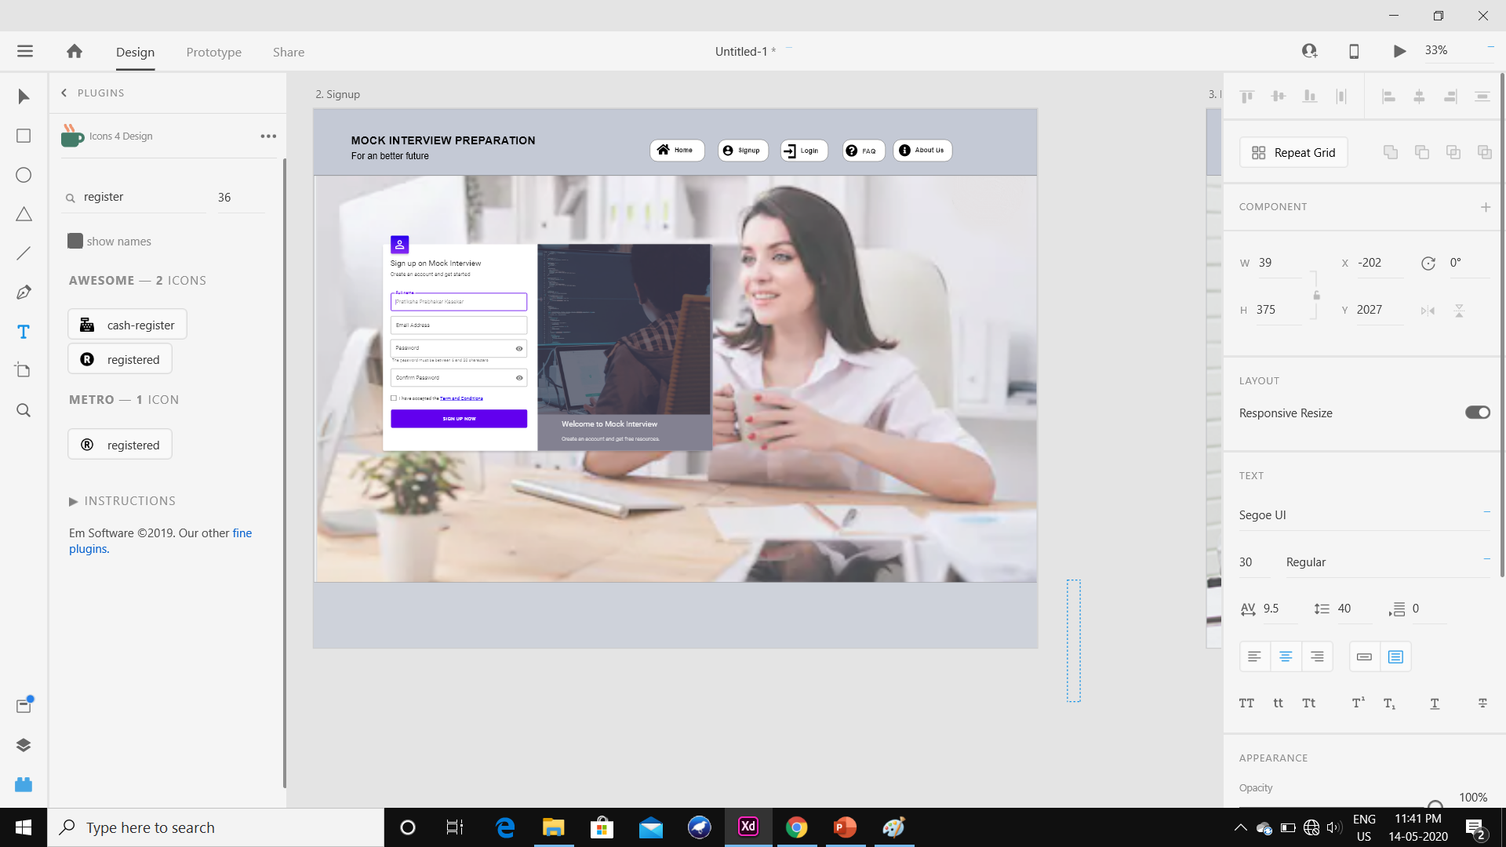
IMPLEMENTATION SNAPSHOTS 2. SIGN-UP
Data A
Data B
Data C

Slide 9
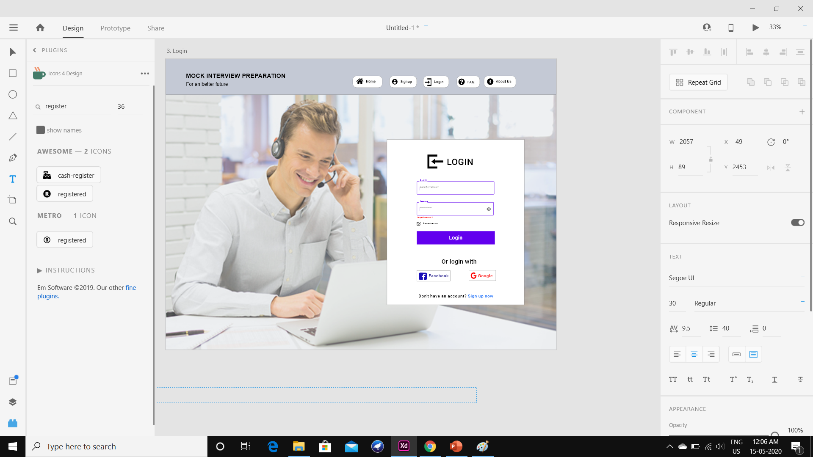
IMPLEMENTATION SNAPSHOTS 3. LOGIN
Data A
Data B
Data C

Slide 10
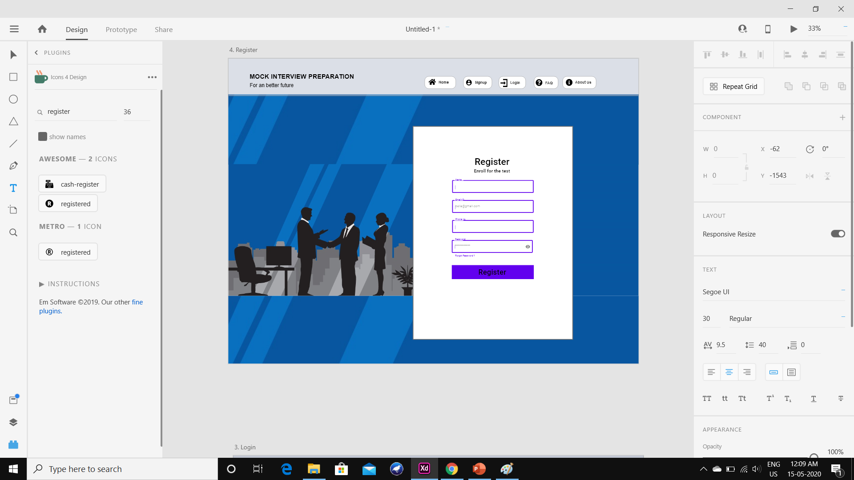
IMPLEMENTATION SNAPSHOTS 4. REGISTER
Data A
Data B
Data C

Slide 11
EXPECTED IMPLEMENTATION WHILE JOINING NEXT SEMESTER
Designing all the site pages
Inserting all the data in the database
Analyzing the algorithm in ML
Analyzing the input with the database
Virtual representation of the interviewer

Slide 12
REFERENCE
1. Chen, L., Zhao, R., Leong, C. W., Lehman, B., Feng, G., & Hoque, M. E. (2017). Automated video interview judgment on a large-sized corpus collected online. 2017 Seventh International Conference on Affective Computing and Intelligent Interaction (ACII). doi:10.1109/acii.2017.8273646
2. Aljarrah, I., & Mohammad, D. (2018). Video content analysis using convolutional neural networks. 2018 9th International Conference on Information and Communication Systems (ICICS). doi:10.1109/iacs.2018.8355453
3. Lu, L., & Hanjalic, A. (2008). Audio Keywords Discovery for Text-Like Audio Content Analysis and Retrieval. IEEE Transactions on Multimedia, 10(1), 74–85. doi:10.1109/tmm.2007.911304
4. Priya, K., Mansoor Roomi, S. M., Shanmugavadivu, P., Sethuraman, M. G., & Kalaivani, P. (2019). An Automated System for the Assesment of Interview Performance through Audio & Emotion Cues. 2019 5th International Conference on Advanced Computing & Communication Systems (ICACCS). doi:10.1109/icaccs.2019.8728458
5. Gorbova, J., Lusi, I., Litvin, A., & Anbarjafari, G. (2017). Automated Screening of Job Candidate Based on Multimodal Video Processing. 2017 IEEE Conference on Computer Vision and Pattern Recognition Workshops (CVPRW). doi:10.1109/cvprw.2017.214
6. Automated scoring of interview videos using Doc2Vec multimodal feature extraction paradigm. Authors: Lei Chen, Gary Feng, Chee Wee Leong, Blair Lehman, Michelle Martin-Raugh, Harrison Kell, Chong Min Lee, Su-Youn Yoon

Slide 13

Thank You

