Slide 1

THE DARK WEB
DARKER AND DEEPER SIDE OF THE INTERNET
Arban Kalyani

Slide 2
WHAT IS THE DARK WEB?
The Dark Web is the part of the World Wide Web that is only accessible by means of special software, allowing users and website operators to remain anonymous or untraceable.

Slide 3
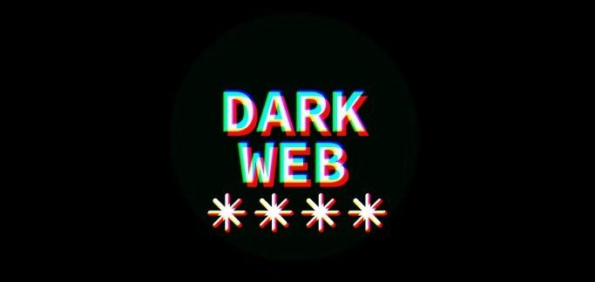

The dark web is a component of the deep web that describes the wider breadth of content that does not appear through regular Internet browsing activities.
The dark web refers to encrypted online content that is not indexed by conventional search engines. Sometimes, the dark web is also called the darknet.

Slide 4
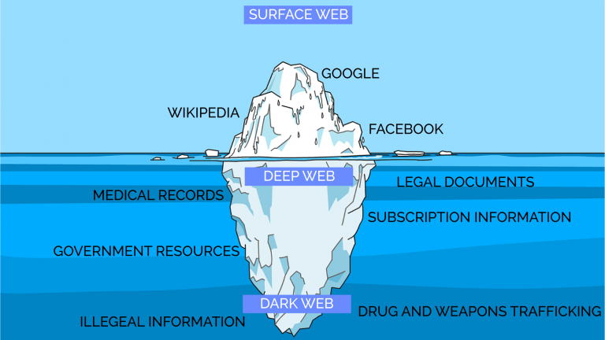

Slide 5

Understanding the Dark Web
(Note: The dark web is still very much a work in progress, and its full costs and benefits are not yet known.)

Slide 6


As with the early Internet, the dark web has also gained a reputation as a haven for illegal activities. The dark web, like the web before it, is frequently blamed for horrible crimes, such as child abuse and murder for hire. However, these crimes existed long before the Internet or the dark web. The dark web makes it harder to enforce both just and unjust laws

Slide 7

. Many of these sites contain only information, with no ability to buy or sell anything. It is true that cryptocurrencies, such as Bitcoin and Monero, are often used for transactions on the dark web. However, one does not have to use the dark web to use cryptocurrencies.

Slide 8


ONLINE BANKING AND PAYMENT FRAUDS
The dark web contains everything requiring a login, such as online banking, pay sites, and file hosting services.
WEB AND FILE HOSTING

Slide 9


NOW, YOU MUST BE THINKING HOW CAN WE BROWSE THE
DARK WEB?
WELL, I HAVE GOT THAT COVERED TOO…W

Slide 10

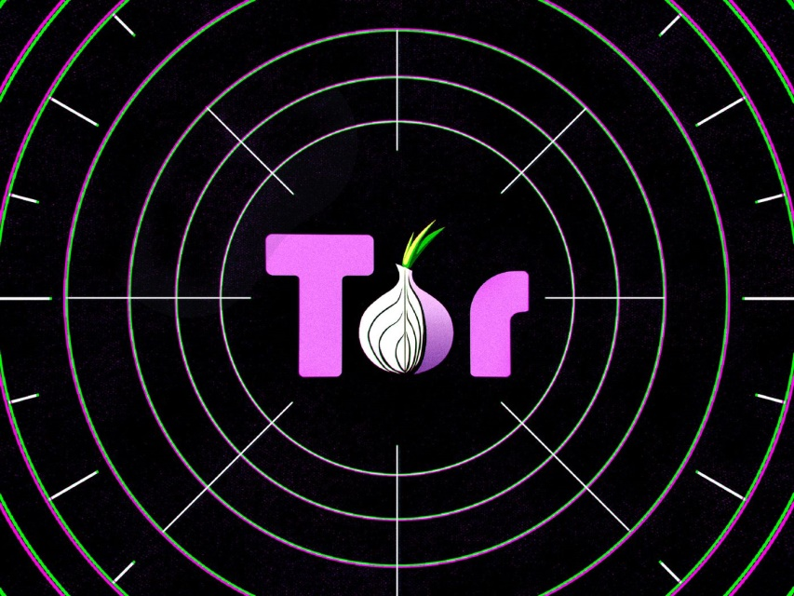
THE DARK WEB IS A SUBSET OF THE DEEP WEB THAT IS INTENTIONALLY HIDDEN, REQUIRING A SPECIFIC BROWSER i.e. TOR TO ACCESS.
NO ONE REALLY KNOWS THE SIZE OF THE DARK WEB, BUT MOST ESTIMATES PUT IT AT AROUND 5% OF THE TOTAL INTERNET. AGAIN, NOT ALL THE DARK WEB IS USED FOR ILLICIT PURPOSES.

Slide 11
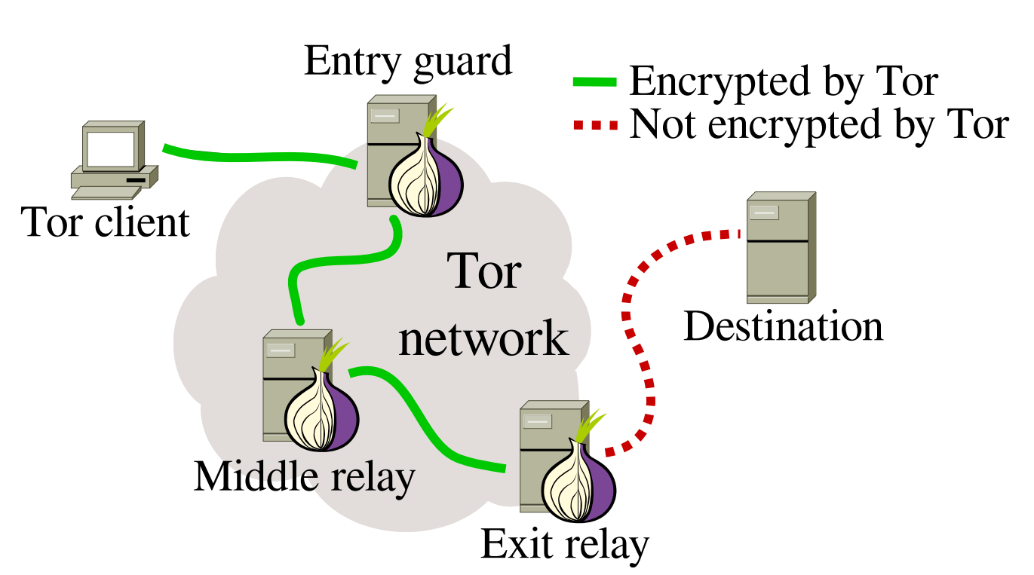
For greater security, all Tor traffic passes through at least three relays before it reaches its destination. The first two relays are middle relays which receive traffic and pass it along to another relay. An exit relay is the final relay that Tor traffic passes through before it reaches its destination.

Slide 12

ADVANTAGES AND DISADVANTAGES
OF THE DARK WEB?

Slide 13

ADVANTAGES
The dark web helps people to maintain privacy and freely express their views.
Privacy is essential for many innocent people terrorized by stalkers and other criminals.
The increasing tendency of potential employers to track posts on social media can also make it difficult to engage in honest discussions publicly.
Finally, the popularity of the dark web with criminals makes it a perfect way for undercover police officers to communicate.

Slide 14

DISADVANTAGES
The dark web empowers ordinary people, but some people will inevitably abuse that power.
The dark web can make it easier to commit some of the worst crimes. For example, the combination of the dark web and cryptocurrencies theoretically makes it much easier to hire someone to commit a murder.
While the dark web promises privacy to its users, it can also be used to violate the privacy of others.
Private photos, medical records, and financial information have all been stolen and shared on the dark web.

Slide 15
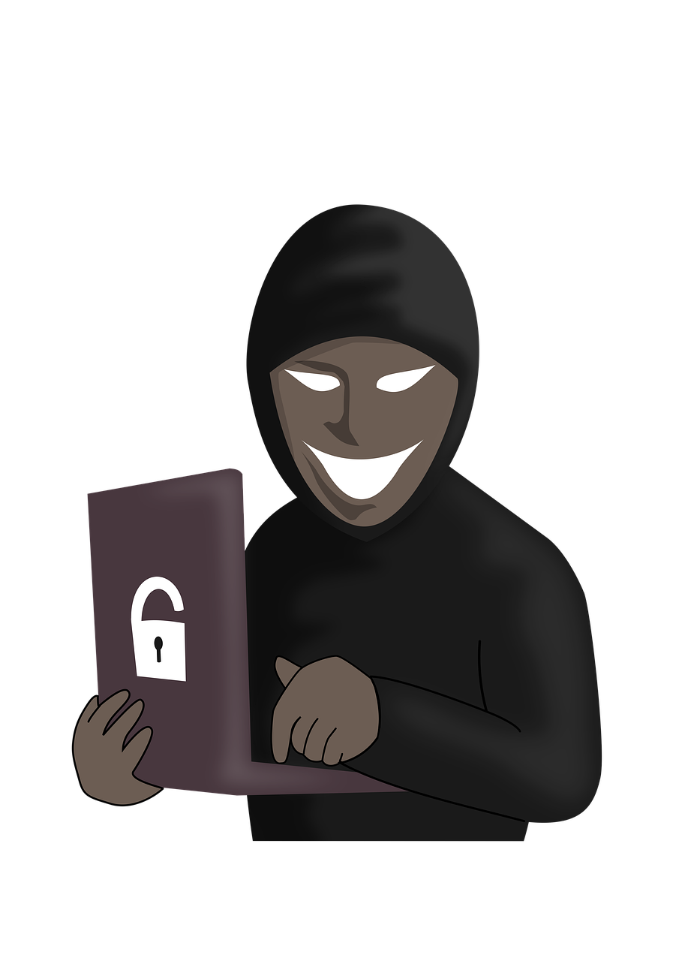

SO, IS THE DARK WEB
A GOOD PLACE OR A BAD PLACE?

Slide 16



