Slide 1
Learning Management System, Virtual Learning Environment and Tools
Mahajan Sanjay O.

Slide 2
Outline
What is LMS?
Types of LMS
LMS Use Cases
Features of LMS
Advantages of LMS
Disadvantages of LMS
LMS Tools
What is VLE?
Advantages of VLE
Disadvantages of VLE
VLE Tools

Slide 3
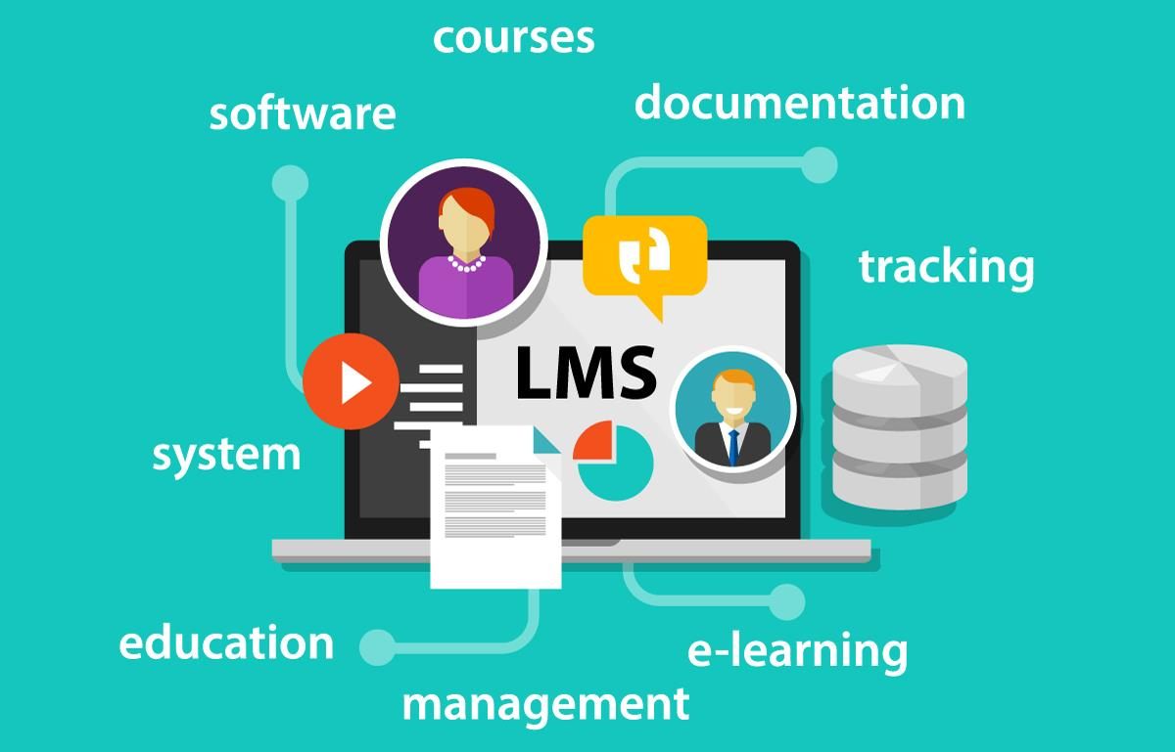
What is LMS?
“A Learning Management System (LMS) is a software application for the administration, documentation, tracking, reporting, automation and delivery of educational courses, training programs, or learning and development programs.”
LMS Users Falls in two Categories
Learners: Participate in online training courses
Administrators: Responsible for managing LMS

Slide 4
Types of LMS
Cloud-based LMS: A cloud-based LMS is hosted on a secure off-site server and allows users to access the product using different devices
Self Hosted LMS: A self-hosted LMS platform is basically a web application, usually sold as a licensed product. You install and maintain the platform on your own server
Software as a Service (SaaS): A cloud LMS runs in a Software as a Service (or SaaS) model. A subscription plan is chosen and is hosted centrally by the software provider
Open Source LMS: An open-source LMS means the creators have made its source code available for any developer or user to modify for any purpose. You’ll have to install, customize, and maintain the system on your own.

Slide 5
LMS Use Cases
Employee Onboarding: supports new employees with their initial onboarding so that they can speed up quickly.
Customer Training: This is especially common for software and technology companies who need to effectively on board users so they can use their product.
Educational/Academic Training: Used to create personalized learning and social learning experiences for students.
Employee Development: To support the talent management and training and development of current employees.

Slide 6
Features of LMS
Responsive Design
Reports and Analytics
Certification
Course Management
Social Learning
Gamification Features
White-labelling
Integrations
Automation
Support Services
Globalisation
Artificial Intelligence (AI)

Slide 7
Advantages of LMS
Benefits for an Organization
Save training cost
Monitor learner progress and performance
Track results
Update content quickly
Train on the go
Improves eLearning accessibility
Benefits for learners
Unlimited access to training content
Self-paced training
Learning from anywhere, any time
Knowledge that sticks

Slide 8
Disadvantages of LMS
Lack of Technical Staff
Some find it hard to motivate and organize themselves
Some Students might feel isolated
The feedback might not be enough
E-Learning is limited to certain disciplines
Lack of quality assurance in online education

Slide 9
LMS Tools
How to choose right Learning Management System?
Needed LMS features
Adaptability
Possibility of integration with current system
After-sales services
Budget for purchasing the software
Examples of LMS
Moodle, Forma LMS, CourseSites, Talent LMS, MyiCourse, Skyprep, Thinkfic

Slide 10

What is VLE?
A Virtual Learning Environment (VLE) as defined by Oxford University Press Online Resources Centre is “a system for delivering learning materials to the students via the web”
Virtual Learning is basically an online classroom or a digital space.
A virtual learning environment is a set of learning and teaching tools which are fashioned to enhance a student’s learning experience by including computers and the internet.

Slide 11
Advantages of VLE
Flexibility
Easy Tracking and Assessment
Accessibility
Simple management
Affordability

Slide 12
Disadvantages of VLE
Communication
Investments
Motivation
Limitations
Getting Lost In Material
Discomfort with Technology

Slide 13
VLE Tools
How to choose right Virtual Learning Environment?
Progress Metrics
Timed Testing Options
Interactive Features
Instant Communication Tools
Video Conferencing Software
Examples of VLEs
ezTalks, LearnCube, BigBlueButton, Cisco Webex Meetings, Adobe connect, Zoom, etc.

Slide 14
To Conclude …
With so many different ways to define e-learning and the educational approaches that can be taken in these learning environments, we can conclude that LMS and VLE are an innovative approach to learning.
It is an environment made up of collaboration, choice, and an array of technological resources that supports a successful online learning experience.

Slide 15
Thank You

