Slide 1

A Seminar Report on
E-PAPER
Guided By,
Prof. Kavita Aher
Dr. Babasaheb Ambedkar Technoogical University, Lonere
Submitted By,
Vishnu Kamlakar Gaddime
(10303320181124510044)

Slide 2
Contents
What is E-PAPER ?
History
Construction of E-Paper
Technologies proposed so For
Applications of E-PAPER
Advantages And Disadvantages of E-PAPER
Future Scope of E-PAPER

Slide 3
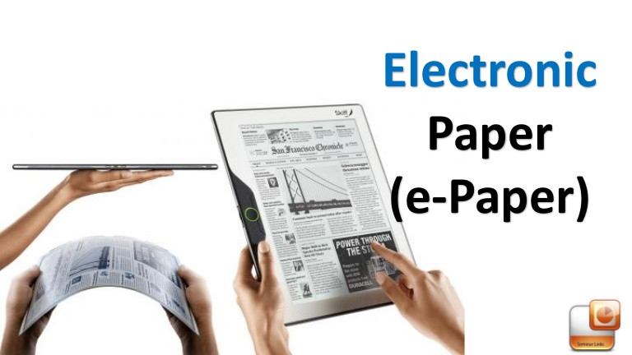
What is E-PAPER ?
E-PAPER is an electronic ink display unit.
It reflect light like ordinary paper.
It is capable of holding text and images.
It is flexible while using plastic materials and electronics.
It is more comfortable to read than conventional display.
A wider viewing angle.
It can read directly from sunlight without fading images.
Low power consumption.

Slide 4
History of E-PAPER
Electronic paper was first developed in 1970 by Nick Sheridon at Xerox Palo Alto Research Center The first electronic paper, called Gyricon.
In the 1990 another type of electronic paper was invented by Joseph Jacobson, who later co-founded the corporation E Ink.
In 1995, in the MIT Media Lab, Professor Neil Gershenfeld, physicist Joseph Jacobson, mathematics student Barrett Comiskey, and mechanical engineering student JD Albert co-created E Ink.
In 2007, Amazon released the first generation of e-reader Kindle, which is equipped with a 6-inch 4th-order electronic paper ink screen.With the popularity of the Kindle, e-paper is truly familiar to consumers.
Dutch daily NRC HANDELSBLAD distributed for the iREXiLiad reader. In 2009 Jason Heikenfeld has tried to create products based on electrofluidic display technology and a process called pigment dispersion.

Slide 5
Construction of E-Paper
It has two different parts.
Front Plane
Back Plane
The front plane consist of E-ink.
The back plane consist of electronic circuits.
To form an E-ink electronic display the ink is printed onto a plastic flim that is laminated to a layer of circuitry.
The E INK fluid consistsof pellets which contain negatively charged black- and positively charged white flakes. They are enclosed in the sphere.
The medium (pellet) is embedded in a light oil. By applying voltage, the flakes can be drawn either to the front- or back of the layer / fluid to display the desired content.

Slide 6
Technologies Proposed
GYRICON
ELECTROPHORETIC DISPLAY
ELECTROWETTING
INTERFEROMETRIC MODULATOR

Slide 7
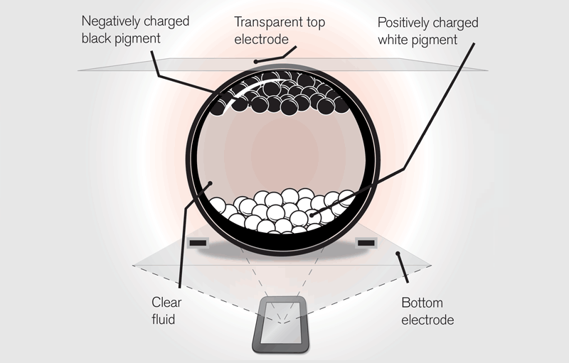
1. Gyricon
It was the first electronic paper and was developed in 1970’s.
Consists of potyethylene spheres having diameter between 75- 106 micrometers.
Each sphere is janus particles composed of negatively charged black plastic on the one side and positively charged white plastic on the other .
These spheres are embedded in transparent silicone made sheet with each spheres suspended in a bubble of oil so that they can rotate freely.
The polarity of the voltage applied to each pair of electrodes then determines whether the white or black side is face-up thus giving the pixel a white or black apparencies.

Slide 8
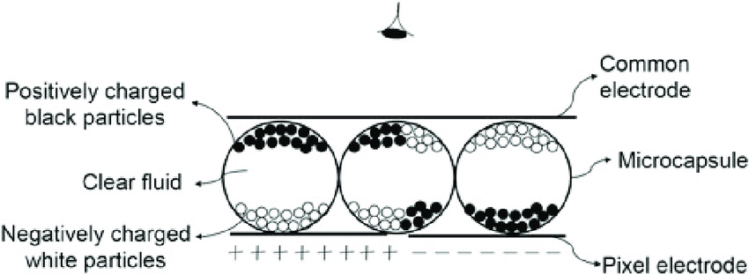
2. Electrophoretic Display
The electronic ink display from E ink is based on encapsulated electrophoretics microcapsule containing many tiny white pigment chips or particles that are suspended in a blue-blacked liquid dye.
Applying an electric field moves the particle about the microcapsulex can be switched into the reflecting or absorbing state by appling a positive or negative voltage across the indium-tin oxide electrodes.
Any kind of electrophoretic display relies on electrostatic migration of light scattering particles in a dyed suspension.
When a positive voltage is applied, the particle migrate electrostatically toward the electrode on viewer side.

Slide 9
3. Electrowetting
Based on the phenomenon of Electrowetting effect controlling the shape of a confined water/oil interface by an applied voltage.
When no voltage is applied there is stacked state i.e oil form thin layer between water and water repellent resulting a coloured pixel.
When voltage is applied stacked is no longer stable causing water to move oil aside this result in partly transparent pixel.

Slide 10
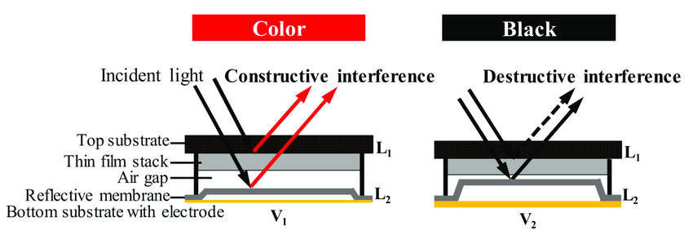
4. Interferometric Modulator
Technology used in electronic Visual display that can create various colors via interference of reflected light.
The color is selected with an electrically switched light modulator comprising a microscope cavity that is switched on and off using driver integrated circuits similar to those used to address liquid crystal display(LCD)

Slide 11


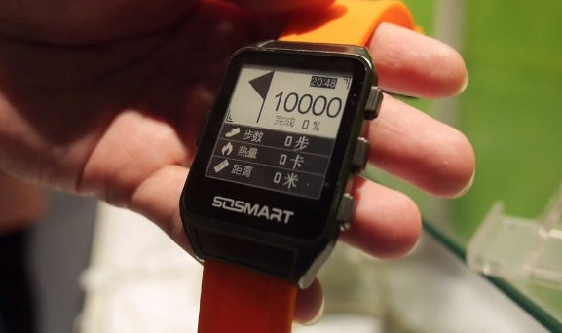
Applications of E-PAPER
Wristwatches
e-Book reader
Eg : Amazon kindle
Electronic shelf Label
In a large department store or supermarket e-paper is used for labelling the sheleves and price tagging
Smart Card Display
Some credit cards contain a smart card to store information such as accumulated credit and money expenses etc.
Mobile Phones
E-Newspaper
Time Table at Stations

Slide 12
Advantages of E-PAPER
Paper like readablity
Bi-stable Display Power consumption only by changing of display content Powerless during periods of unchanged representation of the displayed content Information can be displayed unchanged over a long period of time
High Contrast
Wide viewing angle from all sides
High-resolution
Good readability in direct sun exposure
Suitable for battery applications.

Slide 13
Disadvantages of E-PAPER
A major disadvantage of electronic paper technology is very low refresh rate compared with other low-power display technologies like liquid crystal displays (LCDs).
The technology behind E-paper cannot support animation.
Piracy has become a huge source of problems for organizations in certain types of markets, such as music, movies, and games. With e-books, it could be easy for organizations to lose a lot of money from piracy
Shadow of a image may be visible after refreshing parts of the screen

Slide 14
Future Scope of E-PAPER
The E-paper will be embedded as a cylindrical tube (about 1 centimeter in diameter or 15 to 20 centimeters long), that a person can comfortably carry in his or her pocket
The tube will contain a tightly rolled sheet of Epaper that can be spooled out of a slit in the tube as a flat sheet, for reading, and stored again at the touch of a button.
The document reader will be used for E-mail, the internet, books download from a digital library, technical manuals newspapers, magazines etc. anywhere in the planet.
In 10 to 20 years, consumers might see large E-paper modules that are as thin and as flexible as magazines are today, with display brightness approaching that of conventional print.

Slide 15
Conclusion
Electronic ink is not intended to diminish or do away with traditional displays.Instead electronic ink will initially co-exits with traditional paper other display technologies
In the long run, electronic ink may have multibillion-dollar impact on the publishing industry
Ultimately electronic ink will permit almost any surface to become display brining information ooout of the confines to traditionals devices and into the world around us.

Slide 16


