Slide 1
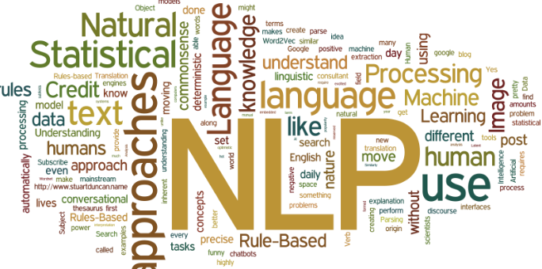

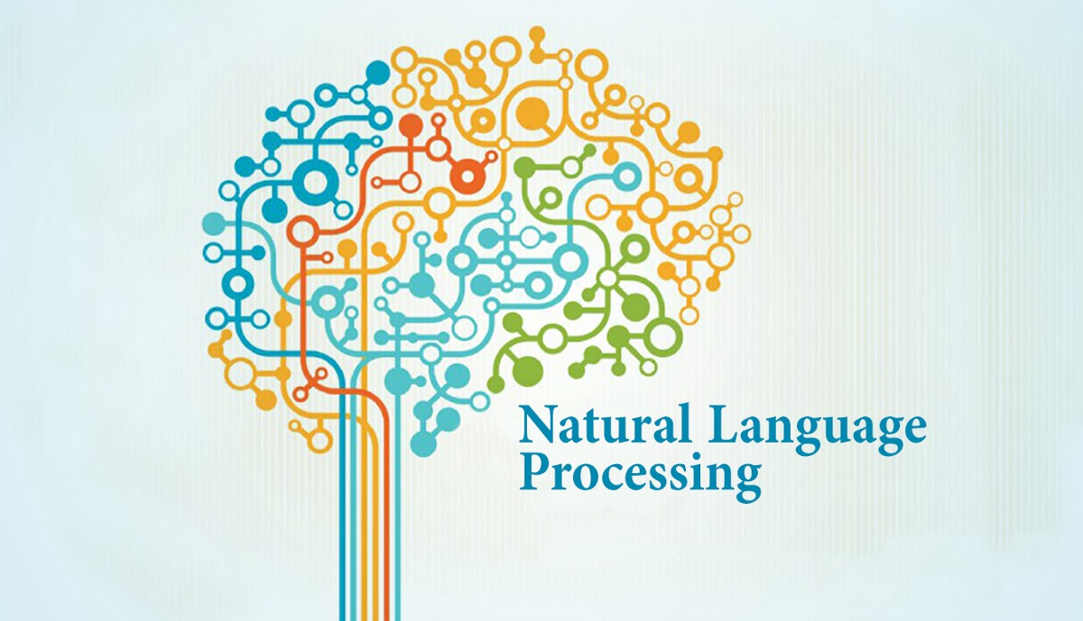
Dr. Babasaheb Ambedkar Technological University, Lonere.
A Seminar On:
Natural Language Processing
Name: Zarrin Jalgaonkar
B.Tech Third Year
Department of Computer Engineering
PRN:10303320191124510041

Slide 2
Outline
Introduction
Components and Processes
Applications
Conclusion

Slide 3
Introduction
What is Natural Language?
What is Natural Language Processing?
History of Natural Language Processing.
Why Natural Language Processing?

Slide 4
Natural Language.
Natural Language refers to the languages spoken by people or by human beings. Example : English, French, Japanese as opposed to artificial languages like C, C++, Java etc.

Slide 5
Natural Language Processing.(NLP)
Natural Language Processing is subfield of linguistics, computer science, and artificial intelligence concerned with the computers and human language.
Process information contained in natural language which allows computer to communicate with people.
Encompasses anything a computer needs to understand natural language and generate natural language.
NLP is also known as Computational Linguistics, Human Language Technology, Natural Language Engineering.

Slide 6
History Of NLP
Symbolic NLP (1950’s – early 1990’s)
1950- NLP started when Alan Turing publishes an article called “Machine Intelligence” what is now called Turing test. There were attempts to automate translation between Russian and English.
1960- The work of Chomsky and others on formal language theory and generative syntax.
Statistical NLP (1990’s – early 2010)
1990- Probabilistic and data-driven models had become quite standard.
2000- A Large amount of spoken and textual data become available.
Neural NLP (present)
Representation learning and Deep Neural Network Machine Learning methods became widespread in NLP and can achieve state-of-the-art results in many tasks such as language modelling, parsing and many others.

Slide 7
Why NLP?
Text is the largest repository of human knowledge and is growing rapidly.
“Cna yuo raed tihs?”
People have no trouble understanding language.
Common sense
Reasoning Capacity
Experience
Computers have:
No common sense knowledge.
No reasoning capacity.
….That’s why we need NLP

Slide 8
Components and Processes
NLP Terminology
Components of NLP.
Steps of NLP.
Approaches to NLP.

Slide 9
NLP Terminology
Sounds which refers to phonology.
Morphology is a study of word formation.
Sentence structure refers to syntax.
Semantics is concerned with the meaning of words.
Pragmatics deals with using and understanding sentences in different situations
Discourse is how preceding sentence can affect the interpretation of the next sentence.

Slide 10
Components of NLP
Natural Language Generation (NLG)
It is the process of producing meaningful phrases and sentences in the form of natural language from some internal representation.
Natural Language Understanding (NLU)
Mapping the given input ( natural language ) into useful representations and analyzing different aspects of the language.
The NLU is harder than NLG.

Slide 11
Natural Language Generation
Natural Language Generation is the process of constructing natural language outputs and can be viewed as the reversed process of NL Understanding.
It involves :
Text planning − Retrieving the relevant content from knowledge base.
Sentence planning − Choosing required words, forming meaningful phrases, setting tone of the sentence.
Text Realization − It is mapping sentence plan into sentence structure.

Slide 12
Natural Language Understanding
NL is very ambiguous. There can be different levels of ambiguity −
Lexical Ambiguity: Exists in the presence of two or more possible meanings of the word within a single sentence.
Example: The fisherman went to the bank.
The bank for money collection or the river bank.
Syntactic Ambiguity: Exists in the presence of two or more possible meanings within the sentence.
Example: I saw the girl with binocular.
Did I have the binoculars? Or did the girl have the binoculars?

Slide 13
Contd..
Referential Ambiguity: Exists when you are referring to something using the pronoun.
Example: Kiran went to Sunita. She said, "I am hungry.“
You do not know that who is hungry, either Kiran or Sunita.
One input can mean different meanings.
Many inputs can mean the same thing.
To remove these ambiguities different steps of analysis are required…

Slide 14
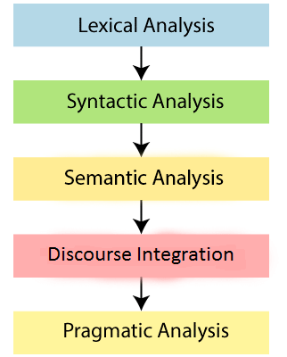
Steps in NLP
Lexical Analysis and Morphological:
Identifying and analyzing the structure of words. Lexical analysis is dividing the whole chunk of text into paragraphs, sentences, and words.
Syntactic Analysis (Parsing):
Syntactic Analysis is used to check grammar, word arrangements, and shows the relationship among the words.
Example: “To the school goes boy” is rejected by English syntactic analyzer.

Slide 15
Semantic Analysis:
Semantic analysis is concerned with the meaning representation. It mainly focuses on the literal meaning of words, phrases, and sentences.
Discourse Integration:
Discourse Integration depends upon the sentences that proceeds it and also invokes the meaning of the sentences that follow it.
Pragmatic Analysis:
It helps you to discover the intended effect by applying a set of rules that characterize cooperative dialogues. Example: “Will you crack open the door?"

Slide 16
Approaches to NLP
Rule-based approaches:
The oldest approaches to NLP.
Tend to focus on pattern-matching or parsing.
Can often be thought of as "fill in the blanks" methods
Have high performance in specific use cases, but often suffer performance degradation when generalized.
Regular expressions and Context Free Grammars are textbook examples of rule-based approaches to NLP.

Slide 17
"Traditional" Machine Learning
Include probabilistic modeling, likelihood maximization, and linear classifiers. These are not neural network models.
Traditional machine learning approaches are characterized by:
training data - in this case, a corpus with markup.
feature engineering - word type, surrounding words, capitalized, plural, etc.
training a model on parameters, (typical of machine learning systems in general)
characterized by finding most probable words, next word, best category, etc.
"semantic slot filling"

Slide 18
Neural Networks
Similar to "traditional" machine learning, but with a few differences:
Feature engineering is generally skipped, as networks will "learn" important features .
instead, streams of raw parameters ("words" -- actually vector representations of words) are fed into neural networks
very large training corpus
Neural networks of use in NLP include recurrent neural networks (RNNs) and convolutional neural networks (CNNs).

Slide 19
Applications of NLP
Question Answering:
Question Answering focuses on building systems that automatically answer the questions asked by humans in a natural language.
Spam Detection:
Spam detection is used to detect unwanted e-mails getting to a user's inbox.
Spelling correction:
Microsoft Corporation provides word processor software like MS-word, PowerPoint for the spelling correction

Slide 20
Sentiment Analysis:
Sentiment Analysis is also known as opinion mining. It is used on the web to analyze the attitude, behavior, and emotional state of the sender. This application is implemented through a combination of NLP (Natural Language Processing) and statistics by assigning the values to the text (positive, negative, or natural), identify the mood of the context (happy, sad, angry, etc.)
Machine Translation:
Machine translation is used to translate text or speech from one natural language to another natural language.
Example: Google Translator

Slide 21
Speech Recognition:
Speech recognition is used for converting spoken words into text. It is used in applications, such as mobile, home automation, video recovery, dictating to Microsoft Word, voice biometrics, voice user interface, and so on.
Chatbot:
Implementing the Chatbot is one of the important applications of NLP. It is used by many companies to provide the customer's chat services.
Information extraction:
Information extraction is one of the most important applications of NLP. It is used for extracting structured information from unstructured or semi-structured machine-readable documents.

Slide 22
Conclusion
Natural Language Vs. Computer Language.
Future of NLP.

Slide 23
Natural Language Vs. Computer Language
Ambiguity is the primary difference between Natural Language and Computer Language.
Natural Language has a very large vocabulary.
Formal programming languages are designed to be unambiguous
They can be defined by a grammar that produce a unique parse tree for each sentence in the language.
Programming languages are also designed for efficient deterministic parsing

Slide 24
Future of NLP
NLP’s future is closely linked to the growth of Artificial Intelligence.
Computers will become more and more capable of receiving and giving useful and resourceful information when combined with natural language generation.
As natural language understanding improves devices will be able to learn from the information online and apply what they learned in real world.
Make computers solve problems like humans as well as perform activities more efficiently than humans.

Slide 25
Thank You…!!!

